Slide 1

Sergeant-at-Arms
Troy Horsley
Sergeant-at-arms

Slide 2
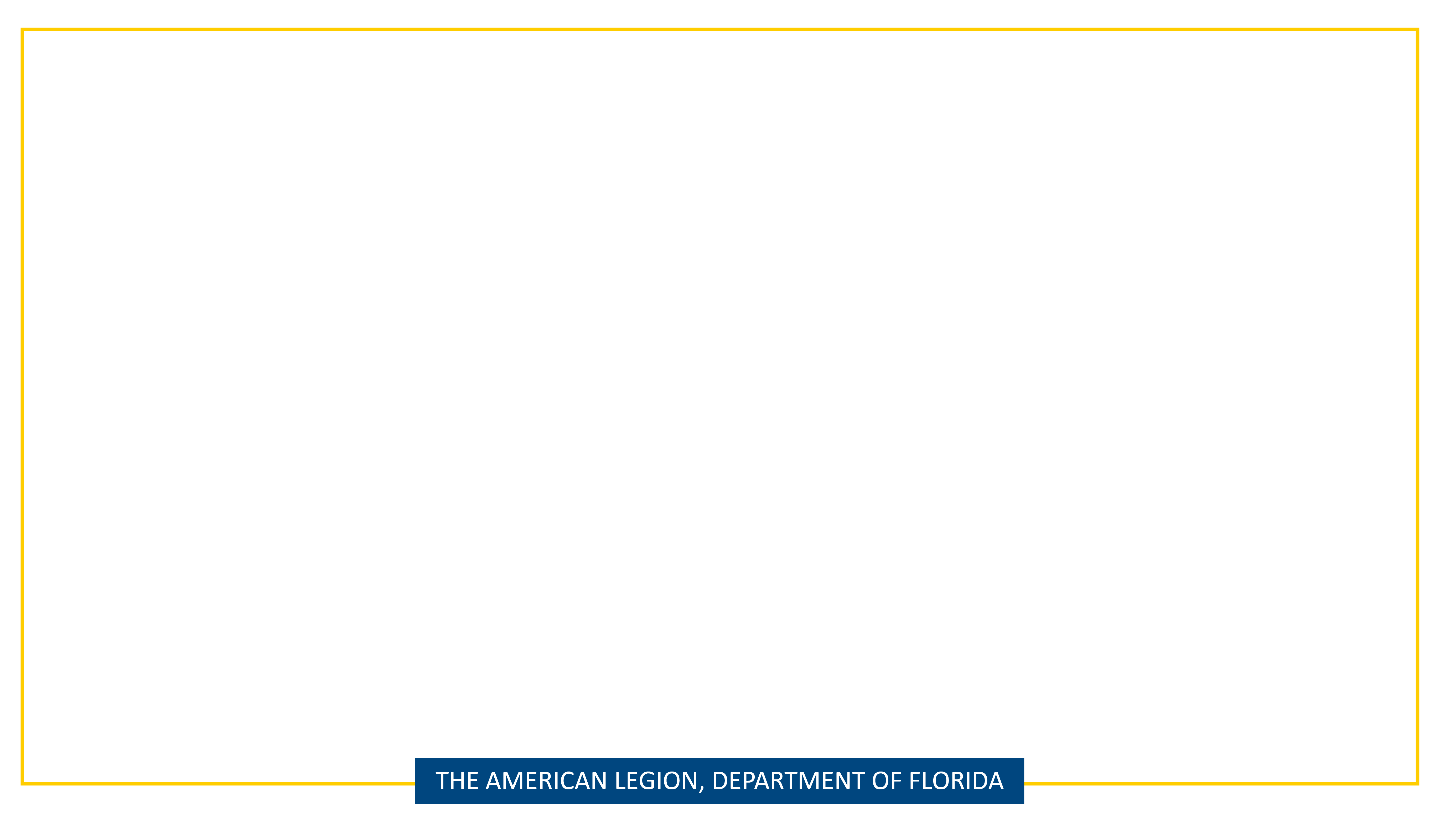
Sgt-at-Arms | Resources
Officers Guide
Department of Florida Sgt-At-Arms & Protocol Manual
Flag Code of The United States Title 4 Chap 1
DOD Directive 1005.8
Flag Flying Order
Guidelines for displaying the United States Flag

Slide 3
Sgt-at-Arms | Officers’ Guide
Arrange Meeting Hall
Assist Post Commander & Adjutant
Lead Color Guard Detail
Flag Etiquette
Post Color Guard Detail
Burial Detail
Other Pageantry
Chair Welcome Committee
Encourage Members To Attend Meetings
Advise Commander on Who Should Be Acknowledged

Slide 4
Sgt-at-Arms | Protocol Manual
Sgt-at-Arms Duties
The American Legion Cap
Hallowed Ground
Preamble of The American Legion
The Meaning & History of the Pledge of Allegiance
POW/MIA Remembrance Ceremony
History of the American Flag
Legion Uniforms; Cords & Braids
Origin of Flag Day
Proper Flag Disposal Ceremony
Proper Flag Display on Vehicles & Bikes
Military Funeral Flag Protocol
American Legion Protocol

Slide 5
Sgt-at-Arms | Flag Code
Flag Code Title 4 U.s.C. 5 code Chap 1
Flag Stars Advertising/Mutilation of flag
Pledge of Allegiance
Display and use of flags by civilians
Time and occasions for display
Position and manner of display
Respect for the flag
Conduct during hoisting, lowering, and passing of flag
Modification of rules and customs by the President

Slide 6
Sgt-at-Arms | Flag Display Guidelines
Public Law 94-344, known as the Federal Flag Code, contains rules for handling and displaying the U.S. flag. While the federal code contains no penalties for misusing the flag, states have their own flag codes and may impose penalties. The language of the federal code makes clear that the flag is a living symbol.

Slide 7
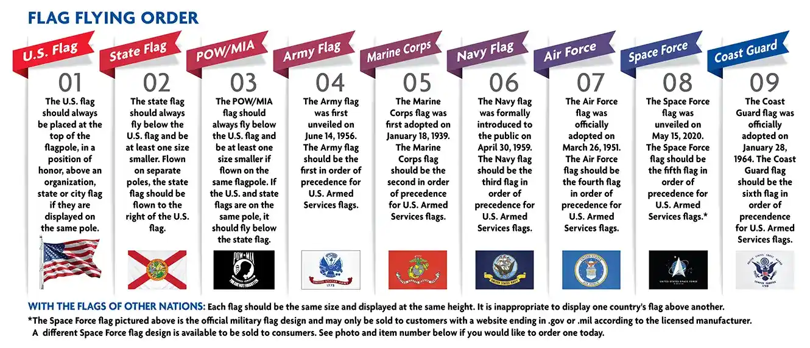
Sgt-at-Arms | Flag Flying Order

Slide 8
Sgt-at-Arms | Internet is never wrong
Public Law No: 116-67 (11/07/2019) National POW/MIA Flag Act
The bill changes the days on which the POW/MIA flag is required to be displayed at specified locations to all days on which the U.S. flag is displayed. (Current law requires the POW/MIA flag to be displayed only on Armed Forces Day, Memorial Day, Flag Day, Independence Day, National POW/MIA Recognition Day, and Veterans Day.)
The order in which the POW/MIA flag is displayed depends on the number of flagpoles and the flags being flown with it:
Single flagpole- The POW/MIA flag is flown directly below the US flag, and is no larger than the US flag
Two flagpoles-The POW/MIA flag is flown under the US flag, and the state flag is flown on the other pole
Three flagpoles-The US flag is flown on the right pole, the POW/MIA flag is flown on the middle pole, and the state flag is flown on the left pole

Slide 9
Sgt-at-Arms | Things to Remember
Traditional guidelines call for displaying the flag in public only from sunrise to sunset. However, the flag may be displayed at all times if it’s illuminated during darkness. The flag should not be subject to weather damage, so it should not be displayed during rain, snow and windstorms unless it is an all-weather flag.
It should be displayed often, but especially on national and state holidays and special occasions. The flag should be displayed on or near the main building of public institutions, schools during school days, and polling places on election days. It should be hoisted briskly and lowered ceremoniously
Helpful Resource:
US Flag Manual from Military Salute Project MSP-08
https://www.usmhc.org/Flag.php

Slide 10
Sgt-at-Arms | POW/MIA
Resolution 288, adopted at the Legion’s 67th National Convention, calls for a POW/MIA empty chair to be placed at all official meetings of The American Legion as a physical symbol of the many American POW/MIAs still unaccounted for from all wars and conflicts involving the United States of America. This is a reminder for all of us to spare no effort to secure the release of any American prisoners from captivity, the repatriation of the remains of those who died bravely in defense of liberty, and a full accounting of those missing. Let us rededicate ourselves to this vital endeavor.”

Slide 11
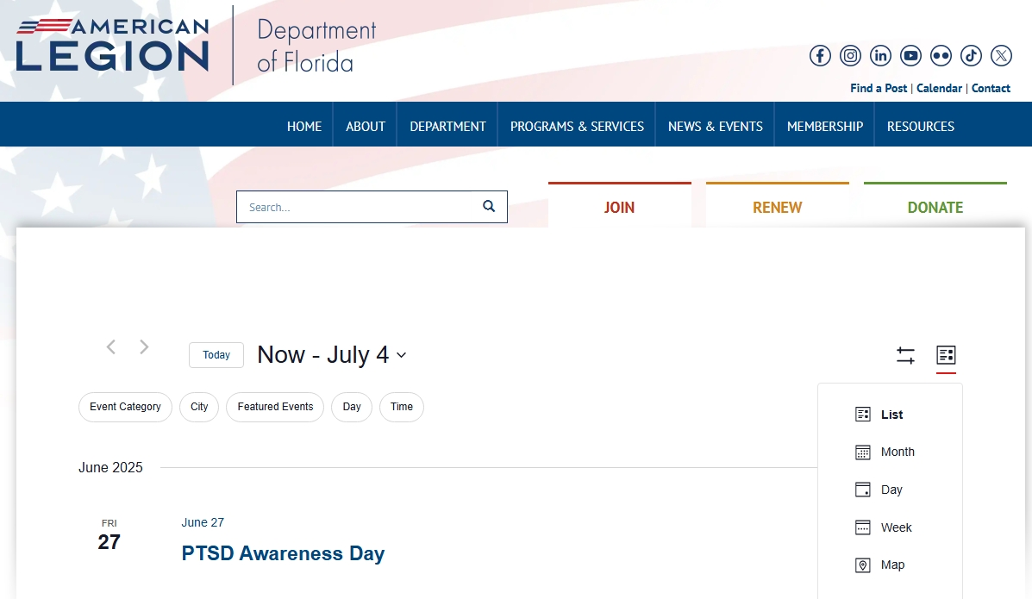
Sgt-at-Arms | Calender of Events

Slide 12
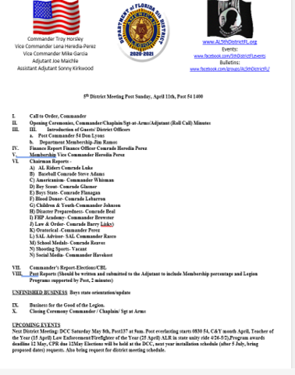
Sgt-at-Arms | Agenda

Slide 13
Sgt-at-Arms | Check List
Make a Guest checklist for legion officers
For Department Officers go to
Department | Florida American Legion (floridalegion.org)
You will find officers/area/district commanders and chairs
For National Officers go to
https://www.legion.org/about/leadership

Slide 14
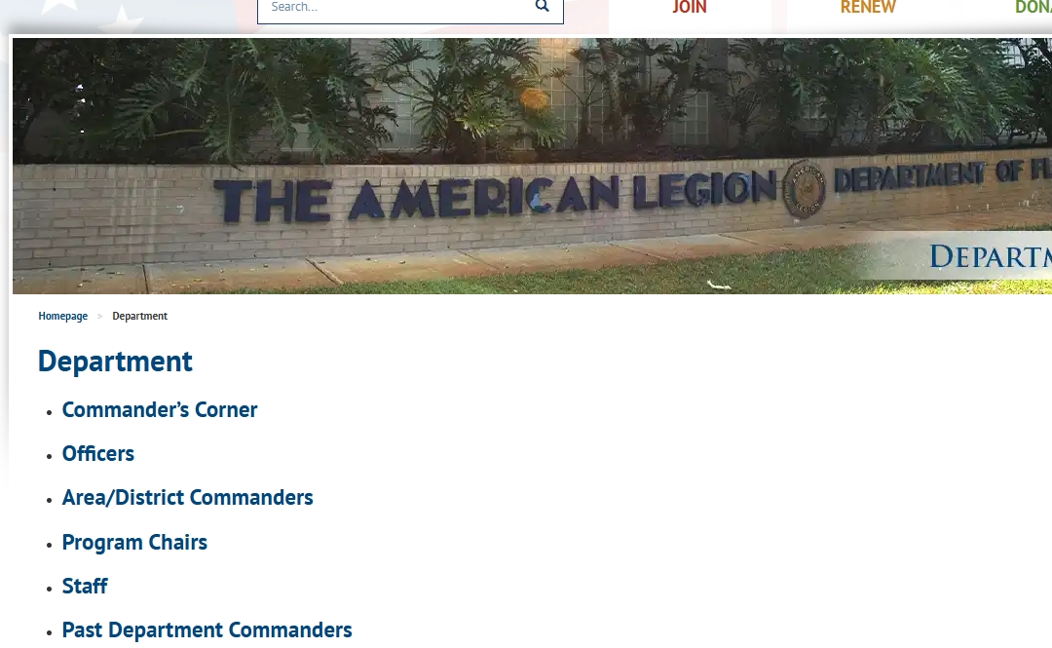
Sgt-at-Arms | Department page

Slide 15
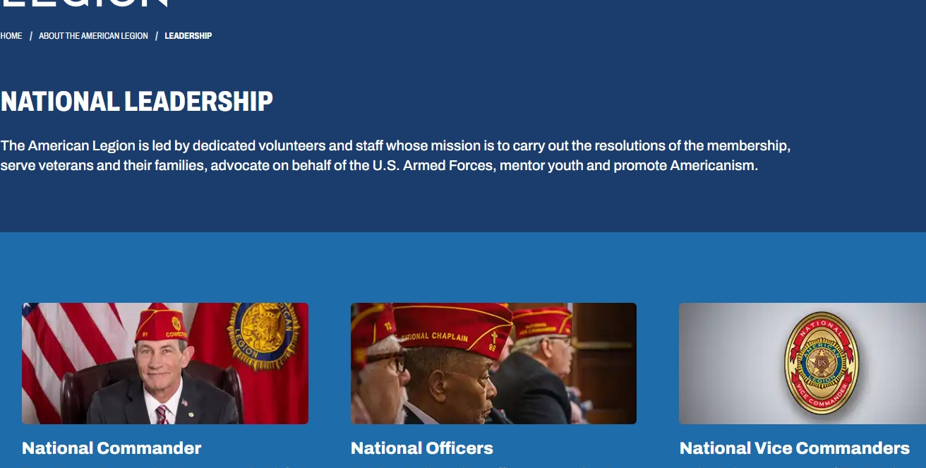
Sgt-at-Arms | National page

Slide 16
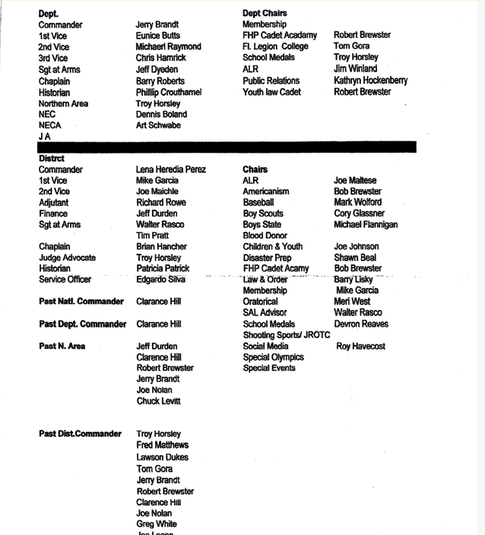
Sgt-at-Arms | Guest list

Slide 17
Sgt-at-Arms | Guests
Order of Guest Introductions for Meetings
Are generally done in order of rank within the organization, from low to high:
Local dignitaries, non-American Legion guests S.A.L. Officers - Local, District, Department, National
Auxiliary Officers -Local District, Department, National
American Legion Officers -Local, District, Department, National American Legion
American Legion Chairs
A national executive committeeman (NEC) or alternate NEC (NECA) should be introduced immediately before the department commander.
If it is a function of both The American Legion and the American Legion Auxiliary, the Auxiliary officers, dignitaries, etc., are introduced first.

Slide 18
Sgt-at-Arms | Guest Protocol
Department Officers present should be given special recognition and the opportunity to extend greeting. The highest office that is present during the meeting should be given the proper respect by first: 3 Raps of the Gavel to get everyone to standing at attention and then stating
the words:
"We are delighted to have our "Department Commander", Jessica Moore, with us today, and we would be happy to hear from her."
The Master of Ceremonies or the Commander introducing should start the Dignitary Clap so others will join in; (the Sergeant-at-Arms escorts them to the podium).

Slide 19
Sgt-at-Arms | Intro chairpersons
A) AL Riders I) FHP Academy
B) Americanism J) Law & Order
C) Baseball K) Oratorical
D) Boy Scout L) POW/MIA
E) Boys State M) SAL
F) Blood Donor N) School Medals
G) Children & Youth O) Shooting Sports
H) Disaster Preparedness P) Social Media

Slide 20
Sgt-at-Arms | Members
There is another duty--one that has a tremendous impact on the post's image, its membership, and its relationship with the members. Every Legionnaire wants to be part of the group. This is particularly important for that new Legionnaire attending their first few meetings. The Sergeant-at-Arms must make certain new members are welcomed, introduced, and made to feel they are important to the post. A welcome committee should be standard for every post. The Sergeant -at-Arms is the logical person to chair such a committee. The members of this committee must welcome new members and guests, make sure they are introduced, and keep the Commander advised as to who should be acknowledged in the proper Protocol order. This committee can also be used to encourage present members to attend meetings.

Slide 21

Questions?

