Slide 1

Legislative & Gaming
Stuart Scott
Legislative chair

Slide 2

Legislative & Gaming | Legislative
Advice
This is for those who are not professional lobbyists
We will focus on the three basic elements of effective lobbying:
  Preparation
  Presentation
  Perseverance

Slide 3
Legislative & Gaming | Legislative
Who?
Know WHO you are attempting to communicate with
Are they on the committee?
Are they active in your area of interest?
What is their background?
Don’t simply “use” them

Slide 4
Legislative & Gaming | Legislative
What?
The process has a design
Don’t ask for too much
Be fair in your request
Understand the realities of the process

Slide 5
Legislative & Gaming | Legislative
Assumptions
They may or may not know anything about us
Inform them about yourself and our organization
Be prepared to explain in detail
Use layman terms to make it easy

Slide 6
Legislative & Gaming | Legislative
When?
Time is a commodity
Legislative Assistants are valuable
Visit your legislator at his home district office

Slide 7
Legislative & Gaming | Legislative
How?
Leave behind written materials
Be concise and factual
Short and sweet
Avoid unnecessary disclosure of information

Slide 8
Legislative & Gaming | Legislative
Do’s and Don’ts
Never make political retribution threats
Don’t sour your victory
Make sure you follow up!
Be sure to show you’re thankful for their help

Slide 9
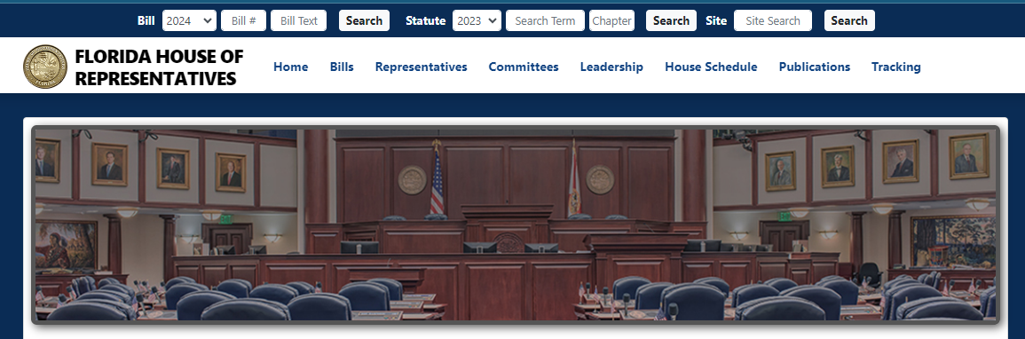
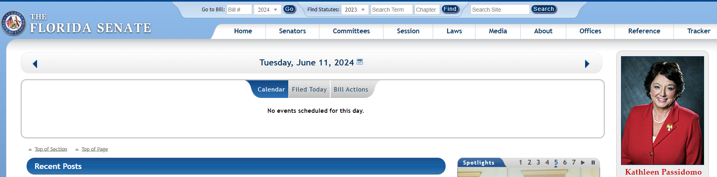
Legislative & Gaming | Legislative
How to Locate Yours

Slide 10

Legislative & Gaming | Legislative
Veteran Legislators!?!
Do we have Florida Veteran Legislators? Why yes, we do!!!

Slide 11
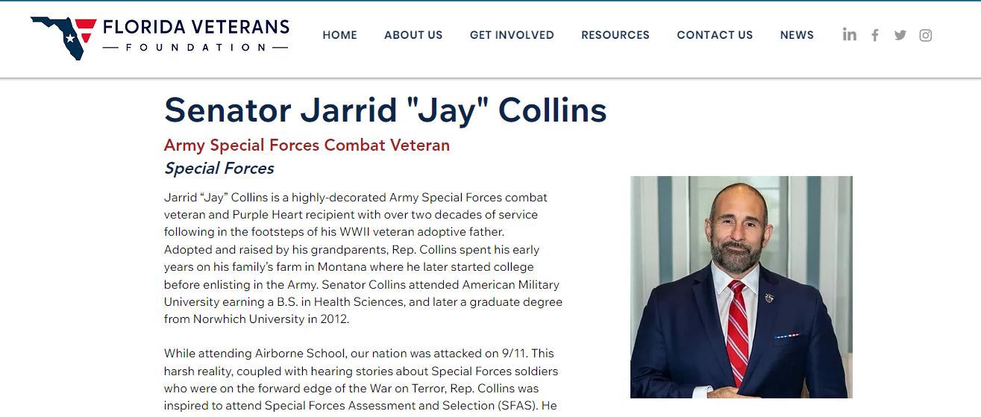
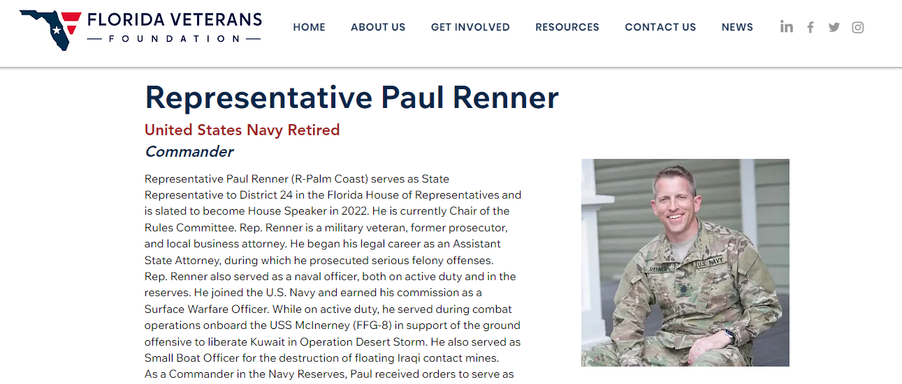
Legislative & Gaming | Legislative
Veteran Legislators!?!

Slide 12
Legislative & Gaming | Legislative
STATE vs U.S. Legislators
Don’t confuse the US Senate and US House of Representatives with the Florida Senate and the Florida House of Representatives
Definitely don’t confuse the bills filed

Slide 13
Legislative & Gaming | Legislative
Allowable’ s
As a 501 (c) organization we have limitations
We must provide an equal opportunity to ALL
Do not indicate a preference for or against
NO fundraising for any candidate

Slide 14
Legislative & Gaming | Legislative
Exercise
RUN

Slide 15


Legislative & Gaming | Legislative

Slide 16

Legislative & Gaming | Legislative

Slide 17
Legislative & Gaming | Gaming
Overview

Slide 18

Questions?

