Slide 1

Post Incident and Investigation Protocol
Bruce E. Comer
Jamie Hanselman
adjutant
Assistant adjutant

Slide 2

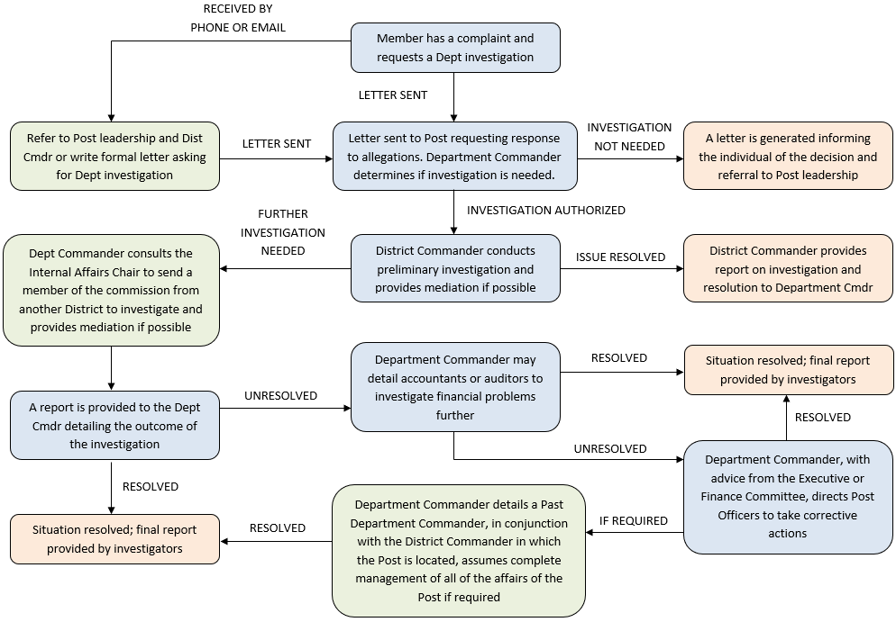
Investigation Protocol | Post Investigation Flowchart
By-Laws Article VI, Section 1

Slide 3

Investigation Protocol | Scan QR Code

Slide 4
Investigation Protocol | Post Investigation Flowchart
Uniform Code of Procedure for the Revocation, Cancellation, or Suspension of
Post Charters

Slide 5
Investigation Protocol | Charges
Initiation of Charges
  Intermediate Body, three Posts, or DEC
  Withdrawal can only happen with consent of the Dept Commander
Filing of Charges
  Filed with Dept Commander at Dept HQ
  Must be in writing, signed, and sworn before an authorized Officer
Content of Charges
  Certified or attested copy Resolution authorizing Charge(s)
  Full details of Post, Commander, and Adjutant
  Detailed statement of Facts and alleged violation(s) of CBL
  Supporting affidavits or documents may be attached
Investigation and Report
  Dept Commander investigates and files a report and recommendation to the DEC for action
  DEC provides a decision…if DEC rejects charges, decision is final

Slide 6
Investigation Protocol | Resolution of the DEC
Surrender of Charter
  Majority vote required to direct the Post to surrender its charter
  DEC then directs the Post to surrender its charter for cancellation prior to date specified
  The resolution shall include that if charter is not surrendered, that a hearing and trial will be held to determine whether the Post charter should be cancelled, suspended or revoked, and the resolution will include:
    Statement that DEC determined a hearing and trial is warranted
    Authorization for Commander and Adjutant to sign a formal complaint
    Names and addresses of members of the hearing subcommittee
    Name and address of Department Judge Advocate or Special Acting Dept JA (SADJA) assisting the subcommittee
    Authorization to hire stenographic or other assistance and shall be charged as directed by DEC
    Subcommittee shall report findings at the next DEC. If hearing or trial not complete, partial report is required.
Service of Process
  Service can be done personally, by registered mail, or at the office/residence
  Proof of service by return receipt or verified return
Notice and Summons
  Service to the Dept Adjutant

Slide 7
Investigation Protocol | Complaint
In all cases, a formal complaint (x3) drawn by Dept JA, signed by Commander and Adjutant, setting forth:
  Statement of fact upon which charges are predicated
  Origin of the charges
  Copy of Resolution of DEC appointing Subcommittee and assistants
  Copy of Uniform Code of Procedure for the Revocation, Cancellation, and Suspension of Post Charters
  Time within which an appearance/answer shall be filed by the Post, not less than 20 or more than 60 days from date of the service of complaint
  Time and Date of hearing and trial, not more than 30 days after the date of expiration of the time for the filing of the answer
  **Complaint may be amended by subcommittee based on the opinion of the subcommittee

Slide 8
Investigation Protocol | Service
The Subcommittee shall cause copy of complaint to be served on Post
Service shall be personally, or by registered mail, or by leaving a copy at principle office or headquarters of Post, or place of residence of the person or officer to be served (Registered Agent)
All service to Dept shall be served to Dept Adjutant at Dept Headquarters
Witness summons may be signed by SADJA, Dept JA, or by a member of the subcommittee

Slide 9
Investigation Protocol | Answer
Defendant Post shall file an answer to complaint within time specified in the complaint, and it shall be filed to Dept JA or Dept Adjutant.
  Shall contain clear and concise statements of fact constituting defense
  Any charge or specification not expressly denied or explained, shall be deemed admitted

Slide 10
Investigation Protocol | Subcommittee
The Subcommittee to hear and try and make written findings of fact and recommendations...shall be appointed by the DEC, and contain at least three (3) members of the DEC, none of which may be from the investigated Post.
If no attorney on subcommittee, questions of law may be answered by Dept JA or SADJA.
Majority of subcommittee shall constitute a quorum. Any proceeding without a quorum must be postponed until a quorum is present.
The Dept JA or SADJA duties is to see trial is prompt, complete, and thorough, make all arrangements for hearings, summoning of witnesses and production of all papers. Shall also see all orders of the subcommittee are carried out. Shall also, along with members of subcommittee, examine and cross-examine all witnesses.

Slide 11
Investigation Protocol | Hearing and Trial
Rules of Evidence prevailing in court of law and equity shall not be controlling
Subcommittee makes all rulings
Due process and equal protection to Defendant and Post at all stages
Trial may be open or closed sessions. All witnesses will be under oath or affirmation
Any party to proceeding may appear in person, by counsel or otherwise, subject to reasonable restrictions, per subcommittee, and to examine/cross-examine witnesses and introduce evidence
Cont’d

Slide 12
Investigation Protocol | Hearing and Trial Cont’d
Stipulations of fact may be introduced into evidence with respect to any issues
Objections to conduct of the hearing shall be stated orally together with a short statement of the grounds and include stenographic report of the hearing
Any party to proceeding is entitled to reasonable period at the close for an oral argument, which shall not be included in the stenographic report of the hearing. Briefs may be filed by the parties within the time fixed by the subcommittee
At subcommittee discretion, hearings may be continued from day to day or adjourned to a later date or venue change with announcement thereof at the hearing by the Chair or Vice-Chair, or other appropriate notice
A stenographic report of the trial shall be made.

Slide 13
Investigation Protocol | Report of Subcommittee
The Subcommittee, after hearings are complete, shall file a complete report with written findings of fact and recommendations to the Dept Adjutant not less than five days prior to the next DEC meeting. The report shall be open to inspection by all members of the DEC and representatives of the defendant Post.
The DEC shall consider and act upon the report.
At the DEC meeting, a representative of the Defendant Post shall be granted privilege of the floor for not more than one (1) hour.
If the subcommittee provides a partial report, the DEC may authorize further hearings to present a final report at the next meeting DEC Meeting.

Slide 14
Investigation Protocol | Appeal
If DEC refuses to cancel, suspend or revoke the charter, such decision is final and no appeal can be taken therefrom
If DEC suspends, cancels or revokes the charter, the Defendant Post and National Adjutant shall be notified by the Dept Adjutant which notice should be mailed within five (5) days of the decision.
Upon receipt of notice of appeal, Dept Commander shall notice the National Commander immediately and cause the Dept JA , or SADJA and subcommittee to submit papers and complete record of hearings to National Commander. National Commander shall then appoint 3-5 members of the NEC (subject Dept NEC or ANEC excluded) for the purpose of hearing the appeal.
Cont’d

Slide 15
Investigation Protocol | Appeal Cont’d
The NEC subcommittee shall meet at least one (1) day prior to the meeting of the NEC and to this committee the National Commander shall refer the complete record, in writing, of said proceedings with such exceptions thereto as are made by the Defendant Post.
NEC subcommittee may make recommendations merely from the records, or it may permit representatives of Dept or the defendant Post to appear and argue before the NEC
Shall review the cause and make recommendations to the NEC
NEC decision shall be final
Associated costs shall be retaxed as the NEC shall deem and equitable.

Slide 16
Investigation Protocol | Disposition
Disposition of Post with Suspended, Cancelled or Revoked Charter
Upon Suspension, the DEC is authorized, empowered and directed to take possession, custody and control of all of the records, property, and assets of and belongings to such Post, and provide for the government and administration of such Post during said suspension period.
Upon Cancellation or revocation of the charter, the DEC is authorized , empowered and directed, to take possession, custody and control of all of the records property and assets of such Post, and take all necessary and proper steps and proceedings to conclude and close the affairs of such Post. DEC may transfer any remaining Post members into appropriate neighboring Posts willing to accept said members.

Slide 17

Questions?

