Slide 1


Veterans Benefits
Instructor: Larry Roberts
2025 Department of Florida
Department Convention
www.floridalegion.org

Slide 2
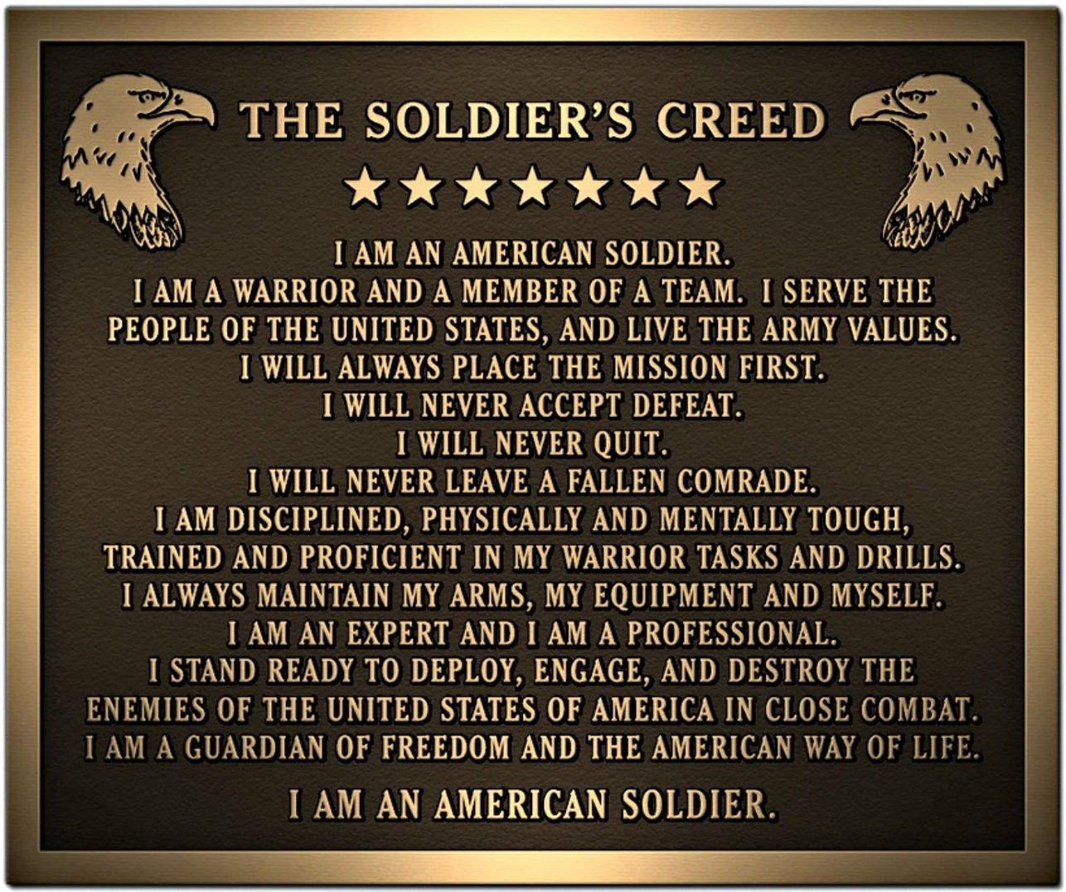

Slide 3


Veterans Helping Veterans
If you were on active duty, the reserves, or the national guard and visited a doctor, hospital, health clinic or any other medical facility for any reason. This could mean thousands of dollars to you and your beneficiaries.
VETERANS BENEFITS

Slide 4
Veterans Helping Veterans
County Veterans Service Officers
Alachua: (352) 264-6740
Baker: (904) 259-2516
Bay: (850) 248-8280
Bradford: (904) 966-6385
Brevard: (321) 633-2012
Broward: (954) 357-6622
Calhoun: (850) 674-8305
Charlotte: (941) 764-5579
Citrus: (352) 527-5915
Clay: (904) 269-6326
Collier: (239) 252-8387
Columbia: (386) 758-1013
Desoto: (863) 993-4860
Dixie: (352) 498-1246
Duval: (904) 630-3680
Escambia: (850) 912-2055
Flagler: (386) 313-4014
Franklin: (850) 653-8096
Gadsden: (850) 875-8661
Gilchrist: (352) 463-3188
Glades: (863) 946-0566
Gulf: (850) 229-6125
Hamilton: (386) 792-1272
Hardee: (863) 773-9853
Hendry: (863) 675-5250
Hernando: (352) 754-4033
Highlands: (863) 402-6623
Hillsborough: (813) 635-8316
Holmes: (850) 547-2897
Indian River: (772) 226-1499
Jackson: (850) 718-0003
Jefferson: (850) 342-0176
Lafayette: (386) 294-5010
Lake: (352) 742-6585
Lee: (239) 533-8381
Leon: (850) 606-1940
Levy: (352) 486-5210
Liberty: (850) 643-5960
Madison: (850) 973-3208
Manatee: (941) 749-3030
Marion: (352) 671-8422
Martin: (772) 288-5448
Miami-Dade: (786) 469-4640
Miami-Dade: (786) 469-4640
Nassau: (904) 548-4670
Okaloosa: (850) 651-7258
Okeechobee: (863) 763-6441
Orange: (407) 836-8990
Osceola: (407) 742-8455
Pasco: (727) 834-3282
Pinellas: (727) 464-8460
Polk: (863) 534-5220
Putnam; (386) 329-0327
Santa Rosa: (850) 981-7110
Sarasota: (941) 861-2899
Seminole: (407) 665-2371
ST- Johns: (904) 209-6160
ST- Lucie: (772) 337-5670
Sumter: (352) 689-4450
Suwannee: (386) 364-3403
Taylor: (850) 838-3513
Union: (386) 496-4248
Volusia: (386) 740-5102
Wakulla: (850) 926-1072
Walton: (850) 892-8140
Washington: (850) 638-6140
VETERANS BENEFITS
Larry Roberts
Department VA Entitlement Chair, Northern VA&R Chair
1301 W. Bell Street
Avon Park, FL 33825
(850) 718-7773

Slide 5
Why there’s a need to help veterans…
  Multiple and extended deployments.
  25% of the homeless are combat veterans.
  Suicide rate for active duty and veterans is 4x greater than that of civilians.
  200 + Veterans become disabled every day.
  Over 2 million veterans live without insurance.
  A Study released in 2022 found as many as 44 veterans die on average per day from suicide. Which is 2.4 times greater than the official estimate.
  Pending claims=801,000
  Back Logged Claims=524,000
VETERANS BENEFITS

Slide 6

Basic Eligibility
  Any person who served in Active Duty Military, who was discharged or released under conditions other than dishonorable, may qualify for VA Health Care Benefits.
VETERANS BENEFITS

Slide 7
Enrollment
  For most veterans, entries into the VA health care system begins by applying for enrollment.
  To apply, complete VA Form 10-10EZ, application for health benefits, which may be obtained from any VA health care facilities or regional benefits office, online at: http://www.VA.gov/10-10ez.htm
  Or call 1-877-222-vets (8387).
  Once enrolled, veterans can receive health care at VA health care facilities anywhere in the country.
VETERANS BENEFITS

Slide 8
Important Documents to Expedite VA Benefits
  In order to expedite delivery, Veterans seeking VA benefits for the first time you must submit a copy of your service discharge form (DD-214, DD-215, or World War II Veterans discharge form)
  The National Personnel Records Center (NPRC) has provided the following website for veterans to gain access to their DD-214 online http://vetrecs.archives.gov/
  You also need a copy of your military medical records if you need to order them you can at www.nationalarchivesandrecordsadministration.gov
  You also need veteran’s marriage certificate, children’s birth certificates or adoption papers to determine children’s benefits.
VETERANS BENEFITS

Slide 9
Tip #1
Have a ”Well-grounded claim” with evidence of a medical condition that either started while you were in the military, or a pre-existing condition that was aggravated by your stint in the military.
Keep all records in a folder by oldest to newest, highlight and tab any condition mentioned in the claim.
VETERANS BENEFITS

Slide 10

Tip #2
  Google / Web Search
  38 CFR Book C, Schedule for Rating Disabilities.
  For your particular issue(s) relevant to what you are claiming.
Must be able to navigate a
computer, have someone
assist if needed.
VETERANS BENEFITS

Slide 11

Tip #3
Get a letter from your doctor stating that your present condition is,
“MORE LIKELY THAN NOT, DIRECTLY RELATED TO THE HEALTH ISSUE YOU HAD IN THE MILITARY”.
VETERANS BENEFITS

Slide 12

Tip #4
Get letters from your family and friends stating, “how it is to live around you with your present condition”.
At the end of the letter make sure this
statement is written. “I HEREBY CERTIFY
THAT THE INFORMATION I HAVE GIVEN IS
TRUE TO THE BEST OF MY KNOWLEDGE
AND BELIEF”.
VETERANS BENEFITS

Slide 13
Service-Connected Disability Compensation
Disability Compensation is a monetary pay to veterans who are disabled by an injury, illness incurred or aggravated during active military service.
These disabilities are considered to be service – connected.
Disability compensation varies with degree of disability and the number of veteran’s dependents and is paid monthly.
Veterans with certain severe disabilities may be eligible for additional special monthly compensation.
Service-Connected Disability Compensation is Tax Free
VETERANS BENEFITS

Slide 14
2025 VA Disability Compensation Rates
% | VETERAN | W/SPOUSE | VET + SPOUSE & CHILD | VETERAN W/ CHILD | ADDITIONAL CHILDREN UNDER 18 | OVER 18/IN SCHOOL
10% | $175.51 | $175.51 | $175.51 | $175.51 | $175.51 | $175.51
20% | $346.95 | $346.95 | $346.95 | $346.95 | $346.95 | $346.95
30% | $538.10 | $601.73 | $648.94 | $580.18 | ADD $31.82 | ADD $102.63
40% | $775.14 | $860.33 | $922.93 | $831.59 | ADD $42.08 | ADD $136.50
50% | $1,103.44 | $1,210.17 | $1,288.17 | $1,174.25 | ADD $52.34 | ADD $171.39
60% | $1,397.70 | $1,525.98 | $1,619.38 | $1,482.88 | ADD $63.63 | ADD $205.26
70% | $1,761.42 | $1,910.23 | $2,020.05 | $1,860.97 | ADD $73.89 | ADD $240.15
80% | $2,047.48 | $2,217.84 | $2,343.05 | $2,161.40 | ADD $84.16 | ADD $274.02
90% | $2,300.87 | $2,492.79 | $2,633.39 | $2,429.16 | ADD $95.45 | ADD $308.92
100% | $3,836.16 | $4,050.04 | $4,206.67 | $3,979.19 | ADD $106.27 | ADD $343.29
VETERANS BENEFITS

Slide 15
Additional Allowances
* Veterans with ratings of at least 30% are eligible for additional allowances for dependents, including spouse, minor children, children between the ages of 18 and 23 who are attending school, children who are permanently incapable of self-support because of disability arising before age 18, and dependent parents. The additional amount depends on the disability rating. For more detailed rates visit: https://bit.ly/vacompensation
VETERANS BENEFITS

Slide 16

Post-Traumatic Stress Disorder
An average of 44 veteran suicides a day
Suicide Prevention Hotline 988 or 1-800-273-8255
In July 2010, the VA Secretary Eric K. Shinseki, allowed for qualification benefits for diagnoses from civilian mental health professionals. Drastically cutting waiting time for veterans.
Symptoms for PTSD at 50% disability
  Memory loss for names of close relatives
  Occupational and social impairment with reduced reliability and productivity
  Difficulty in establishing and maintain effective and social relationships
  Anxiety
  Chronic sleep impairment
  Depressed mood
  Mild memory loss
If you have been diagnosed with PTSD it does not mean that you will lose your right to own a firearm.
VETERANS BENEFITS

Slide 17
Agent Orange Symptoms
  VA assumes that certain diseases can be related to a Veteran’s qualifying military service. We call these "presumptive diseases”. VA has recognized certain cancers and other health problems as presumptive diseases associated with exposure to Agent Orange or other herbicides during military service. Veterans and their survivors may be eligible for benefits for these diseases.
  AL Amyloidosis A rare disease caused when an abnormal protein, amyloid, enters tissues or organs Chronic B-cell.
  Leukemia’s A type of cancer which affects white blood cells.
  Chloracne (or similar acne form disease) a skin condition that occurs soon after exposure to chemicals and looks like common forms of acne seen in teenagers. Under VA's rating regulations, it must be at least 10 percent disabling within one year of exposure to herbicides.
  Diabetes Mellitus Type 2 A disease characterized by high blood sugar levels resulting from the body’s inability to respond properly to the hormone insulin.
  Hodgkin’s disease A malignant lymphoma (cancer) characterized by progressive enlargement of the lymph nodes, liver, and spleen, and by progressive anemia.
  Ischemic Heart Disease A disease characterized by a reduced supply of blood to the heart that leads to chest pain.
VETERANS BENEFITS

Slide 18
Agent Orange Symptoms
  Multiple Myeloma A cancer of plasma cells, a type of white blood cell in bone marrow.
  Non-Hodgkin’s Lymphoma A group of cancers that affect the lymph glands and other lymphatic tissue.
  Parkinson’s disease A progressive disorder of the nervous system that affects muscle movement Peripheral Neuropathy, Early-Onset a nervous system condition that causes numbness, tingling, and motor weakness. Under VA's rating regulations, it must be at least 10 percent disabling within one year of herbicide exposure.
  Porphyria Cutanea Tarda A disorder characterized by liver dysfunction and by thinning and blistering of the skin in sun-exposed areas. Under VA's rating regulations, it must be at least 10 percent disabling within one year of exposure to herbicides.
  Prostate Cancer Of the prostate; one of the most common cancers among men Respiratory Cancers (includes lung cancer) Cancers of the lung, larynx, trachea, and bronchus Soft Tissue
  Sarcomas (other than osteosarcoma, chondrosarcoma, Kaposi’s sarcoma, or mesothelioma) A group of different types of cancers in body tissues such as muscle, fat, blood and lymph vessels, and connective tissues
Department of VA add three new serious illnesses https://bit.ly/agentorangevets
  Bladder Cancer
  Hypothyroidism
  Parkinson’s – Like Symptoms
VETERANS BENEFITS

Slide 19
Herbicide Tests and Storage in the U.S.
Agent Orange and other herbicides used in Vietnam were tested or stored elsewhere, including many military bases in the United States. Below is a list of Florida bases.
Orlando / Cocoa, 1944
Near Lake George, 1944
Army Grove Air Force’s Tactical Center, 1944
Marathon, 1944
Bushnell Army Airfield, 1945
Avon Air Force Base, 1951
Eglin Air Force Base, 1952
Avon Park Air Force Base, 1954
Jacksonville, 1962
Eglin AFB, C-52A, 1962-1970
Apalachicola National Forest near Sopchoppy, 1967
Eglin AFB, 1968
VETERANS BENEFITS

Slide 20
Death and Burial Benefits Essential Planning Guide
Eligibility: Veterans discharged from active duty, under conditions other than dishonorable and service members who died while on active duty. To verify eligibility for burial and memorial benefits, a copy of veterans’ discharge document “DD214” that specifies the period(s) of active duty and character of discharge, along with the deceased’s death certificate and proof of relationship to veteran (for eligible family members) are all that usually needed to determine eligibility.
VETERANS BENEFITS
  VA National Cemeteries
  ( 147 National Cemeteries )
  Headstone and Markers
  ( VA Form 40-1330 )
  Presidential Memorial Certificates
  ( VA Form 40-0247 )
  Burial Flag
  ( VA Form 27-2008 or U.S.P.S. and Funeral Director )
  Reimbursement of Burial Expenses
  ( VA Form 21-530 )
  Burial Allowance
  ( VA Form 21-530 )
  Plot Allowance
  ( VA Form 21-530 )
  Military Funeral Honors
  ( Active Military or Local Veteran Originations )

Slide 21
Florida Veterans’ Benefits Guide (2023)
  www.FloridaVets.org
  www.FloridaVeteransFoundationorg
  (850) 488-4181 or 4182
  Education Benefits for Veterans and families
  G.I. Home Loan
  Property Tax Exemptions
  Burial Benefits
  “V” for Veteran Designation on Driver License
100% Disabled Veteran State ID card
Driver License & State ID Fee Exemptions
Disabled Veteran Motor Vehicle License Plate
Florida State Park Discount Passes
Hunting and Fishing
Employment
Reemployment Rights
VETERANS BENEFITS

Slide 22
Veterans’ Preference
  Since the time of the Civil War, veterans of the U.S. armed forces have been given some degree of preference in appointments to federal jobs.
  To receive preference, a veteran must have been discharged or released from active duty in the U.S. armed forces under honorable conditions (with an honorable or general discharge). Preference is also provided for the spouse of a veteran with a permanent and total service-connected disability and widows and widowers of deceased veterans who died in service.
  A veteran with 100% disability can still work, as long as they are not “unemployable”.
VETERANS BENEFITS

Slide 23


Veteran Discounts and Deals
For discounts and/or free tickets visit these online websites:
  VetTix.com
  Military.com
  Govx.com
  Operation outdoor freedom
  Veteran holidays
Rays Baseball
Guide Fitter
Ask every where
you go!
VETERANS BENEFITS

Slide 24

Women Veterans
The Sunshine State is home of approximately 162,000 women veterans. Many women veterans don’t even know they are eligible for full range of federal, state and local benefits.
VETERANS BENEFITS

Slide 25

PACT ACT
The PACT Act is a new law that expands VA health care benefits for Veterans exposed to burn pits, Agent Orange, and other toxic substances.
VETERANS BENEFITS

Slide 26
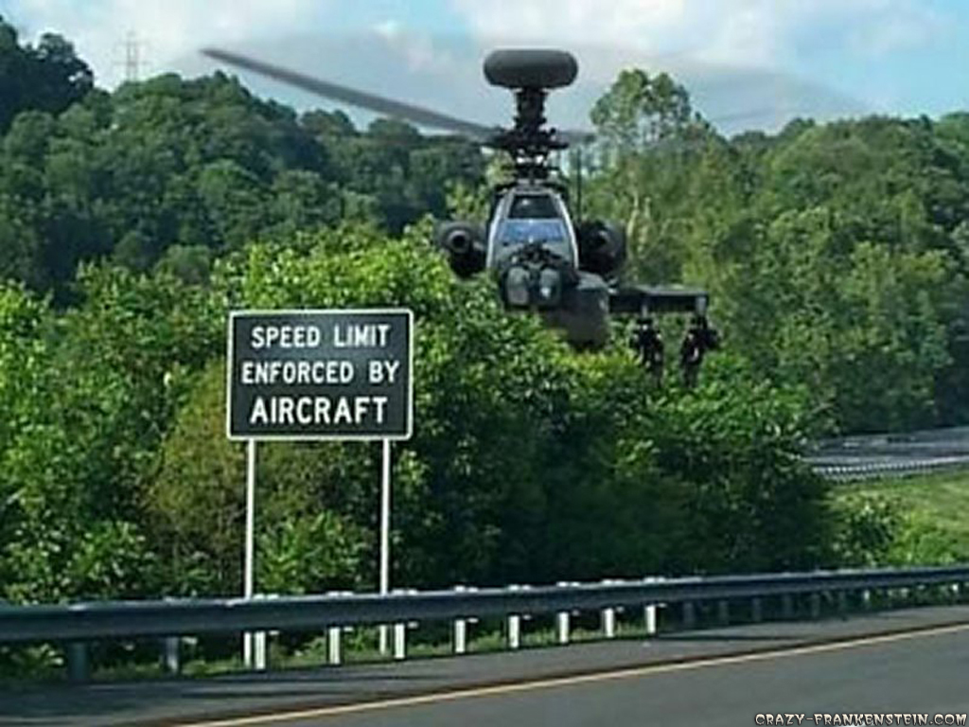
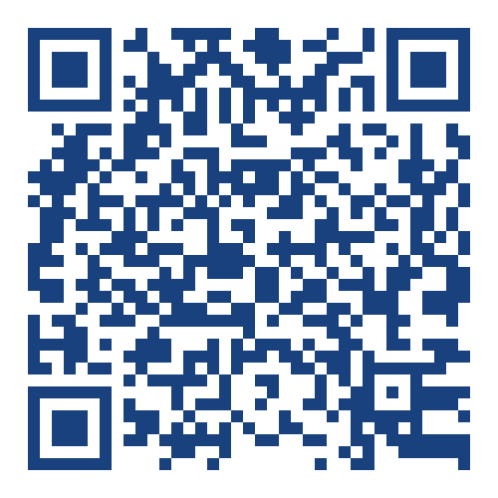
*
Please leave feedback.

