Slide 1

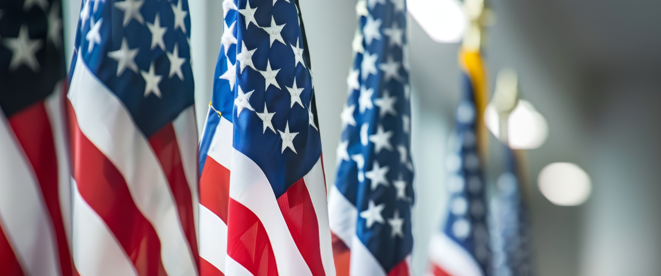
Sgt-at-Arms, Color Guard, and Honor Guard Training
Instructor (s): Troy Horsley
2025 Department of Florida
DEPARTMENT CONVENTION
www.floridalegion.org

Slide 2

SGT-AT ARMS resources
Officer Guide
Department of Florida SGT-At-Arms Protocol Manual
Flag Code of The United States Title 4 Chap 1
DOD Directive 1005.8- Provides Guidance for formations
Guidelines for displaying Flag
Sgt-at-Arms, Color Guard, and Honor Guard Training

Slide 3
Officers Guide
Arrange Meeting Hall
Assist Post Commander & Adjutant
Lead Color Guard Detail
Flag Etiquette
Post Color Guard Detail
Burial Detail
Other Pageantry
Chair Welcome Committee
Encourage Members To Attend Meetings
Advise Commander on Who Should Be Acknowledged
Sgt-at-Arms, Color Guard, and Honor Guard Training

Slide 4
AMERICAN LEGION DEPARTMENT OF FLORIDA SGT-AT-ARMS PROTOCOL MANUAL
SGT-AT-ARMS DUTIES
THE AMERICAN LEGION CAP
HALLOWED GROUND
PREAMBLE OF THE AMERICAN LEGION
THE MEANING OF THE PLEDGE OF ALLEGIANCE
POW/MIA REMEMBRANCES
HISTORY OF THE AMERICAN FLAG
HISTORY OF PLEDGE OF ALLEGIANCE
LEGION UNIFORMS; CORDS & BRAIDS
ORIGIN OF FLAG DAY
PROPER FLAG DISPOSAL CEREMONY
PROPER FLAG DISPLAY ON VEHICLES & BIKES
MILITARY FUNERAL FLAG PROTOCOL
AMERICAN LEGION PROTOCOL
Sgt-at-Arms, Color Guard, and Honor Guard Training

Slide 5
Flag Code Title 4 U.S.C 5 code Chap 1
Flag Stars Advertising/Mutilation of flag
Pledge of Allegiance
Display and use of flags by civilians
Time and occasions for display
Position and manner of display
Respect for flag
Conduct during hoisting, lowering and passing flag
Modification of rules and customs by president
Sgt-at-Arms, Color Guard, and Honor Guard Training

Slide 6
Guidelines for Displaying the flag
Public Law 94-344, known as the Federal Flag Code, contains rules for handling and displaying the U.S. flag. While the federal code contains no penalties for misusing the flag, states have their own flag codes and may impose penalties. The language of the federal code makes clear that the flag is a living symbol.
Sgt-at-Arms, Color Guard, and Honor Guard Training

Slide 7
Half Staff Notification's
Email
Starsandstripesdaily.org
Txt the word Flag to 534466
Sgt-at-Arms, Color Guard, and Honor Guard Training

Slide 8
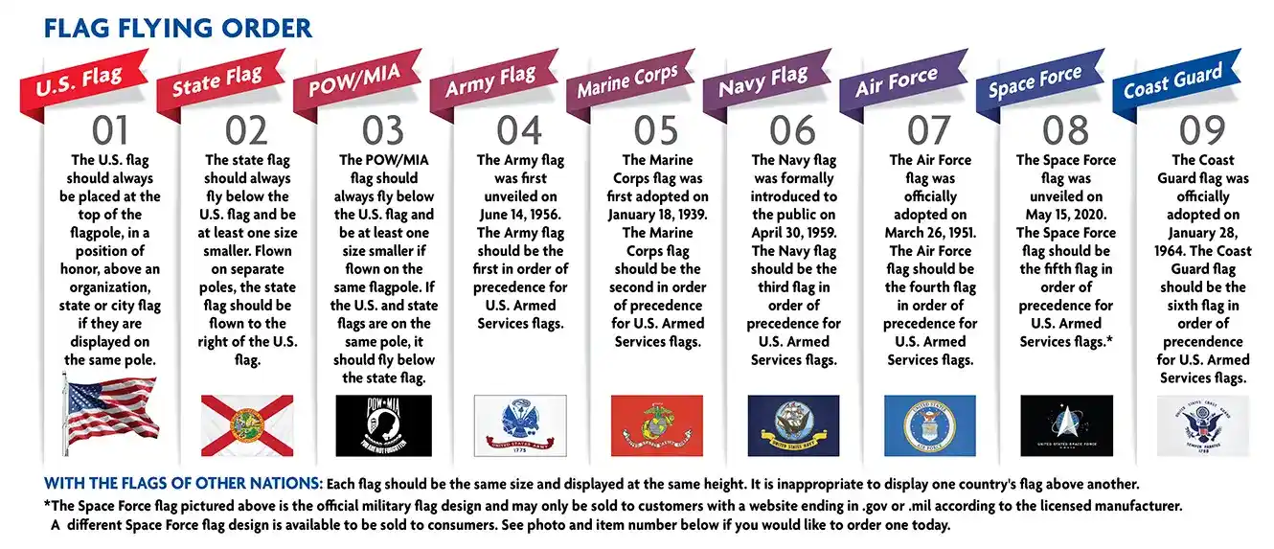
Flag Flying order
Sgt-at-Arms, Color Guard, and Honor Guard Training

Slide 9
Answers
Public Law No: 116-67 (11/07/2019) National POW/MIA Flag Act
The bill changes the days on which the POW/MIA flag is required to be displayed at specified locations to all days on which the U.S. flag is displayed. (Current law requires the POW/MIA flag to be displayed only on Armed Forces Day, Memorial Day, Flag Day, Independence Day, National POW/MIA Recognition Day, and Veterans Day.)
The order in which the POW/MIA flag is displayed depends on the number of flagpoles and the flags being flown with it:
Single flagpole- The POW/MIA flag is flown directly below the US flag, and is no larger than the US flag
Two flagpoles-The POW/MIA flag is flown under the US flag, and the state flag is flown on the other pole
Three flagpoles-The US flag is flown on the right pole, the POW/MIA flag is flown on the middle pole, and the state flag is flown on the left pole
During war, the Coast Guard flag flies between the Navy and the Air Force, matching the date of origin or birthday rule.
Sgt-at-Arms, Color Guard, and Honor Guard Training

Slide 10
Things to remember
Traditional guidelines call for displaying the flag in public only from sunrise to sunset. However, the flag may be displayed at all times if it’s illuminated during darkness. The flag should not be subject to weather damage, so it should not be displayed during rain, snow and wind storms unless it is an all-weather flag.
It should be displayed often, but especially on national and state holidays and special occasions. The flag should be displayed on or near the main building of public institutions, schools during school days, and polling places on election days. It should be hoisted briskly and lowered ceremoniously
Sgt-at-Arms, Color Guard, and Honor Guard Training

Slide 11
2025 CHANGE TO FLAG CODE
Pentagon drops ban on service members displaying US flags horizontally at big events
Under the old rules outlined on Feb. 10, 2023, uniformed service members were barred from participating directly in the “unfurling, holding, and/or carrying of giant horizontal U.S. flags.”
Defense Department personnel may now show the flag, regardless of its size or position, at eligible public sporting and other community events, provided that such displays are done in a respectful manner
Sgt-at-Arms, Color Guard, and Honor Guard Training

Slide 12
Helpful reference
US Flag Manual from Military Salute Project MSP-08
https://www.usmhc.org/Flag.php
Sgt-at-Arms, Color Guard, and Honor Guard Training

Slide 13
Prior to your meeting
The Sergeant-at-Arms should meet with the Commander prior to the meeting and see if any guests are expected, any special requirements he or she has to set the Meeting room up properly. Go over Escorting any special guests and how the room should be set up. It may need to be set up different from time to time and as Sergeant-at-Arms you have to Anticipate different things and what the Commander may be thinking of next during the meeting. Always get assistant Sergeant-at-Arms in order to help you setup and break down the room, identify guests and check membership cards.
Sgt-at-Arms, Color Guard, and Honor Guard Training

Slide 14
Make a Guest check list for legion officers
For department officers go to
Department | Florida American Legion (floridalegion.org)
You will find officers/area/district commanders and chairs
For national officers go to
https://www.legion.org/about/leadership
Sgt-at-Arms, Color Guard, and Honor Guard Training

Slide 15
Guest introductions for meetings
American Legion officers are introduced in the order by which they were installed into office: sergeant-at-arms, historian, judge advocate, chaplain, treasurer or finance officer, vice commanders, and commander. As with all rules, there are some exceptions. If it is a function of both The American Legion and the American Legion Auxiliary, the Auxiliary officers, dignitaries, etc., are introduced first. A national executive committeeman (NEC) or alternate NEC (NECA) should be introduced immediately before the department commander.
Sgt-at-Arms, Color Guard, and Honor Guard Training

Slide 16
Guest introductions for meetings
Order of Introduction
- Are generally done in order of rank within the organization, from low to high:
- Local dignitaries, non-American Legion guests S.A.L. Officers - Local, District, Department, National
- Auxiliary Officers -Local District, Department, National
- American Legion Officers -Local, District, Department, National American Legion
Sgt-at-Arms, Color Guard, and Honor Guard Training

Slide 17
Guest Protocol
Department Officers present should be given special recognition and the opportunity to extend greeting. The highest office that is present during the meeting should be given the proper respect by first: 3 Raps of the Gavel to get everyone to standing at attention and then stating
the words:
"We are delighted to have our "Department Commander", Chris Hamrick, with us today, and
we would be happy to hear from him." The M of C or Commander introducing should
start the Dignitary Clap so others will join in; (the Sergeant¬at-Arms escorts him to the podium).
Sgt-at-Arms, Color Guard, and Honor Guard Training

Slide 18
POW/MIA
Resolution 288, adopted at the Legion’s 67th National Convention, calls for a POW/MIA empty chair to be placed at all official meetings of The American Legion as a physical symbol of the many American POW/MIAs still unaccounted for from all wars and conflicts involving the United States of America. This is a reminder for all of us to spare no effort to secure the release of any American prisoners from captivity, the repatriation of the remains of those who died bravely in defense of liberty, and a full accounting of those missing. Let us rededicate ourselves to this vital endeavor.”
Some post do the ceremony some do not
Some posts Have SAA advance and place while being read during the opening
Upon completion, observe a moment of silence
During closing of meeting, all present join SAA rendering a slow salute
Sgt-at-Arms, Color Guard, and Honor Guard Training

Slide 19
Welcoming Committee
The Importance of Having a Welcoming Committee for a POST
A welcoming committee is an integral part of any organization, especially for a POST. The role of this committee is often underestimated, but it is crucial for fostering community engagement, building trust, and establishing a positive first impression for newcomers. Here are several reasons why having a welcoming committee is important for a POST.
Sgt-at-Arms, Color Guard, and Honor Guard Training

Slide 20
Welcoming Committee
1. First Impressions Matter
2. Facilitates Smooth Transitions
3. Promotes Inclusion and Belonging
4. Encourages Engagement and Retention
5. Creates a Culture of Hospitality
6. Boosts Networking Opportunities
7. Provides a Resource for New Members
8. Strengthens the Organization’s Reputation
Sgt-at-Arms, Color Guard, and Honor Guard Training

Slide 21
You Can Help
In a world where individuals seek meaningful connections and community involvement, the role of a welcoming committee in a POST cannot be overstated. It is the first line of communication that establishes trust, fosters inclusion, and encourages active participation. By creating an environment where new members feel genuinely welcome and supported, the welcoming committee not only enhances individual experiences but also contributes to the overall success and longevity of the organization. As such, investing time and resources into a welcoming committee should be a priority for any POST that wants to thrive in today's interconnected world.
Sgt-at-Arms, Color Guard, and Honor Guard Training

Slide 22

Honor/Color Guard
Sgt-at-Arms, Color Guard, and Honor Guard Training

Slide 23
Honor/Color Guard
https://youtu.be/WEEYCuGJmOw?si=884qys6199T_bKt-&t=1116
Start 18:36
Sgt-at-Arms, Color Guard, and Honor Guard Training

Slide 24
Honor/Color Guard
There are five classes of competition: Advancing/Retiring Colors, Military, Military-Open, Open and JROTC Drill. To be considered for the National Commander’s Color Guard, units must compete in either Military or Military-Open and Advancing/Retiring Colors. Units can represent any part of the Legion Family or have a combination of members in the unit
Sgt-at-Arms, Color Guard, and Honor Guard Training

Slide 25
Honor/Color Guard
The inspection will certify that the required number of participants are available for competition,and to ensure personal appearances and condition of uniforms are both professional and identical. Uniforms should be in accordance with each director’s judgement of visual presentation. However, a general inspection of the members entering the competition area will take place and if an infraction is noticed, a penalty will be assessed.
Sgt-at-Arms, Color Guard, and Honor Guard Training

Slide 26
UNIFORM AND EQUIPMENT
The style and color of uniform will be optional with each unit provided they are within the
dignity and propriety required when carrying the National Colors. Headgear is required to be
worn by all members of the unit. If the Color Guard does not wear Color Guard headgear
specific to the Color Guard such as helmets or berets, members shall wear the official uniform
hat of the member’s organization within The American Legion Family.
Required authorized equipment will consist of National Colors*, American Legion
Organizational Banner, and at least two weapons.
Additional authorized equipment, such as flags, sidearm, sabers and swords may be carried and
can be simulated. “Replica rifles” may be used, as long as they have the same weight as the real
rifle, plus the bolt mechanism.“Simulated rifles” (rifles of lesser weight with or without
simulated bolt mechanism) should not be used
Sgt-at-Arms, Color Guard, and Honor Guard Training

Slide 27
POST AND RETRIEVE
This maneuver includes the U.S. Flag and The American Legion organizational banner. The
U.S. Flag is to be posted to the right of the Saluting Point with its front facing the field.
Colors must be properly guarded at all times; for guarding purposes, weapons shall at all times
be in the possession of the guarding member. During the ceremony of Posting and Retrieving,
two (2) salutes are required, to be executed simultaneously by all members; one directly
following posting and one salute directly prior to retrieving colors. A color is deemed posted
immediately upon the release of the pike. A color is deemed retrieved upon the intentional grasp
of the pike. The U.S. Flag and Banner may be posted simultaneously, if not so posted the U.S.
Flag must be posted last. The U.S. Flag and Banner may be retrieved simultaneously. However,
if not so retrieved, the U.S. Flag must be retrieved first.
Sgt-at-Arms, Color Guard, and Honor Guard Training

Slide 28
POSTING (ADVANCING) COLORS
Color Guard consisting of a minimum number of four (4) is formed at the rear of the room/hall
in a rank or file, whichever may suit the situation best, formation facing the Commander’s
station.
In forming a rank, the National Color is to the right of the Post Color and the two Guards are on
the respective flanks. In forming a file, the National Color is second in file, preceded by a Rifle
Guard and followed respectively by the Post Color and a Rifle Guard.
To properly form the Guard, the following sequence of Commands may be used: “Fall In”-
“Dress Right Dress”-“Ready Front”-“Right or Left Shoulder Arms”-(Color bearers should
assume the position of carry or any other suitable position at this command) “Forward March.”
The above-mentioned commands put the Guard in a forward motion.
Sgt-at-Arms, Color Guard, and Honor Guard Training

Slide 29
POSTING (ADVANCING) COLORS
Upon arriving at a position in front of the Commander’s station, the following commands may
be used: “Guard Halt-Post Colors” (The National Color bearer steps off in the direction of the
Flag receptacle to the right of the Commander’s station, halting and facing front upon arriving in
front of same). The Post Color bearer follows the same procedure to the Flag receptacle to the
left of the Commander’s station. During this procedure the Rifle Guards will assume the
position of Port Arms. The next command may be “Place Colors.” Colors may be placed by
stepping forward with one foot and placing Colors into the receptacles, making sure any top
ornament on each respective color is facing the assemblage. It must be remembered that the
Colors may be posted simultaneously, or the Post Color is posted first followed by the National
Color. The Color Bearers then return to the position of attention. The next command may be
“Present Arms.” The Rifle Guards should render the prescribed salute with their pieces and the
Color Bearers should render a right hand salute. (Post Color Bearer should either face the
National Color or turn toward the American Flag while executing the salute).
Sgt-at-Arms, Color Guard, and Honor Guard Training

Slide 30
POSTING (ADVANCING) COLORS
The next command sequence may be “Right Shoulder Arms” (Color Bearers recovering from hand salute on same), “Assemble March” (Color Bearers may face the center and step off respectively in the direction from which they came and assume their positions in the formation facing the rear of the competition area.
The Rifle Guards may execute an about-face on command and be prepared to move out on the next command with Guard intact).
The next command may be “Forward March” and upon arriving at the starting point, the Guard should be halted with the command of “Guard Halt” and then the Guard may be given “Fall Out.”
Sgt-at-Arms, Color Guard, and Honor Guard Training

Slide 31
RETRIEVING COLORS
Retrieving the Colors may be executed in nearly the same manner except substituting the
command of “Retrieve Colors” for “Post Colors,” and giving the command “Present Arms”
upon the Color Bearers arrival in front of their respective colors (Color Bearers will salute at this
time).
The next sequence of commands may be “Right Shoulder Arms” (Color bearers will assume
position of attention) “Take Colors” (Color Bearers putting one foot forward to take Colors and
assuming position of attention, after securing same). It must be remembered that the Colors may
be retrieved simultaneously, or the National Color is retrieved first followed by the Post Color.
The next commands may be “Assemble, March” (Color Bearers executing same marching as in
returning from Posting). The Rifle Guards will execute about-face after Colors have arrived in
respective positions. The Guard may be retired in the same manner as it was in Posting, with the
exception of the last command, which should be “Dismissed.”
Sgt-at-Arms, Color Guard, and Honor Guard Training

Slide 32
Honor/Color Guard
www.legion.org › Color-Guard-Application-Advancing-Retiring
Usually required mid to late July after approval from Department of Florida
Sgt-at-Arms, Color Guard, and Honor Guard Training

Slide 33
Questions
Thank You
for attending
Sgt-at-Arms, Color Guard, and Honor Guard Training

