Slide 1

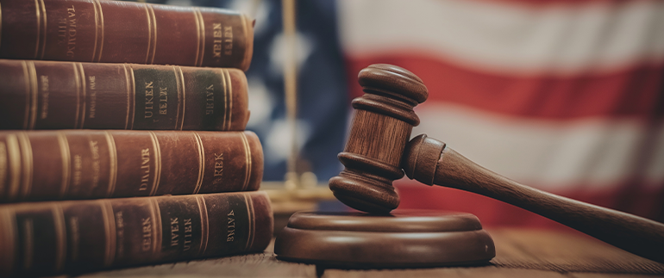
Judge Advocate
Training
Instructors:
Judge Advocate David Pleasanton, Esq.
Assistant Judge Advocate Curtis McNeil, Esq.
2025 Department of Florida
Department Convention
www.floridalegion.org

Slide 2

Moot Trail
POST ABC
V
BOB BUTTHEAD
FACTUAL SCENARIO
JUDGE ADVOCATE TRAINING

Slide 3
Factual Scenario
Commander of the post, ABC, Billy Badass, and his wife, Karen Badass, are at the post home on Saturday, June 8, 2024, at approximately 6 PM.
They are sitting at a table in the social quarters of the post home.
Bob Butthead is disabled and normally uses a wheelchair, but on June 8, 2024, was using crutches.
Bob Butthead has been at the bar for a while.
Bob, Butthead, at approximately 6 PM, pays his tab and decides to leave.
On the way to the door, Bob Butthead loses his balance and bumps into the table where Commander Badass, and his wife, Karen, are sitting.
Karen Badass tells Bob Butthead that he is drunk, that he drinks too much, and that he should watch where he is going.
JUDGE ADVOCATE TRAINING
Notes:
C

Slide 4
Factual Scenario Continued
Bob Butthead apologizes and says he is sorry.
Karen Badass replies that he is drunk and should not get drunk at Post ABC.
Bob Butthead, as he is turning to leave, says, “I may be drunk, but you are ugly. The difference is, I will be sober in the morning, but she will still be ugly.”
Karen Badass then takes her glass of wine and throws the liquid content onto Bob Butthead.
Bob Butthead turns back around to face Karen Badass; as he is doing this, Commander Badass gets up and pushes/shoves Bob Butthead in the chest, causing Bob Butthead to fall down.
JUDGE ADVOCATE TRAINING

Slide 5
Factual Scenario Continued
Legionnaires, other than Commander and Karen Badass, help Bob Butthead up and to his car.
The next day, June 9, 2024, charges are preferred by Sally Busybody against Commander Badass.
Sally Busybody is a member of Post ABC but was not present at the post at the time of the incident. It is known that she dislikes Commander Badass, and they have had problems in the past.
Karen Badass is not a member of Post ABC, but is the past president of the Post ABC Auxiliary in there still a member of the Post ABC Auxiliary.
JUDGE ADVOCATE TRAINING

Slide 6
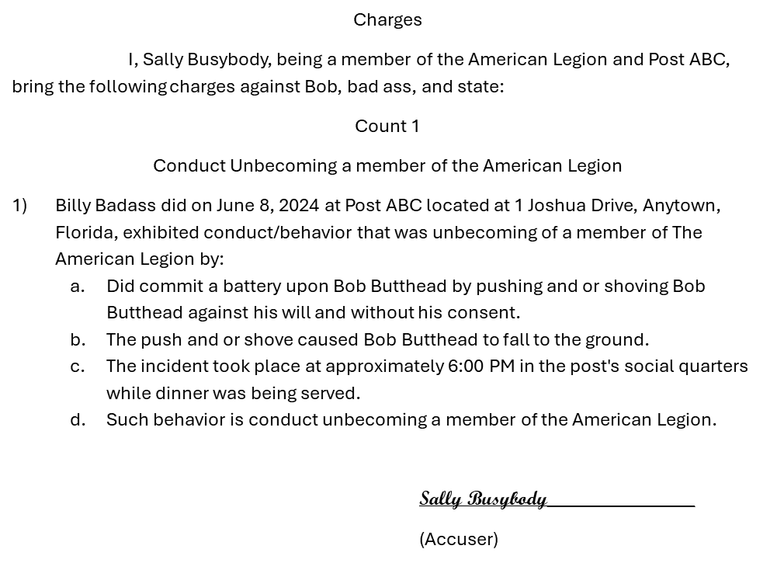
Charges
Post ABC
V
Bob Badass
JUDGE ADVOCATE TRAINING

Slide 7
Charges Continued
STATE OF FLORIDA. }
ss
COUNTY OF Xanadu}
BEFORE ME,
The undersigned authority, a Notary Public, duly commissioned in, and for the said County and State, personally appeared Sallie Busybody, who is personally known to me, or produced ________________________________, as identification and known to me to be the same person described in and who acknowledged, sworn, and executed the foregoing instrument, as true and correct.
WITNESS my hand and seal this 9th day of June, 2024.
____________________________________
Notary Public
My Commission Expires:
JUDGE ADVOCATE TRAINING

Slide 8
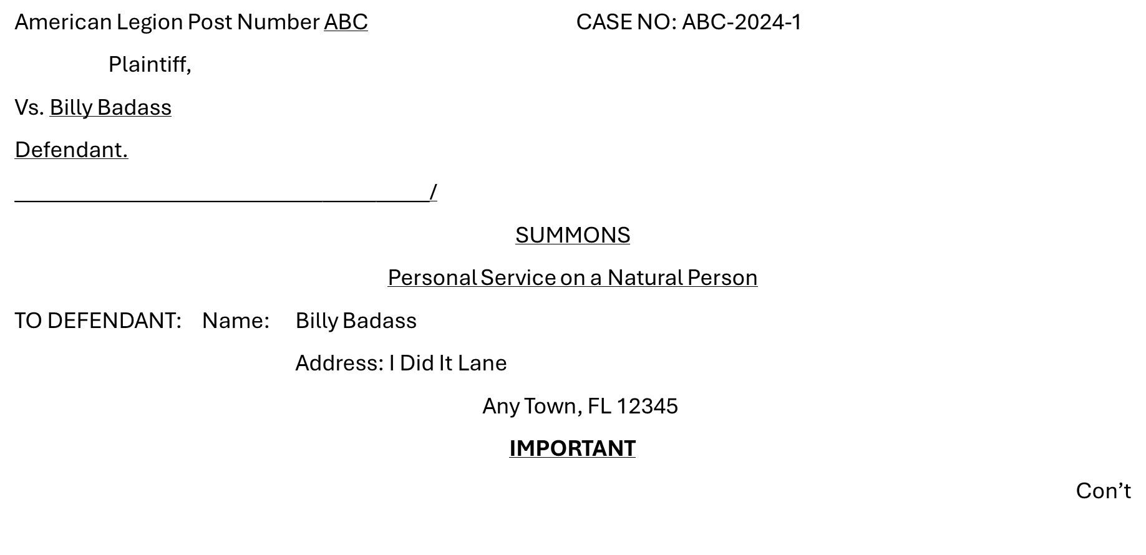
Summons
JUDGE ADVOCATE TRAINING

Slide 9
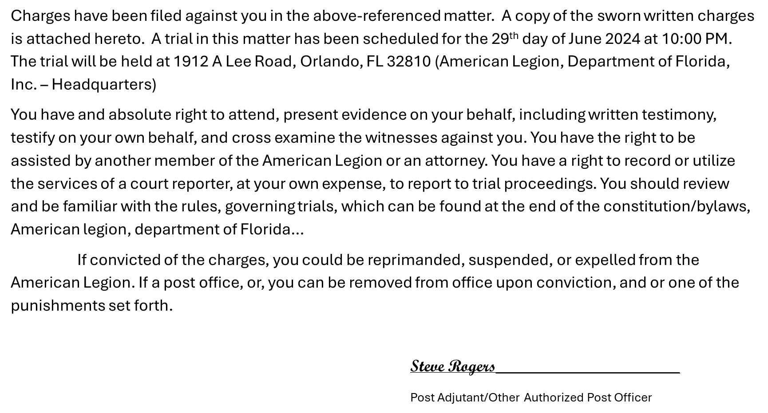
Summons Continued
JUDGE ADVOCATE TRAINING

Slide 10
Victim Statement
Bob Butthead (Statement)
Member of Post ABC.
Injured leg while in active duty.
Can walk with the use of crutches or a walker.
Usually uses a wheelchair.
Arrived at Post ABC on June 8, 2024.
Drank Shirley Temple’s.
Other people at the bar teased him.
JUDGE ADVOCATE TRAINING

Slide 11
Victim Statement Continued
Started drinking Bud Light.
I Got up to leave at bout 6 PM.
Walking to the door on my crutches, I lost my balance.
Bumped into the table.
I apologized and started for the door.
Lady accused me of being drunk.
She said I drink too much and should watch where I was going.
I told her I might be drunk, but she was ugly. The difference is I will be sober tomorrow morning, but you will still be ugly. She threw a drink on me. I turn back around.
I was shoved to the ground by Commander Badass.
JUDGE ADVOCATE TRAINING

Slide 12
Witness Statement
Susie Bartender (Statement)
I was tending bar at Post ABC on June 8, 2024.
I came on duty at 4:00 PM.
Bob Butthead was on his usual barstool when I started my shift.
Susie served Bob Butthead four Bud Lights.
Bob butthead left the Post at about 6:00 PM. On the way out, there was a problem at the table where Commander Badass and his wife were sitting.
Heard a commotion, looked up, and saw Commander Badass shove Bob Butthead in the chest.
Bob Butthead fell to the ground.
Other legionnaires helped Bob butthead up and to his car.
JUDGE ADVOCATE TRAINING

Slide 13
Witness Statement (2)
Karen Badass (Statement)
June 8, 2024, came to Post ABC with her husband, Billy Badass for drinks and dinner.
Served about 3:30 PM.
Eating dinner.
Bob Butthead is always drunk.
Stumbled into the table and spilled my glass of wine on him.
Accused me of being ugly.
Husband, Billy Badass defended her honor.
Confronted Bob Butthead.
Bob Butthead slipped and fell down.
JUDGE ADVOCATE TRAINING

Slide 14
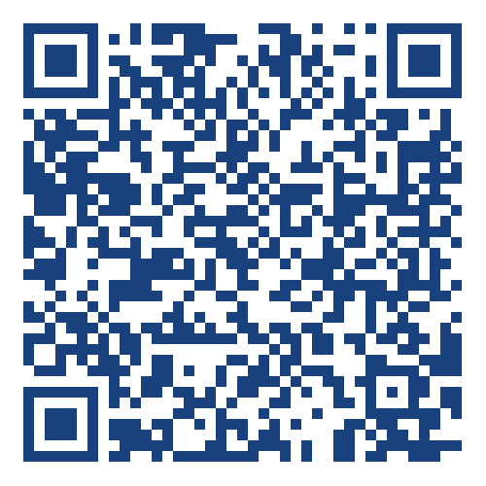
Questions?
Judge advocate training
Please leave feedback.

