Slide 1


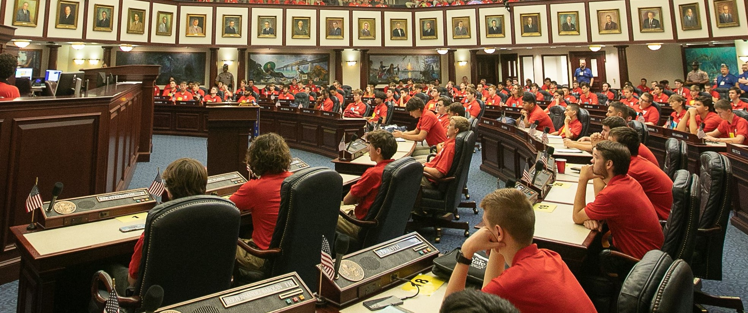
Florida
Boys State
Instructor: Darcy Bockman-Wright
Department of Florida
2025 Leadership Retreat
www.floridalegion.org

Slide 2

Agenda
Introduction
Appointing a Post/District chair
Choosing delegates
Important dates
Expectations
Final tips & takeaways
FLORIDA BOYS STATE

Slide 3
Introduction
FLORIDA BOYS STATE

Slide 4
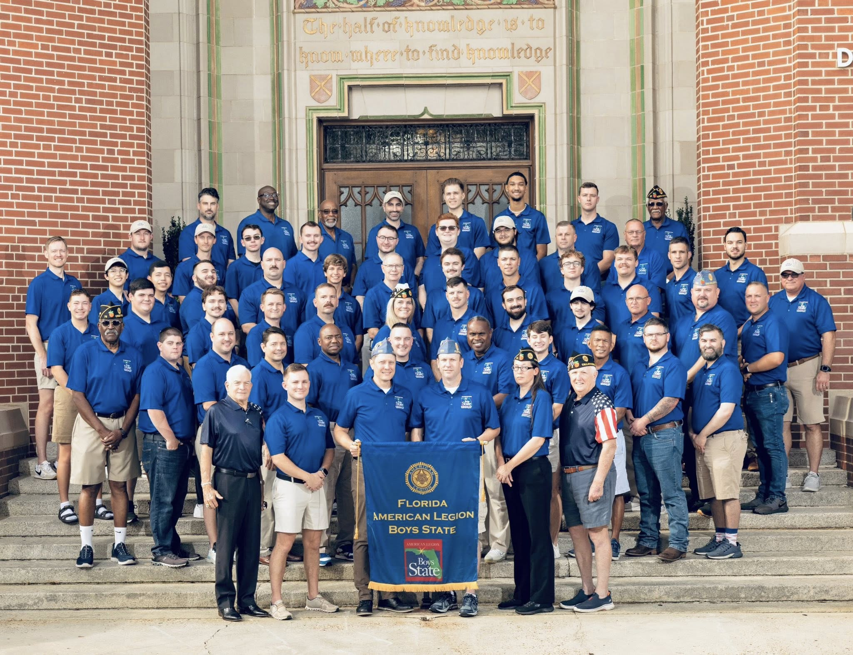
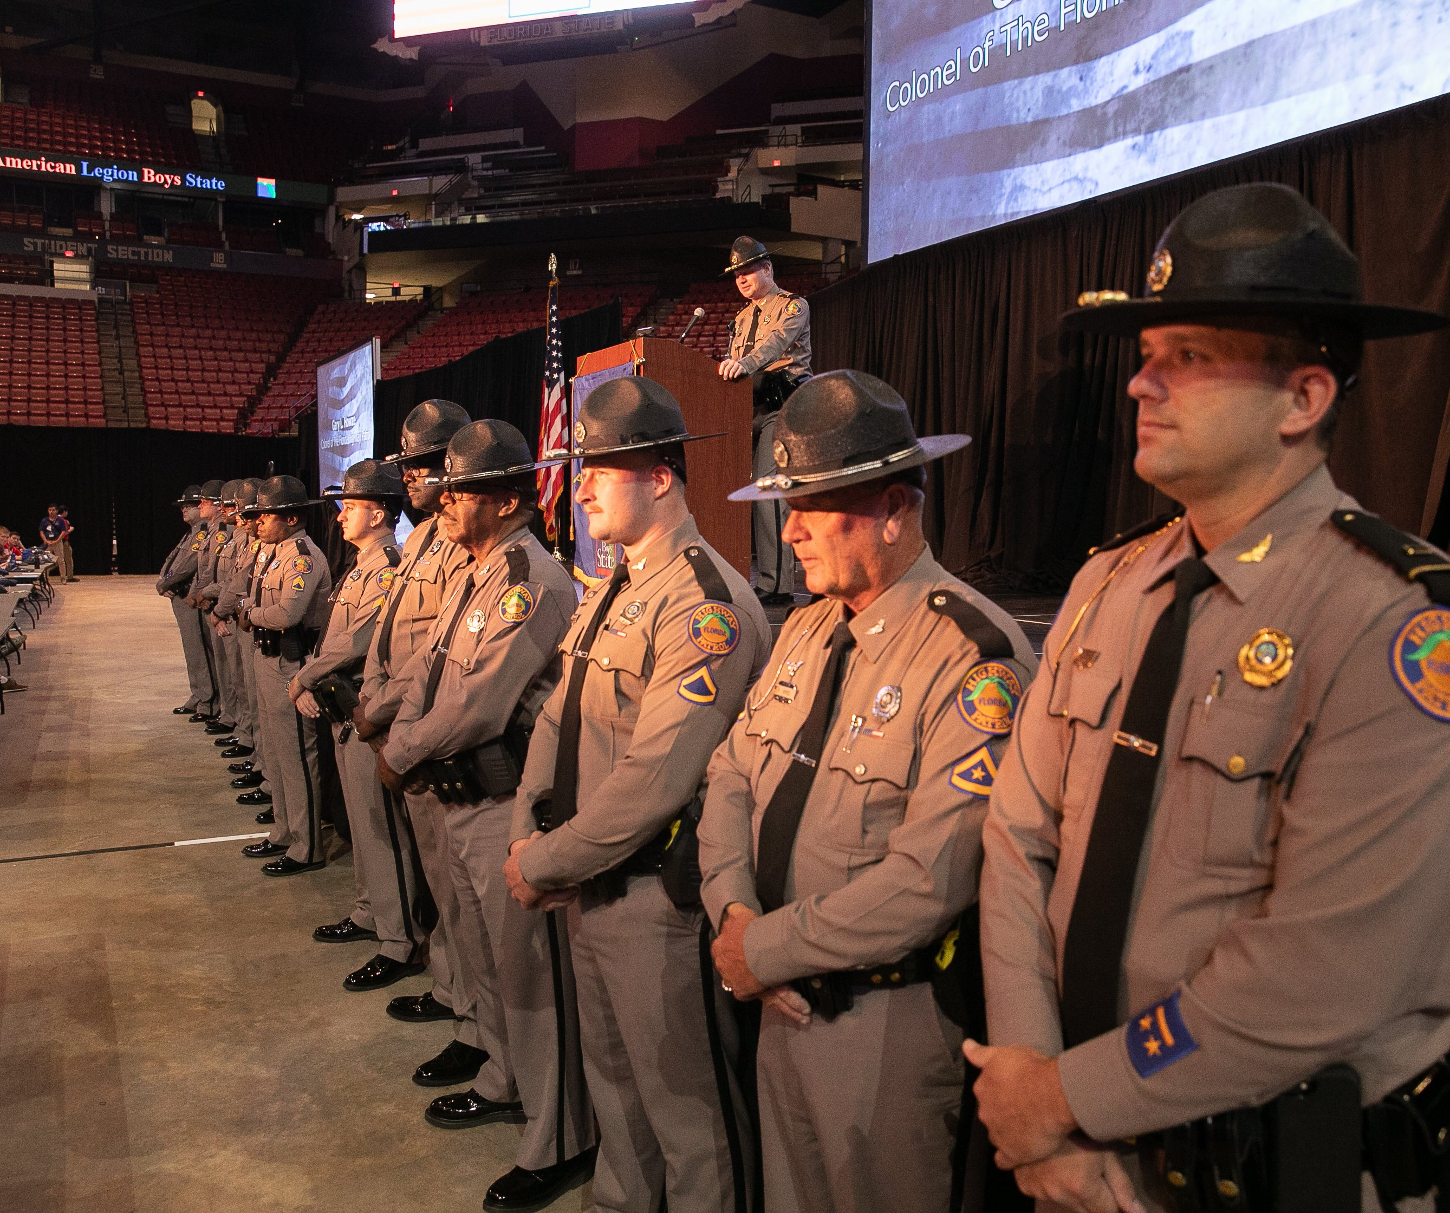
Post/District Chairs
FLORIDA BOYS STATE

Slide 5
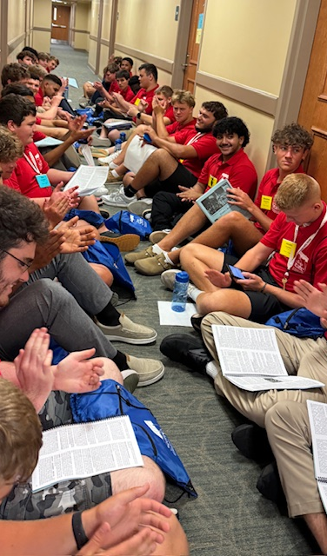
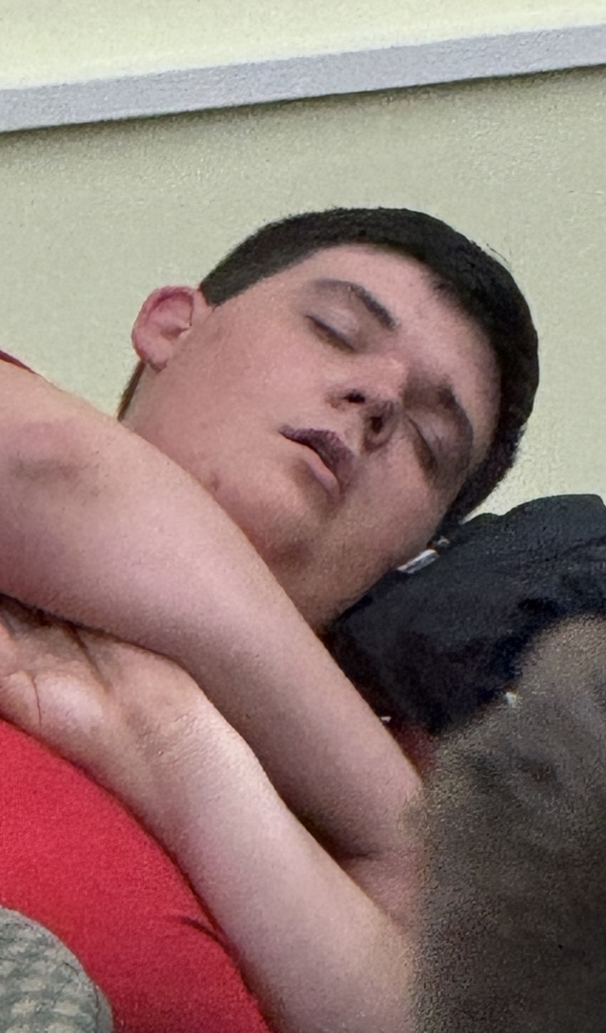
The Ideal Delegates
FLORIDA BOYS STATE

Slide 6
Important Dates
September – Program packets will be sent to chairs
September-Beginning of December - Prepare budget for the program, get applications out to potential delegates and Payments to Dept
Mid-December-January - Post begin making Delegate and Alternate selections.
January - Online registration begins. Payments for Delegates conclude at the end of January.
Mid-March - Registration ENDS
March/April - District orientations
May 9th – Boys State Alumni Dinner at Department HQ
June 14th -20th – 82nd Session of Boys State
FLORIDA BOYS STATE

Slide 7
Expectations
FLORIDA BOYS STATE
ARE KEY TO THEIR SUCCESS

Slide 8
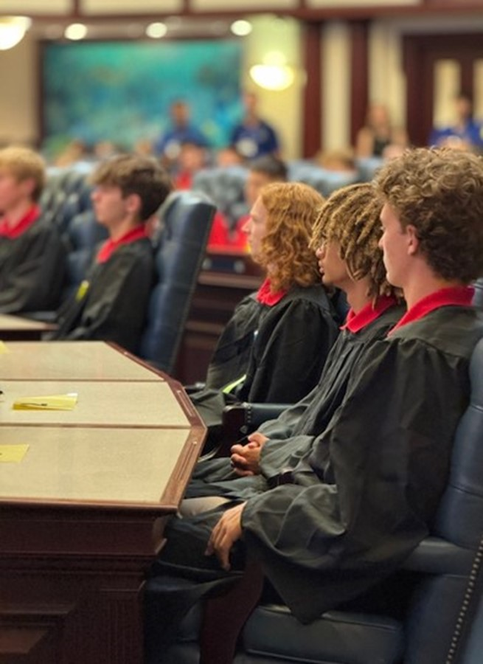
Tips and Take-a-ways
  Make sure its in the budget
  Do fundraisers
  Work with other Post
  If able have a committee
  Be mindful of deadlines
  Pick and engage the right delegates
  Ask for help
FLORIDA BOYS STATE
“By failing to prepare, you are preparing to fail” ~ Benjamin Franklin

Slide 9
Questions?
FLORIDA BOYS STATE

Slide 10
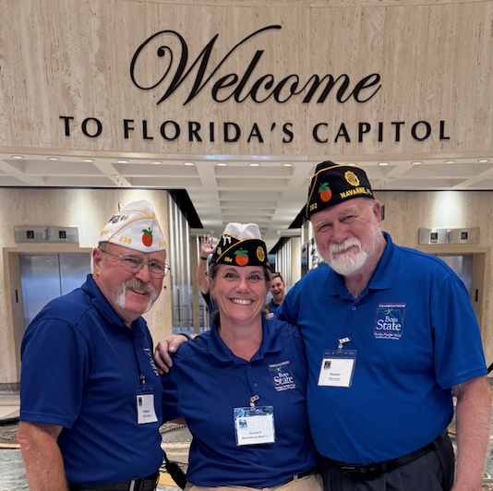
Thank You
Sonny Decker
502-640-8586
Darcy Bockman-Wright
308-520-5959
Email: boysstate@legionmail.org
FLORIDA BOYS STATE

