Slide 1


Retreat, July 13, 2025
Jim Wineland, ALR Chair
AMERICAN LEGION RIDERS

Slide 2
Standard Operating Procedures
(Effective & Adopted by the DEC on 11-24-2024)
Table of Contents
Article I: Department ALR Advisory Committee
Article II: Sub-Committees
Article III: Finance
Article IV: Florida Motorcycle Safety Program
Article V: American Legion Rider Chapter
Article VI: Patches and Apparel
VII: Amendments
VIII: Effective Date
Participant Accident Waiver/Release of Liability Form
Chapter Standing Rules

Slide 3
American Legion Riders Advisory Committee
Section 1. Members
The Committee shall consist of the following ALR members: Chair, Vice Chair, one (1) Area Chair from each Area (Northern, Eastern, Central, Southern, Southwestern, Western); one (1) District Chair from each District, Adjutant/Finance Officer, Assistant Adjutant/Finance Officer, Chaplain, Safety Officer, New Chapter Development Officer, and Sergeant-At-Arms.
Section 2. Qualifications
The Chair, Vice Chair, and Area Chairs must be a member in good standing of The American Legion and a current American Legion Rider within the Department of Florida.
The District Chairs, Adjutant/Finance Officer, Assistant Adjutant/Finance Officer, Chaplain, Road Captain/Safety Officer, New Chapter Development Officer, and Sergeant-At-Arms must be a member in good standing of The American Legion Family and a current American Legion Rider within the Department of Florida.
Must be a current or past officer of an American Legion Rider Chapter.

Slide 4
SELECTION PROCESS
(That includes YOU)
Section 3. Selection
The Chair shall be appointed by the Department Commander.
Each Area Commander, with the recommendations of the ALR Chair, shall appoint an Area Chair.
Each District Commander, with the recommendations of the ALR Chair, shall appoint the District Chair.
The Chair appoints the Vice Chair, Adjutant/Finance Officer, Chaplain, Road Captain/Safety Officer, New Chapter Development Officer, and Sergeant-At-Arms with the approval of the Department Commander.
The Chair, Assistant Chair, and Adjutant/Finance Officer shall select the Assistant Adjutant/Finance Officer.

Slide 5
Area Chair Duties
Area Chair
  Shall assume the duties of the Chair in their absence at the instruction of the Department Commander or Department Executive Committee.
  Shall make reports to the Chair before the Department Convention, Fall Conference, and ALR Summit. Reports should cover all aspects of Chapter membership, recruitment, social events, mileage, hours, and funds expended in support of community events and programs, training, and any other information for the good of the American Legion Riders. Monitors to ensure all necessary reports to the Department Commander and Department Executive Committee are submitted promptly.
  Monitor to ensure all Chapters are following the rules and procedures as set forth by the Department of Florida.
  Responsible for ensuring the administration, operation, and safety of the Chapters and following guidelines set forth by the Department of Florida and the National Organization in their area.
  Visit Chapters within their area regularly.
  Provide advice and assistance to Posts within their region that wish to start an ALR Chapter in conjunction with the Committee's New Chapter Development Officer.
  Represents Chapters within their Area at all Committee meetings.

Slide 6
District Chair Duties
District Chair
  Shall make reports to the Area Chair before the Fall Conference, ALR Summit, and the Department Convention. Reports should cover all aspects of Chapter membership, recruitment, social events, mileage, hours, and funds expended in support of community events and programs, training, and any other information for the good of The American Legion.
  Monitor to ensure all Chapters are following the rules and procedures as set forth by the Department of Florida.
  Ensure the administration, operation, and safety of the Chapters in their areas and following guidelines set forth by the Department of Florida and The National Organization
  Visit Chapters within their District regularly.
  Provide advice and assistance to Posts within their District that wish to start an ALR Chapter in conjunction with the Committee's New Chapter Development Officer.
Represent Chapters within their District at all Committee meetings.

Slide 7
COMMITTEE MEETINGS
Section 5. Meetings
There shall be three (3) official Committee meetings as scheduled by the Department Adjutant. These meetings are at the Department Fall Conference, the American Legion Riders Summit, and the Department Convention. All Committee members are expected to attend. Additional meetings may be called by the Committee Chair at their discretion.
Minutes of all meetings must be prepared by the Committee Adjutant and submitted to the Department Adjutant.

Slide 8
When Choosing the Chairs, Consider the Following:
Have you consulted with the ALR Chair on the appointment?
Do they have reliable transportation?
Are they able to attend all three the Committee Meetings?
Are they familiar with the ALR SOP and Standing Rules?
How are their communication skills?
Will they be able to carry out the duties of the position?

Slide 9
ALR Organization
ARTICLE V
AMERICAN LEGION RIDER CHAPTER
Purpose
To use our Association to ·promote and support the programs of The American Legion.
To organize and participate in charity events helping our Veterans, their families, and the Local Community.
To participate in parades and other ceremonies which are in keeping with the Aims and Purposes of The American Legion.
To promote motorcycle safety programs and to provide a social atmosphere for American Legion Family members who share the same interest.

Slide 10
ALR Organization
Section 1. Establishment of Chapters
  Chapters must have a minimum of six (6) qualified Riders.
  Chapters must take the Post number of the sponsoring Post.
  Chapters must be sponsored by a Post, agreed to by the ALR Committee, and approved by the Department Commander before it is considered an official Chapter and chartered.
  Chapters may be suspended or canceled by the Department Executive Committee after due notice in the event it violates the provisions of this SOP.
Section 5. Organization
  An ALR Chapter is a Post Level Program of The American Legion and exists at the discretion of the sponsoring Post.
Section 8. Discipline
  The American Legion Riders is an American Legion program, discipline may only be addressed by the sponsoring Post.

Slide 11
ALR Organization
(*Modified by DEC on 6-12-2025)
Section 2. Qualifications
  Must be a member in good standing of The American Legion, Sons of the American Legion, or American Legion Auxiliary.
  Members of a sponsoring post may not at any time hold membership in more than one Chapter of the ALR.
  *The ALR is a Post Program. If an individual does not have an ALR Chapter at their Post Home and is a member in good standing, they may apply for membership in an ALR Chapter at another Post without transferring their membership at their Post, Unit, or Squadron Home. This does not apply to members of Headquarters Post 400, Unit 400, or Squadron 9999.
  Each ALR member shall establish and maintain membership by owning, either individually or through marriage, a common-law marriage, a life partnership, or a long-term relationship, a motorcycle, trike, or auto-cycle licensed and insured by ALR member’s state law. The operator must have a license with proper endorsement.
  On Department of Florida or National motorcycle events, a minimum of 750cc will be required to participate along with the proper endorsements, insurance, and signed waiver.
  Individual ALR Chapters may allow continued membership for those members who have given up motorcycle ownership due to age, illness, injury, or other reasons beyond a member's control.

Slide 12
Supporters
Section 4. Support Members
  Chapters may accept support members, but at a minimum, they must:
  Be a Legion Family member (i.e., The American Legion, Sons of The American Legion, or The American Legion Auxiliary) in good standing under the guidelines of one of the three organizations and identified by a "Supporter" Rocker under the ALR back patch.
  A supporter may only be a Supporter of one ALR Chapter.
  May only hold the Adjutant/Finance Officer positions at the Chapter level.
  May not hold any Department ALR Committee position.
  May not vote at the Chapter level unless specifically authorized by the Chapter’s Standing Rules.

Slide 13
Future Riders
Section 3. Future Rider Members
  Chapters may accept Future Rider members, but at a minimum, they must:
    Be a Junior member of the American Legion Auxiliary or Sons of The American Legion and be identified by a Future or Junior Rider patch.
    The Parent or Legal Guardian must sign the Participant Accident Waiver/Release of Liability form.

Slide 14
Standing Rules
1. Optional Positions: The Chapter may choose Optional Officers such as Historians, Communication, and other positions as needed.
Select all that apply.
Quartermaster
Membership Chair
Historian
Event Coordinator
Webmaster
Advisory Committee

Slide 15
Standing Rules, Continued
Supporters:
  The Chapter will accept Supporters as a part of our membership as outlined. Supporters will have a voice and will ____ or will not____ have a vote.
Future Riders:
  The Chapter will accept Future Riders as a part of our Rider program. A signed waiver must be completed by the Parent/Legal Guardian.
Meetings:
  The regular meeting of the Chapter shall be held at ____________on the________of each month at ____ am/pm to conduct and discuss business as may properly be brought up for action.
  _______ or ____% of voting members of the ALR Chapter shall constitute a Quorum at any regular or special meeting.
Finances:
  I. Membership Dues shall be $________per year.
  II. Lifetime Membership shall be $____________.
  III. Discretionary Expenditures: Under extenuating circumstances, the ALR Director has the authority to disburse up to $_____________per month at his/her discretion for the good of the Riders.

Slide 16
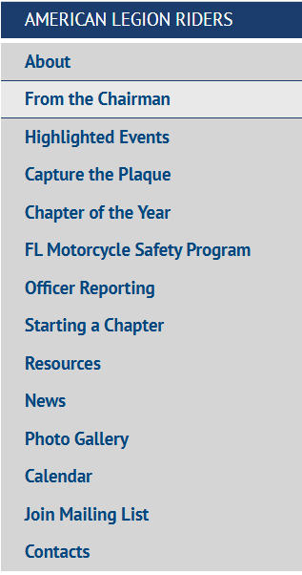
To Obtain a Copy of the ALR Standing Operating Procedures
& Standing Rules, please visit: https://www.floridalegion.org/programs-services/legion-riders/resourcesforms/
The Florida ALR Website offers our members a source of information on our events as well as training resources and documents. Check us Out!
https://www.floridalegion.org/programs-services/legion-riders/about/

Slide 17

Conflict Resolution
What causes Conflict?
    A Lack of Common Understanding
    Poor Communication Skills
    Unclear or Unfair Expectations
    Power Plays and Manipulations
    Leadership Styles
    Resistance to Change
    Differences in personalities
    Working Style
Find a Peaceful Solution to a Disagreement
    Stay Calm and Just take a Moment
    Find a private, comfortable place to discuss the conflict
    Acknowledge that a problem exists
    Agree to find a Resolution
    Work to understand the perspective of everyone involved

Slide 18
American Legion Riders
Frequently Asked Questions
Q. Can the Chapter require a probationary/vetting period for a perspective member?
A. No, we are not a Motorcycle Club (MC). Refer to the ALR SOP, Article II American Legion Rider Chapter, Section 2-Qualifications #1.
Q. If a member has a Lifetime Membership with the ALR and has not paid his/her family dues, is his membership with the ALR suspended?
A. Yes, The member would not be in ‘good standing’ at that time if their family membership has not been paid. If riding with the Chapter, you cannot report their miles and hours when reporting.
Q. Is there a membership ID# associated with the ALR member?
A. Your perspective Post may require one but there is no requirement on the state level for members to have an ID#.
Q. Can the spouse/significant other who does not qualify for membership under the families of the American Legion join the ALR?
A. No, they do not qualify as a Rider or Supporter. Refer to the ALR SOP, Article II American Legion Rider Chapter, Section 2-Qualifications #1. They may ride with the Chapter, however, you cannot report their miles and hours when reporting.

Slide 19
American Legion Riders
Frequently Asked Questions
Q. Can a Chapter discipline, suspend or expel an ALR member under any circumstance?
A. No, The ALR Chapter is a Post program and has no authority to discipline a member. If circumstances arise, the Director must engage the E-Board or Commander of the American Legion or the Auxiliary President (whichever applies) and report the incident. Any action to discipline, suspend or expel the member is the action of the governing body of the American Legion. Suspension for non-payment of membership dues is allowed.
Q. May I count both my hours & miles under the Legionnaires, SAL and/our Auxiliary?
A. If you report your miles & hours under the Legionnaires or SAL, you may NOT report them under the Riders…It is one or the other. If you are an Auxiliary member, you may record your miles & hours to both entities. The Auxiliary is a separate entity from the American Legion.
Q. Is it true that if our Chapter rides out of District, we can report double miles?
A. This statement is only true during the month of April when participating in the Round Robin or in October when participating in the Merry-go-Round. See for further clarification:
Merry-go-Round | Florida American Legion (floridalegion.org)
Round Robin | Florida American Legion (floridalegion.org)
Q. Can I be a member of another Post’s Riders group?
A. If your Post has a Rider Chapter, the answer is NO. If your Post does not have a Chapter, then the answer is YES. At no time can you be a member of more than one chapter. Refer to the ALR SOP, Article II American Legion Rider Chapter, Section 2-Qualifications #2

Slide 20


AMERICAN LEGION RIDERS
TOTAL MONIES RAISED 2024-2025
POW/MIA Chapel - $8240.00
Tim Morris’ Toys for Patrick Space Force Kids - $5000.00
Merry-go-Round/Children & Youth Picnic - $10,000.00
In-State Unity Ride/State Rally
Project Vet Relief/Suicide Prevention Initiative Funds Collected- $388,735.85
  GRAND TOTAL $411,975.85
** Increase of $36,852.86

Slide 21
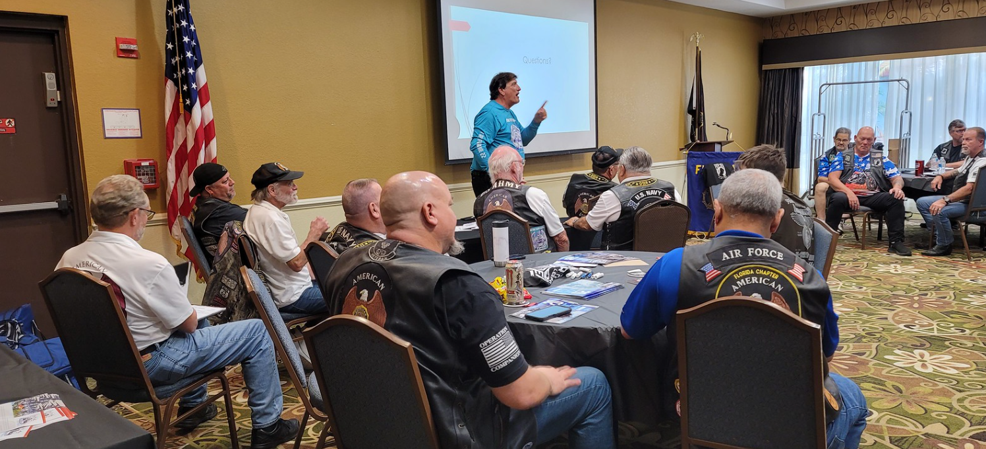
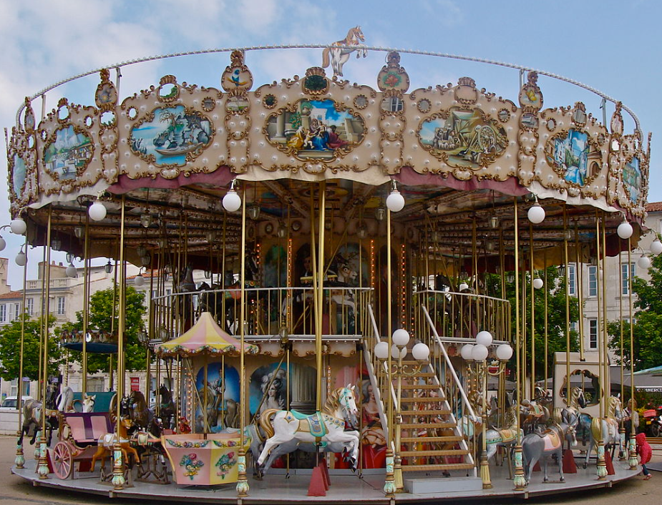


A CALL TO SUPPORT THE ALR EVENTS
Merry-Go-Round
Month of October
ALR Commitment:
*10K to Child & Youth Picnic
*5K Tim Morris’ Toys for Patrick Space Force KIDS
ALR 10th Annual Summit
Where? Hilton Daytona Beach Oceanfront Resort
Why? Top notch Instructors. Provides training on Reporting, Officer Responsibilities, Safety & Group Riding, First Responder & Trauma and so much more. Opportunity to get together with old friends and make new, sharing ideas, & camaraderie.
Round Robin – Month of April
In-State Unity Ride – April 19-24, 2026 ALR State Rally – April 25, 2026
All Net Proceeds Benefit:
PROJECT VET RELIEF/SUICIDE PREVENTION INITIATIVE
POW/MIA Ceremony & Ride
When? September 20,2025
Where? Jacksonville, FL

Slide 22
2025 -2026 SCHEDULE OF EVENTS
NATIONAL LEGACY RUN – August 17th – 21ST, 2025
NATIONAL CONVENTION – August 23rd -28th , 2025 – Tampa, FL
POW/MIA CEREMONY – September 20th , 2025 – Jacksonville, FL
MERRY-GO-ROUND – October 1st – October 31ST, 2025 – Supporting Children & Youth
FALL CONFERENCE – November 21st -23rd , 2025
SUMMIT MEET & GREET – February 18th , 2026
SUMMIT – CLASS SCHEDULE – February 19th – 21st, 2026
ROUND ROBIN - April 1st – April 30th, 2026– Supporting PVR/SPI
CHILDREN & YOUTH PICNIC – April 11th, 2026
MEET & GREET For the In-State Unity Ride - April 19th, 2026
IN-STATE UNITY RIDE - April 20th - April 24th , 2026
ALR STATE RALLY – April 25th, 2026
DEPARTMENT OF FL CONVENTION – June 11th -14th, 2026

Slide 23


Slide 24
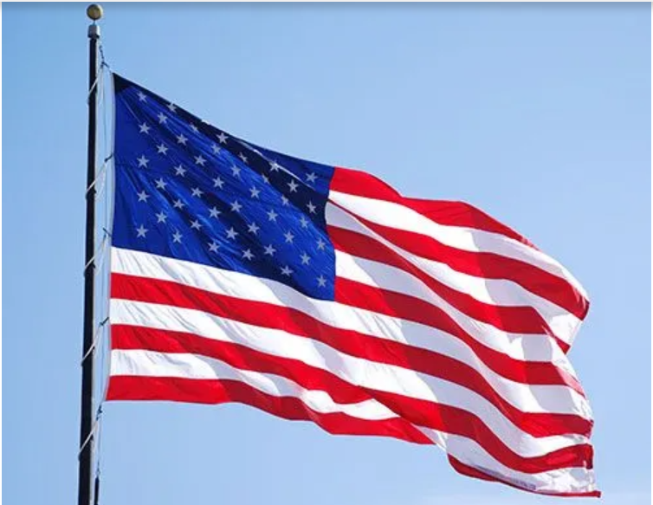
GOD BLESS THE UNITED STATES OF AMERICA

