Slide 1

Adjutant’s Briefing
Bruce E. Comer
Department adjutant

Slide 2

Department Staff

Slide 3

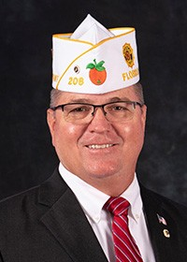
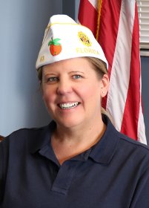
Department Staff| Introductions
Bruce Comer
Department Adjutant
Jamie Hanselman
Department Assistant Adjutant
8 ½ Years of Dedication
2 Months of Dedication
Oversight - Responsible for the overall efficient, effective, and financially sound management of all aspects of the organization.
Business Activities - Develops and maintains systems and procedures to accurately monitor all business activities. Includes the efficient utilization of all resources, compliance with
National and State regulatory requirements
Office Manager – Meet with staff on regular basis, monitor duties, provide support
HR – Primary contact for staff, request, issues and complaints
Post Issues – Provides guidance and assistance
Deadlines – Monitors Deadlines for meetings, DCC, EC/FC, amendments/resolutions
(i.e. Constitution/By-Laws)
Liaison - Responsible for relationships with the National Organization, Legislative branches of our Government (local, State and National)
Committees – General oversight of Department Executive Committee, Finance Committee, and Program Boards to strategically plan for, establish and implement short and long-range goals and objectives.
Event Oversight – Provide assistance, and address issues during Department Events
Collaborate – provide opinions and suggestions, and review various projects at Dept.

Slide 4
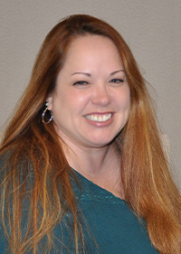
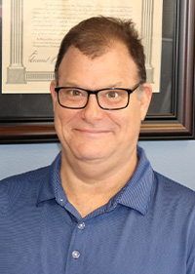
Department Staff| Introductions
Rachel Castleberry
Executive Assistant
Daniel Albert
Senior Staff Accountant
17 ½ Years of Dedication
1 ½ Years of Dedication
Record Keeping – Maintain records for archive
Post Constitution & Bylaws – Communicates and corresponds with the Department Judge Advocate and Posts regarding Constitution and By-Laws updates submitted to Department Headquarters for review and approval.
Minutes – Record for Executive and Finance Committee meetings
Expenses – Process and verify expense reports for officers/chairmen
Reporting – Produce financial reports requested
Financials – Manage all financial transactions including accounts receivable, accounts payable, expense management, fixed assets, general ledger entries, and deposits
Executive Information – Preparation and distribution of agenda and materials for Department Executive Committee meetings
Travel – Make travel arrangements and compile documents for travel-related meetings with detailed itineraries for Commander and Adjutant
Administrative – Assist with other administrative needs of Dept.
HR – Research and manage employee benefits, tracking employee time and processing payroll

Slide 5
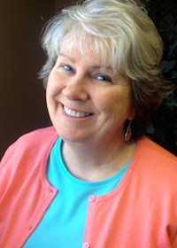
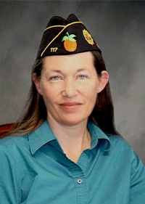
Department Staff| Introductions
JoAnn Collins
Membership Director
Bekki Boarman
Programs Director
13 Years of Dedication
6 ½ Years of Dedication
Processing– Process membership for Legion and SAL
Reporting – Provide statements and reporting for membership
Transmittals – Process transmittals to National
Awards – Reporting and tracking of membership awards
Materials – Provide and manage program materials and manuals
EOY – Provide end of year mailings and manage CPR’s
Programs – Oversee and provide support for 27 Legion Programs
New Post– Prepare and distribute kits to new posts
Supplies – Fulfill requests for membership supplies and information
Customer Service – Facilitate membership questions and issues
Awards – Review and manage program trophies and awards
PSO – Manage registration and support for Service Office School
Administrative – Prepare Dept Roster, SAL Roster, provide stationary to officers and chairs

Slide 6
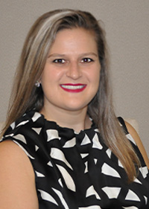
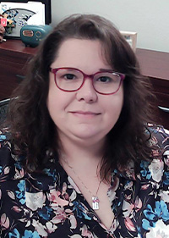
Department Staff| Introductions
Jennifer Cooper
Fundraising Director
Carrie Kolze
Creative Services Manager
11 Years of Dedication
9 Years of Dedication
Database– Manage fundraising databases and PROJECT: VetRelief’s database
Caging – Caging donations and raffle donations, oversee fundraising vendors
Direct Mail – Oversee vendors, review and provide recommendations on provided content
Creative – Design and provide creative for all Dept needs: promo items, coins, pins, marketing materials, agendas, signs, etc
Social Media – Maintain and create content for all social media platforms
Website – Maintain and create content for Dept Website
Communication – Communicate via email/letters with donors, manage donor relationships, communicate with Dept heads on progress and provide feedback based on research
PROJECT: VetRelief – Oversee administrative duties, reporting, create marketing materials, maintain website and social media, resolve issues, manage caseworkers, communicate with board, provide promotional materials, serve as board secretary
Emblem Sales – Administrative and assist with ordering, creating/designing new products
Branding – Create and maintain consistent branding throughout Dept.
Publications – Layout and oversee Legion Link, create press releases as needed, create forms
Technology – Provide direct support with technology issues and needs at Dept and Dept events.

Slide 7
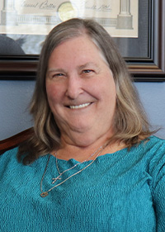
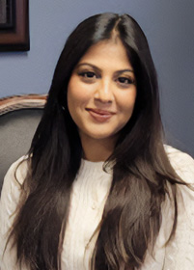
Department Staff| Introductions
Lois Stachelrodt
Receptionist / Emblem Sales
Zahra Nathoo
Event Coordinator
3 Years of Dedication
7 Months of Dedication
Reception– Answer and direct incoming calls, greet and direct Dept visitors and vendors
Records – Maintain records of Posts’ Tax Exemption Status
Mail – Post and sort outgoing/incoming mail and faxes
Emblem Sales – Process sales and
Event Coordinator – Develops all project plans for Department Convention and Fall Conference
National Convention - Coordinates Florida activities
DCC – Creates District Constitutional Conference Mailings
Administrative – Coordinates site visits for
online orders, manage inventory, provide reports as needed, resolve customer issues
Ordering– Track and order office supplies, order custom items following bidding protocol
Administrative – Assist with administrative tasks as needed
Time and Place Committee
Roster – Maintains Department Roster
Hall Rentals – Responsible for Headquarters Hall Rental and relationships with vendors

Slide 8
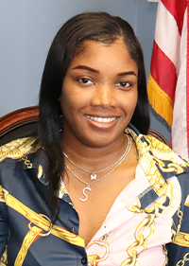
Department Staff| Introductions
Shenicia Williams
Veteran Services Caseworker
6 Months of Dedication
Casework– Communicate with applicants, ensure correct paperwork is received, provides alternative solutions, process TFA cases under National guidelines, process PROJECT: VetRelief cases.
Assist – Assists veterans with various questions and concerns

Slide 9
Questions?

