Slide 1


AMERICAN LEGION RIDERS
Veterans Affairs & Rehabilitation Services
Larry Roberts, Northern VA&R Chair
VA Entitlement Chair
Project Vet Relief, Chair

Slide 2
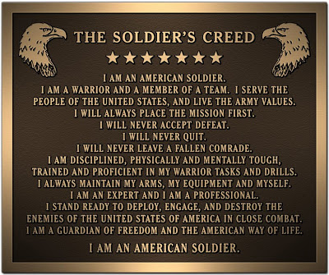

Slide 3
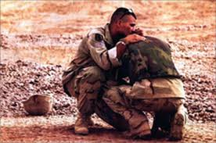
Veterans Helping Veterans
If you were on active duty, the reserves, or the National Guard and visited a doctor, hospital, health clinic or any other medical facility for any reason. This could mean thousands of dollars to you and your beneficiaries.

Slide 4
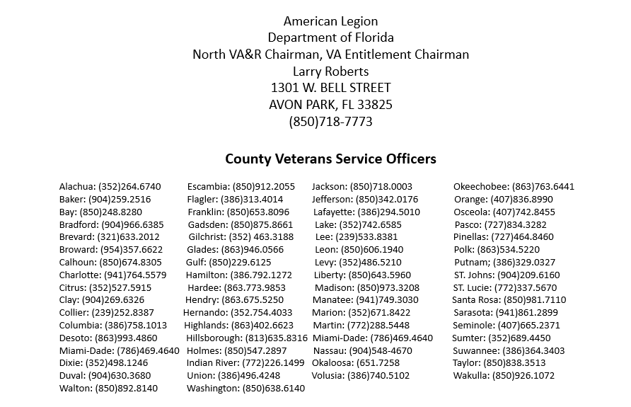
Veterans Helping Veterans

Slide 5
Why there’s a Need to Help Veterans
Multiple and extended deployments
• 25% of the homeless are combat veterans.
• Suicide rate for active duty and veterans is 4x greater than that of civilians.
• 200 + Veterans become disabled every day.
• Over 2 million veterans live without insurance.
• A Study released in 2022 found as many as 44 veterans die on average per day from suicide.
Which is 2.4 times greater than the official estimate.
Pending claims=801,000
Back Logged Claims=524,000

Slide 6
Basic Eligibility
Any person who served in Active-Duty Military, who was discharged or released under conditions other than dishonorable, may qualify for VA Health Care Benefits.

Slide 7
Enrollment
For most veterans, entries into the VA health care system begins by applying for enrollment.
To apply, complete VA Form 10-10EZ, application for health benefits, which may be obtained from any VA health care facilities
or regional benefits office, online at: http://www.VA.gov/10-10ez.htm
Or call 1-877-222-vets (8387).
Once enrolled, veterans can receive health care at VA health care facilities anywhere in the country.

Slide 8
Important Documents to Expedite VA Benefits
In order to expedite delivery, Veterans seeking VA benefits for the first time you must submit a copy of your service discharge form (DD-214, DD-215, or World War II Veterans discharge form),
The National Personnel Records Center (NPRC) has provided the following website for veterans to gain access to their DD-214 online http://vetrecs.archives.gov/
You also need a copy of your military medical records if you need to order them you can at www.nationalarchivesandrecordsadministration.gov
You also need veteran’s marriage certificate, children’s birth certificates or adoption papers to determine children’s benefits

Slide 9
Tip # 1
Have a ”Well-grounded claim” with evidence of a medical condition that either started while you were in the military, or a pre-existing condition that was aggravated by your stint in the military.
(keep all records in a folder by oldest to newest, highlight and tab any condition mentioned in the claim )

Slide 10
Tip #2
  Google:
  38 CFR Book C, Schedule for Rating Disabilities.
  For your particular issue(s) relevant to what you are claiming.
  (Must be able to navigate a computer, have someone assist if needed)

Slide 11
Tip#3
Get a letter from your doctor stating that your present condition is…
“MORE LIKELY THAN NOT, DIRECTLY RELATED TO THE HEALTH ISSUE YOU HAD IN THE MILITARY”.

Slide 12
TIP#4
Get letters from your family and friends stating, “how it is to live around you with your present condition”.
At the end of the letter make sure this statement is written:
“I HEREBY CERTIFY THAT THE INFORMATION I HAVE GIVEN IS TRUE TO THE BEST OF MY KNOWLEDGE AND BELIEF”.

Slide 13
Service-Connected Disability Compensation
Disability Compensation is a monetary pay to veterans who are disabled by an injury, illness incurred or aggravated during active military service.
These disabilities are considered to be service – connected.
Disability compensation varies with degree of disability and the number of veteran’s dependents and is paid monthly.
Veterans with certain severe disabilities may be eligible for additional special monthly compensation.
Service-Connected Disability Compensation is Tax Free

Slide 14
2023 VA Disability Compensation Rates
 | VETERAN | W/SPOUSE | VET + SPOUSE & CHILD | VETERAN W/ CHILD | ADDITIONAL CHILDREN UNDER 18 | OVER 18/IN SCHOOL
10% | $165.92 | $165.92 | $165.92 | $165.92 | $165.92 | $165.92
20% | $327.99 | $327.99 | $327.99 | $327.99 | $327.99 | $327.99
30% | $508.05 | $568.05 | $612.05 | $548.05 | ADD $30.00 | ADD $97.00
40% | $731.86 | $811.86 | $870.86 | $785.86 | ADD $40.00 | ADD $129.00
50% | $1,041.82 | $1,141.82 | $1,215.82 | $1,108.82 | ADD $50.00 | ADD $162.00
60% | $1,319.65 | $1,440.65 | $1,528.65 | $1,400.65 | ADD $60.00 | ADD $194.00
70% | $1,663.06 | $1,804.06 | $1,907.06 | $1,757.06 | ADD $70.00 | ADD $226.00
80% | $1,933.15 | $2,212.15 | $2,212.15 | $2,041.15 | ADD $80.00 | ADD $259.00
90% | $2,172.39 | $2,353.39 | $2,486.39 | $2,293.39 | ADD $90.00 | ADD $291.00
100% | $3,621.95 | $3,517.84 | $3,971.78 | $3,784.02 | ADD $100.34 | ADD $324.12

Slide 15
Veterans with ratings of at least 30% are eligible for additional allowances for dependents, including spouse, minor children, children between the ages of 18 and 23 who are attending school, children who are permanently incapable of self-support because of disability arising before age 18, and dependent parents. The additional amount depends on the disability rating. For more detailed rates visit:
//www.military.com/benefits/veteran-benefits/va compensation-tables

Slide 16
Post Traumatic Stress Disorder
An average of 44 Veteran Suicides a day
988 Suicide Prevention Hotline 988 or 1-800-273-8255
In July 2010, the VA Secretary Eric K. Shinseki, Allowed for qualification benefits for diagnoses from civilian mental health professionals. Drastically cutting waiting time for veterans.
Symptoms for PTSD at 50% disability
• Memory loss for names of close relatives
• Occupational and social impairment with reduced reliability and productivity
• Difficulty in establishing and maintain effective and social relationships
• Anxiety
• Chronic sleep impairment
• Depressed mood
• Mild memory loss
If you have been diagnosed with PTSD it does not mean that you will lose your right to own a firearm.

Slide 17
Agent Orange Symptoms
VA assumes that certain diseases can be related to a Veteran’s qualifying military service. We call these "presumptive diseases." VA has recognized certain cancers and other health problems as presumptive diseases associated with exposure to Agent Orange or other herbicides during military service. Veterans and their survivors may be eligible for benefits for these diseases.
AL Amyloidosis A rare disease caused when an abnormal protein, amyloid, enters tissues or organs Chronic B-cell.
Leukemia’s A type of cancer which affects white blood cells.
Chloracne (or similar acne form disease) a skin condition that occurs soon after exposure to chemicals and looks like common forms of acne seen in teenagers. Under VA's rating regulations, it must be at least 10 percent disabling within one year of exposure to herbicides.
Diabetes Mellitus Type 2 A disease characterized by high blood sugar levels resulting from the body’s inability to respond properly to the hormone insulin.
Hodgkin’s disease A malignant lymphoma (cancer) characterized by progressive enlargement of the lymph nodes, liver, and spleen, and by progressive anemia.
Ischemic Heart Disease A disease characterized by a reduced supply of blood to the heart that leads to chest pain.

Slide 18
Multiple Myeloma A cancer of plasma cells, a type of white blood cell in bone marrow.
Non-Hodgkin’s Lymphoma A group of cancers that affect the lymph glands and other lymphatic tissue.
Parkinson’s disease A progressive disorder of the nervous system that affects muscle movement Peripheral Neuropathy, Early-Onset a nervous system condition that causes numbness, tingling, and motor weakness. Under VA's rating regulations, it must be at least 10 percent disabling within one year of herbicide exposure.
Porphyria Cutanea Tarda A disorder characterized by liver dysfunction and by thinning and blistering of the skin in sun-exposed areas. Under VA's rating regulations, it must be at least 10 percent disabling within one year of exposure to herbicides.
Prostate Cancer Of the prostate; one of the most common cancers among men Respiratory Cancers (includes lung cancer) Cancers of the lung, larynx, trachea, and bronchus Soft Tissue
Sarcomas (other than osteosarcoma, chondrosarcoma, Kaposi’s sarcoma, or mesothelioma) A group of different types of cancers in body tissues such as muscle, fat, blood and lymph vessels, and connective tissues - See more at:
Department of VA add three new serious illnesses
Bladder Cancer
Hypothyroidism
Parkinson’s – Like Symptoms
http://www.publichealth.va.gov/exposures/agentorange/conditions/index.asp#sthash.DGJ6nSWv.dpuf

Slide 19
U.S. Department of Veterans Affairs
Herbicide Tests and Storage in the U.S.
Agent Orange and other herbicides used in Vietnam were tested or stored elsewhere, including many military bases in the United States. Below is a list of bases.
Florida Locations: Orlando, FL; Cocoa, FL Date: 1944 Near Lake George, FL Date: 1944 Orlando, FL at Army Grove Air Force’s Tactical Center Date: 1944 Marathon, FL Dates: 1944 Bushnell Army Air Field, FL Date: 1945 Avon Air Force Base, FL Date: 1951 Englin Air Force Base, FL Date: 1952 Avon Park Air Force Base, FL Date: 1954 Jacksonville, FL Date: 1962 Eglin AFB, C-52A test area Dates: 1962-1970 Apalachicola National Forest near Sopchoppy, FL Date: 1967 Eglin AFB,FL Date: 1968

Slide 20
Death and Burial Benefits
Eligibility: Veterans discharged from active duty, under conditions other than dishonorable and service members who died while on active duty. To verify eligibility for burial and memorial benefits, a copy of veterans’ discharge document “DD214” that specifies the period(s) of active duty and character of discharge, along with the deceased’s death certificate and proof of relationship to veteran for eligible family members) are all that usually needed to determine eligibility.
VA National Cemeteries ( 147 National Cemeteries ) Headstone and Markers ( VA Form 40-1330 ) Presidential Memorial Certificates ( VA Form 40-0247 ) Burial Flag ( VA Form 27-2008 or U.S. Post Office and Funeral Director ) Reimbursement of Burial Expenses ( VA Form 21-530 ) Burial Allowance ( VA Form 21-530 ) Plot Allowance ( VA Form 21-530 ) Military Funeral Honors ( Active Military or Local Veteran Originations )

Slide 21
2023 Florida Veteran’s Benefits Guide
www.FloridaVets.org
www.FloridaVeteransFoundationorg
(850) 488-4181 or 4182
Education Benefits for Veterans and families
G.I. Home Loan
Property Tax Exemptions
Burial Benefits
“V” for Veteran Designation on Driver License
100% Disabled Veteran State ID card
Driver License & State ID Fee Exemptions
Disabled Veteran Motor Vehicle License Plate
Florida State Park Discount Passes
Hunting and Fishing
Employment
Reemployment Rights

Slide 22
Veterans’ Preference
Since the time of the Civil War, veterans of the U.S. armed forces have been given some degree of preference in appointments to federal jobs.
To receive preference, a veteran must have been discharged or released from active duty in the U.S. armed forces under honorable conditions (with an honorable or general discharge). Preference is also provided for the spouse of a veteran with a permanent and total service-connected disability and widows and widowers of deceased veterans who died in service.
A veteran with 100% disability can still work, as long as they are not “unemployable”.

Slide 23

For discounts and/or free tickets
Visit these online websites
VetTix.com
Military.com
Govx.com
Operation outdoor freedom
Veteran holidays
Rays Baseball
Guide Fitter
Military/Veteran Discounts
Ask everywhere you go!

Slide 24
WOMEN VETERANS
The Sunshine State is home of approximately 162,000 women veterans. Many women veterans don’t even know they are eligible for full range of federal, state and local benefits.

Slide 25
PACT ACT
The PACT Act is a new law that expands VA health care benefits for Veterans exposed to burn pits, Agent Orange, and other toxic substances.

Slide 26


Slide 27

QUESTIONS ?????

