Slide 1


AMERICAN LEGION RIDERS
SGT-AT-ARMS TRAINING
Dave Hulin
Jeff Hawk

Slide 2
SGT-AT-ARMS TRAINING AGENDA
Officer Guide
Department of Florida ALR SOP
American Legion Department of Florida SGT-At-Arms Protocol Manual
DOD Directive 1005.8 Flag Presentation in Formation
Flag Code of The United States Manual
Automobile & Motorcycle Flag Display Guidelines For Non-Military Vehicles
Resolution Number Five
Additional Resources
Questions

Slide 3
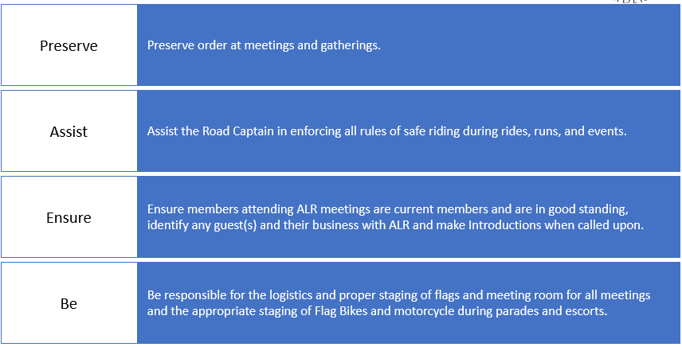
DEPARTMENT of FLORIDA ALR SOP
SGT-At-Arms Duties

Slide 4
SGT-At-Arms Duties
Preserve Order at Meetings and Gatherings
      Secure the Hall
      POW/MIA Ceremony
      Lead the Pledge of Allegiance
      Ensure an orderly atmosphere during meetings
      You may be called upon in the absence of the Post Sgt-at-Arms to perform at ceremonies or meetings
      When your Director is at the podium, You are on Duty!

Slide 5
SGT-At-Arms Duties
Assist the Road Captain in enforcing all Rules of safe riding during rides, runs, and events.
    Pre-Ride Briefings
    Cover the Route
    Hazards
    Hand Signals

Slide 6
SGT-At-Arms Duties
Ensure Members attending ALR meetings are current members and are in good standing, identify any guest(s) and their business with ALR and make introductions when called upon.
Know your members – Are they in good standing?
Prior to the meeting
Are their any guests? What’s their business with the Riders?
Escort the guest and Introduce him/her to the general membership

Slide 7
SGT-At-Arms Duties
Be responsible for the logistics and proper staging of flags for meeting room for all meetings and the appropriate staging of Flag Bikes and motorcycle during parades and escorts.
    US Flag is positioned on its own right as the motorcycle moves forward
    Size of the US Flag is equal to or greater than any other flag
    Various positions are acceptable depending on mounting apparatus
    Proper Staging of Flag Bikes for parades and or escorts

Slide 8
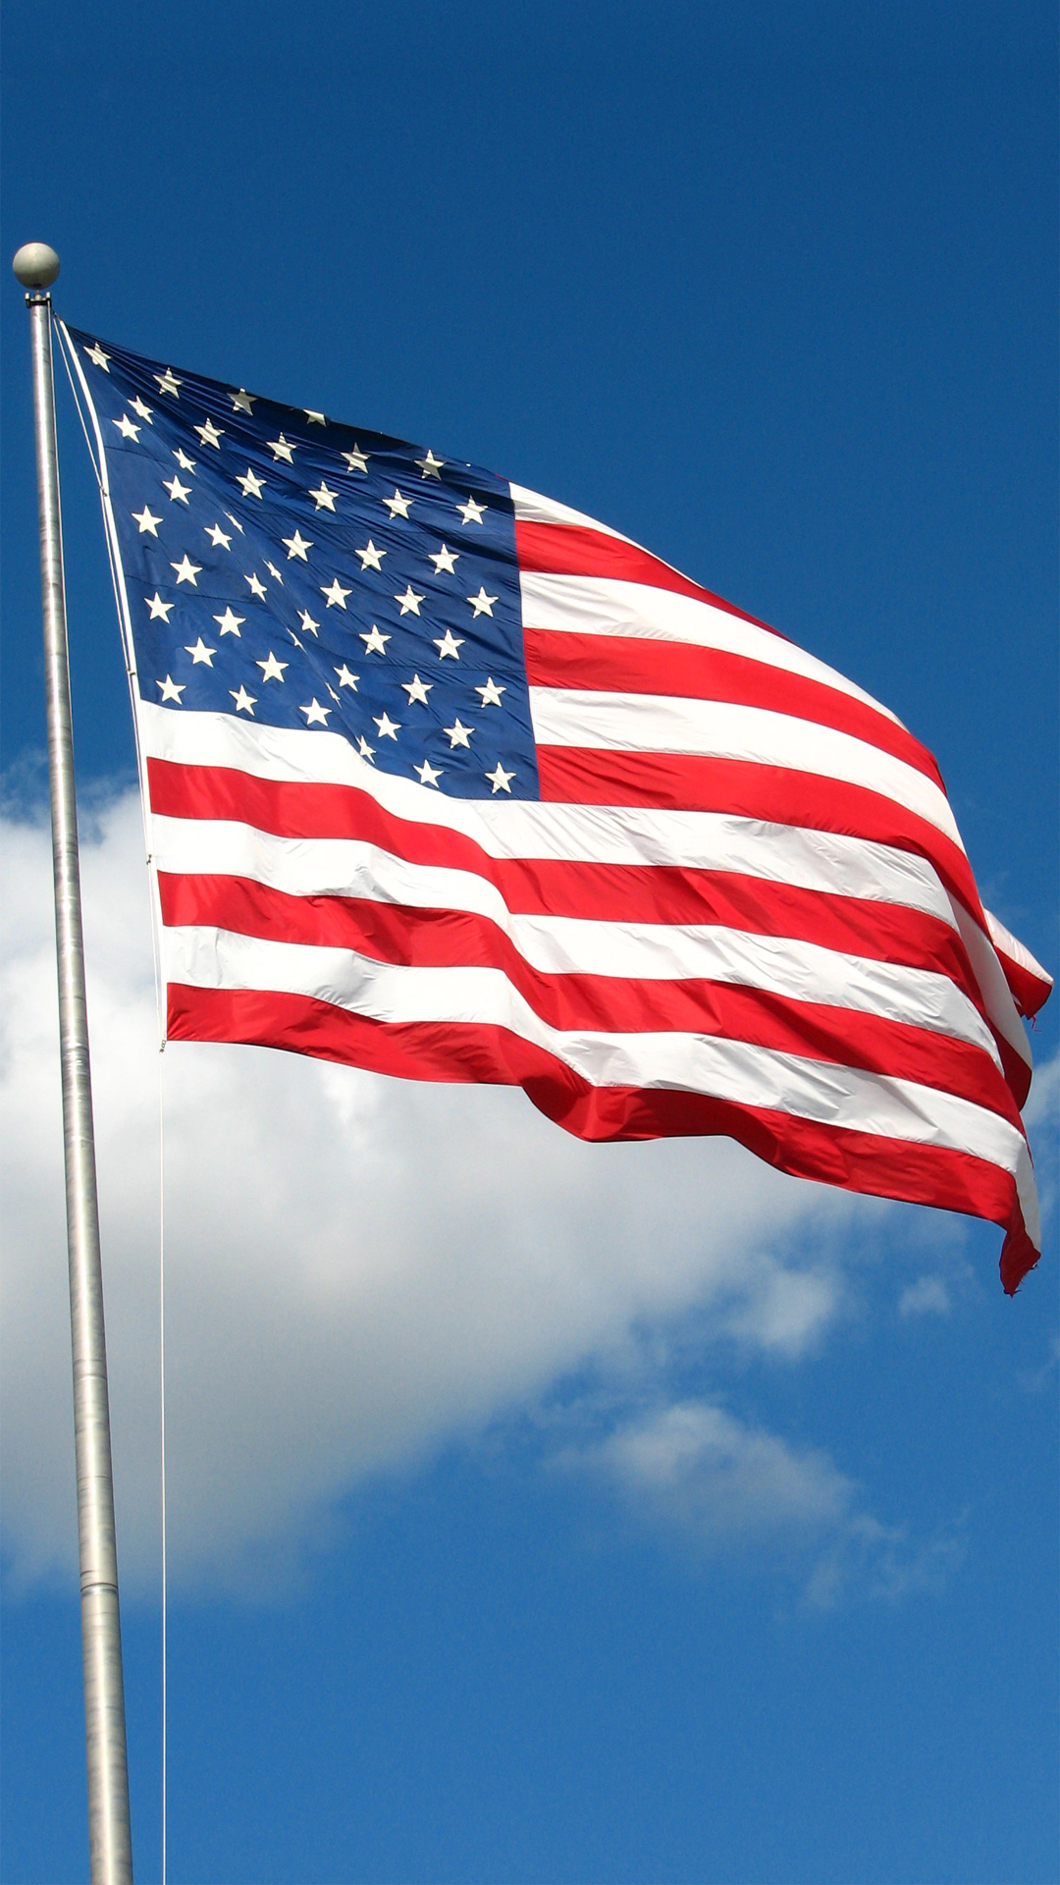
FLAG CODE
The Flag Code Title 4, United States Code, Chapter 1
  The United States Flag Code establishes advisory rules for display and care of the national flag of the United States of America. It is Chapter 5 of Title 4 of the United States Code.
AMERICAN LEGION PUBLISHED (Let’s Be Right on Flag Etiquette)

Slide 9
THE PLEDGE OF ALLEGIANCE
Stand at Attention facing the Flag
Uncover - Place Legion Cap in Right hand over Heart
  If no Cap, Right Hand over Heart
Veterans or Out-of-Uniform Military Personnel
  Per National Defense Authorization Act of 2008
    Permits a salute during raising, lowering, or passing US Flag
What is the meaning of the Pledge of Allegiance?
The Pledge says You are promising to be True to the United States of America!

Slide 10
POW/MIA EMPTY CHAIR
Opening of the Meeting, Salute US Flag, Approach the Empty Chair carrying the folded POW/MIA flag/cover
Reverently, unfold the flag/cover and drape it over the Empty Chair with the crest facing the membership
Salute slowly showing Respect
After the Meeting is concluded, Salute US Flag, Approach the Empty Chair
Salute slowly showing Respect
  All Legionnaires Salute slowly
  All other guess salute by covering their heart with their right hand
Retrieve the POW/MIA flag/cover

Slide 11
HALLOWED GROUND
Flags in Place and Posted
  No one is to reach between the flags
Proper Etiquette
  Approach American flag, Stop & Salute
  Proceed to the Left side of the Flag & behind Speaker
  When Business is Complete, Walk to the Speaker’s Left, Clear the Flag, Stop & Salute
  If Auxiliary or non-military, approach from the Right Side of the Organizational Flag
  The American Flag should NEVER touch the floor/ground for any reason
THE ONE OF THE TASKS OF THE SERGEANT-AT-ARMS IS TO WATCH OVER FLAG ETIQUETTE

Slide 12
Sergeant-At-Arms on Duty
Prior to the start of the Meeting, Announce to the membership that “The meeting is about to begin”
Ask the membership to silence their phones
Secure the hall
POW/MIA Ceremony
Lead the Pledge of Allegiance
Announce & Escort Guests
Keep order throughout the Meeting
Retrieve the POW/MIA Flag/Cover

Slide 13
OFFICERS GUIDE & MANUAL of CEREMONIES SGT-At-Arms Duties
Arrange Meeting Hall
Assist Post Commander & Adjutant
Lead Color Guard Detail
Flag Etiquette
Post Color Guard Detail
Burial Detail
Other Pageantry
Chair Welcome Committee
Encourage Members To Attend Meetings
Advise Commander on Who Should Be Acknowledged

Slide 14
AMERICAN LEGION DEPARTMENT OF FLORIDA SGT-AT-ARMS PROTOCOL MANUAL
SGT-AT-ARMS DUTIES
THE AMERICAN LEGION CAP
HALLOWED GROUND
PREAMBLE OF THE AMERICAN LEGION
THE MEANING OF THE PLEDGE OF ALLEGIANCE
POW/MIA REMEMBERANCES
HISTORY OF THE AMERICAN FLAG
HISTORY OF PLEDGE OF ALLEGIANCE
LEGION UNIFORMS; CORDS & BRAIDS
ORIGIN OF FLAG DAY
PROPER FLAG DISPOSAL CEREMONY
PROPER FLAG DISPLAY ON VEHICLES & BIKES
MILITARY FUNERAL FLAG PROTOCOL
AMERICAN LEGION PROTOCOL

Slide 15
ADDITIONALLY
OFFICER’S GUIDE
POST CONSTITUTION & BY-LAWS
DEPARTMENT OF FLORIDA RIDERS SOP
ALR STANDING RULES

Slide 16
The Sergeant-at-Arms is the Sentinel, the Guard of the Post
QUESTIONS?
Thank You For Your Attention
The Sergeant-at-Arms Duties and Responsibilities Manual (9/22) is available on the Website

