Slide 1
AMERICAN LEGION RIDERS Reporting Procedures
Beverly Wooten, ALR Adjutant

Slide 2
ALR REPORTING REQUIREMENTS
ALR Officer Reporting
Monthly Chapter Reporting
Miles
Volunteer Hours
Chapter’s Cash Donations
Membership Details
District Reports
Special Events
Merry-Go-Round
Round Robin
Consolidated Post Report (CPR) & Addendum – Due by May 1st
ALR Department of FL – End of Year Reporting – Due by May 31st

Slide 3
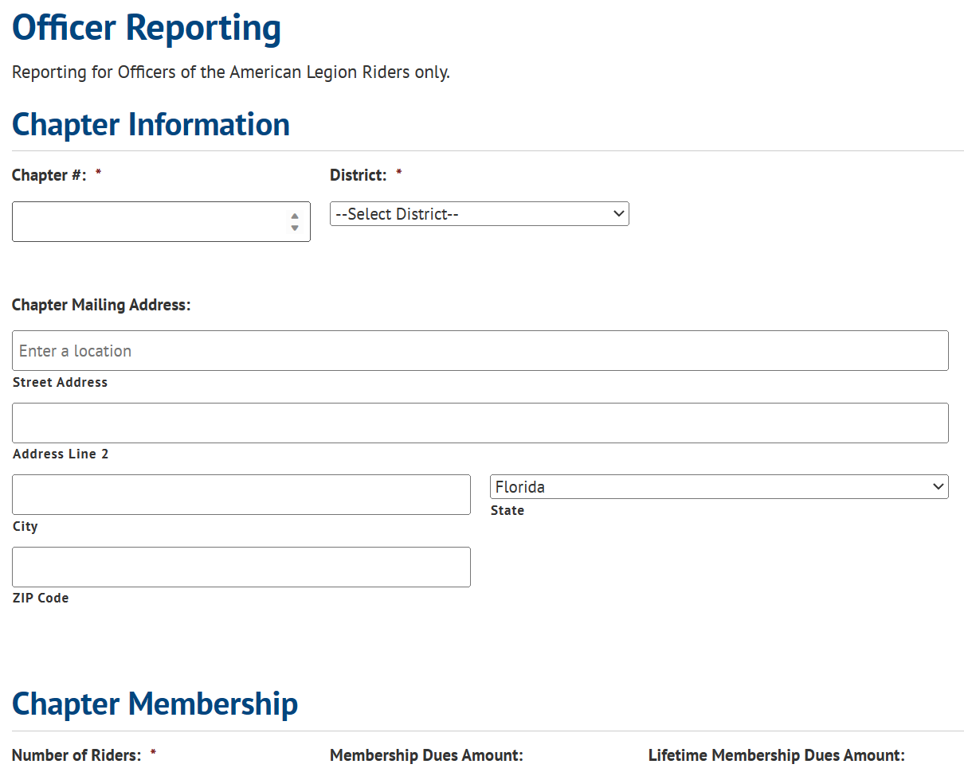
ALR Department of FL – Officer Reporting
https://www.floridalegion.org/programs-services/legion-riders/alr-officer-report/

Slide 4
ALR OFFICER REPORTING
When to Report
No Sooner that April
A Change in Officers
Who Should Report? Which Officer?
Enhanced Reporting
Chapter Address Auto Populated
Number of Riders – ALL Members (Inc. Supporters & Future Riders)
Chapter Meeting Days – Drop Down Options
Notes
Captures specifics the Chapter would like to share
LET’S DO IT LIVE!

Slide 5
ALR OFFICER REPORTING
WHAT HAPPENS NEXT?
Department sends the report to the ALR Adjutant Weekly
Adjutant scrubs the Report
Report is sent to:
ALR Chair
Area Chairs
District Chairs
Asst District Chairs
Missing Chapters
WHAT IS THE PURPOSE OF THE OFFICER REPORTING?

Slide 6
CHAPTER REPORTING
MEMBERSHIP STATS
How Many Legionnaires, Auxiliary, SAL, Future Riders
MILES
VOLUNTARY HOURS
CASH DONATIONS
UPCOMING EVENTS
EVENTS SUPPORTED
TRACK THE NUMBER OF MEMBERS ATTENDING THE FOLLOWING:
Convention
Merry-go-Round
Fall Conference
ALR Summit
Round Robin
In-State Unity Ride
State Rally

Slide 7
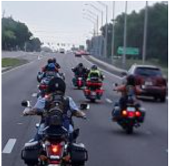
What Miles & Hours are Reportable?
All meetings of the Post/State/National
Legionnaires/SAL/Auxiliary/Rider Monthly & E-Board meetings
Committee Meetings
Convention, Fall Conferences, ALR Summit
Post Activities Sponsored by Legion/SAL/Auxiliary/Riders
Selling Raffle Tickets
Shopping/Preparation for events
Post Improvements
Fund Raising Events
State Sponsored Rides
Round Robin
Merry-Go-Round
National Legacy Ride
In-State Unity Ride
Awareness Rides – Scheduled or Unscheduled
Community Events
Parades/Escorts

Slide 8
NOTE!!
IF YOUR VOLUNTEER HOURS ARE REPORTED UNDER THE LEGION OR SAL, YOU MAY NOT REPORT THE HOURS UNDER THE RIDERS. YOU MAY REPORT THE MILEAGE.
IF YOU ARE AN AUXILIARY MEMBER, YOU MAY REPORT UNDER BOTH THE AUXILIARY AND THE RIDERS AS THEY ARE A SEPARATE AMERICAN LEGION ENTITY.

Slide 9
MANUAL TRACKING
EXCEL SPREADSHEET
RECORD VOLUNTEER HOURS & MILES MONTHLY/QUARTERLY/YEARLY TOTALS
Go to Excel Spreadsheet

Slide 10
LEARN ALTERNATIVE REPORTING METHODS
HOW TO CREATE YOUR ONLINE
TRACKING FORM, CREATE SPREADSHEET, AND ADD ICON TO CELLPHONE HOME SCREEN
Presented by: Sue Nist
COMING SOON!!!
Volunteer Hours & Miles Tracking APP
Presented by: Loreen Skobel

Slide 11
CASH DONATIONS
Adjutant/Finance Officer’s Responsibility
Donations from Raffles, Poker Runs, etc.
DO NOT Include “Donations in Kind”
Report Funds My Chapter Donated in Actual $$
CASH DONATIONS = MONIES GIVEN TO AN ORGANIZATION OR PERSON

Slide 12
CHAPTER CASH DONATIONS ARE NOT…
Personal Raffle Ticket purchases
Personal Registration Fees
Personal Cash Donations
Purchase of Event Lunches
ETC.
**May be reported on your Personal Tax Return under Charitable Contributions**

Slide 13
When are these Statistics Reported and to Whom?
Monthly Chapter Meetings
Monthly/Quarterly to Your District Chair
Post Adjutant for CPR & Addendum Report – May 1st
End of Year Online Reporting – May 31st

Slide 14
Area & District Chair Responsibilities Relating to Reporting
Article 1 – Department ALR Committee
2. Area Chairman
b. Shall make reports to the Chairman before the Fall Conference, ALR Summit, and the Department Convention. Reports should cover all aspects of Chapter membership, recruitment, social events, mileage, hours, and funds expended in support of community events and programs, training and any other information for the good of the American Legion Riders.
3. District Chairman
a. Shall make reports to the Area Chairman before the Fall Conference, ALR Summit, and the Department Convention. Reports should cover all aspects of Chapter membership, recruitment, social events, mileage, hours and funds expended in support of community events and programs, training and any other information for the good of The American Legion Riders.
Review Chapter, District, Area Reports

Slide 15
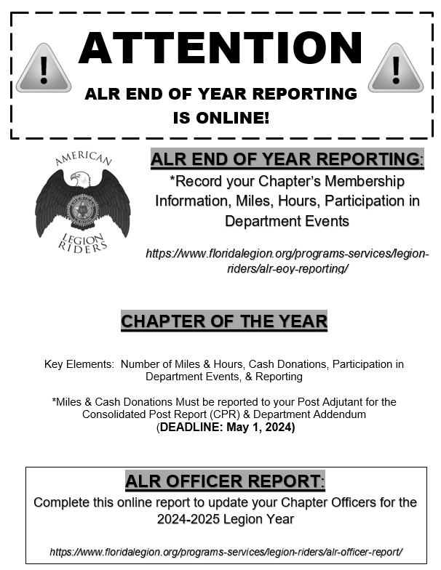
Department of Florida Includes this Notification in the “Year End” packet. It is sent to the Post Adjutant during the month of March.

Slide 16
MERRY-GO-ROUND
Supporting Children & Youth Programs
Month of October
Promotes Unity
Plan Fun Rides
Friendly Competition between Districts
Bragging Rights for the Merry-Go-Round Trophy Presented @ Fall Conference

Slide 17
ROUND ROBIN
Supporting Project: Vet Relief/Suicide Prevention Initiative
Month of April
Promotes Unity
Plan Fun Rides
Friendly Competition between Districts
Bragging Rights for the Round Robin Trophy
Presented @ Convention

Slide 18
Merry-go-Round & Round Robin
Same Rules
Same Registration Process
Same Reporting Process
Same Point Calculations
Same Bonus Point Criteria
Supporting Different Charities
Let’s Review Online

Slide 19
How does the In-State Unity Ride work with
Round Robin as Both are held in the month of April?
Same Rules Apply – Must have a Minimum of 3 Riders per Chapter
Counts as a Unity Ride IF you have 3 Chapters with 3 Riders
DO NOT CONFUSE A UNITY RIDE WITH THE IN-STATE UNITY RIDE
Each day of the In-State Unity Ride is a different Round Robin Ride
Must Register and Pay $5 per Day
Report Each Day Separately
Designate a Point of Contact to Collect Funds & Report

Slide 20
Consolidated Post Report (CPR) & Addendum
Due to Post Commander/Post Adjutant by May 1st, 2024
Due to Department on May 10th, 2024
Captures Miles & Cash Donations
Chapter Membership Information
How many Legionnaires?
How many Auxiliary members?
How many SAL members?

Slide 21
American Legion Riders 2023- 2024 Elements of the CPR & Department Addendum
ALR Director or Designated Officer MUST work with the Post Adjutant or Commander to capture correct statistics
Post Adjutants are not clear on reporting details
Many Chapters do not provide statistics for the CPR & Addendum Report to the Post Adjutant or Commander

Slide 22
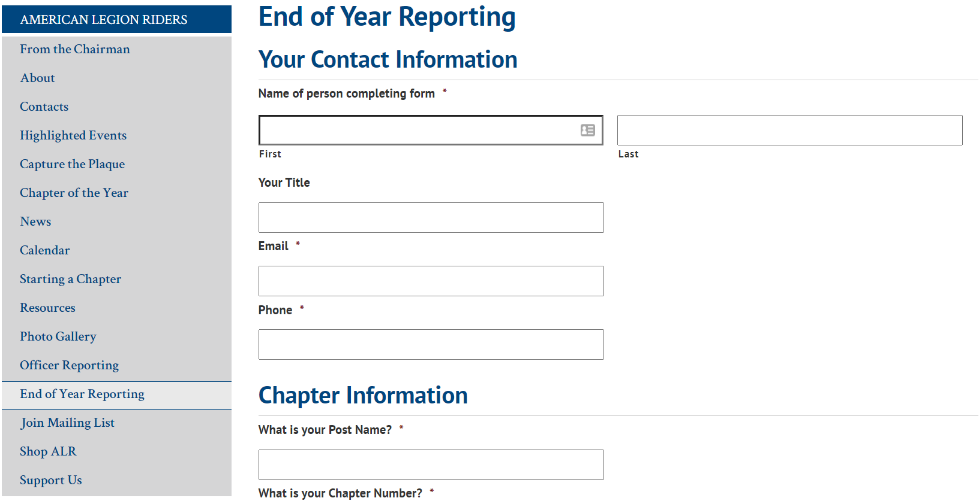
ALR Department of FL – End of Year Reporting
https://www.floridalegion.org/programs-services/legion-riders/alr-eoy-reporting/
Due May 31, 2024

Slide 23
Chapter of the Year Award

Slide 24
Chapter of the Year
SMALL (6-30 Members)
MEDIUM (31-60 Members)
LARGE (61-100+)

Slide 25
Chapter of the Year Calculation Revision 2023-2024

Slide 26
CHAPTER DOCUMENTATION
START UP LETTER
APPROVAL LETTER (in lieu of)
STANDARD OPERATING PROCEDURES (SOP)
SOP ACKNOWLEDGMENT FORM
CHAPTER STANDING RULES (updated every 3 years)
CHARTER MEMBERS LISTING
COPY OF CHARTER*
*If one has not been issued, upon submission of all the Chapter Documentation, one will be issued by the Department of FL.*

