Slide 1
AMERICAN LEGION RIDERS
Navigating the ALR Website
Virna Luke, 5th District Social Media Chair

Slide 2
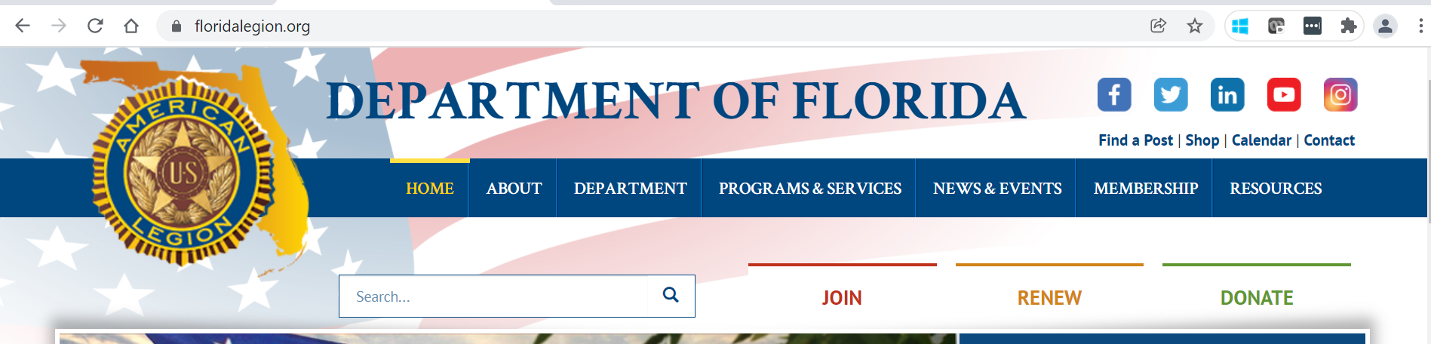
American Legion Riders Website
Search for website – floridalegion.org
Under “Programs & Services” select “American Legion Riders” from the dropdown list – You are now on the Riders home page!

Slide 3
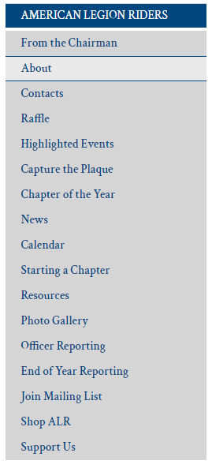
American Legion Riders Web Page
From the Home Page
Make your selection!

Slide 4
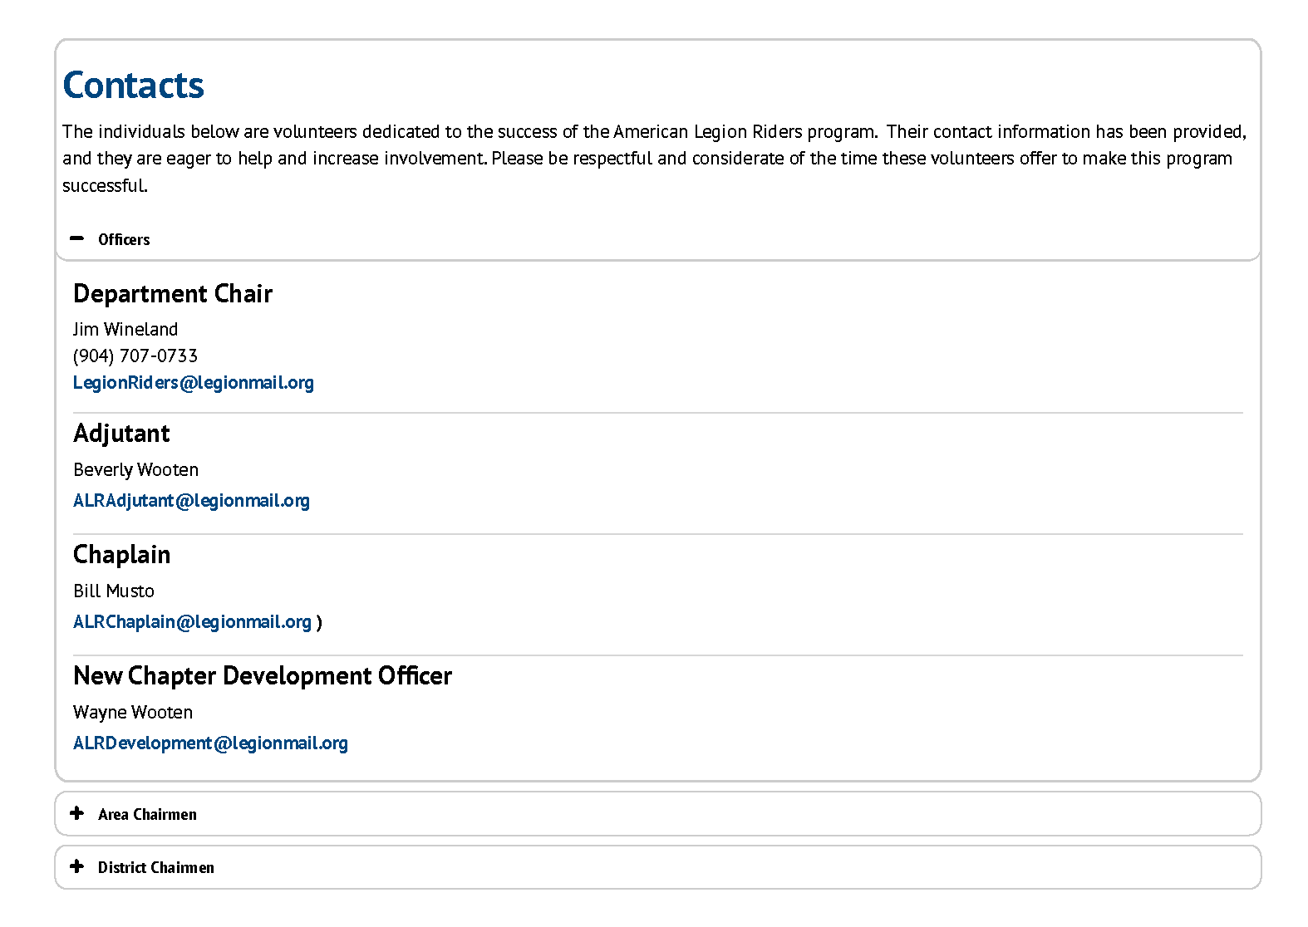
Department ALR Committee
Click + to expand lists

Slide 5
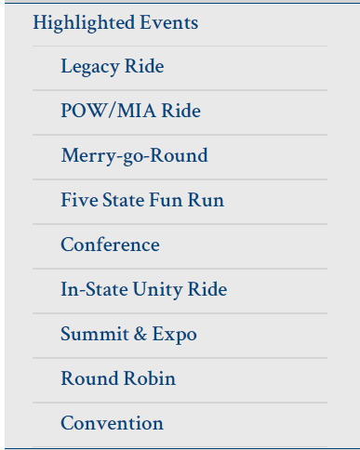

HIGHLIGHTED EVENTS
National Legacy Ride
August 20-24, 2023
View Event
POW/MIA Ceremony & Ride
September 16, 2023
View Event
Merry Go-Round (C&Y)
October 1 – 31, 2023
View Event
Fall Conference
November 17-19, 2023
View Event
Summit
January 31 – February 3, 2024
View Event
Round Robin (PVR/SPI)
April 1 – 30, 2024
View Event
In-State Unity Ride & Rally
April 21-27, 2024
View Event
Department Convention
June 15-18, 2023
View Event

Slide 6
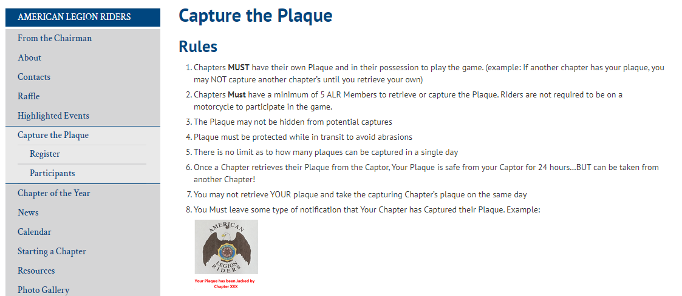
CAPTURE THE PLAQUE
Register! Let everyone know you’re playing the Game!
Helps to know where to ride next!
Participants - listed by District, Chapter #, & City

Slide 7
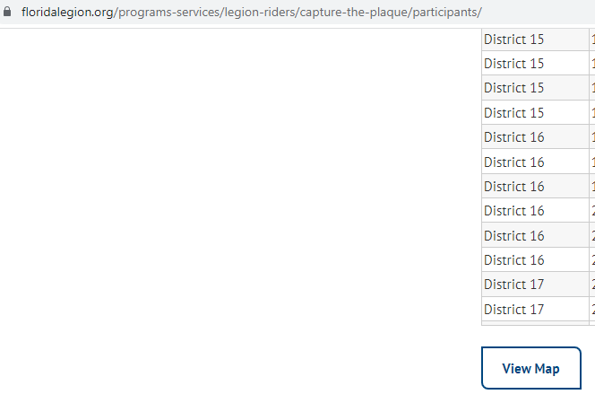
CAPTURE THE PLAQUE
Updated Map!
Click Participants
Scroll down
Click View Map

Slide 8
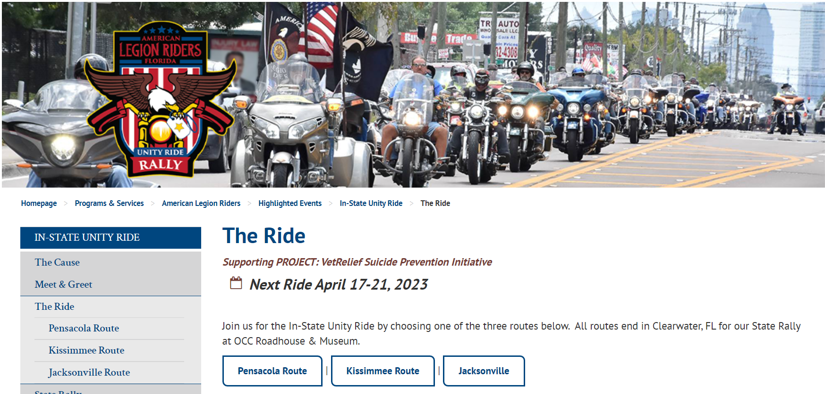
IN-STATE UNITY RIDE
April 21-27, 2024

Slide 9
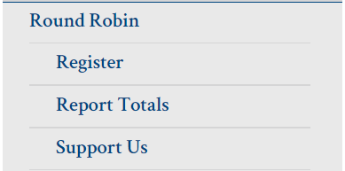
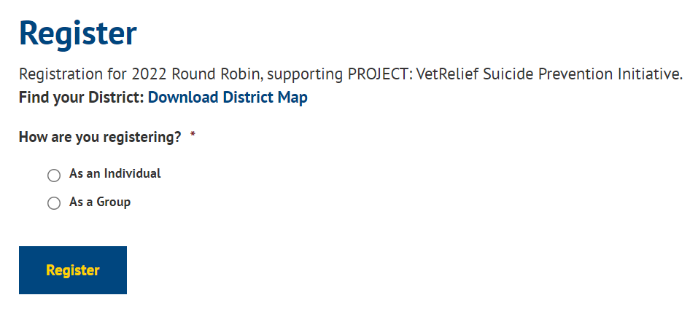
Round Robin /Merry-go-Round
Registration Made Easier!

Slide 10
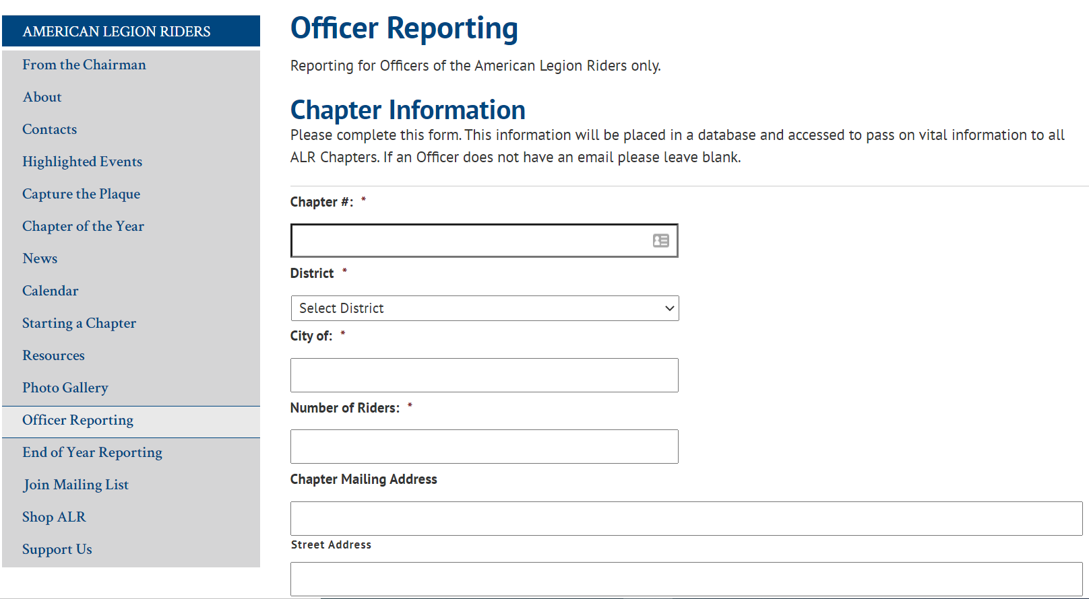
OFFICER REPORTING
DUE BY CONVENTION

Slide 11
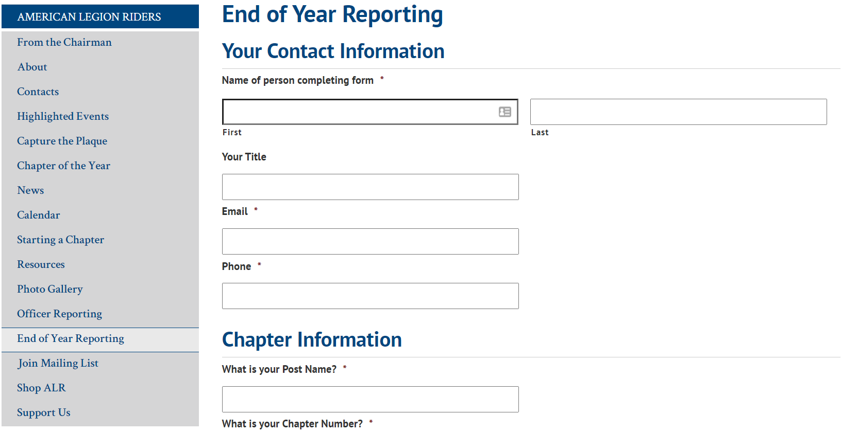
EOY REPORTING
Due May 31, 2024

Slide 12
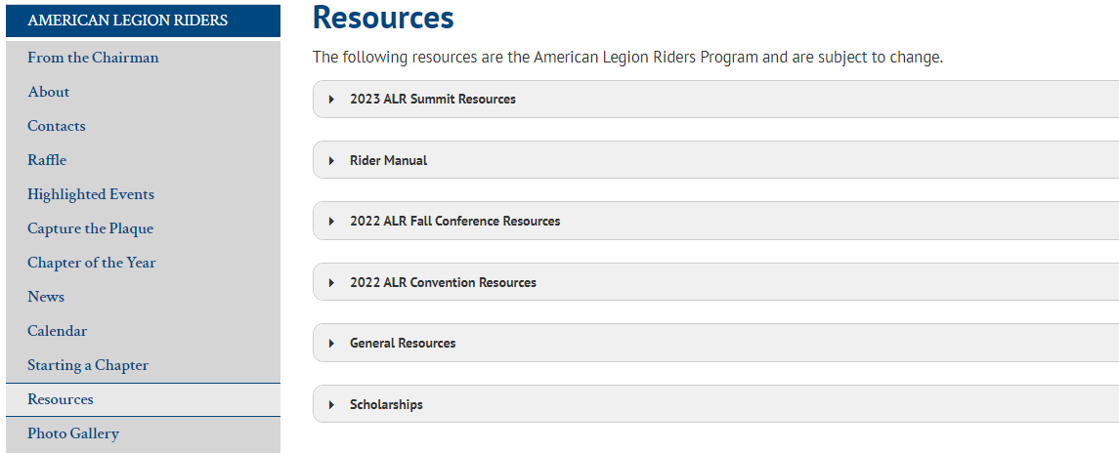
RESOURCES
Click arrows to expand for more info

Slide 13
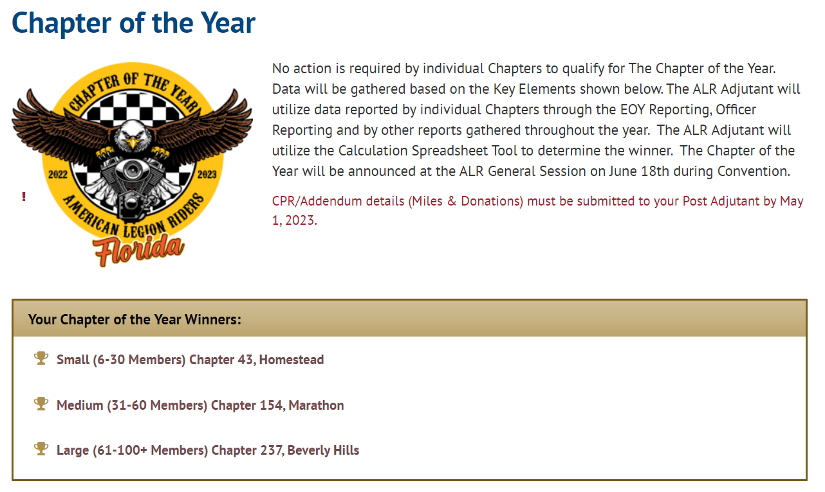
CHAPTER OF THE YEAR
Attend the Reporting Procedures Class to Learn More!
CPR/Addendum details (Miles & Donations) must be submitted to your Post Adjutant by May 1, 2024.
Chapter 43, Homestead
Chapter 101, Bushnell
Chapter 237, Beverly Hills

Slide 14
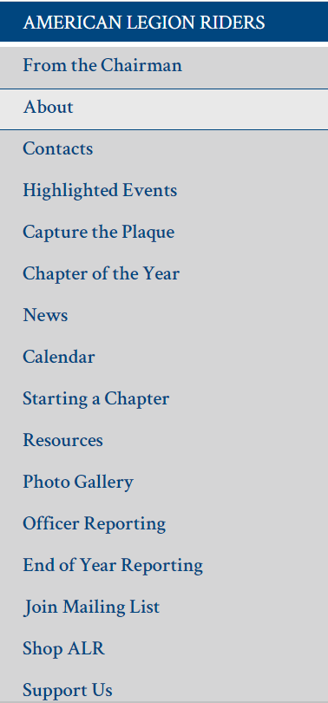
ALR Website
Current Monthly Article
Current News-Submit to: ckolze@floridalegion.org
FL American Legion Calendar
How to start a Chapter!!
Photos - submit to: ckolze@floridalegion.org
Get Your Summit Shirts Here!

Slide 15
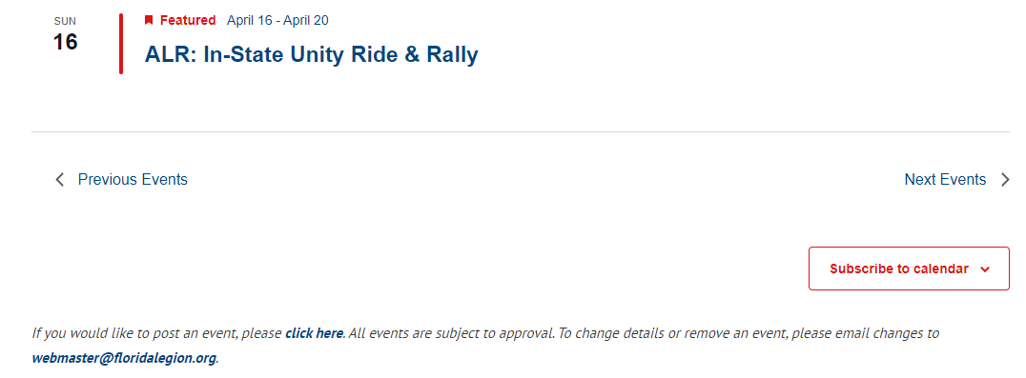
CALENDAR
Scroll to bottom and click to submit your event

Slide 16

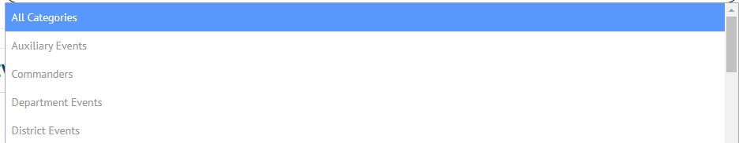
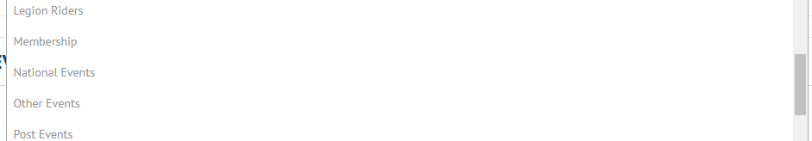
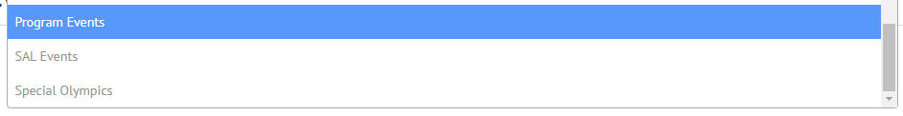
CALENDAR
More selection of categories, choose all categories, or select one(s) for your event. NO LIMIT!
To advertise your
Event!

Slide 17


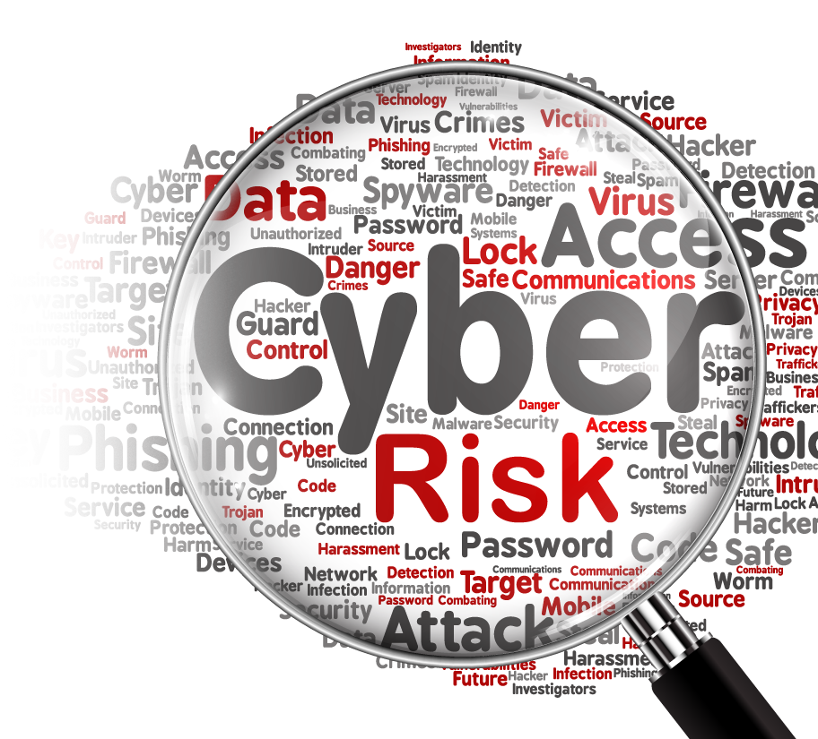
WEB
DEVELOPMENT
Lamar Camacho, Web Master
District 8 Chair

Slide 18


CYBERSECURITY AWARENESS
WHAT IS CYBERSECURITY
Cybersecurity focuses on protecting computers, networks, and information from unauthorized access or attack.
Essentially, if a device connects to the Internet, it is vulnerable to attacks and needs protecting.
Creating awareness regarding the threats are important in this digital age.
How do you use the Internet?
What are your main concerns about using the Internet?
Have you ever had your identity stolen?
Do you have antivirus software on your computer and update it on a regular basis?
Many scammers target Americans ages 55 and older via emails and websites for charitable donations, online dating services, online auctions, buyer’s clubs, health insurance, prescription medications, and health care.
At home, at work, and in the community, our growing use of technology, coupled with increasing cyber threats and risks to our privacy, demands greater security in our online world.

Slide 19
IDENTITY THEFT
Identity theft is the illegal use of someone else's personal information in order to obtain money or credit.
Tips
Don’t use the same password twice.
Choose a password that means something to you and you only; use strong passwords with eight characters or more that uses a combination of numbers, letters, and symbols.
Do not reveal personally identifiable information online such as your full name, telephone number, address, social security number, insurance policy number, credit card information, or doctor’s name.
Avoid opening attachments, clicking on links, or responding to email messages from unknown senders or companies that ask for your personal information.
When making online donations, make sure any charity you donate to is a legitimate nonprofit organization and that you type in the web address instead of following a link.
Be sure to shred bank and credit card statements before throwing them in the trash; talk to your bank about using passwords and photo identification on credit cards and bank accounts.
Check your bank and credit card statements monthly for unusual charges.

Slide 20
FRAUD & PHISHING
Fraud is the intentional perversion of truth in order to induce another to part with something of value or to surrender a legal right.
Phishing is a scam by which an email user is duped into revealing personal or confidential information that the scammer can use illicitly or fraudulently.
Tips
Most organizations – banks, companies, etc. - don’t ask for your personal information over email. Beware of requests to update or confirm your personal information.
Do not open attachments, click links, or respond to email messages from unknown senders
Don’t access your personal or banking accounts online from a public computer or kiosk.
Beware of “free” prizes; if you think an offer is too good to be true, then it probably is.
Make sure you change your passwords often and avoid using the same password for multiple accounts.
Install and regularly update software firewall, antivirus, and anti-spyware programs. These programs can help to protect the data on your computer.

Slide 21
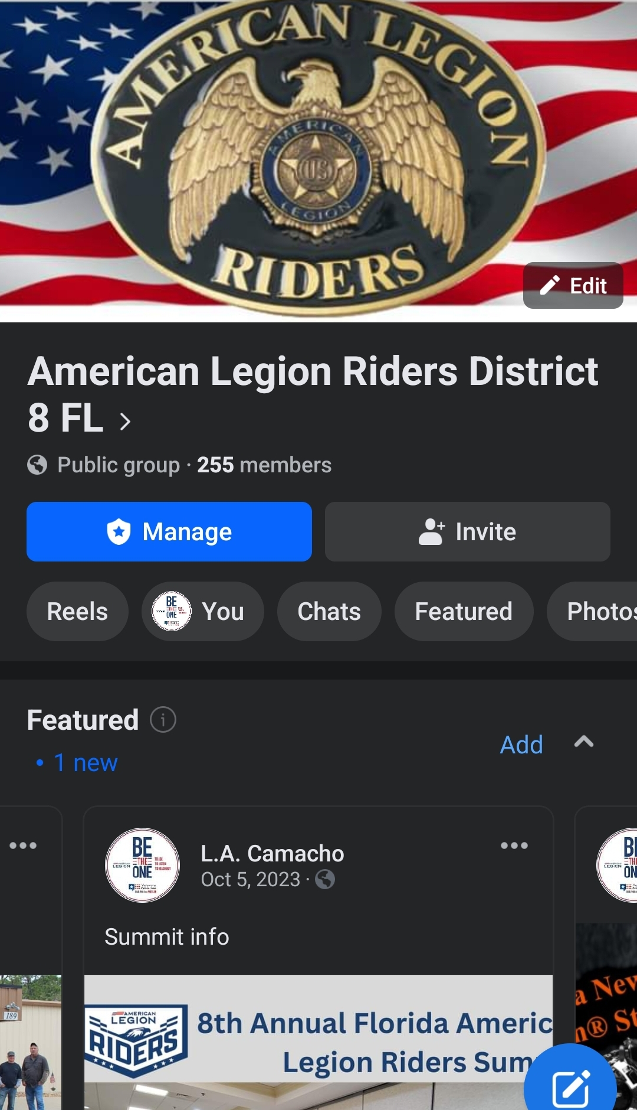
Facebook Presence
Utilizing Social Media via a ‘Public’ Facebook Group can facilitate an easy access site for members.
Offers the opportunity to reach out to potential donors and engage with the community.
An easy and cost-effective way to spread awareness and build a support base.
Chats
Featured News
Photos
Events
Files
‘Live’ Page

Slide 22
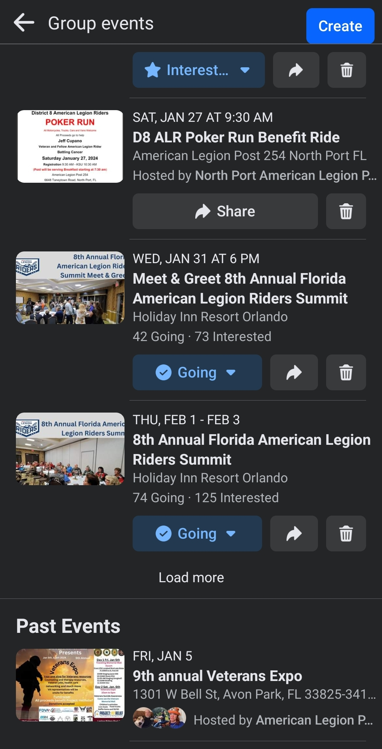
Facebook Events
Creating Events
Events created in the Group are easy to set up
Provides detailed info about the event
Flyer is used as the main picture- can print or email
Provides a sequential order of events for that group
Events can be shared between groups
Corrections and updates are instant
Can show an expected number of participants
Allows for discussion within the event page
The event is just as important as setting it up!

Slide 23
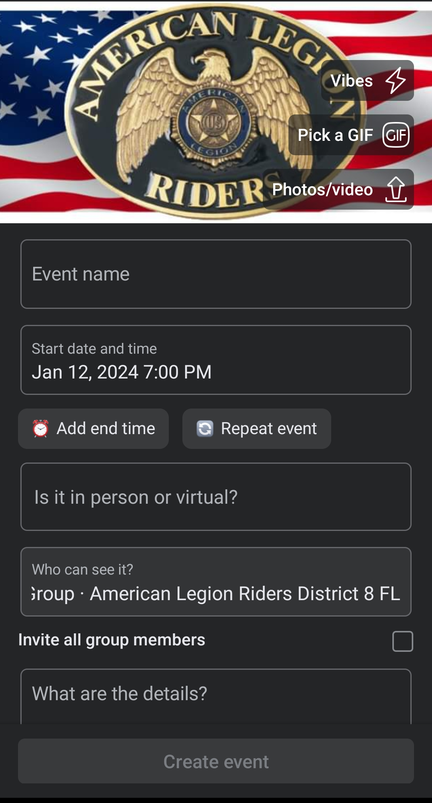







EVENT CREATION
Once you click ‘Create Event’, the basic information page comes up:
  Photos/Video – This is where a DIGITAL copy of the flyer should be used, allowing anyone to print, download and distribute it.
  Event Name – Enter as it appears on the flyer.
  Start Date and Time – Add End Time
    If it repeats, you can enter that here
  Is it in person or virtual - Enter the Address of the event! (Important!) This will create a map link on the event page.
  Who can see it? Populates from your group automatically
  Invite all group members (tick box)– Sends invite once complete.
  What are the details? – This is where to enter as much information about the event as needed. This helps in case a change needs to be made, edit it here, and wherever it was shared it will be updated as well. One time operation!

Slide 24

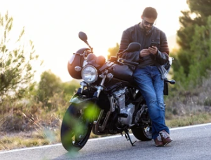
VISIT THE WEBSITE AND GROUP PAGES OFTEN!
If your District has a Website, or FB page, submit the links to ALR8thDistrict@legionmail.org and we will process adding them to the Department site

Slide 25

QUESTIONS????

