Slide 1
AMERICAN LEGION RIDERS
HOW TO CREATE YOUR ONLINE
TRACKING FORM, CREATE SPREADSHEET, AND ADD ICON TO CELLPHONE HOME SCREEN
Go To https://docs.google.com/forms
Sue Nist, ALR Director, Chapter 129

Slide 2
Create New Form – Select Start New Form

Slide 3
Click on “Untitled Form” to Name Your Form & Form Description
Suggested Title – ALR Chapter # or ALR District #
Suggested Form Description: Volunteer Tracking – Miles & Hours

Slide 4
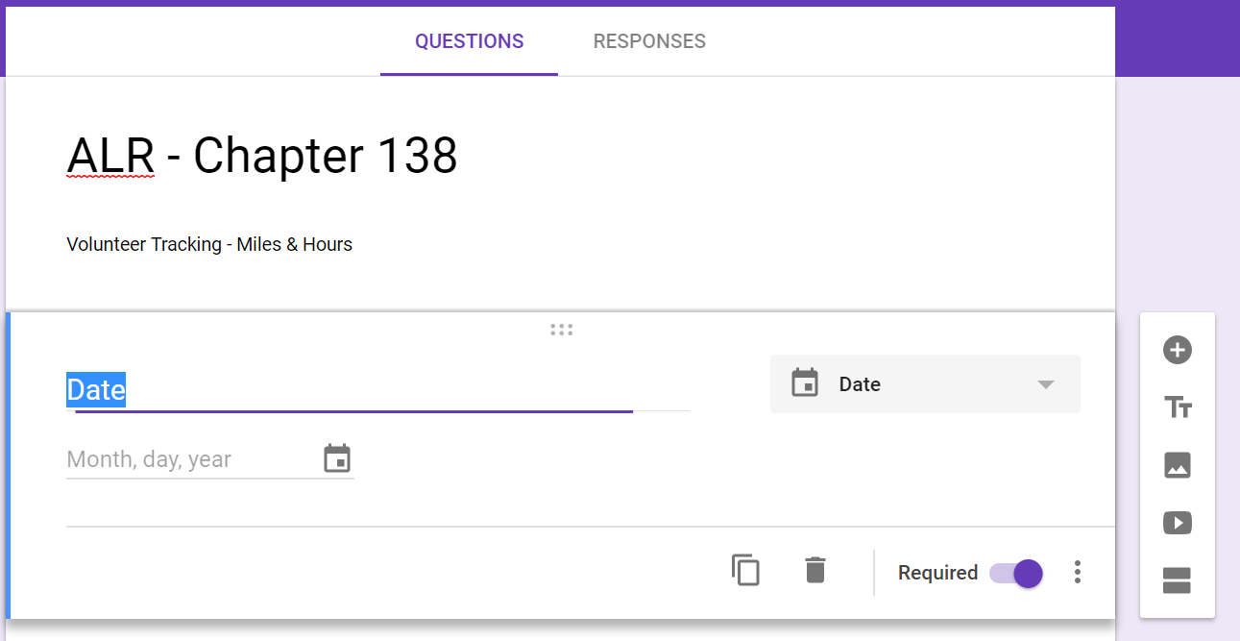
Adding Fields
Add New Field
Ensure that ALL fields are marked REQUIRED

Slide 5
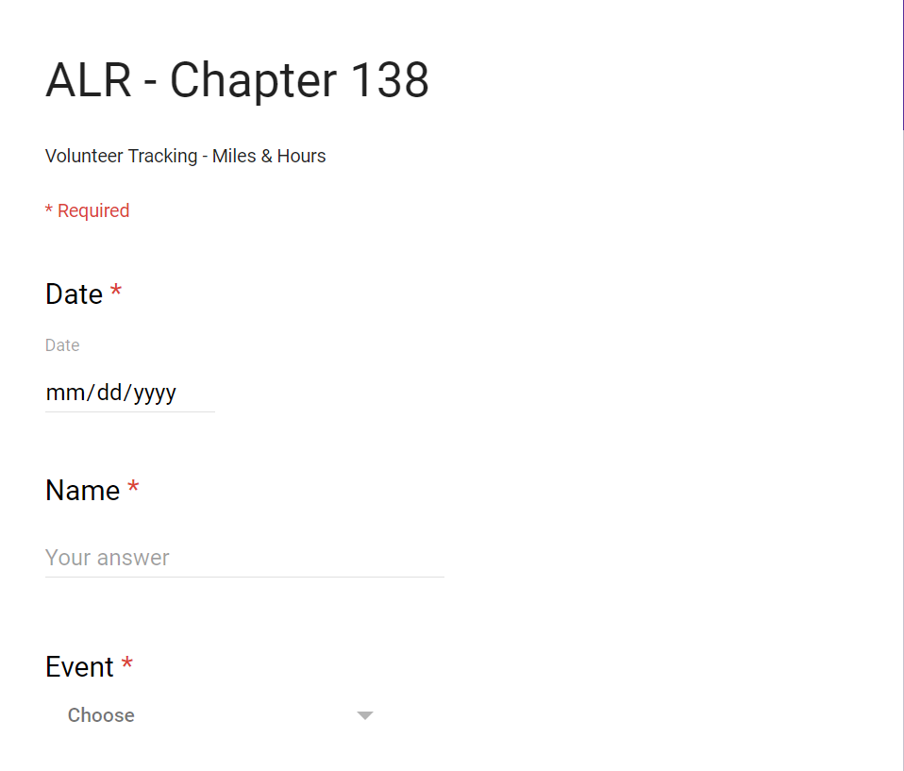
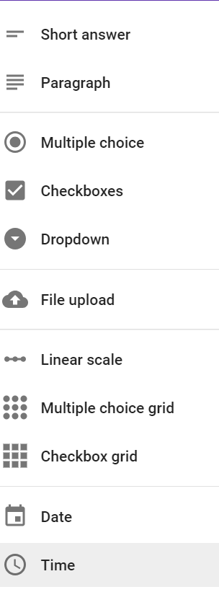
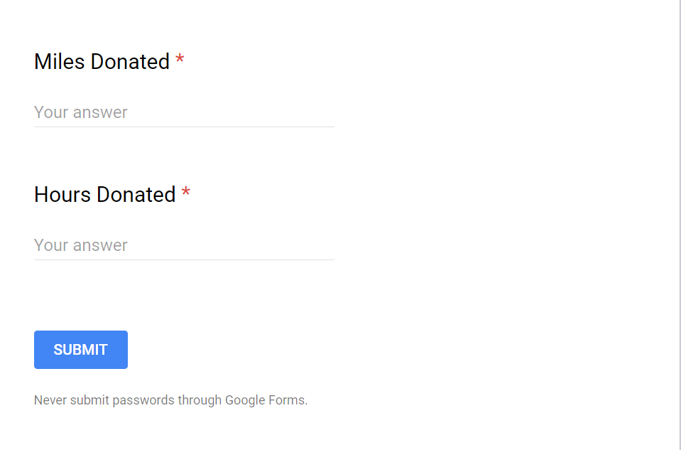
Use Drop Down Option

Slide 6
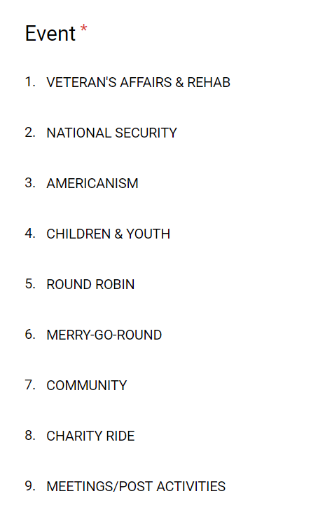
SUGGESTED CATEGORIES

Slide 7
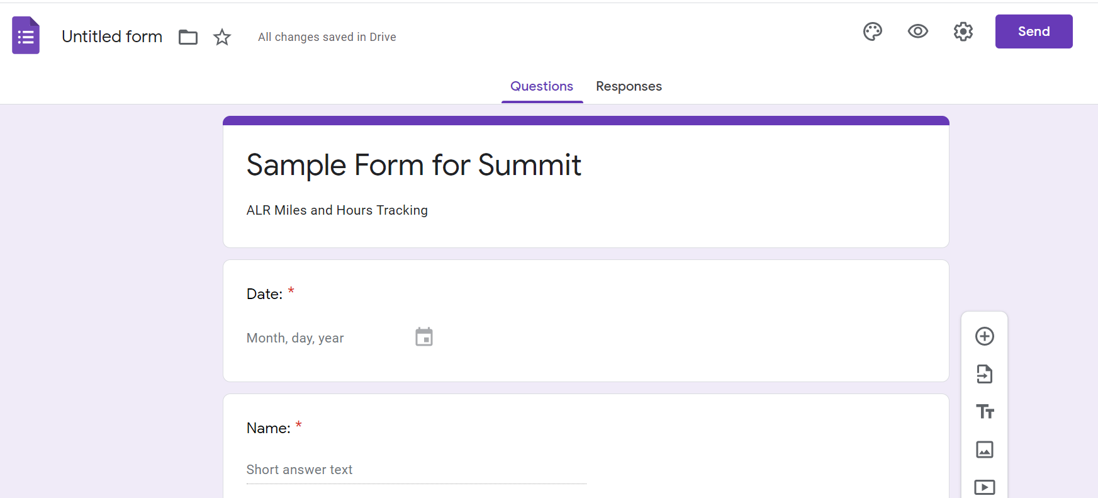
Email Newly Created Form

Slide 8
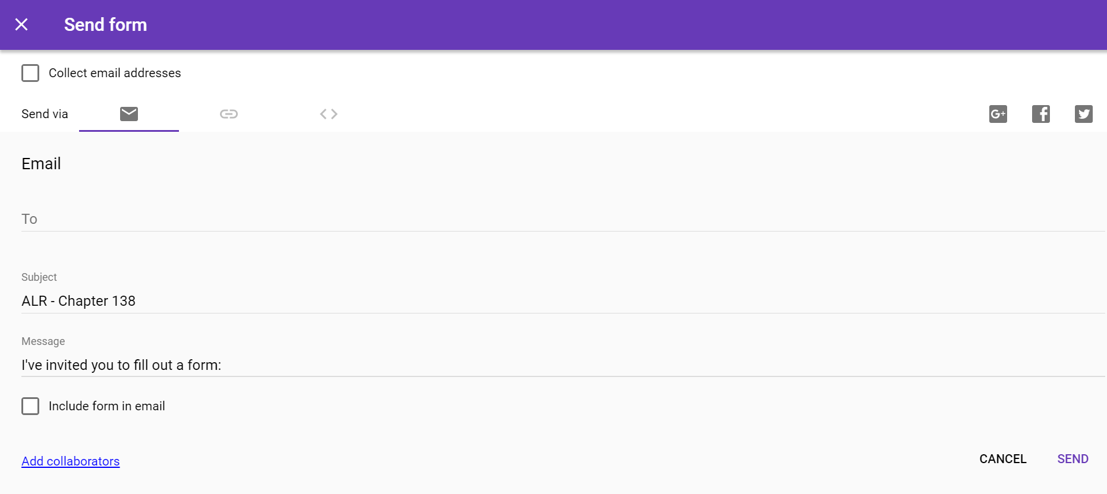

Slide 9
After your ride or activity, complete the form and SUBMIT!

Slide 10
Creating a Spreadsheet

Slide 11
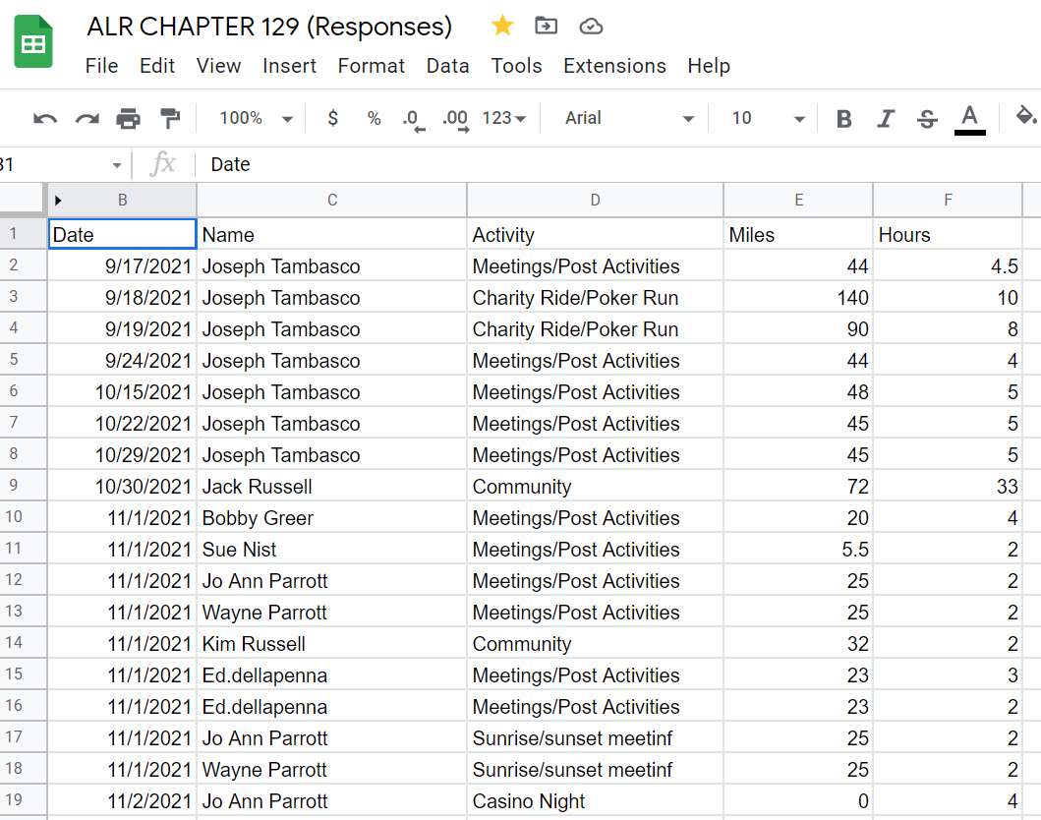
Total Columns for District Report

Slide 12
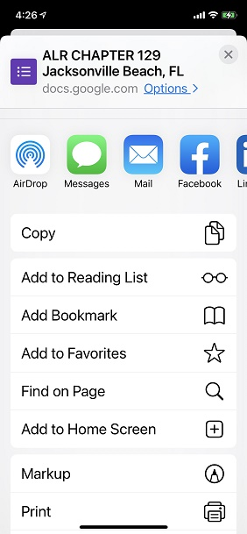
Add Form to Cellphone Home Screen
For an iPhone:
Open the form in your email using your phone
Click on the Upload symbol and scroll down to Add to Home Screen

Slide 13
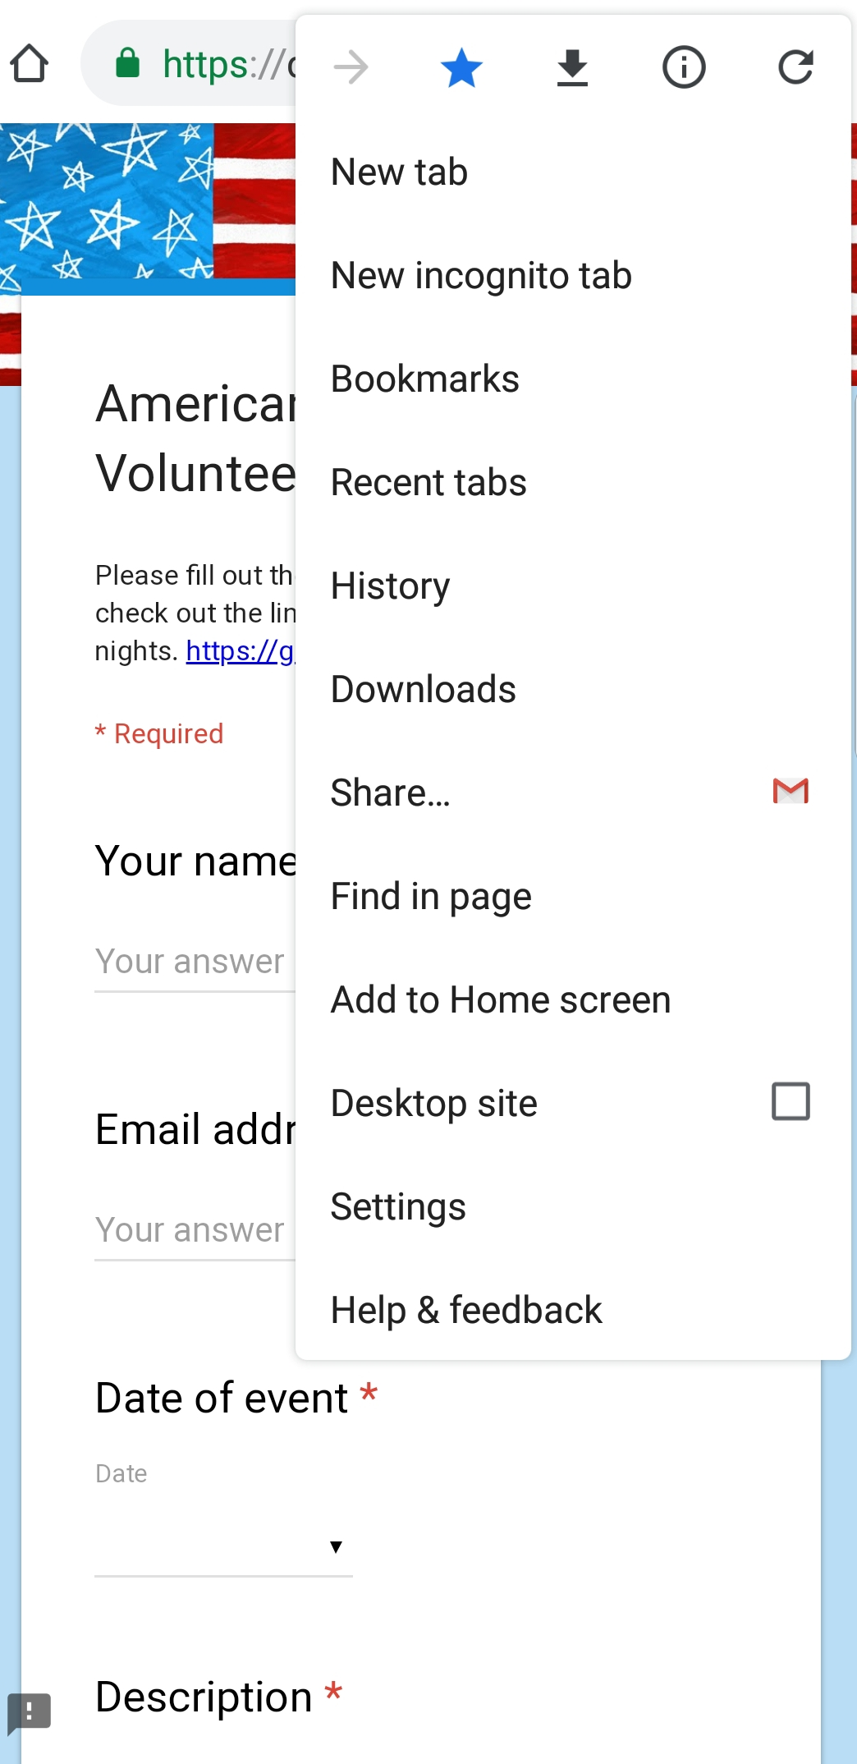
Add Form to Cellphone Home Screen
For Android:
Get the link to your Google Form from whoever has it…and open your internet browser of choice
Click on the three little dots at the top of the browser to bring up the Edit menu. (Right)

Slide 14
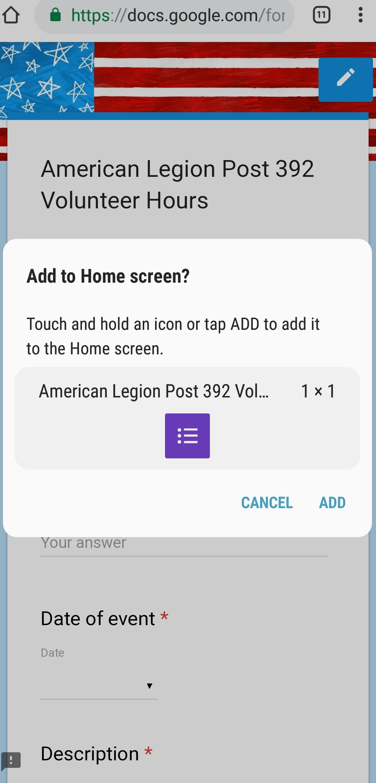
Add Form to Cellphone Home Screen
Once you click Add to Home Screen, the phone will prompt you for a name. You can leave the name the same as the name of the page, or customize it. Click Add (Left)
Once you click Add, you can click Add again and the phone will just add that icon anywhere, or you can click and hold the icon to add it where you want it. (Right)

Slide 15
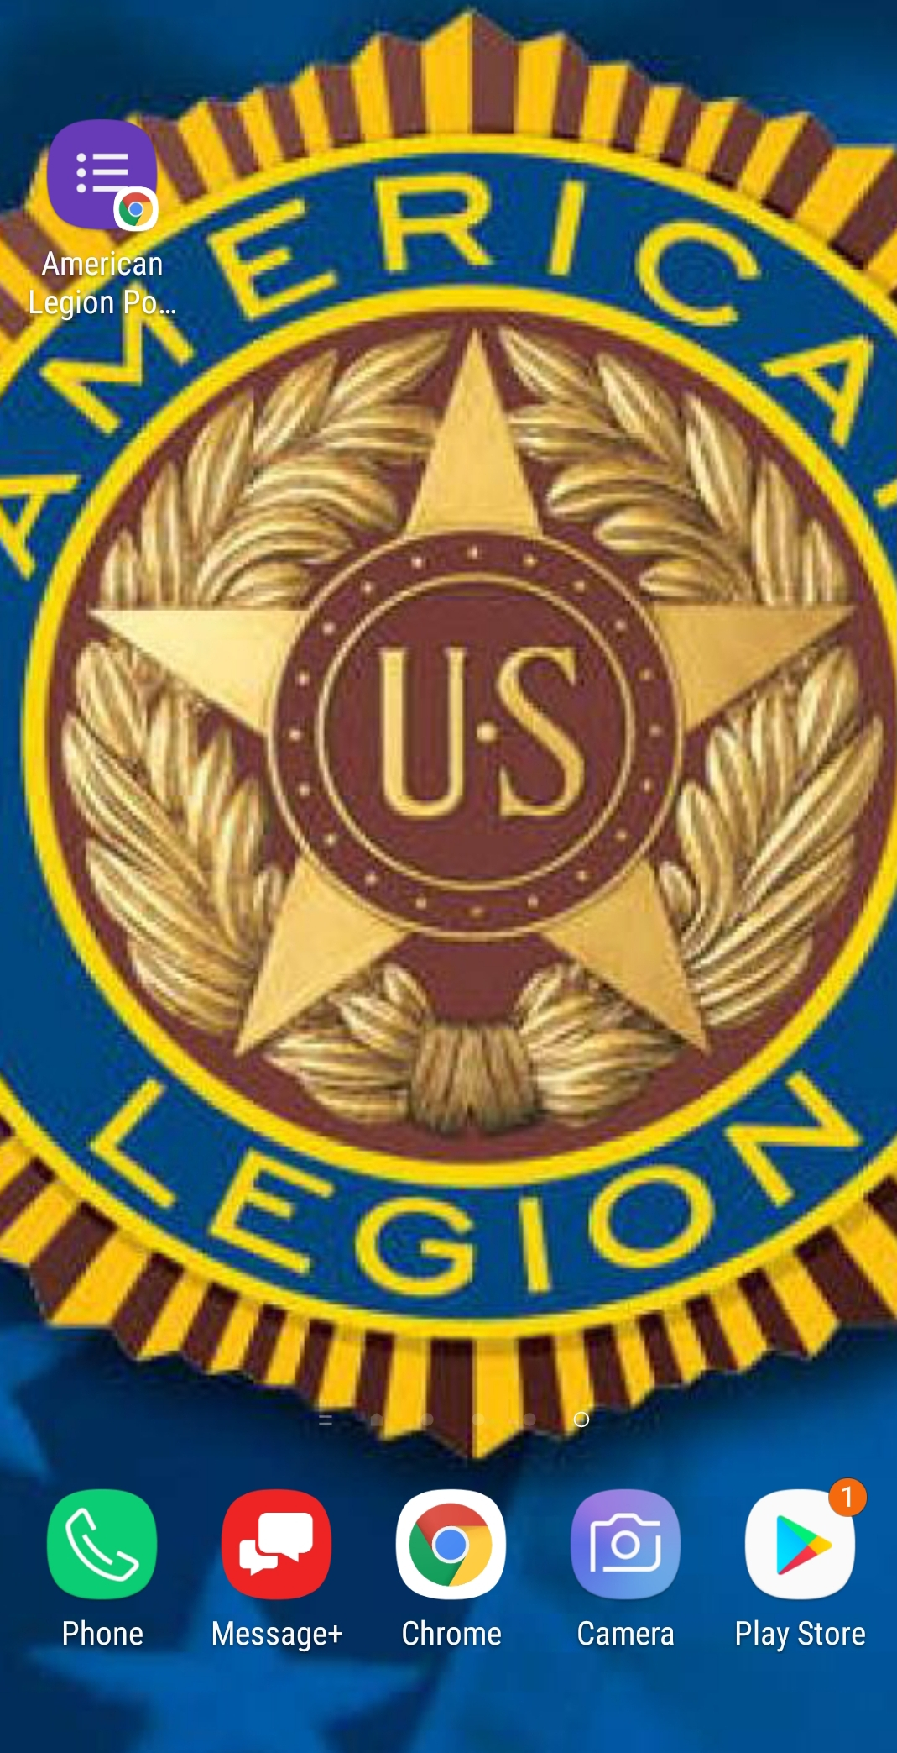
Look for the Purple Icon
The icon will appear on your phone display. Click on icon, complete form, and submit.
EASY PEASY!!

Slide 16
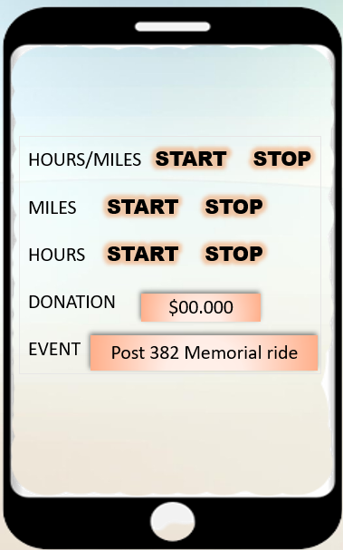
COMING SOON!!
Volunteer Hours & Miles Tracking APP

Slide 17
Capturing Miles & Hours
You can track trips/mileage as the app runs in the background on your phone. (preferably google maps API)
Will have full control when you start and stop rides.
Hours start automatically with trip and end when user completes trip.
Hours will continue being tracked even when user is not driving.
Will have a way to track hours without mileage.
Will have a tab with preloaded location names and event type. (Authorized reporter will input this data)
All tabs are optional

Slide 18
Tracking APP
*How it Works*
I’m riding to my volunteer location for the day. I will open my app and hit record from my driveway. The App will begin capturing my miles and my hours. When I arrive at my destination, the recording of mileage will automatically stop and my hours will continue to be captured. When I get back on my bike, the app starts recording my mileage once again. When I arrive at home, I select stop on the app. All the miles and volunteer hours have been recorded for the day.

Slide 19
Authorization
There are three tier locations with one authorized reporter each. (Each location will have 1-4 logins for their authorized reporter)
Chapter level (has 4 entities)
District Level (16 Districts)
Department level (with 4 entities)

Slide 20
Reporting
Chapter level reporter will be able to automatically receive all data from the Rider members.
Chapter level reporters will approve all data before it is automatically populated to District level.
District must approve before it is automatically populated to Department.
All level reporters will be able to submit their events with dates and name of event and post location (this is the data that a member will have a tab of)

Slide 21
Tracking APP
Reporters will be able to connect a member's miles and hours to an event if member did not specify one before they submit to higher tier.
Reports will be available for email or download.
A backup of all data will be available to app owner daily in case of any glitches or loss of data.

Slide 22
Volunteer Hours & Miles Tracking APP
Feedback – Questions?
Need BETA testers ☺
POC: Loreen Skobel
POST 382/District 1
850-530-7567
Loreenskobel@gmail.com

Slide 23
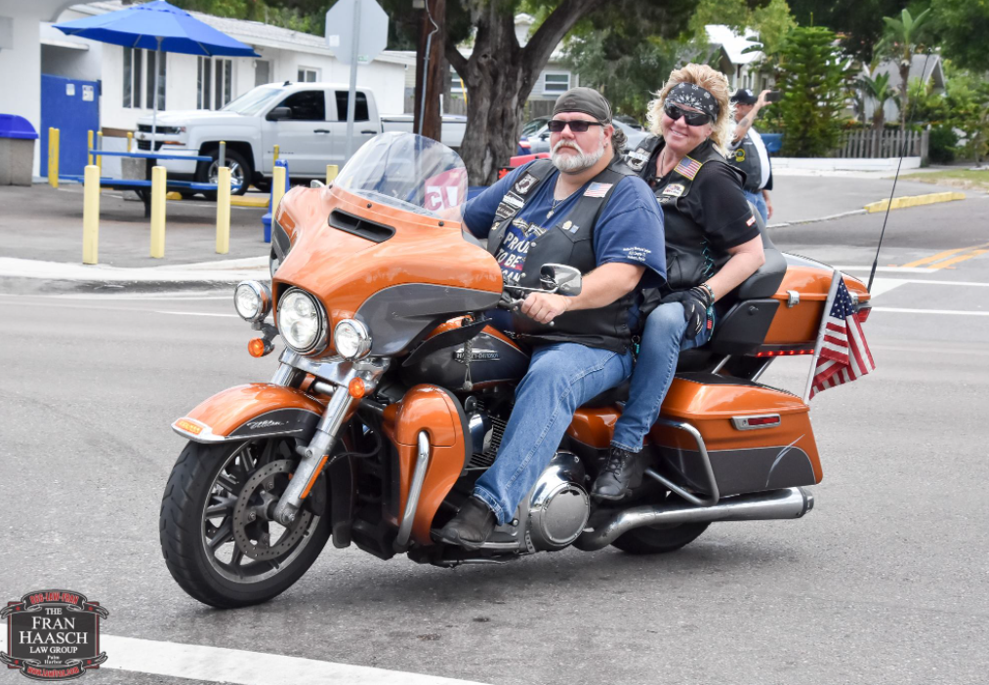
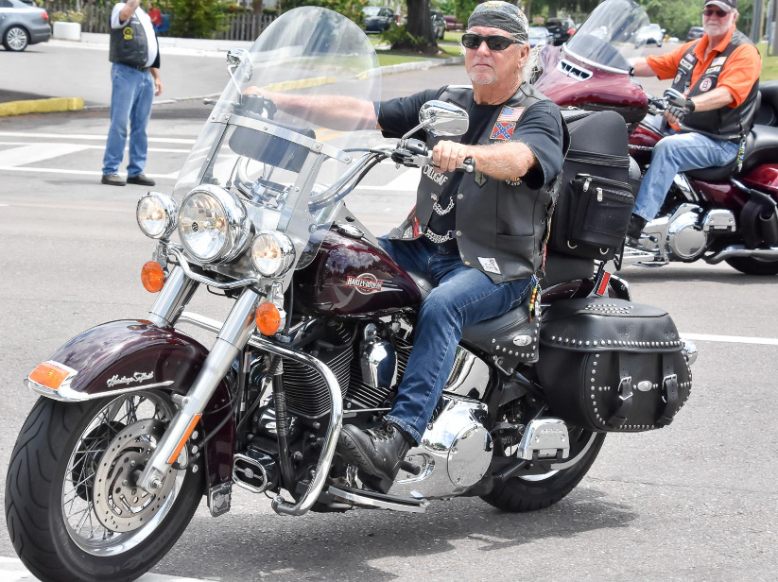
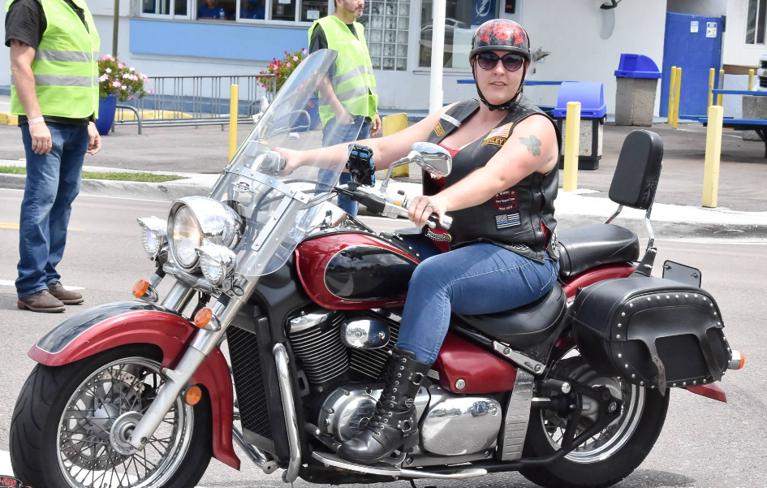
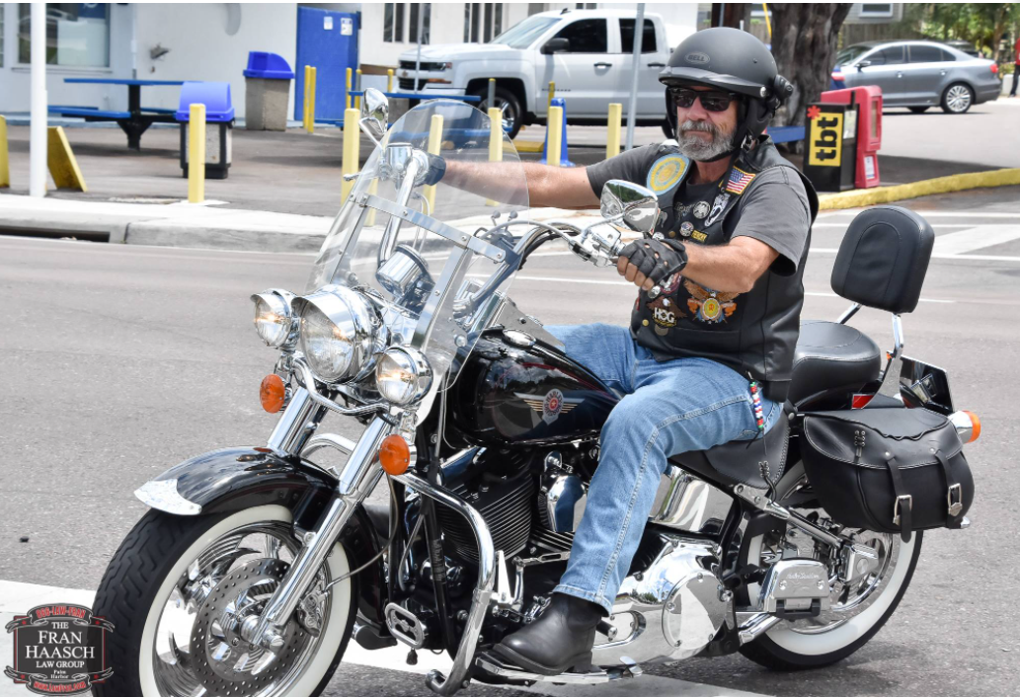
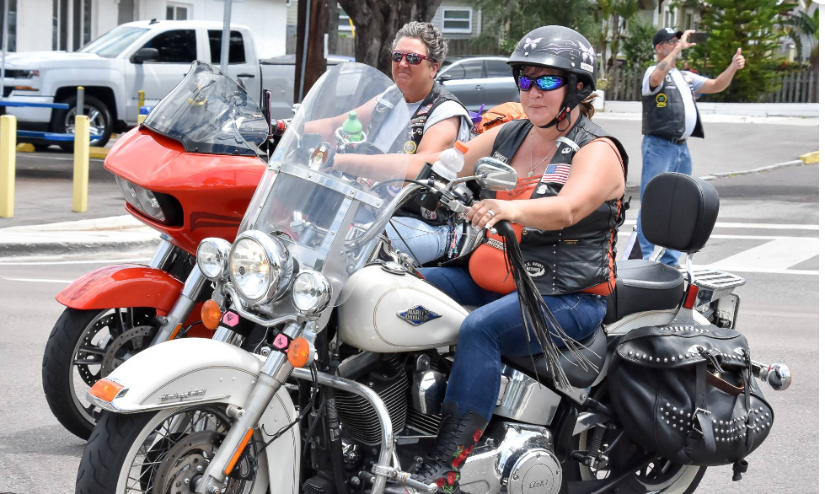
LET’S RIDE!!

