Slide 1
AMERICAN LEGION RIDERS
FINANCE OFFICER TRAINING
Michael “Gambler” Raymond
Commander

Slide 2
As the Finance Officer of my Chapter, What should I know and what are my Responsibilities?

Slide 3
ARTICLE II American Legion Riders SOP
Section 8. Finances
Finances will be derived from Membership Dues, sale of approved merchandise and such other revenue sources as approved by the ALR General Membership.
Checks issued by the ALR Chapter must have the Post Finance Officer or his/her designee as one of the signatories on the bank account. The ALR Chapter may decide the other Chapter signatories on said instrument.
The ALR Chapter Finance Officer must file a financial statement detailing receipts and disbursements, each month with the Post Financial Officer which will be reported to the Post General Membership.
An ALR Chapter may not incur any debt in the name of Post without prior approval of the Post membership documented in the Post Memberships minutes.
The ALR Chapter of a Post is a subordinate organization to the sponsoring Post which is a non-profit organization and a tax-exempt Corporation under the laws of the State of Florida.
Should the ALR Chapter be dissolved or suspended, all funds and assets will be immediately turned over to the sponsoring Post for disposition.

Slide 4
I. Finances will be derived from Membership Dues, sale of approved merchandise and such other revenue sources as approved by the ALR General Membership.
Membership dues
Each Chapter sets the amount of their dues
Each Chapter decides whether they have a PUFL program
Sale of Approved Merchandise
Other Revenue Sources
Poker Runs
Raffles
Dinners, etc.

Slide 5
II. Checks issued by the ALR Chapter must have the Post Finance Officer or his/her designee as one of the signatories on the bank account. The ALR Chapter may decide the other Chapter signatories on said instrument.
Open a checking account
Must be approved by the general membership
State the signatories
Information must be included in the official minutes
Existing checking account
Submit ALR minutes showing the newly elected officers to the bank to change signatories as needed
Recommend obtaining a Debit Card
American Legion Riders Post XXX
Recommend the usage of 2 signatures

Slide 6
III. The ALR Chapter Finance Officer must file a financial statement detailing receipts and disbursements, each month with the Post Financial Officer which will be reported to the Post General Membership.
Provide a full accounting of the Chapter’s Finances
Submit to the Post Finance Officer monthly
Include deposits and disbursements
Identify all expenditures
Reconcile bank statement monthly
Retain receipts
Report cash donations at Year End to Post Adjutant/Commander by May 1st, 2024

Slide 7
IV. An ALR Chapter may not incur any debt in the name of Post without prior approval of the Post membership documented in the Post Memberships minutes.
The Post retains financial responsibility of every entity using their EIN
The Post General Membership ONLY
Can Pledge assets to incur debt
Must be Approved at the Post General Membership Meeting

Slide 8
V. The ALR Chapter of a Post is a subordinate organization to the sponsoring Post which is a non-profit organization and a tax-exempt Corporation under the laws of the State of Florida.
Employer Identification Number (EIN) issued to each Post by the IRS
ALR is a program of the Post and operates under the Post’s EIN
The Post is Non-Profit & Tax Exempt – 501(c)(19) War Veteran’s Organization
Each Post is Required to file IRS Form 990 (Non-Profit Tax Return)
IRS can revoke the Non-Profit Status if Return is not Filed
Failure to file - Post considered a For-Profit Company
American Legion Riders will NO longer be a Non-Profit Organization
FL Dept of Revenue issues the Consumer’s Certificate of Exemption

Slide 9
VI. Should the ALR Chapter be dissolved or suspended, all funds and assets will be immediately turned over to the sponsoring Post.
Funds & Assets belong to the Post
Operate under the Post’s EIN
ALR is a program of the Post
Spend down funds as pledged
As the Post Finance Officer or other designee is a signatory, permission may be required

Slide 10
Section 5. Duties, 3B Finance Officer
Finance Officer:
Maintains accurate records of all transactions by the sponsoring Post's financial requirements.
Deposits funds in an assigned bank-account and disburses funds as approved by the Chapter.
Provides financial reports to the sponsoring Post Executive Committee monthly.
Collect dues as required

Slide 11
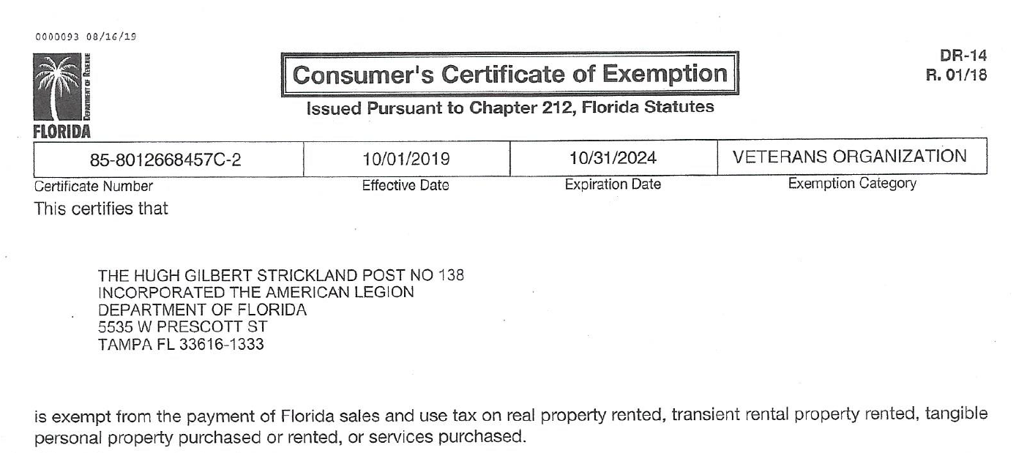
Secure a Copy of the Post’s Consumer’s Certificate of Exemption
Will Allow the Chapter to make purchases free of sales tax
May save on sales tax @ Convention, Summit, Conference dependent upon method of payment

Slide 12
How Do I Record Donated Items?
Item is Donated for Auction/Raffle
Item is Considered an Asset & Contribution Revenue
Contribution Revenue must be reported on Schedule G of the IRS Form 990 *
*REPORTING of DONATED ITEMS – Schedule G, IRS Publication Form 990 (Separate Document)
Provide Receipt to Donor

Slide 13
Example of a Donation Receipt

Slide 14
Reporting Cash Winnings over $600.00
IRS Requires that Income Tax be Withheld
Consult your tax accountant
Rates may vary
Sponsoring Organization is responsible to withhold
IRS has the ability to demand the taxes not withheld from the Post
Non-payment could result in a tax lien

Slide 15
PERSONAL DONATIONS
YOUR PERSONAL DONATIONS MAY NOT BE COUNTED AS A PART OF YOUR CHAPTER’S CASH DONATIONS. THIS WOULD INCLUDE EXPENSES SUCH AS:
*RAFFLE TICKETS
*FOOD PURCHASES
*AUCTION ITEMS
*REGISTRATION
*ETC.
THESE EXPENSES MAY BE COUNTED AS “CHARITABLE CONTRIBUTIONS” ON YOUR PERSONAL TAX RETURN.

Slide 16
QUESTIONS??

