Slide 1

Event Planning
Denny Luke, Northern Area Chair

Slide 2
What can you expect to get out of this class?
Different type of events your Chapter may host
Legal Requirements
Considerations

Slide 3
Type of Events
Fun Run or Overnight Fun Run
Small Charity Ride i.e. Poker/Dice Run etc.
Large Charity Ride
Escort i.e. Funeral, Dignitary, etc.
LEO escorted Rides
In house dinner, fundraiser, Party

Slide 4
Fun Run
Will it be a day ride, or will it include a layover for one or more nights?
Will only your Chapter members be attending?
Will other Chapter members be attending?
Will non-ALR members be attending?
  Obtain Waiver from the ALR website.

Slide 5
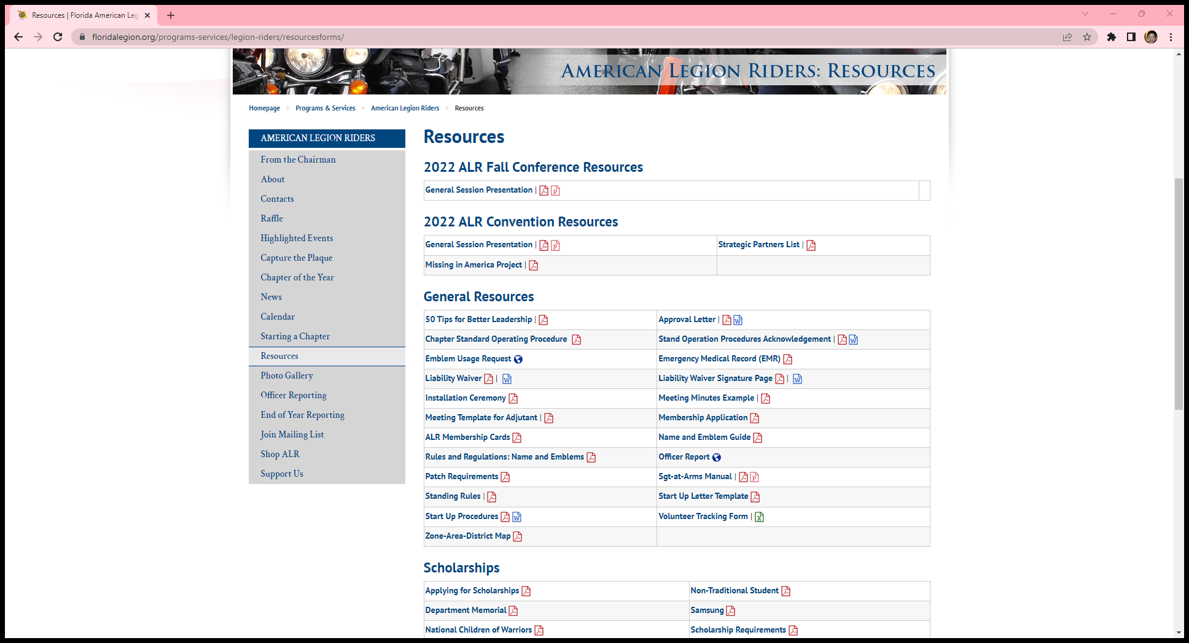
Check the ALR website Resource Page for your administrative needs.
Attend
the ALR
Website
Class to
learn what
the site offers.

Slide 6
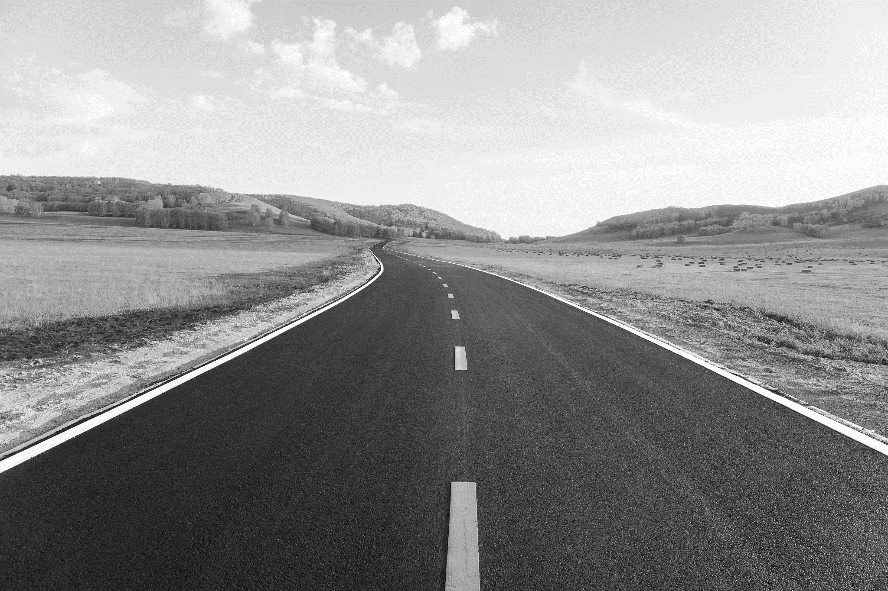
You must decide which is more important, the destination or the ride to the destination. Then plan accordingly.
  Choose between the quickest route or the more scenic route
  Food stops, gas stops, etc. should be based upon your members needs.
    Tank size, bladder size, caloric needs, dietary restrictions, etc.
  Will there be tolls or other charges on your route? Will cash be needed?
  Will there be non-Legion family members on the ride that would need to be signed into a Post?

Slide 7
Charity Ride
Small Poker/Dice Ride
Large Poker Dice Ride
Paid Fun Run

Slide 8
Be realistic in estimating the number of attendees.
A large event will require more member assistance.
Will you be serving food? Games? Entertainment?
Will it require resources from outside your Post?
you may want to establish a committee with members responsible for individual tasks.

Slide 9
Remember as an Event Coordinator or Chairman you do not need to do or know how to do everything.
It is your job to recruit, assign and motivate talent.
Assemble a good team. Assign goals and timelines holding them accountable.
Offer feedback on what is right or any desired change of direction.
Keep them focused on their area of responsibility.

Slide 10
Create your own Responsibility Form tailored for your specific event.
Most are comfortable using Excel or Word to create forms.
List the tasks and who is responsible for completion.

Slide 11
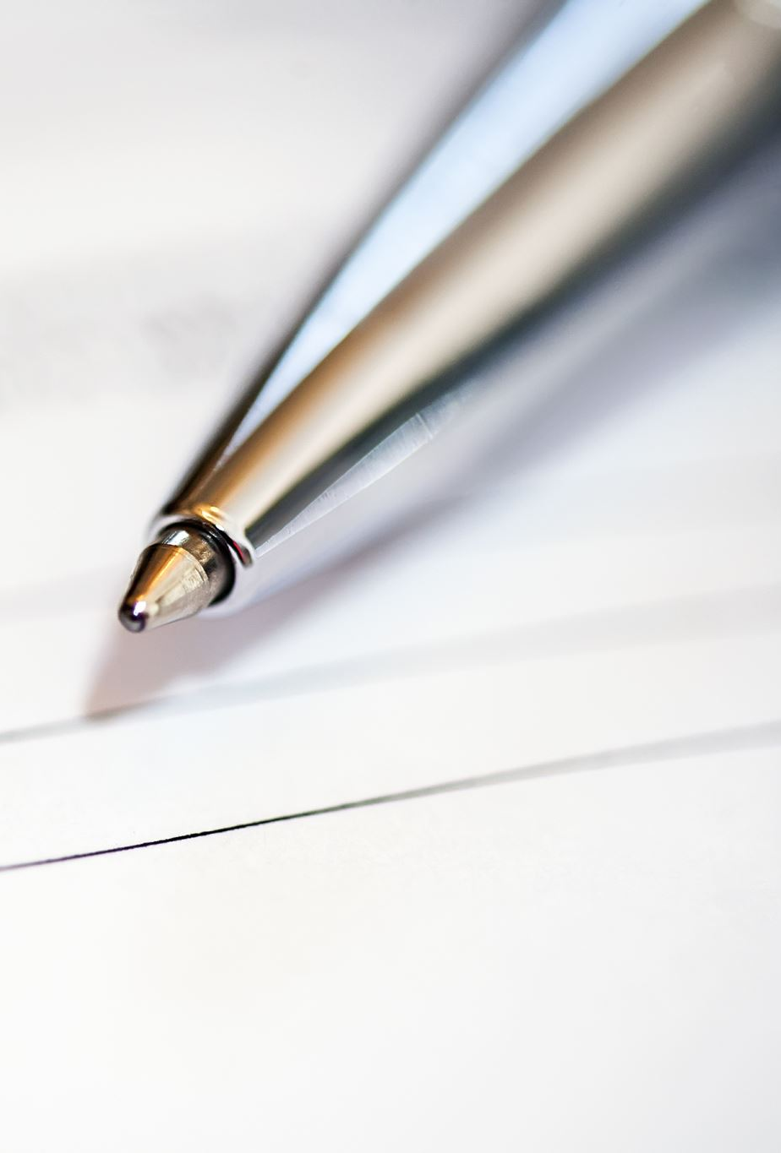
Date and Time of Event
ENSURE YOU CHECK FOR OTHER EVENTS SCHEDULED FOR THE SAME DAY and/or TIME!!!
  Do not step on other events especially ALR Chapter events in your area!
  Some Districts require (and all should in my opinion) their Chapters to submit their event and date to the District leadership for approval/acknowledgement.
  Generate a Pre- Event Notification Form.
  Deliver the Notification Form to all establishments involved in your event.
  Get the contact information of the Post Commander, Canteen Manager, Owner/Manager of establishment.
  Give them a copy of the Notification Form and give them your contact information.

Slide 12
Create your own Notification Form tailored for your specific Event.
I suggest you complete 2 forms giving one to the establishment and retain the other for your records.
I normally take a pic of the completed form with my phone.

Slide 13
ALR Escort Rides
Be advised - The ALR does not have the authority to violate any public traffic regulations.
  Officially we can not block intersections or run red lights.
  Most LEO’s will not intervene with an ALR Escort especially a Funeral Escort.
  Encourage all members in the entourage to put on their flashing lights. This normally signifies the group is together and others should not break the line.

Slide 14
Law Enforcement Officer (LEO) Escorted Rides
Contact your local law enforcement agency to inquire about their requirements and availability.
In smaller communities, Posts may have a friendlier relationship with LEO than in larger cities, therefore it may be easier to obtain LEO assistance.
What are their jurisdiction limitations, can they escort for the whole Ride?
Will they work with other LEO’s from other jurisdictions?
What will the cost be and how will the invoice be paid?

Slide 15
In House Dinner,
Fundraiser or Party
Ensure you clear your event with the Post leadership and get it on the Post calendar.
Will it be held inside or will it be outside?
Will you need the use of the kitchen?
  Do you need a Food Handling Certification? If so, attend the FHC class being offered at Summit.
Will you need a Special Permit or any type of city/county permit?

Slide 16
Regardless of the type of event you are planning, all events have a lot in common.
Planning
Communication
Cooperation
You need knowledge of the rules & regulations surrounding your event for your community.

Slide 17
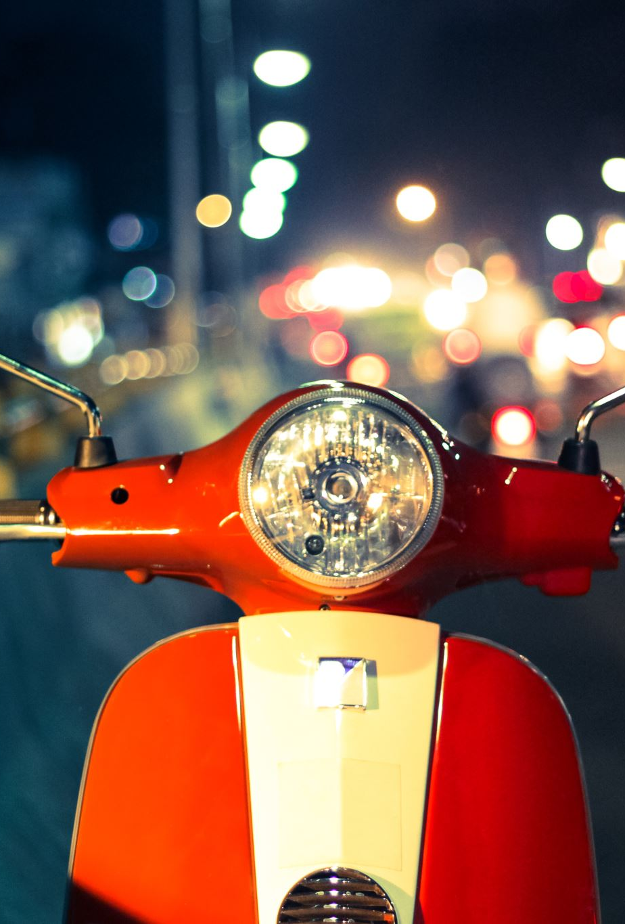
Communication is vital and appreciated!
Communicate with the establishment your expectations, needs and desires. Maybe you would like the establishment to provide a lite snack or maybe nothing because your next stop is a food stop.
A couple days prior to the event call or visit all entities involved.
  Having the original signed notification form handy will prevent a lot of finger pointing !
While on the Ride, call the next stop prior to departure. Give them the approximate number of Riders and estimated arrival time.

Slide 18
Advertisement
Create an Event Flyer as soon as possible.
Create a Facebook Event Page as soon as possible.
Use QR codes – there are many free apps
  Google has one that’s accessible on Chrome.

Slide 19

Event Flyers
Remember to create your Flyer as if everyone reading it is from out of State.
Be aware of The American Legion Trademark Restrictions and in good taste with no foul language, nudity, etc.
Include an address and phone number for all stops on the flyer or score sheet.

Slide 20
There are a lot of good and free flyer maker software applications on the web. Find one you are comfortable with and use it.
Top 10 Online Tools For Making Professional Flyers
1: Canva
2: Stencil
3: Adobe Spark
4: VistaCreate
5: Piktochart
6: Visme
7: MyCreativeShop

Slide 21
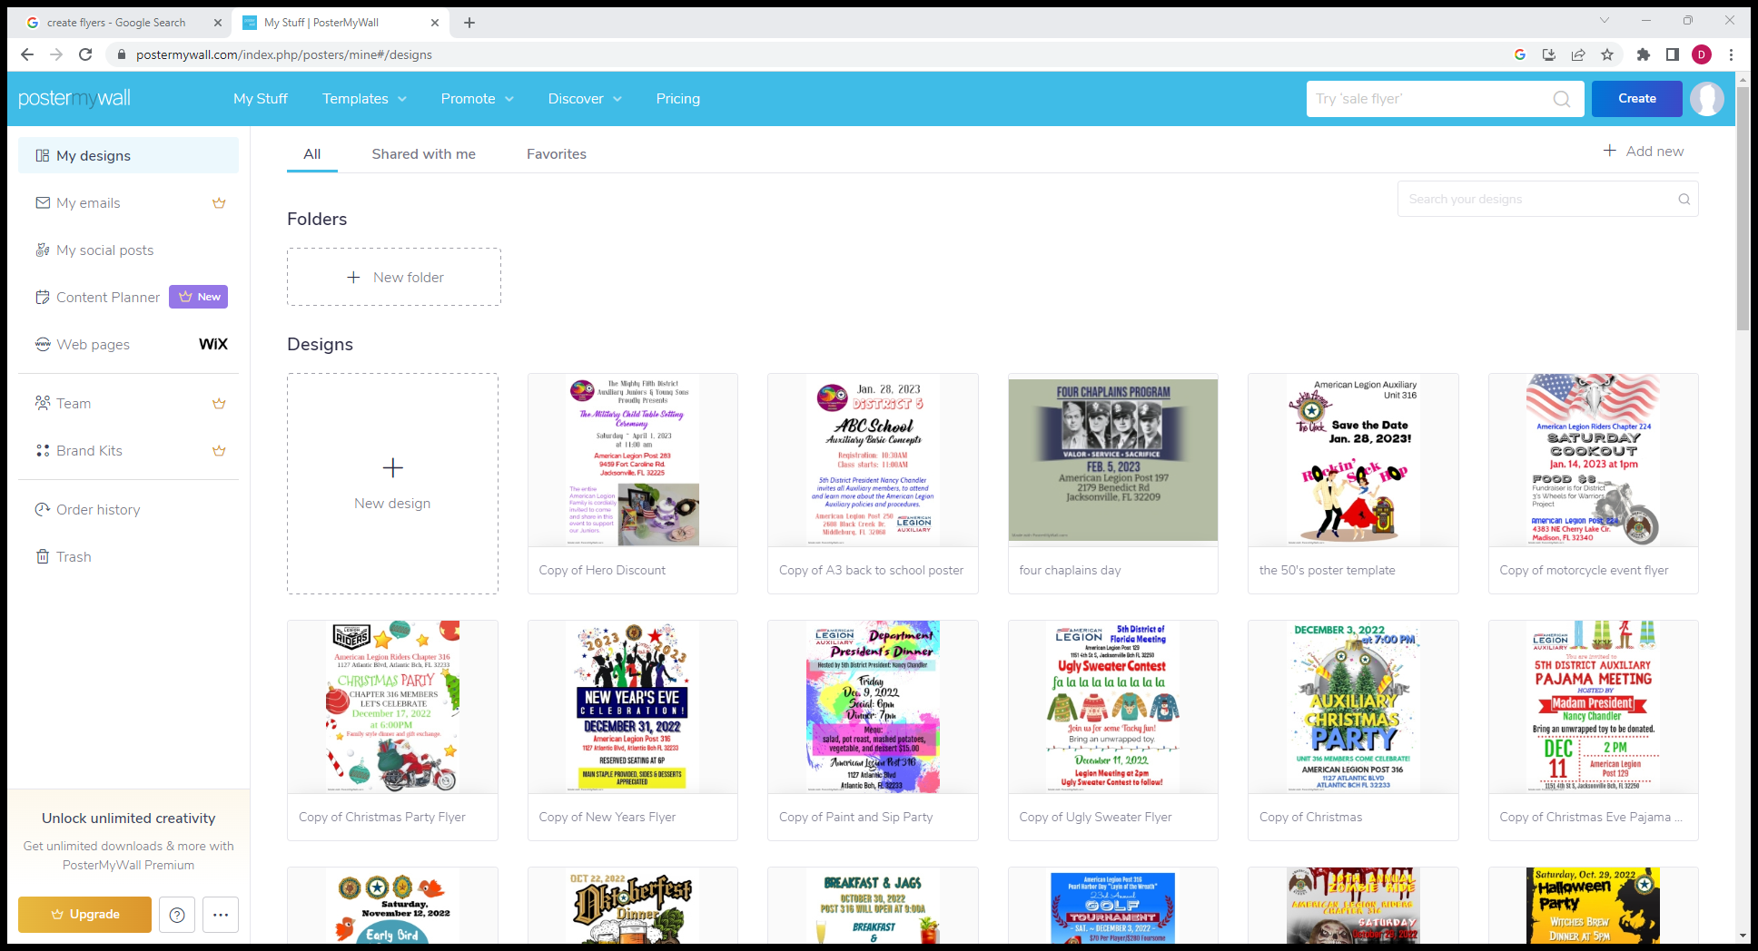
A Good Free & Easy to use Flyer Website is: postermywall.com

Slide 22

The American Legion Name and Emblem
Use and Protection Guide
Basically, nothing can touch or be superimposed on our Emblems
https://www.floridalegion.org/wp-content/uploads/2018/09/Name-Emblem-Guide-WEB.pdf

Slide 23

Event Flyers
Consider the colors you use on the Flyer. This is important for 2 reasons:
  Color printer cartridges are not cheap.
  You do not want your information to get lost in a sea of color.
  The viewer needs to immediately see the “Who, When, Where, What & Why” Don’t have similar background and print color as it will all bleed together.
  Upload your Flyer to every website you can find and drop off at all motorcycle high use locations.

Slide 24
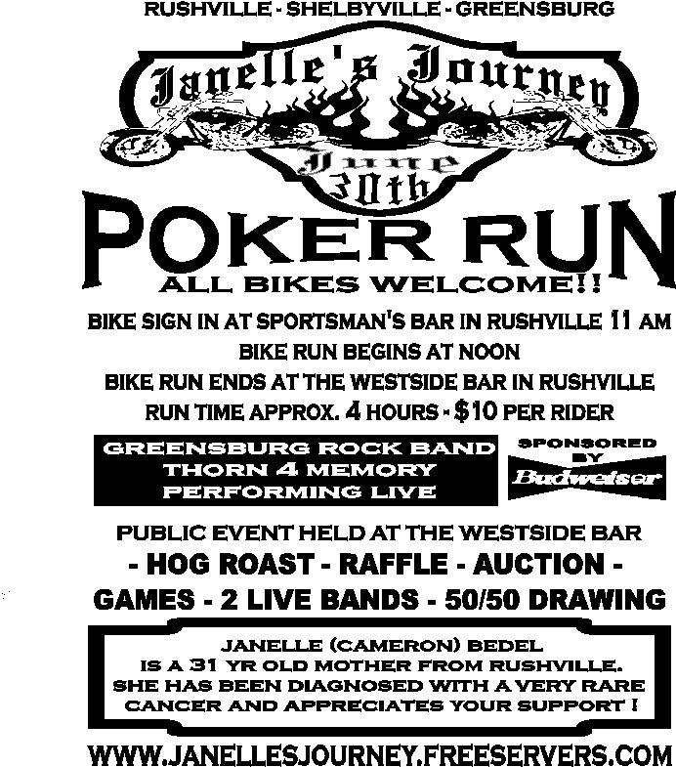
Bad example of a flyer
Do you know where to go to register?
What are the stops?
Where is the afterparty?

Slide 25
Considerations
Permits
Fees
Insurance
Advertisement
Notification to Post and/or participating establishments
Route Planning
Entertainment and/or food
Hotel accommodations

Slide 26
Each municipality is unique unto themselves, however, most only require an event permit if blocking a street(s).
Most motorcycle events are considered a rolling street blockage so therefore do not require a city permit.
Be aware, if you are requesting a LEO escort you may want to consider paying for a permit which LEO will give preference to.
Permits

Slide 27

Will you need a temporary permit to sell alcohol during your event? Know the laws of your City/County
Will your event will be within the confines of your Post?
Will it be in your Post parking lot which is not enclosed? If so, you may be required to obtain a Special Permit or Permits.
The Department of Business & Professional Regulation will issue a Special Temporary Alcohol Permit for a maximum of 3 days for a single event. Your organization is limited to 12 events per year. The current cost is $25.00.

Slide 28
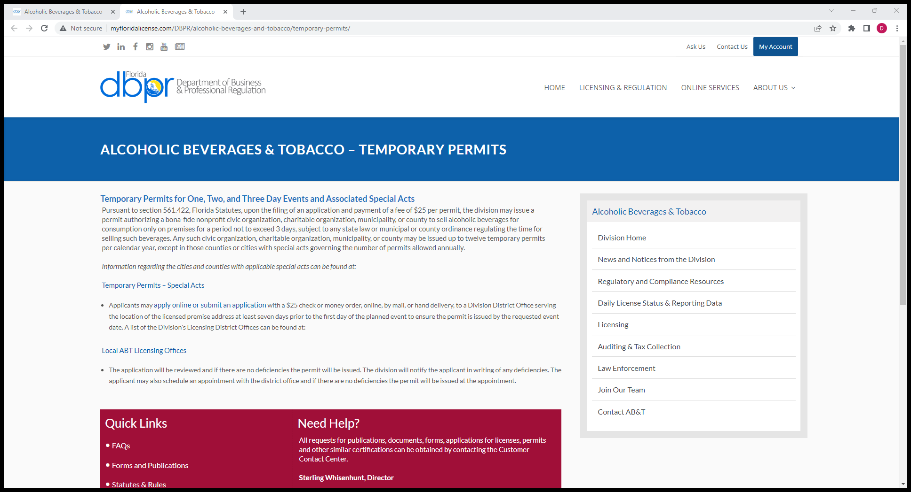

Slide 29

Fees
Will there be any associated fees with your event?
What are they, how much are they, who pays them and how do you pay them?

Slide 30
Insurance Requirements
It has always been recommended if you are having a special event, you should request an insurance rider on your Post liability insurance to cover your event.
These insurance riders are of minimal cost and well worth the time and expense.
If your event is involving any other entities other than your Post, they may well require you to indemnify them on your policy and provide them with a copy of your insurance rider.

Slide 31
Most Common Types of Post Insurance Coverage:
Property Damage
Liability
Director & Officer
Employee theft, etc.
Sons of the American Legion Squadron and American Legion Riders Chapter should be indemnified on the Post policy.
Ask your Commander what insurance coverage the Post maintains on the property and the members.

Slide 32
Typical Event Insurance Limit Requirements
General Liability $1,000,000.00
Property Damage $1,000,000.00
Personal Injury $1,000,000.00

Slide 33
Media and Advertising
Create a Media Release.
  Be Short & Concise
Write a short narrative of your event to accompany your Media Release.
  The who, what, when, where & why about your event.
Post your event on the Department website, District website and Post/Chapter website.
Upload your Event to all motorcycle centric websites.
Present your Media Release and narrative to every news organization in your area.

Slide 34
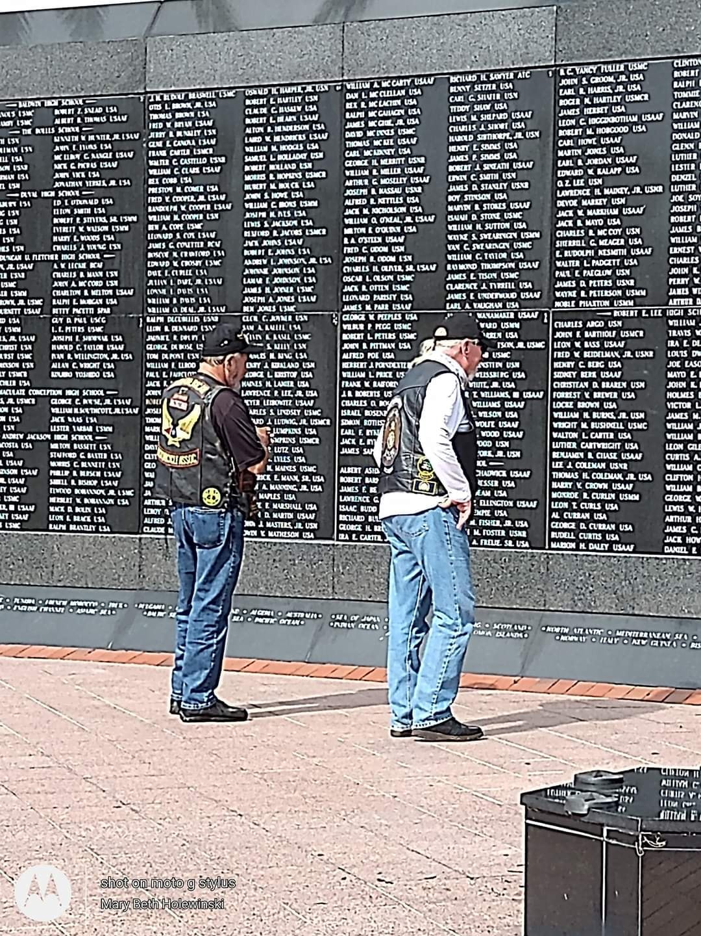
TAKE PICTURES & VIDEOS
Write
Write a short story about the Event.
Upload
Upload the pictures & videos to an event album.
Create
Create a story on Facebook, Instagram, YouTube, Twitter, Snapchat, etc.
Link
Link your event album to your story.

Slide 35

I asked Scott Butler, an editor with the Times Union newspaper in Jacksonville how we could better get our stories posted.
His response:
“It’s pretty much just like we’ve always been taught as Journalists about the five W’s and an H.
Just be sure to include the who, what, where, when, why, and how of your event.
For us it’s also about the local angle because newspaper staffs are dwindling down to nothing these days.
So we’re pretty much going to ignore it unless there’s a good local peg. Also, think about anything you can provide that would make it easier to cover or write up, because our resources are pretty thin.
Things like quotes, contacts and photos are a must.”

Slide 36
Legal Issues
Gift Tax
IAW IRS Pub 525 & 709 - $16,000.00 can be gifted to an individual per year up to 12.6 million per lifetime.
In the event you gift is in excess of the upper limit, the tax burden is on the donor not the giftee.
If you exceed the $16,000.00 limit, your organization must file a gift tax Form 709 with the IRS. The rates range from 18% - 40%

Slide 37
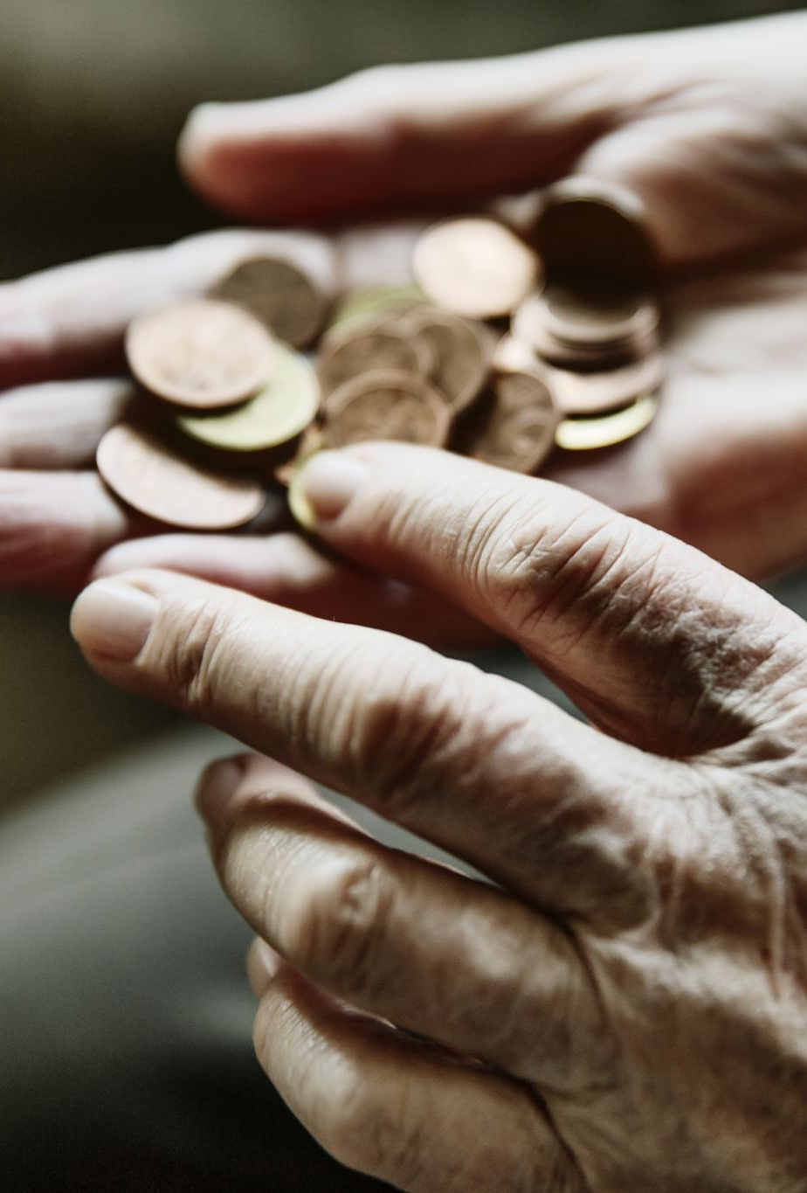
Wording Matters
Events cost money! How will they be paid?
Most organizations solicit donations or sponsorships.
  If you state 100% of your donation will be going to the charity, 100% of the donation or sponsorship must go to the charity.
Decide during the planning stage what fund(s) will be used to support the event. If on your flyer you state, all money raised will be donated then you are locked into donating the gross - not the net proceeds raised.
The term “profits” implies only the net revenue will be donated.

Slide 38
Florida Gambling Statutes Title XLVI, Chapter 849
Section 849.0935 does not prohibit an organization from conducting “Drawings By Chance” if they comply with all provisions in chapter 496 (Solicitation of Funds)
All brochures, advertisements, notices must conspicuously disclose:
  The rules of the drawing.
  The full name of the organization and location.
  The source of funds used to award or purchase prizes.
  That no purchase or contribution is necessary to obtain a ticket.
  The date, hour, & place of the drawing & prizes awarded.
    Exception would be any drawing not offered to the public more than 3 days prior to the drawing.

Slide 39
Create an event binder with copies of everything pertaining to
your event.
This will sound elementary but write everything down.
Contacts, Phone Numbers, Email addresses, Quantities, Cost, Everything!
Have a post event debrief, list what went right, what went wrong,
What you want to change next time, etc.
Start planning your next years event as soon as your debrief is over
Next year it would be nice to know quantiles, costs & contacts.

Slide 40
In Summary
Decide the type of event
When and where
Will an Event Committee be needed?
Will permits or insurance riders be required?
What will the event cost and how will it be funded?
Promote the Event
Record and publish the Event on Social Media.
Perform a debrief as soon as possible while everything is fresh in everyone’s mind.
Start planning for your next years Event!

