Slide 1
Florida Legion Riders Chaplain Training*
For god and country
Loren King, Chaplain
(407) 222-6625
Quiet_knights@yahoo.com
*adapted from AMERICAN LEGION “Chaplain’s How to…” Manual

Slide 2
Qualifications
Qualifications (from the American Legion Chaplain’s how-to manual edited for riders)
How is the Chaplain selected?
Chapter Chaplains are elected in keeping with the specific Standard Operating Procedures (SOP).
Must the Chaplain be ordained?
No, most are not.
What other characteristics should the Chaplain possess?
He/she should be a caring person.
There should be a desire to help others.

Slide 3
Qualifications
A Positive Attitude Towards:
Yourself
Spiritual matters
The unit served
The American Legion Riders
Willing to serve where there is a need.
The ability to keep things confidential
Neutral when helping settle disputes
Helpful, but not necessary to be a public speaker

Slide 4
Ok, I’m the Chaplain. Now what?
Duties and responsibilities of the Rider’s Chaplain
Provide spiritual guidance to the Director and the Chapter
Provide opening and closing prayer at all Riders' meetings and before all rides
Provide back-up to Post/AUX/SAL Chaplain when needed

Slide 5
1. Spiritual Guidance
The Chaplain is the Spiritual Leader of the Chapter
Not a Religious Leader
Faith is an integral part of the Legion, Religion is not
Non-Denominational or Cultural emphasis

Slide 6
2. Provide Prayer
Opening and closing prayers for meetings are part of the ceremonial aspect of the Legion
Prayers should be as basic as possible for the situation at hand without regard to denominational bias
Prayers:
Chaplain gives the invocation (opening Prayer) and benediction (closing Prayer) at meetings.
What prayers should be given?
Should they be limited to the written ones found in our manuals? No

Slide 7
3. Provide Back-up
Regardless of your affiliation, Assist where needed
Be present at as many Legion events as possible.
Be willing to fill in as needed.
Serve and minister where there is a need
Be available to help the Post/AUX/SAL Chaplain in performing their duties.

Slide 8
Additional Information
This information should go to the Commander as they prepare the annual CPR. – Due May 1st, 2023
letters/cards sent
telephone calls made
miles traveled as a Chaplain
hours spent on Chaplain activities
money spent
Be aware of the resources available in Your community. (Handout)

Slide 9
Additional Information cont.
The Chaplain should participate in as many of the following events as possible:
Four Chaplain Days and Religious Emphasis Weeks
Memorial Day
Independence Day events
Veterans Day Memorials
Installations
Initiations
Funeral and memorials when requested
Visit the ill, bereaved, shut-ins, disabled, and prospective members
Provide spiritual leadership through the Legion's "Service to God and Country" program

Slide 10
Chaplain's Calendar*
The chaplain will find it helpful to be aware of upcoming events around which he/she can plan his/her work. Prayers and service can be built around special occasions during the year. The chaplain's calendar below should prove most helpful in anticipating service responsibilities.
January……………………..New Year's Day; Vietnam Cease-Fire - January 27, 1973
February……………….…Americanism Month; First Sunday - Four Chaplains Sunday; Religious Emphasis Week; President's Day; Valentine Day
March……………………….………………………………..American Legion Birthday
April…………………..……………………...Holy Seasons; Children & Youth Month
May…………….…...….Mother's Day; Armed Forces Day; Poppy Day; Memorial Day
June…………….………...……………..D-Day - June 6, 1944; Flag Day; Father's Day
July………………………...……Independence Day; Korean War Ended - July 27, 1953
August………………………………………………………………National Convention
September…………….…...V-J Day - September 2, 1945; Labor Day; Citizenship Day; Regional Conferences
October……………………………………………………………………Columbus Day
November………………….………………….Election Day; Veterans Day - Armistice - November 11, 1918; Thanksgiving Day; Family Week
December……………….….....……..Pearl Harbor Day - December 7, 1941; Festival of Hanukkah & Christmas
*Source the "Service to God and Country" Chaplain's Handbook. (Handout)

Slide 11
Conclusion
The Chaplaincy is essential to the work of The American Legion.
A Chaplain‘s presence is needed for all events.
The Chaplaincy is more than reading prayers.
One final statement:
Look like a Chaplain
Act like a Chaplain
Be a Chaplain!
Notes:
No program will be complete without it. The position of chaplain is an important one. Each chaplain should take pride in serving God and Country. Be positive in your attitude toward the chaplaincy and the total work of The American Legion. Remember, at all times, you are to keep confidences. Your integrity and that of our organization depend upon it.
Mingle with the people. Make it possible for the members to easily contact you with their concerns and problems. Look sharp and be sharp! Properly wear a clean cap. Wear it with pride because it is our uniform. The cap tells people who you are. As you pass a mirror look to see if all is well.
as important as they may be, at regularly scheduled events. It can be as important and productive as you are willing to make it. We exist to serve others. New opportunities for the chaplain‘s ministry are opening daily. The aging of our members make it essential that we be alert for all service needs

Slide 12
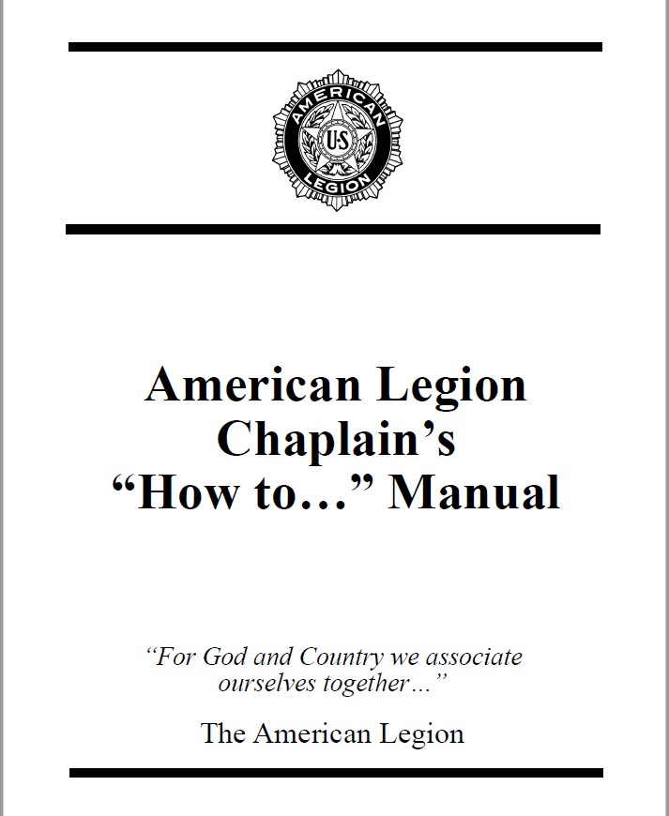
Available resources
"Service to God and Country" Chaplains Handbook
The Chaplain’s Prayer Manual
Auxiliary Chaplains’ Prayer book
Sons of the American Legion Chaplains’ “Manual of Ceremony and Prayer”
AMERICAN LEGION
CHAPLAIN’S “HOW TO…” MANUAL
And if you must have something to read from, GOOGLE it!
Notes:
All these manuals are available through Emblem Sales or for download at Legion.org Don’t limit yourself to written works. Take time to write down poems, scripture, words of encouragement that you come across and use them to help you. You can find information anywhere. You just have to change it to fit your needs.

Slide 13
Questions?

