Slide 1
AMERICAN LEGION RIDERS
ADJUTANT & MEMBERSHIP TRAINING
Melanie Caputo, District 6 Adjutant

Slide 2
Article I, Section 4: Duties, #4 Department Adjutant
Records minutes of all Committee activities.
Maintains copies of minutes and reports.
Handles all administrative functions and correspondence of the Committee at the direction of the Chairman.

Slide 3
Article II, Section 5:Duties, #3 Chapter Adjutant/Finance Officer*
Adjutant
Shall Maintain Membership Records sufficient to Establish:
Members in good standing
Eligibility to be a Rider
Members contact information
Motorcycle license and local insurance requirements
Maintain membership records of members who are current and in good standing and provide an accurate roster.
Send delinquent notices to members whose dues have lapsed and to those Lifetime members who have not provided proof of eligibility by January 1st.
Maintains a full and accurate record of all chapter proceedings
*In Smaller Chapters the Adjutant may also be required to assume the Finance Officer Position

Slide 4
Article II, Section 5:Duties, #3 Chapter Adjutant/Finance Officer
B. Finance Officer
Maintains accurate records of all transactions by the sponsoring Post’s financial requirements.
Deposit funds in assigned bank account and disburse funds as approved by the Chapter.
Provides financial reports to the sponsoring Post Executive Committee monthly.
Collect dues as required.
Learn More by Attending the Financial Officer Training

Slide 5
ADJUTANT DUTIES AT-A-GLANCE
Support Your Director
Record Accurate Minutes of Meetings
Keep Records Accurate, Timely, Current and Secure
Distribute Minutes via Email (If approved method by your Chapter)
Officer Reporting/CPR & Addendum
-To Learn More, Attend the Reporting & Chapter of the Year Class-
Membership Validation *
Attach all Copies of Reports with the Minutes
Keep Information Flowing – Both Ways
*If Adjutant is Responsible for Membership

Slide 6
MEETING MINUTES TEMPLATE
AMERICAN LEGION RIDERS, CHAPTER xxx
General Membership Meeting Minutes _________2024
Meeting called to order by Director XXXXX XXXXXX @ ___________am/pm
Opening Ceremonies
Roll Call: Roster available upon request.
Quorum achieved
22 current members in Attendance.
Correspondence: ______________________________________________
New Members: __________________________________________________
Introduction of Guests ____________________________________________
Reading of the Minutes
The minutes have been posted online. Motion to accept by _________________, second by _______________and approved.
Financial Report _______________________ provided the financial report. Motion to accept, subject to audit, by__________ , second by ____________ and approved.
Additional comments________________________________________________

Slide 7
MEETING MINUTES TEMPLATE
Officer’s Reports:
Director___________________________________________________________________________
Asst. Director_______________________________________________________________________
Chaplain___________________________________________________________________________
Road Captain_______________________________________________________________________
Safety Officer_______________________________________________________________________
Quarter Master_____________________________________________________________________
Membership _______________________________________________________________________
Committee Reports:_____________________________________________________
Old Business_____________________ _______________________________
New Business_________________________________ ___________________
Good of the Riders _______________________________________________________
Additional Comments:____________________________________________________
Next meeting Scheduled: ____________________
Meeting Adjourned @ _________________am/pm

Slide 8
ALR STANDING RULES 1. OPTIONAL POSITIONS
MEMBERSHIP
Maintain membership records of members who are current and in good standing and provide an accurate roster. Maintain the members contact information and current release forms.
Inform all members of the information required to maintain current membership no later than 30 days before their due date.
Send a delinquent notice to members whose dues have lapsed and to those Life-Time Members who have not provided proof of eligibility
by January 1st.
Provide a list of members who are delinquent over 30 days from January 1st, thus making them not current and therefore “members not in good standing.”
Maintain a supply of blank membership cards and applications.
Collect yearly dues and issue membership cards to eligible and approved
members upon verification of current membership.
Provide a detailed report of current membership during monthly meetings.
All monies collected above the $25.00 shall be promptly turned over to the Finance Officer for deposit.
Membership Chair will send out a current roster to all members at a minimum of every six months. Members who do not want their information published will notify the membership chairman.

Slide 9
MEMBERSHIP AT-A-GLANCE
Validation of Membership
Dues MUST be current ie: Legionnaire, Auxiliary, or SAL
If Membership is at another Post, ensure Post does not have a Rider Program & ensure member is in good standing at their home Post
Future Riders - Must be a junior member of The Sons of The American Legion or The American Legion Auxiliary and identified by a “Future Rider” patch.
Accident Waiver/Release of Liability Form
Signature Required - Update Annually
The parent or legal guardian must sign the Participant Accident Waiver/Release of Liability form
Incorporate ALR Membership Renewal w/Post’s Early Bird Membership Drive
Provide Chapter Membership Information for CPR/Addendum by May 1st to Post Adjutant
# of Legionnaires, Auxiliary, SAL
Keep Accurate Records
Provide a Membership Packet
Perform Routine Audits

Slide 10
NEW MEMBER PACKET
Once the Potential Member is Voted into the Chapter
Welcome Letter from the Director
Accident Waiver/Release of Liability
Emergency Contact Information
Medication Listing
Standard Operating Procedure
Chapter’s Standing Rules
Membership Card

Slide 11
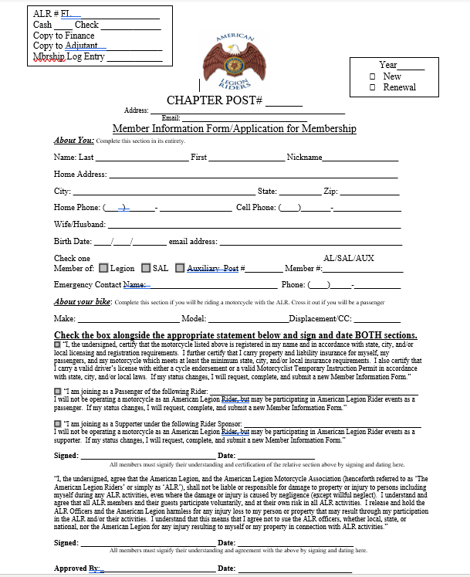
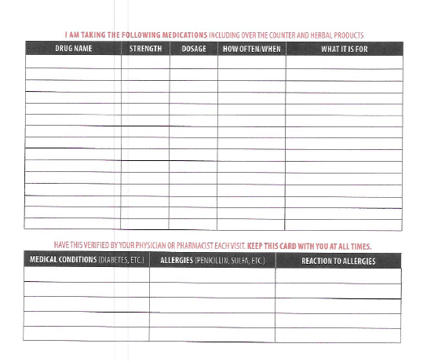
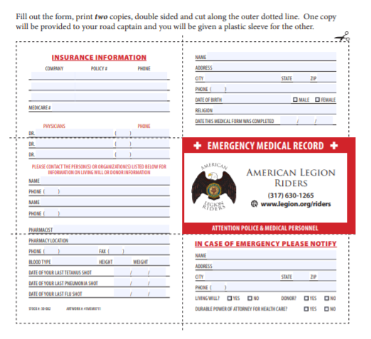
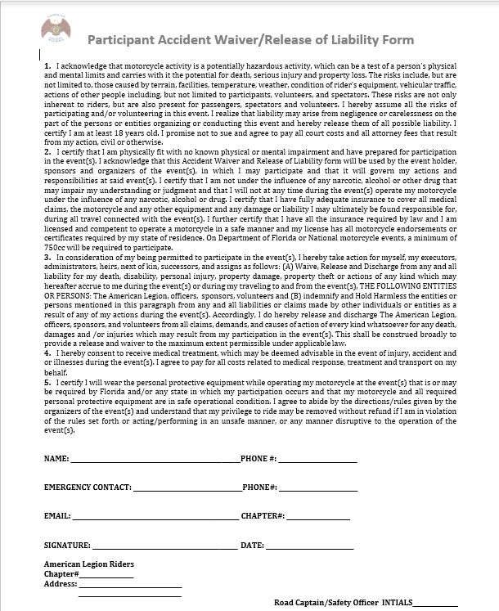
REQUIRED DOCUMENTATION
Accident Waiver
*Medication Listing
*Emergency Contact Information
Membership Application
*To be Kept on his/her person or bike

Slide 12
MEMBERSHIP TEMPLATE
Template can be Found on the Website!

Slide 13
QUESTIONS??

