Slide 1
AMERICAN LEGION RIDERS Road Captain & Rider Safety
Bobby Greer, ALR Chapter 129 Road Captain
Wayne Parrott, ALR Chapter 129 Asst. Road Captain
Ted Wieder, ALR Florida Road Captain & Safety Officer,
727-637-1114, twadjuster@ymail.com

Slide 2
RIDER’S CREED
Riders dedicate themselves to the success of the American Legion. I know that, through my efforts, I can make a difference.
I alone am responsible for myself and to my fellow riders. I will conduct myself with the highest degree of integrity and honor.
Deeds, not words, create change. I will persevere against any and all things that prevent my success. My resolve and strength will overcome all obstacles.
Each rider is first a member of the American Legion Family. I will actively participate and willingly support their endeavors.
Readily will I join other riders in activities and events which support our missions. I will do so gladly, knowing I volunteered to be an American Legion Rider.
Success is the only acceptable conclusion. I will allow nothing to dissuade me or impede me from service to my family, community, country, and especially our Veterans.

Slide 3
LEARNING OBJECTIVES
Road Captain’s responsibility to the riders, group, and themselves.
ALR’s responsibility to the American Legion and other AL Family members
Consequences of actions to our riders and their family
Defining the role of a Leader and Individual responsibilities
Methods for group riding with two-wheel and three-wheel
Videos: Personal Protection, Group Riding, Awareness of safety

Slide 4
GROUP SAFETY PROCEDURE
Road Captains, Safety Officers/ Sweep
Organize and promote safe group riding
Pre-ride briefing. in-route communication and Small groups pre-ride briefing
Group size accommodation and skill level for each flight of riders
Rider’s Care
Bathroom, food and water stops
Ride time between post and stops
Calling ahead for accommodations
Flag displaying in group rides (as per manufacturer and speed)
Parade and Non-Parade
Accident assistances
Blocking and Chasing vehicles (See ALR Road Captain Guide)

Slide 5
Road Captains and Safety Officers/ Sweep Responsibility to the Riders and Group Riding
New Rider(s) Safety
Rider(s) Experience, Skills, AGE and Physical Attributes
Road Captain(s) Experience, Skills, Training
Defining your role as a leader and individual responsibilities to decrease Accidents

Slide 6
INDIVIDUAL RESPONSIBILITIES
Safety Equipment PPE
Drinking and Medicine
Speed of travel
Passing, Lane Position, and Formation
Signs
Skill level

Slide 7
TRAUMATIC BRAIN INJURY
WHY TO BE AWARE ALL THE TIME

Slide 8
TBI- Traumatic Brain Injury-“It can happen to you”

Slide 9
DECISIONS MADE AS A ROAD CAPTAIN AND RIDER WILL IMPACT OTHERS’ AND YOUR SELF (Sister’s Decision)

Slide 11
WHAT DO YOU SEE?

Slide 12
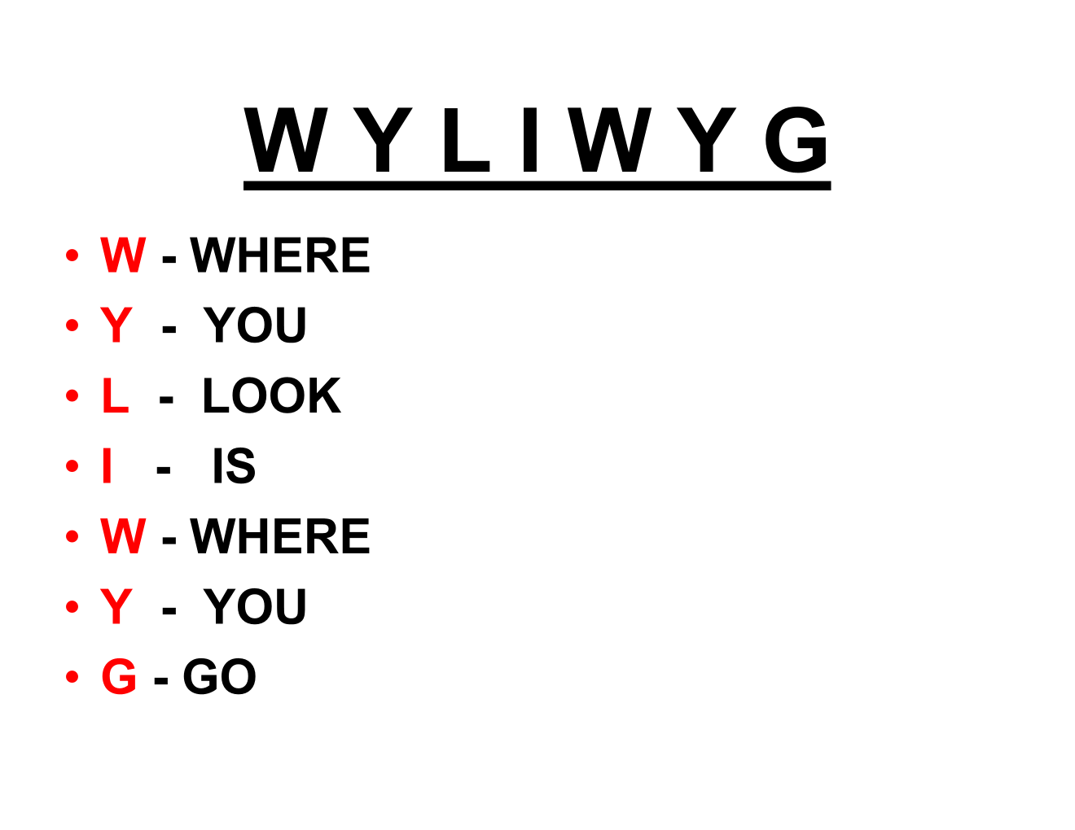

Slide 13
WHAT CHANGES TO FLORIDA’S COMPARATIVE NEGLIGENCE LAWS MEAN FOR MOTORCYCLISTS
Fran Haasch:
I realize this will not be the most popular view, but I have been advising every biker I know to start wearing a helmet. Here’s why you should, too.
Florida’s new tort reform law, HB837, went into effect on March 24, 2023. One of the absolute worst parts of the bill is that we are now a contributory negligence state. This means that if a biker is injured in an accident and is found to be 50.1% at fault, they could be barred from recovering damages.
A possible “real world” example – you are riding your motorcycle without a helmet as you are legally allowed to do because you are over 21 and have insurance, you are stopped at a red light, a person in a CAR/ BIKE/ Truck rear-ends you, causing you to fly off your bike and suffer a brain/body injury. With the NEW LAW, the lawyer for the insurance company can argue that because you were not wearing a helmet, your negligence contributed to your injury, if they can prove that you were 50.1% or more negligent, you can lose the case and get absolutely zero recovery.
You are riding your motorcycle without a helmet, freedom that riders in the state of Florida have been legally allowed since July 1, 2000; another person is at fault for causing the accident and your injuries, but because of contributory negligence, you might not be able to recover anything for your injuries, pain, and suffering, long-term care, NOTHING!
This means that riders who choose not to wear a helmet could be putting themselves at much greater financial risk in the event of an accident. Even if another party is primarily at fault for the accident, the rider’s decision not to wear a helmet could be used against them in court and could result in a complete loss of damages.
During the legislative hearings, there were at least four (4) separate amendments to exempt helmetless motorcyclists who complied with the helmet laws – fs. 316.211 – from the new contributory negligence law. The Republican majority in both the House and Senate voted down all the amendments.

Slide 14
RIDE TYPES
Group Riding
Sponsor Rides
Poker Runs
Parades

Slide 15
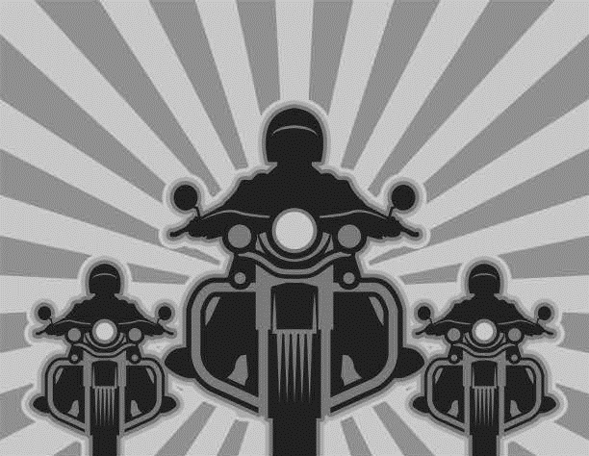
MFS GROUP RIDING

Slide 16
MFS GROUP RIDING VIDEO

Slide 17
GROUP RIDER POSITIONS
Road Captain and Wing Rider
Newer Group Riders
Safety Officer- Sweep
Experience Riders
Mid-Captain Rider (EMT-Paramedic- First Responder)

Slide 18
HAND SIGNALS and TURN SIGNALS “USE THEM”

Slide 19
DISCLAIMER
Information in this presentation, the Rider’s Manual, and all associated documents are derived from various valued sources. This material is intended for educational purposes only and provided only to the American Legion Riders and Supporters. If you believe any information needs to be reviewed, bring it to the attention of the department leadership for review. The safety and the ride belong to each Rider and their passenger. If for any reason, the Rider and their passenger are not riding safely, they may and can be told to leave for the safety of themselves and other rides. If for any reason, you as a Rider believe that you cannot ride in a safe manner, ask for help, and it will be provided, or discontinue the ride in a safe manner.
Let us ride safely, responsibly and set a good example for others. We are representing the American Legion!!!

