Slide 1
MEMBERSHIP

Slide 2
WHY IS IT IMPORTANT

Slide 3
WHO IS MEMBERSHIP

Slide 4
Membership is everyone’s responsibility Every DISTRICT AND Post should have a membership chair and team

Slide 5
Just like everyone should “Be the One” to prevent veteran suicide, everyone should “Be the One” for membership

Slide 6
Your Department Membership Team
Department Chair – Bruce Carl
Central Area Chair– Ray Perez
Eastern Area Chair – Bruce Thurber
Northern Area Chair – Victoria Ziegler
Southern Area Chair – Johnny Castro
Southwestern Area Chair – John Dollinger
Western Area Chair – Sonny Decker

Slide 7
Department Goals for 2023-2024
Target Date | Designation | Required%
September 7, 2023 | Early bird kickoff | 50%
October 4, 2023 | Fall Meetings | 55%
November 1, 2023 | Veteran’s Day | 65%
December 6, 2023 | Pearl Harbor Day | 75%
January 10, 2024 | Mid-Winter | 80%
February 7, 2024 | Presidents Day | 85%
March 6, 2024 | Legion Birthday | 90%
April 3, 2024 | Children and Youth | 95%
May 8, 2024 | Armed Forces Day | 100%
May 31, 2024 |  | 100+1 mbr%

Slide 8
National Goals for 2023-2024
Target Date | Designation | Required%
September 13, 2023 | Early bird kickoff | 50%
October 12, 2023 | Fall Meetings | 55%
November 8, 2023 | Veteran’s Day | 65%
December 13, 2023 | Pearl Harbor Day | 75%
January 18, 2024 | Mid-Winter | 80%
February 14, 2024 | Presidents Day | 85%
March 13, 2024 | Legion Birthday | 90%
April 10, 2024 | Children and Youth | 95%
May 15, 2024 | Armed Forces Day | 100%
Delegate Strength |  | 30 days prior to convention

Slide 9
AWARDS

Slide 10
District Commander Race to the Top
100% District Membership by March 31st, 2024

Slide 11
Post 100% Membership by May 8th
All posts achieving 100% membership by May 8th, 2024, will receive a certificate, 100% Department ribbon, 100% Department pins, and 100% Department coins

Slide 12
Awards Tracking for 100% pins and coins 103% National Commander Award

Slide 13
Post Awards Post Highest Percentage of Membership Award The Post with the highest percentage of membership in each of the 5 categories by May 31, 2024, receives $200. No forms are needed. Department verified. All Posts achieving 100%+ 1 by May 31, 2024, will receive a plaque.

Slide 14
District/Area Commander Awards 100%+1 & Highest Percentage of Membership District/Area Commander Achievement Award The District Commanders who achieve 100% +1 by May 31, 2024, will receive a check for $125.00. The District Commander with the highest percentage will also receive 2 tickets to the Commander’s Banquet. The Area Commanders who achieve 100% +1 by May 31, 2024, will receive a check for $125.00. The Area Commander with the highest percentage will also receive 2 tickets to the Commander’s Banquet.

Slide 15
New Post, Revitalization, Pioneer Awards

Slide 16
NATIONAL AWARDS

Slide 17
How are we going to get there?

Slide 18
Buddy Checks

Slide 19
Be involved with the community(clubs, youth athletics, fraternal organizations, schools) College campuses Chamber of Commerce

Slide 20
Ask your relatives and neighbors

Slide 21
Set up an American Legion booth at local community events, festivals, fairs or in shopping malls and store fronts.

Slide 22
Keep working the DMS list. It is updated periodically.

Slide 23
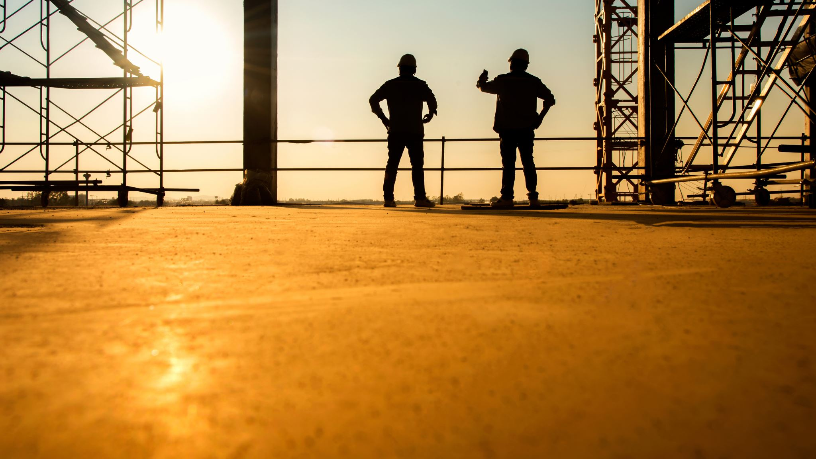
Talk to Active Duty and Guard Reserve Units

Slide 24
Have an "Open House"

Slide 25
Post Revitalizations

Slide 26
Training(at least 2-3 per District/Area) Individual Posts

Slide 27
Membership drives

Slide 28
Work together as a family Find out what your members want Keep your members informed Not all Posts are the same

Slide 29
If your Post is within 5 or 10 members or less to reach 100%, see if the Post can pay for them. Work with your District team to bring in DMS400 AD members to reach goals

Slide 30
Mylegion.org

Slide 31
Working together as a team, we should be able to accomplish our goals

Slide 32
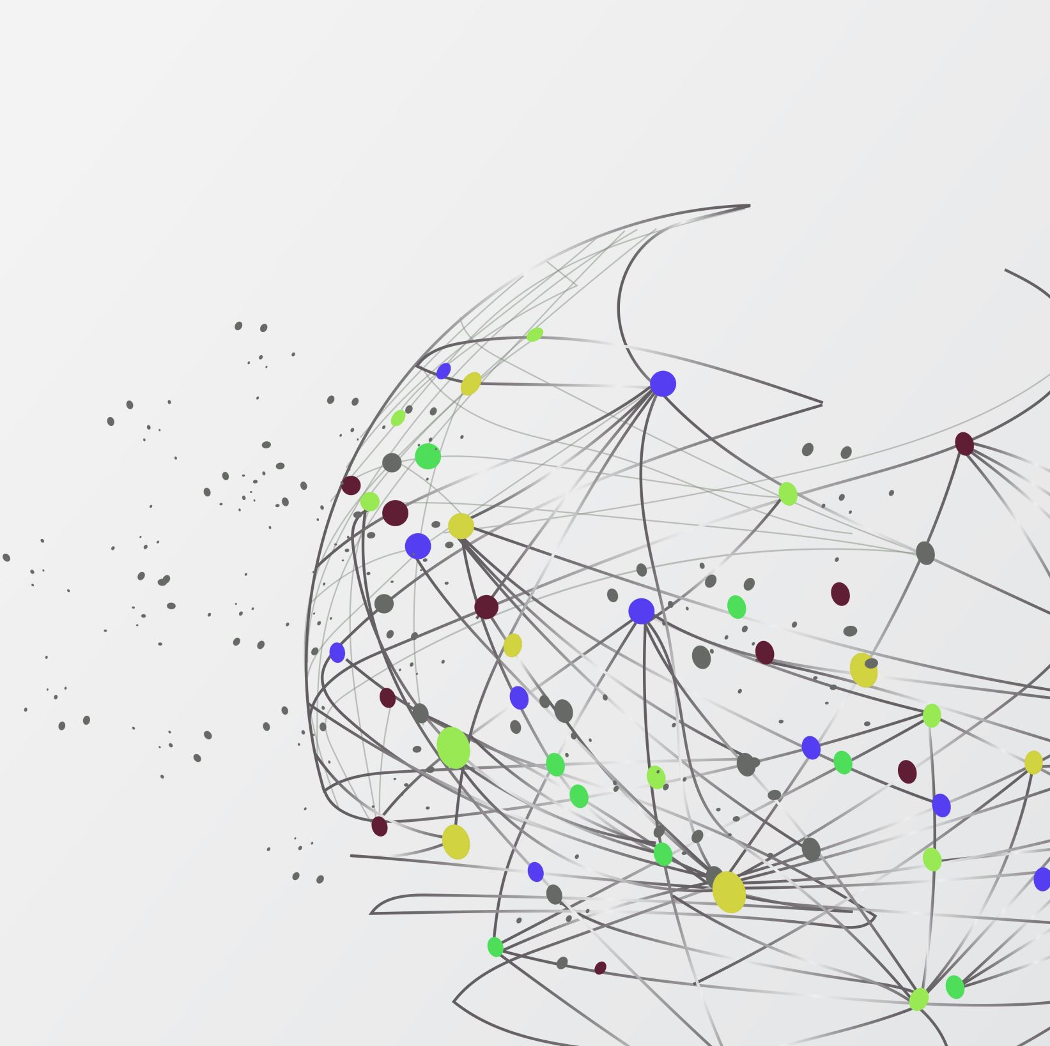
Maintain an open line of communication. Remember no question is dumb

Slide 33
Remember to “Be the One for Veteran Suicide Prevention” and “Be the One For Membership.”

Slide 34
Your Membership Team is here to assist in anyway we can to help you be successful in reaching your 100% goal. We are there for you and all you need to do is ask. As your Department Membership Chair, as well as the Membership team, We would love to see as many Posts, Districts, and Areas achieve 100%. Let’s all put Florida back on the top at National!

Slide 35
$5.00 National Dues Increase July 1st Per Capita will be $34.00 per member

Slide 36
Common Issues this year Not having a mylegion.org account Not using the correct email to create an account Duplicate accounts(more than 1 member number)

Slide 37
When processing memberships or renewing online, make sure you are hitting the correct items (year, one year renewal or auto-renewal) Three-year renewal

Slide 38
mENTORING

Slide 39
Best of luck to everyone. Let’s all hit 100%
Any Questions?

