Slide 1
LEGION COLLEGE December 16, 2023 Jim Wineland, ALR Chair
AMERICAN LEGION RIDERS

Slide 2
ALR Mission
The American Legion Riders are formed to promote the aims and purposes of The American Legion as a family-oriented motorcycling activity for members of The American Legion Family.
To promote motorcycle safety programs and to provide a social atmosphere
for members who share the same Interest.
To participate in events and ceremonies which are in keeping with the aims
and purposes of The American Legion.
To organize and participate in charity events helping our veterans, their families, and the local community.
To use our association to promote and support the programs of The
American Legion.
The ALR is not a motorcycle club (M/C) and does not practice M/C rules or regulations. There is no patching or pledging permitted. An ALR Chapter Member is not permitted to join the "Council of Clubs."

Slide 3
New Chapter
The Post has the interest and commitment of at least Six (6) individuals who are members in good standing of the American Legion Family.
Director
Assistant Director
Adjutant/Finance Officer
Sgt-at-Arms
Road Captain
Chaplain

Slide 4
Developing a Chapter
The Start-Up Officers and other committed Start-Up Members are to adopt the ALR SOP as posted on the ALR Website.
Develop their “Standing Rules”, template on the website.
Send a Copy of the following documents to the ALR Department Adjutant.
Copy of Start-Up Letter, requesting an ALR Chapter, on Post’s letterhead, signed by the Post Commander
Copy of the Post Legionnaire meeting minutes, voting in a new Chapter
Copy of the Chapter’s Standing Rules.
A list of Chapter members to be placed on the Chapter’s Charter

Slide 5
Developing a Chapter – Cont.
Upon final approval and receipt of the Department signed Charter, have the Post Commander and Adjutant sign the Charter
Membership applications will include a liability waiver
Post general membership approve a checking account for your chapter under the EIN issue to the Post
Please Contact our New Chapter Service Officer for assistance

Slide 6
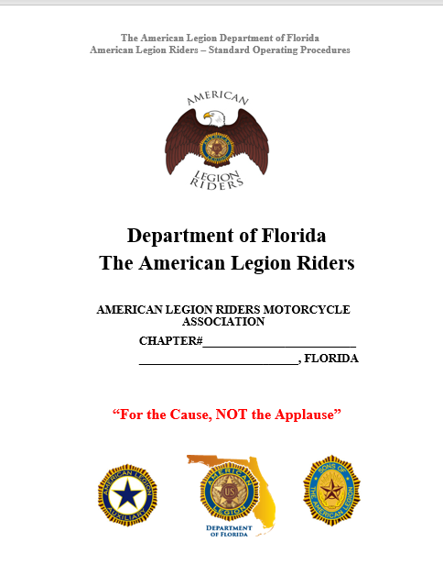
SOP ACKNOWLEDGEMENT & STANDING RULES

Slide 7
FUTURE RIDER PROGRAM
ARTICLE II
AMERICAN LEGION RIDER CHAPTER
Future Rider Members: Chapters may accept future rider members, but at a minimum they must:
Be a Junior member of The American Legion Auxiliary or Sons of the American Legion and identified by a “Future Rider” patch.
The Parent or Legal Guardian must sign the Participant Accident Waiver/Release of Liability form.
Standing Rules
Participant Accident Waiver/Release of Liability

Slide 8
Current ALR Status
Total number of Chapters 135
Estimated total number of Riders 6,000
Total Money Donated yr. 2022 - 2023 $1,183,488
Total miles reported yr. 2022 - 2023 2,659,219

Slide 9
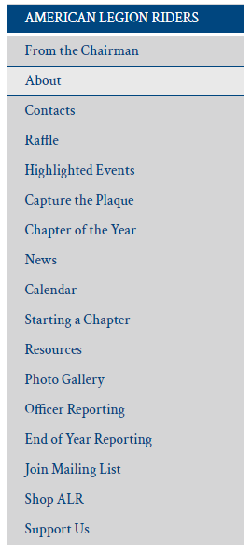
WEBSITE CONTENT https://www.floridalegion.org/programs-services/legion-riders/
Drive Chapters Directors/Riders to the website for Updates, General Information
From the Chairman Article – Monthly
Updated Content & Forms
Chapter of the Year
Capture the Plaque
Presentations/Documents from Summit online for reference
Pictures

Slide 10
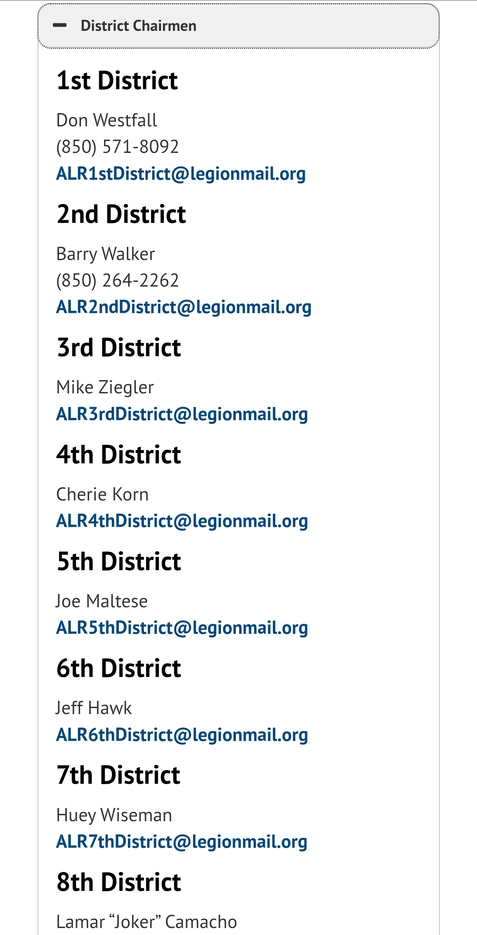
ALR Web Links
The proposal is to create links to each
Districts Web space or Facebook Groups
beside the Districts officers Email addresses
This will allow for more accessibility between the Districts and Chapters for information and events. Once implemented all the contact information per district will be available in one place.
If your District has a Website, or FB page, submit the links to ALR8thDistrict@legionmail.org and we will initiate the process of adding it to the Department site

Slide 12
Motorcycle Safety Education Fund
The Motorcycle Safety Education Bill (SB 838) was signed on May 23, 2023, by Governor Ron DeSantis.
Went into effect on July 1, 2023.
ALR is one of 3 non-profits motorcycle organizations selected. Paperwork submitted and approved.
Promote motorcycle safety by utilizing pamphlets, advertisements, public service announcements, digital media, social media, and websites, and participate in grassroots motorcycle events.
Quarterly Meetings
Phased Approach
Phase I – Establish a Baseline – Research & Goals
Phase 2 –Identify/Develop Deliverables
Phase 3 – Execution in Q2-Q3
Phase 4 – Evaluate – Ongoing

Slide 13
PROGRAM GOALS
SAVE LIVES
Prevent as many Injuries as Possible to Florida Motorcyclists
Create Programs that Benefit All Florida Motorcyclists
Collaborate with other Program Administrators
Increase Safety Awareness
How We Accomplish these Goals
Conduct & Participate Motorcycle Safety Skills, Training & Education
Digital & Social Media Communication
Webinars
Community Engagement
Motorcycle Safety-Themed Events

Slide 14
3 Motorcycle Organizations Selected

Slide 15
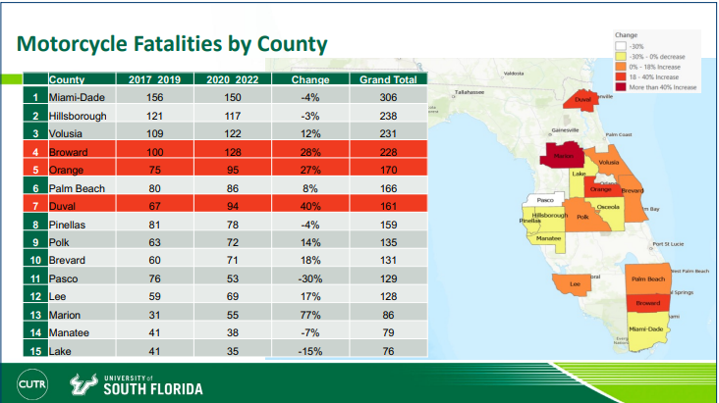
Fatality & Motorcycle Types in Crashes Statistics Provided by: University of South Florida

Slide 16
Fatality & Motorcycle Types in Crashes Statistics Provided by: University of South Florida

Slide 17
Fatality & Motorcycle Types in Crashes Statistics Provided by: University of South Florida

Slide 18
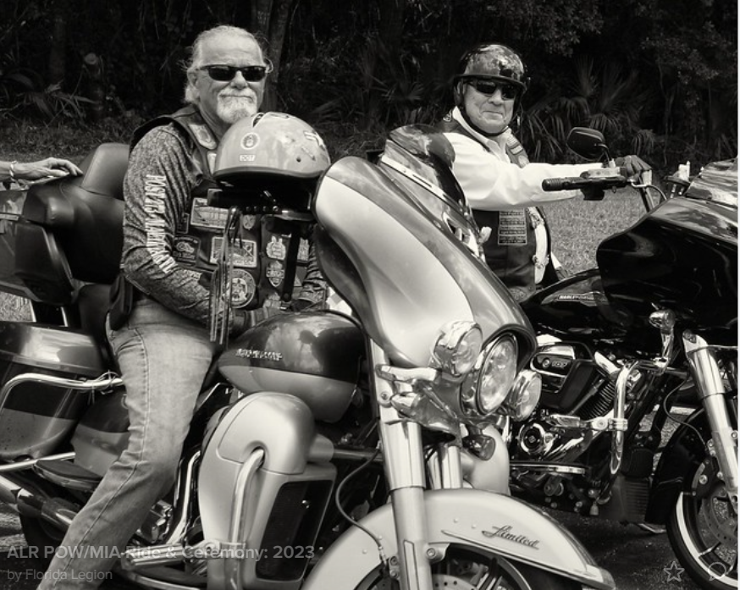
AMERICAN LEGION RIDERS
DEPARTMENT OF FLORIDA
EVENTS SUMMARY TO DATE

Slide 19
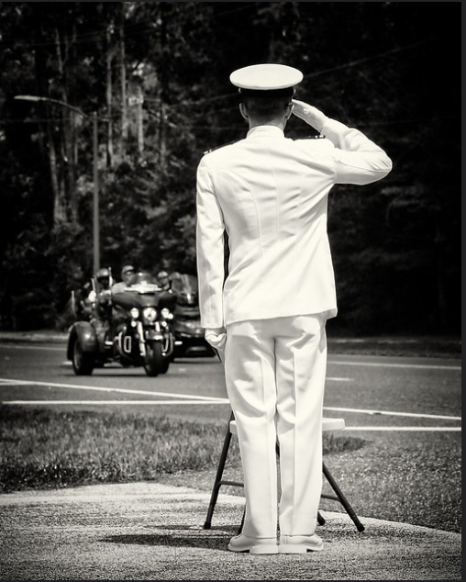
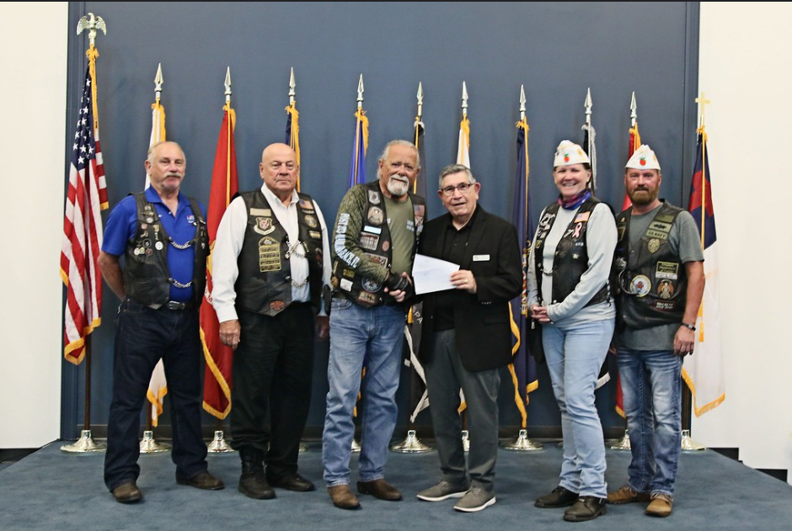
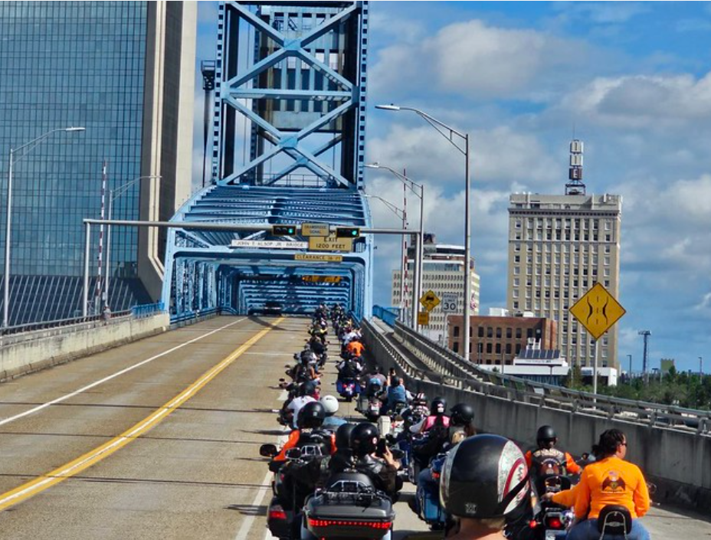
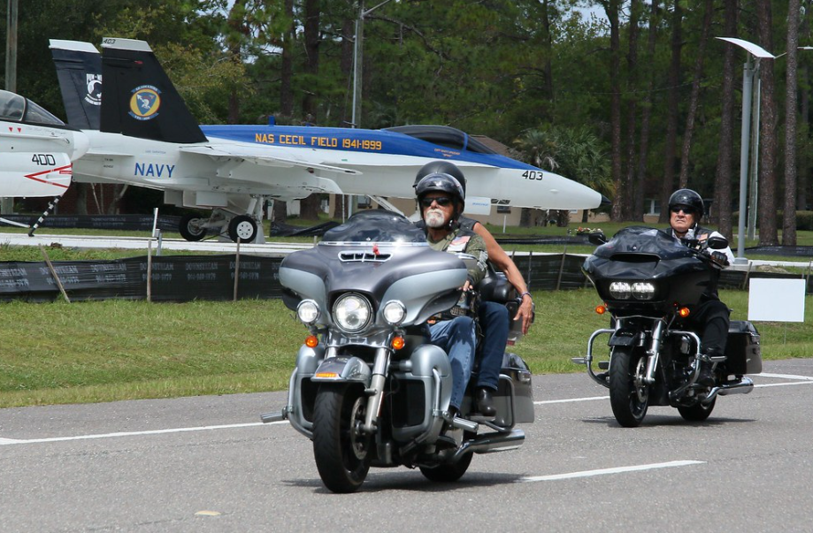
3rd ANNUAL POW/MIA CEREMONY & RIDE
September 16, 2023 - Jacksonville
Ride began @ Adamec Harley Davidson Dealership
7 Bridges Ride – 99.3 Miles – 2 hrs. 20 Mins – JSO Police Escort
Ride ended @ NATIONAL POW/MIA Memorial Park
Jax University NROTC performed the Parade of Colors &
Missing Man Table Ceremony
263 Bikes/Trikes Participated – 361 Participants
Meet & Greet & After Social Event @ Post 283
Total Chapel Donations - $5690.00

Slide 20
2023-2024 SCHEDULE OF EVENTS
Summit, Meet & Greet, January 31, 2024, Classes February 1-3, 2024.
“Round Robin,” Month of April 2024
Children and Youth Picnic, TBD
In-State Unity Ride – Meet & Greet, April 21st. Ride April 22-26.
Rally April 27th. Location OCC Clearwater, Fl.

Slide 21
ALR Summit – January 31st – February 3, 2024
Hotel Information:
NOW BOOKING !!!
Holiday Inn Resort – Lake Buena Vista 13351 State Rd 535 Orlando, FL 32821
Group Code: American Legion Riders 2024 Cut-Off Date: January 1, 2024
1-877-666-3243

Slide 22
In-State Unity Ride April 22-26, 2024
3 Routes – West Coast, Central, East Coast

Slide 23
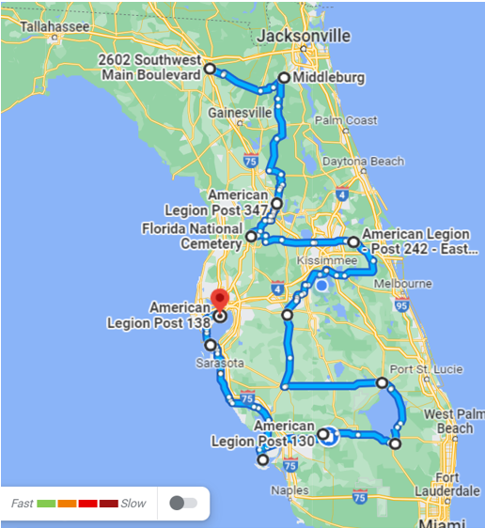
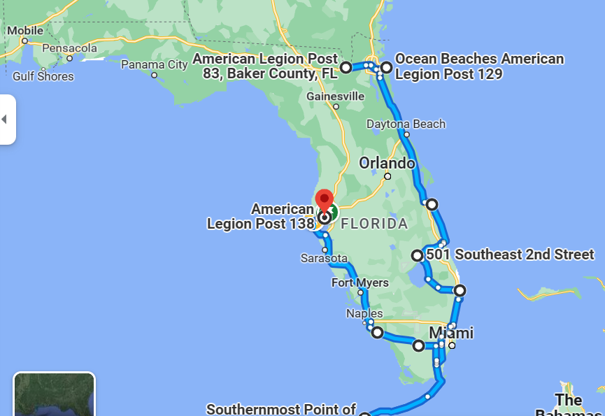
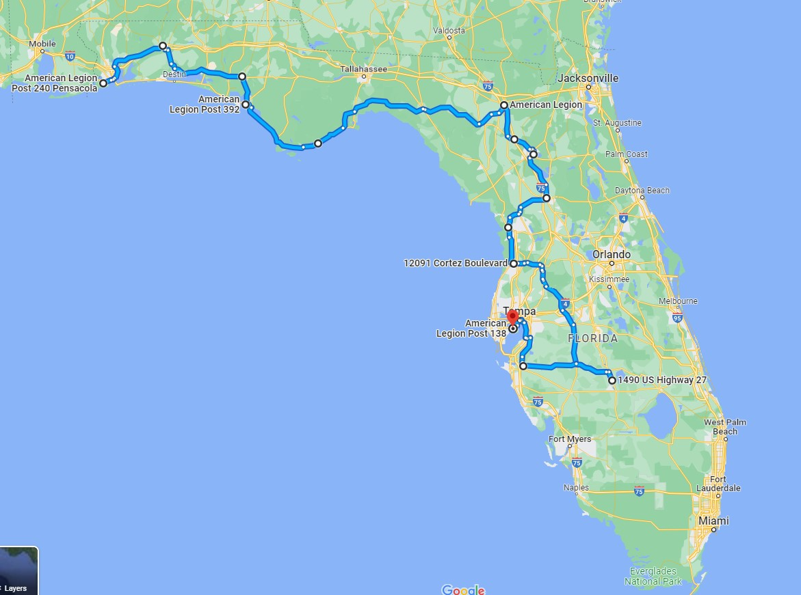
ALR IN-STATE UNITY RIDE Routes Subject to Change – Still in planning stage
Central Route – 1027 Miles
East Coast Route – 1026 Miles
West Coast Route – 765 Miles

Slide 24
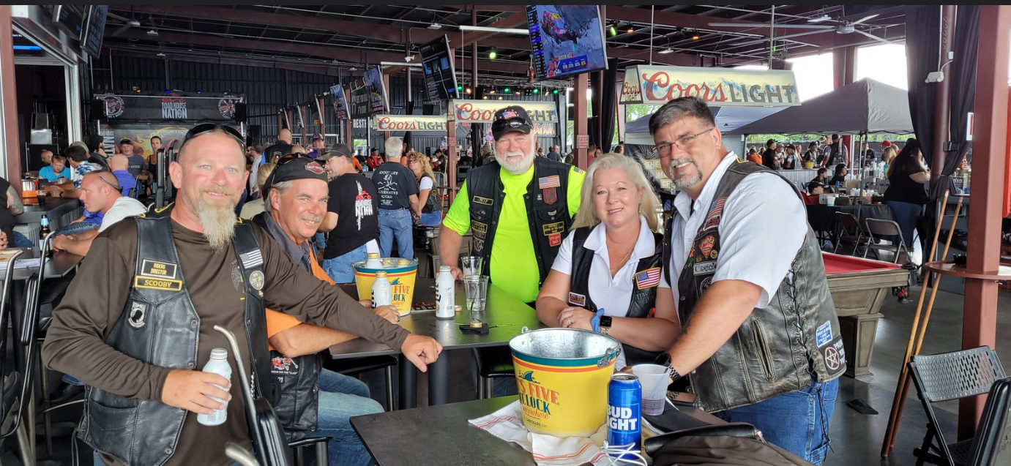
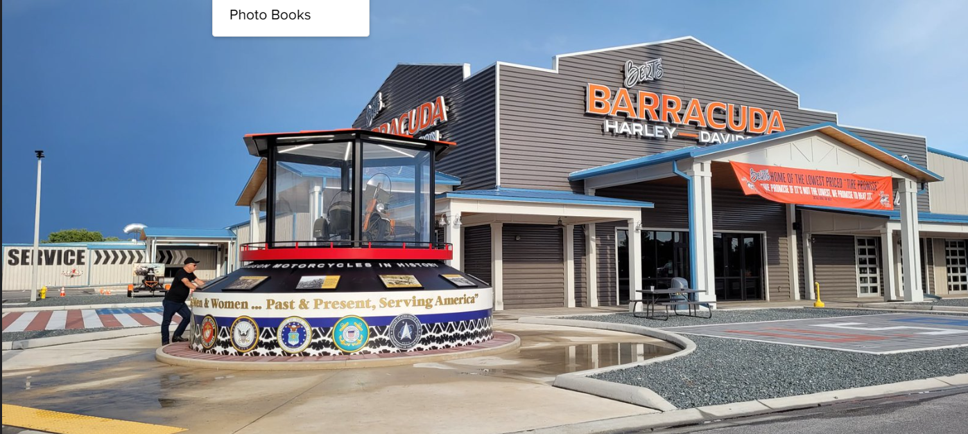
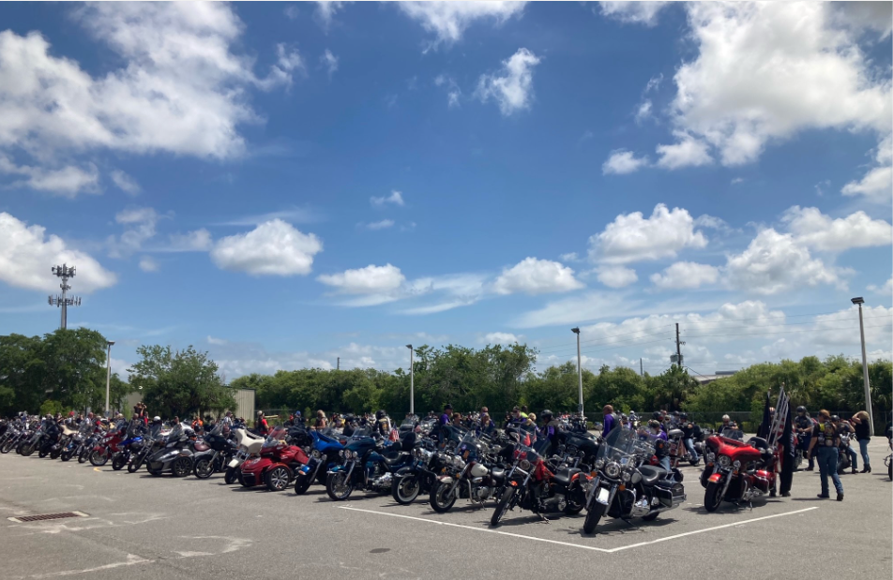
ALR State Rally Update
OCC RoadHouse & Museum
Date & Time – April 27th , 2023 - 12-5pm
Raffles – Chapter/District Donations
Food – Order from the Menu
Entertainment – Band
Vendors – OCC to book

Slide 25
RAFFLE – 2024 STREET GLIDE Online Ticket Sales $20 Per Ticket or 6 for $100
Drawing @ 5pm

Slide 26
PROJECT VET RELIEF/SUICIDE PREVENTION INIATITIVE 2024 GOAL INCREASE BY 10%

Slide 27
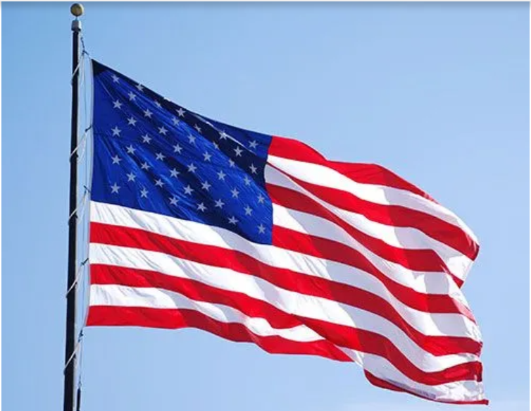
GOD BLESS THE UNITED STATES OF AMERICA

