Slide 1
Fundraising for Nonprofits
Jennifer Cooper
floridalegion.org
Inspired by “The 5 Keys to Successful Fundraising” by Sandra Sims

Slide 2
Overview
Building a Team
Choose the Right Fundraiser
Stay Organized
Follow Through
Raffles
Post Fundraising Opportunity
Notes:
Inspired by materials received at Rollins

Slide 3
Building A Team

Slide 4
Building A Team
Recruit Volunteers
Assign Roles and Responsibilities
Tap into skill sets, relationships or connections
Notes:
Teams lighten the load and distribute duties among several people

Slide 5
Building A Team
Effective Teamwork:
Need a leader
Define each person’s role or responsibility
Communicate often!

Slide 6
Building A Team
Divide into Committees:
Admin/Logistics/Finance
Sponsorships / Ticket Sales
Entertainment
Auction / Raffle
Volunteers
Marketing / Social Media

Slide 7
Choose the Right Fundraiser
(Answering the WHY)

Slide 8
WHY We Need Money
Post needs money to stay in business
Personal motivation
Specific goal you’re working towards (i.e., Send 10 boys to Boys State, fund Post repairs)
For charity – Do your research!
Notes:
1. We all know dues does not fund everything
3. something you’re passionate about, or fill a need of the Post (i.e. a member’s house burned down)
4. Know the ins and outs of the charity. What is their mission or how they help the community. Take a tour of the organization or talk to someone.

Slide 9
WHY People Give
Things they relate to
Personal connections
Emergencies (i.e., Hurricane damage, house fires, etc.)
Interest in improvements or additions
Recognize the brand/mission
In memory or honor of

Slide 10
Choosing the Right Fundraiser
Find something unique but familiar
What resources or connections do you have?
Who’s your audience? What are their interests?
Capture the spirit of your Post
Notes:
Different types of fundraisers – most common = EVENTS, raffles, direct solicitation/mailings
What would they attend or what are their interests?
If your community is already into cornhole, then a Cornhole Tournament might make sense. But if no one has ever heard of cornhole … that’s not the right fundraiser for you.

Slide 11
Stay Organized

Slide 12
Create Goals
Specific amount of money raised
Bring in new members
Sell a certain number of tickets
Special guests in attendance

Slide 13
Set a Budget
Determine if you can support up-front cost
Anticipate how much you could raise
Identify the true cost of the event
See cost-to-profit ratio throughout the planning process

Slide 14
Set a Budget
Revenue (ticket sales, sponsorship, raffles, etc.)
Expenses (food, location, parking, supplies, etc.)
If expenses exceed revenue, is it worth having the event?
Notes:
TRICK QUESTION – maybe! Depends on what your goals are for the event. INVESTMENT?

Slide 15
Budget Example
Income
Expenses
Item | Amount
Ticket Sales | $250
Sponsorships | $1,500
Auction | $600
50/50 Raffle | $300
TOTAL | $2,650
Item | Amount
Entertainment | $300
Printing Costs | $100
Decorations | $150
Food | $500
TOTAL | $1,050

Slide 16
Budget Example
NET = $1,600
Cost Profit Ratio – 60%
Notes:
Is it worth having this event? TRICK QUESTION – depends on what goals you set to accomplish.

Slide 17
Sponsors / Donors
Donated items are budget-relieving
Post Vendors are excellent prospects
Reach out to local businesses
Use your sphere of influence

Slide 18
Develop a Timeline
Start at event date, or deadline and work backwards
Include major and minor details (checklist)
Set deadlines for when things need to be done
Check in periodically to stay on track

Slide 19
Follow Up

Slide 20
Celebrate!
Present proceeds to beneficiary
List accomplishments
Share stories
Complete budget with actual expenses & revenue

Slide 21
Say Thank You
Letter / Personal note
Recognize during event, present award
Print on event materials
Meaningful gift or story on their impact

Slide 22
Evaluate
What worked?
What needs improvement?
How can you make it better?
Do we have the fundraiser again?

Slide 23
Raffles

Slide 24
Raffles
MOST raffles, lotteries, or games of chance are considered gambling and are illegal…
Exception for qualifying nonprofits (our loop-hole)
Notes:
- we just have to adhere to certain rules

Slide 25
Raffle Disclaimer
We are NOT attorneys,
BUT…

Slide 26
Raffles – Fees / Pricing
NO fees = can not say someone is required to pay for a raffle ticket
Violation – “Tickets cost $100”
Correct – “a suggested donation for a ticket is $100”

Slide 27
Raffles – Materials
Must properly display following information on EVERY brochure, advertisement, entry form, etc.
Source of funds used for award prizes
Date, hour and location where the winner is selected
Outline rules and regulations governing contest
Name group/business who will benefit from proceeds
Notes:
No literature or advertisement may be misleading, false, or deceptive.

Slide 28
Raffles – Winners
Must be selected at random
Illegal to remove, disqualify, reject, or otherwise discriminate based on whether the entrant paid or not
No minimum number of tickets
All prizes must be awarded
Winners must be notified in a timely manner
Notes:
Can’t require X number of tickets to win

Slide 29
Post Opportunity Dept. 50/50 Raffles

Slide 30
50/50 RAFFLE FUNDRAISER
50/50 RAFFLE FUNDRAISER

Slide 31
REVENUE BREAKDOWN
10%
50%
40%
FEES
WINNER
DEPT/POST
Rafflebox
Transaction
Dept – 30%
Post – 10%*
*Participating Posts Only
Notes:
10% off the top.. Then 50% of net proceeds.. And Dept/Post share the remaining

Slide 32
REVENUE SHARE
POST
40%
10% of tickets submitted supporting Post
$500 bonus for Winner’s Post
DEPT
Unrelated Business Taxes
Advertising
Marketing Materials
Early Bird Winner ($1,000)
Administrative Personnel
Notes:
10% of gross revenue, not net
Proceeds given on a quarterly basis

Slide 33
WHO IS ELIGIBLE?
Florida participants
Do NOT have to be Legion Member
18 years or older
US residents
Legion Staff not eligible

Slide 34
LEGAL MATTERS
Prize Pool vs. Jackpot
“Half the Cash”
Ticket submission vs. purchase
Free entry
Notes:
Sought legal advice and are legally compliant

Slide 35
MARKETING MATERIALS
Department Supplied
Posters / Flyers
Business Cards
Coasters
Table-Top Displays

Slide 36
HOW TO PROMOTE
Utilize Marketing Items
Share on Social Media (Post & Personal)
Post on Apps (Nextdoor, Ring, etc.)
Put in Post newsletter
Email to friends/family
Share during meetings/events
Display Ticker on TV/Monitor
Host a Watch Party for Drawing
Notes:
Table tops, restrooms, events

Slide 38
CUSTOM LINK
WWW.FLORIDA5050.ORG/XX

Slide 39
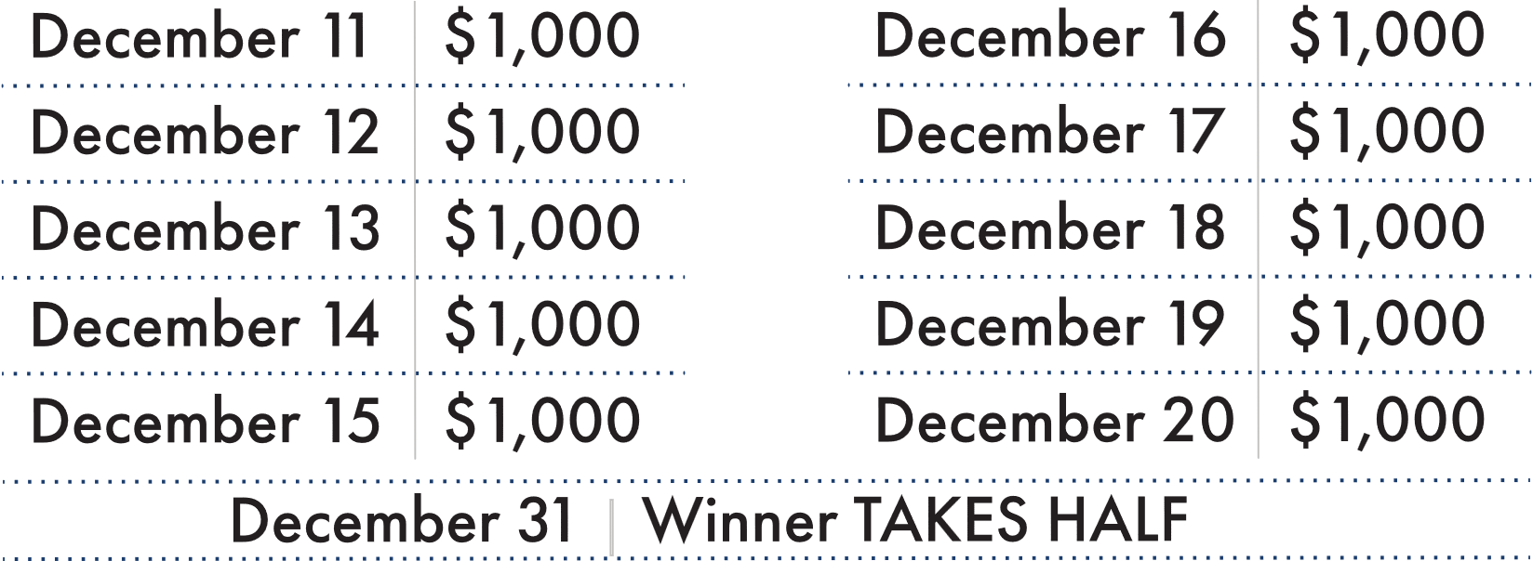
Post Proceeds:
25%

Slide 40
Questions?

