Slide 1
Welcome to Florida American Legion College
2023-2024
floridalegion.org

Slide 2
Finance Officer Role:
Do’s & Don’ts of the Class
Agenda is Subject to Change
No Phone Calls and/or Texting during Class
Be on Time
Let the Instructor Finish before asking Questions
Always Work as a Group
Respect Each Other like Professionals

Slide 3
Overview
National
Function & Operations
Jim Ramos

Slide 4
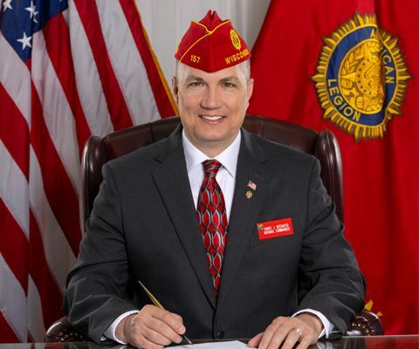
Post Finance Officer’s Charge
2023 – 2024
National Commander
Daniel J. Seehafer (WI)
“Be The One” to prevent veteran suicide.

Slide 5
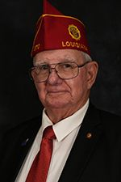
Finance Officer Role:
2023 – 2024
Southeast Region National Vice Commander
Charles D. Aucoin (LA)

Slide 6
Department
Function & Operations
Bruce Comer
Department Adjutant
floridalegion.org

Slide 7
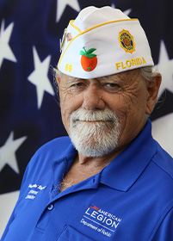
2023 – 2024
Department Commander
Michael Raymond
floridalegion.org

Slide 8
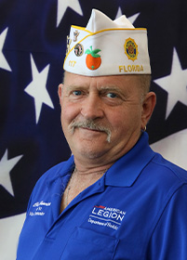
2023 – 2024
1st Vice Commander
Chris Hamrick
floridalegion.org

Slide 9
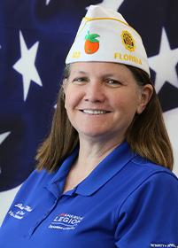
2023 – 2024
2nd Vice Commander
Jessica Moore
floridalegion.org

Slide 10
Meet the staff
floridalegion.org

Slide 11
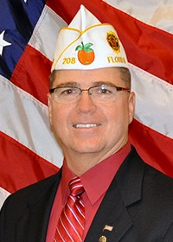
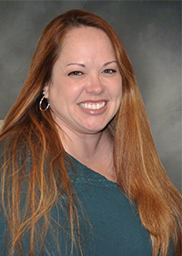
Bruce Comer Department Adjutant
Rachel Castleberry Executive Assistant
6 ½ Years of Dedication
15 ½ Years of Dedication
Office Manager – Meet with staff on regular basis, monitor duties, provide support
HR – Primary contact for staff, request, issues and complaints
Post Issues – Guidance and assistance
Support – Adjutant & Asst. Adjutant with Dept and Post compliance
Post Constitution & Bylaws
Post Properties
Congressman Legislative Business
Deadlines – Monitor Deadlines for meetings, DCC, EC/FC, amendments/resolutions
Event Oversight – Provide assistance, address issues during Department Events
Collaborate – provide opinions, suggestions, and review various projects at Dept.
Minutes – Record for Executive and Finance committees
Executive Information - For Department Convention and Fall Conference
Travel – arrange travel and record keeping
Administrative – Assist with other administrative needs of Dept.
floridalegion.org

Slide 12
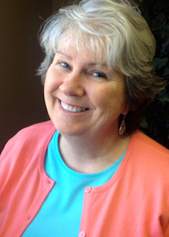
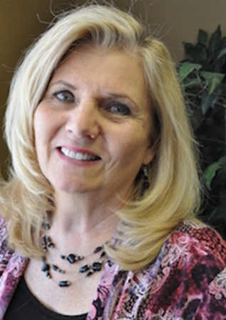
JoAnn Collins Membership Director
Bobbi Halle Finance Director
11 Years of Dedication
14 ½ Years of Dedication
Processing– Process membership for Legion and SAL
Reporting – Provide statements and reporting for membership
Transmittals – Process transmittals to National
Expenses – Process and verify expense reports for officers / chairmen
Reporting – Produce financial reports requested
Financials – manage all financial transactions including accounts
Awards – Reporting and tracking of membership awards
New Post– Prepare and distribute kits to new posts
Supplies – Fulfill requests for membership supplies and information
Customer Service – Facilitate membership questions and issues
receivable, accounts payable, expense management, fixed assets, general ledger entries and deposits
HR – Research and manage employee benefits, tracking employee time and processing payroll
floridalegion.org

Slide 13
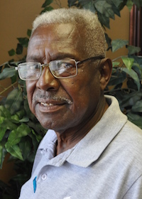
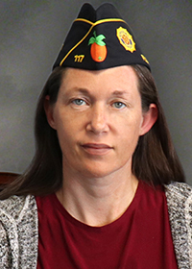
Willie Leonard Maintenance
Bekki Tibbs Programs Director
54 Years of Dedication
5 Years of Dedication
Maintenance– Maintains Department buildings and fixtures as required
Vendors – Meets with maintenance vendors
Security – Monitors security of Department property
Materials – Provide and manage program materials and manuals
EOY – Provide end of year mailings and manage CPR’s
Programs – Oversee and provide support for 27 Legion Programs
Errands – Runs mail to and from Post office, picks up supplies as needed
Awards – Review and manage program trophies and awards
PSO – Manage registration and support for Service Office School
Administrative – Prepare Dept Roster, SAL Roster, provide stationary to officers and chairmen
floridalegion.org

Slide 14
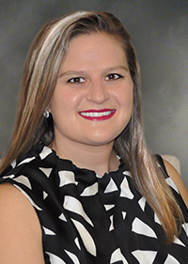
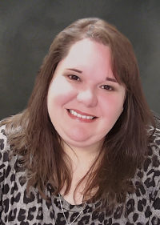
Jennifer Cooper Fundraising Director
Carrie Kolze Creative Services Manager
9 Years of Dedication
7 Years of Dedication
Database– Manage fundraising databases, membership database needs and PROJECT: VetRelief’s database.
Caging – Caging donations and raffle donations, oversee fundraising vendors
Creative – Design and provide creative for all Dept needs: promo items, coins, pins, marketing materials, agendas, signs, etc
Social Media – Maintain and create content for all social media platforms
Direct Mail – Oversee vendors, review and provide recommendations on provided content
Communication – Communicate via email/letters with donors, manage donor relationships, communicate with Dept heads on progress and provide feedback based on research
PROJECT: VetRelief – Oversee administrative duties, reporting, create marketing materials, maintain website and social media, resolve issues, manage caseworkers, communicate with board, provide promotional materials, serve as board secretary
Website – Maintain and create content for Dept Website
Emblem Sales – Manage online store, administrative and assist with ordering, creating/designing new products
Branding – Create and maintain consistent branding throughout Dept.
Publications – Layout and oversee Legion Link, create press releases as needed, create forms
Technology – Provide direct support with technology issues and needs at Dept and Dept events.
floridalegion.org

Slide 15
February 2023

Slide 16
Post Complaints
Bruce Comer
Department Adjutant
The American Legion Department of Florida
February 2023

Slide 17
Recent
Issues
Text here.
February 2023

Slide 18
Reasons
Personality Conflicts
Management Style Conflicts
Allegations of a Financial Nature
Typically involve the Post Canteen
…occasionally are legitimate violations of Constitution and By-Laws
Post
Complaints
February 2023

Slide 19
Handled by Post Leadership whenever possible
District Commander involvement;
When Post fails to properly address issue
When deals with issue within upper echelon of Post leadership
Provide advice/recommendations directly to the Post
Provide mediation when needed
Resolutions
February 2023

Slide 20
Requirement
Written complaint
Detailed and include violation(s) and evidence (if possible)
Current paid Member of Post
Department Commander Actions
Seeks advice of Executive Committee, PDC Committee or Finance Committee when Executive Committee not in session
Additional action required, PDC Committee in conjunction with District Commander, will take action and provide specific detailed guidance for management of all Post affairs (NOTE: Management should be returned as soon as possible)
ALL COSTS WILL BE INCURRED BY THE POST
Further
Actions
February 2023

Slide 21
POST INVESTIGATION FLOWCHART
IAW ByLaws Article IV, Section 7
Member has complaint and requests Department Investigation
Received by Phone or Email
Letter Received
Referral to Post leadership and District Commander or write formal letter asking for Department investigation
Letter sent to Post requesting response to allegations. Department Commander determines if investigation is needed
Investigation Not Needed
A letter is generated informing the individual of the decision and referral to Post leadership
Letter Received
Investigation Authorized
Department Commander consults the Internal Affairs Chair to send a member of the commission from another District to investigate and provide recommendations
Further Investigation Needed
District Commander conducts preliminary investigation and provides mediation if possible
District Commander provides report on investigation and resolution to Department Commander
Resolved
Unresolved
A report is provided to the Department Commander detailing the outcome of the investigation
Department Commander, with advice from the Executive, PDC, or Finance Committee, directs Post officers to take corrective actions
Final report provided by investigators
Unresolved
Resolved
Unresolved
Resolved
Resolved
Final report provided by investigators
PDC Committee in conjunction with the District Commander will take action to resolve the situation
Resolved
February 2023

Slide 22
Post Finance Officer’s Charge
Scenario Presentations
by Districts

Slide 23
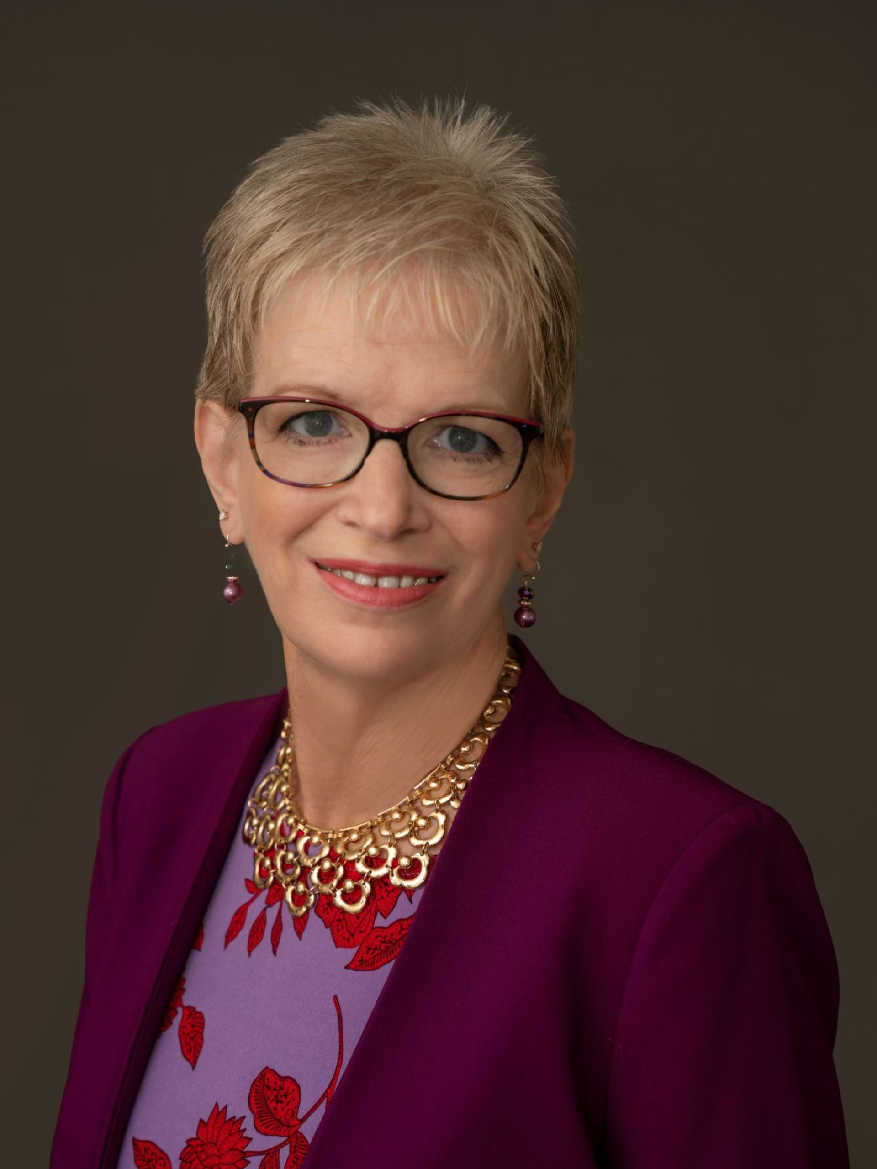
2023 – 2024
Department Auxiliary President
Dee Bell
Bells in Service

Slide 24
Programs overview
Bekki Tibbs Programs Director
01
floridalegion.org

Slide 25
Americanism Programs
An unfailing love of country, loyalty to its institutions and ideals, eagerness to defend it against all enemies, individual allegiance to the flag, and a desire to secure the blessings of liberty to ourselves and our posterity.
There are a number of programs that fall under Americanism, many of which have their own program chairs.
01
floridalegion.org

Slide 26
Americanism Programs
Operation Comfort Warrior
American Legion Baseball*
Scouting*
Youth Law Cadet*
Junior Shooting Sports*
Boys State/Boys Nation*
High School Oratorical*
School Medals*
American Education Week
Veterans in the Classroom
Scholarships*
Citizenship Outreach
Get Out the Vote
Flag Education

Slide 27
American legion baseball
Senior State Tournament – 19-23 July 2023
Junior State Tournament – 28-30 July 2023
One of the major youth activities of Americanism, teaching citizenship through organized recreation, loyalty, respect for the rules and decisions, fair play, courage, and physical fitness.
floridalegion.org

Slide 28
Boys state
79th Florida American Legion Boys State – 18-24 June 2023
A weeklong program for male high school juniors to learn about the rights, privileges, duties and responsibilities of a franchised citizen through lecture and hands-on activities to build the “51st State.”
floridalegion.org

Slide 29
High school oratorical
Department Contest – 25 February 2023
National Contest – 21-23 April 2023
A two-part speech contest, presenting participants with a challenge that teaches important leadership qualities, the history of law, the ability to think and speak clearly, and an understanding of the duties, responsibilities, rights, and privileges of American citizenship.
floridalegion.org

Slide 30
Junior shooting sports
National Contest – 20-23 July 2023
Provides gun safety and marksmanship training for young people, age 14-18, as well as offering opportunities for competitive shooting.
floridalegion.org

Slide 31
Youth law cadet
Youth Law Cadet Week– 09-14 July 2023
A weeklong program providing young men and women with hands-on experiences with insight into the operations of law enforcement agencies.

Slide 32
Children & Youth
The belief that every child should have a home, should have health, education, character, and opportunity.
01
floridalegion.org

Slide 33
Blood Donor
Contributing to the health and welfare of the community, helping to keep thousands alive after major operations, accidents, or medical problems.
01
floridalegion.org

Slide 34
Scouting
Posts supporting Units (charted or sponsored), continuing the over 100-year tradition of veterans bringing their skills and experience to help build character and positive traits in our country’s youth.
01
floridalegion.org

Slide 35
Employer Awards
Recognizing individuals and companies who employ and retain veterans, workers with disabilities, and older workers.
01
floridalegion.org

Slide 36
JROTC
Supporting the future’s top military leaders by assisting local high school, college, and university ROTC units.
01
floridalegion.org

Slide 37
Law & Order
Fostering a strong sense of law and order by recognizing outstanding law enforcement officers, firefighters, and EMT/paramedics.
01
floridalegion.org

Slide 38
Legion Riders
Legion, Auxiliary, & SAL members raising money and participating in memorial ceremonies and community parades while on motorcycles.
01
floridalegion.org

Slide 39
POW/MIA
Honoring the memory of POWs and MIA personnel during ceremonies and supporting the Joint POW/MIA Accounting Command.
01
floridalegion.org

Slide 40
School Medals
Designed to place emphasis on the qualities of courage, honor, leadership, patriotism, scholarship, and service in K-12 schools and universities.
01
floridalegion.org

Slide 41
Women Veterans
Assisting female veterans in transitioning to civilian life and dealing with physical and mental health issues.
01
floridalegion.org

Slide 42
End of Year Awards
Included with all Program & End of Year packets, available online.
Greater understanding of Post participation beyond CPR/Addendum statistics.
Deadline 03 March 2023.
01
floridalegion.org

Slide 43
Fundraising for Nonprofits
Jennifer Cooper
floridalegion.org
Inspired by “The 5 Keys to Successful Fundraising” by Sandra Sims

Slide 44
Overview
Building a Team
Choose the Right Fundraiser
Stay Organized
Follow Through
Raffles
Post Fundraising Opportunity
Notes:
Inspired by materials received at Rollins

Slide 45
Building A Team

Slide 46
Building A Team
Recruit Volunteers
Assign Roles and Responsibilities
Tap into skill sets, relationships or connections
Notes:
Teams lighten the load and distribute duties among several people

Slide 47
Building A Team
Effective Teamwork:
Need a leader
Define each person’s role or responsibility
Communicate often!

Slide 48
Building A Team
Divide into Committees:
Admin/Logistics/Finance
Sponsorships / Ticket Sales
Entertainment
Auction / Raffle
Volunteers
Marketing / Social Media

Slide 49
Choose the Right Fundraiser
(Answering the WHY)

Slide 50
WHY We Need Money
Post needs money to stay in business
Personal motivation
Specific goal you’re working towards (i.e., Send 10 boys to Boys State, fund Post repairs)
For charity – Do your research!
Notes:
1. We all know dues does not fund everything
3. something you’re passionate about, or fill a need of the Post (i.e. a member’s house burned down)
4. Know the ins and outs of the charity. What is their mission or how they help the community. Take a tour of the organization or talk to someone.

Slide 51
WHY People Give
Things they relate to
Personal connections
Emergencies (i.e., Hurricane damage, house fires, etc.)
Interest in improvements or additions
Recognize the brand/mission
In memory or honor of

Slide 52
Choosing the Right Fundraiser
Find something unique but familiar
What resources or connections do you have?
Who’s your audience? What are their interests?
Capture the spirit of your Post
Notes:
Different types of fundraisers – most common = EVENTS, raffles, direct solicitation/mailings
What would they attend or what are their interests?
If your community is already into cornhole, then a Cornhole Tournament might make sense. But if no one has ever heard of cornhole … that’s not the right fundraiser for you.

Slide 53
Stay Organized

Slide 54
Create Goals
Specific amount of money raised
Bring in new members
Sell a certain number of tickets
Special guests in attendance

Slide 55
Set a Budget
Determine if you can support up-front cost
Anticipate how much you could raise
Identify the true cost of the event
See cost-to-profit ratio throughout the planning process

Slide 56
Set a Budget
Revenue (ticket sales, sponsorship, raffles, etc.)
Expenses (food, location, parking, supplies, etc.)
If expenses exceed revenue, is it worth having the event?
Notes:
TRICK QUESTION – maybe! Depends on what your goals are for the event. INVESTMENT?

Slide 57
Budget Example
Income
Expenses
Item | Amount
Ticket Sales | $250
Sponsorships | $1,500
Auction | $600
50/50 Raffle | $300
TOTAL | $2,650
Item | Amount
Entertainment | $300
Printing Costs | $100
Decorations | $150
Food | $500
TOTAL | $1,050

Slide 58
Budget Example
NET = $1,600
Cost Profit Ratio – 60%
Notes:
Is it worth having this event? TRICK QUESTION – depends on what goals you set to accomplish.

Slide 59
Sponsors / Donors
Donated items are budget-relieving
Post Vendors are excellent prospects
Reach out to local businesses
Use your sphere of influence

Slide 60
Develop a Timeline
Start at event date, or deadline and work backwards
Include major and minor details (checklist)
Set deadlines for when things need to be done
Check in periodically to stay on track

Slide 61
Follow Up

Slide 62
Celebrate!
Present proceeds to beneficiary
List accomplishments
Share stories
Complete budget with actual expenses & revenue

Slide 63
Say Thank You
Letter / Personal note
Recognize during event, present award
Print on event materials
Meaningful gift or story on their impact

Slide 64
Evaluate
What worked?
What needs improvement?
How can you make it better?
Do we have the fundraiser again?

Slide 65
Raffles

Slide 66
Raffles
MOST raffles, lotteries, or games of chance are considered gambling and are illegal…
Exception for qualifying nonprofits (our loop-hole)
Notes:
- we just have to adhere to certain rules

Slide 67
Raffle Disclaimer
We are NOT attorneys,
BUT…

Slide 68
Raffles – Fees / Pricing
NO fees = can not say someone is required to pay for a raffle ticket
Violation – “Tickets cost $100”
Correct – “a suggested donation for a ticket is $100”

Slide 69
Raffles – Materials
Must properly display following information on EVERY brochure, advertisement, entry form, etc.
Source of funds used for award prizes
Date, hour and location where the winner is selected
Outline rules and regulations governing contest
Name group/business who will benefit from proceeds
Notes:
No literature or advertisement may be misleading, false, or deceptive.

Slide 70
Raffles – Winners
Must be selected at random
Illegal to remove, disqualify, reject, or otherwise discriminate based on whether the entrant paid or not
No minimum number of tickets
All prizes must be awarded
Winners must be notified in a timely manner
Notes:
Can’t require X number of tickets to win

Slide 71
Post Opportunity Dept. 50/50 Raffles

Slide 72
50/50 RAFFLE FUNDRAISER
50/50 RAFFLE FUNDRAISER

Slide 73
REVENUE BREAKDOWN
10%
50%
40%
FEES
WINNER
DEPT/POST
Rafflebox
Transaction
Dept – 30%
Post – 10%*
*Participating Posts Only
Notes:
10% off the top.. Then 50% of net proceeds.. And Dept/Post share the remaining

Slide 74
REVENUE SHARE
POST
40%
10% of tickets submitted supporting Post
$500 bonus for Winner’s Post
DEPT
Unrelated Business Taxes
Advertising
Marketing Materials
Early Bird Winner ($1,000)
Administrative Personnel
Notes:
10% of gross revenue, not net
Proceeds given on a quarterly basis

Slide 75
WHO IS ELIGIBLE?
Florida participants
Do NOT have to be Legion Member
18 years or older
US residents
Legion Staff not eligible

Slide 76
LEGAL MATTERS
Prize Pool vs. Jackpot
“Half the Cash”
Ticket submission vs. purchase
Free entry
Notes:
Sought legal advice and are legally compliant

Slide 77
MARKETING MATERIALS
Department Supplied
Posters / Flyers
Business Cards
Coasters
Table-Top Displays

Slide 78
HOW TO PROMOTE
Utilize Marketing Items
Share on Social Media (Post & Personal)
Post on Apps (Nextdoor, Ring, etc.)
Put in Post newsletter
Email to friends/family
Share during meetings/events
Display Ticker on TV/Monitor
Host a Watch Party for Drawing
Notes:
Table tops, restrooms, events

Slide 79
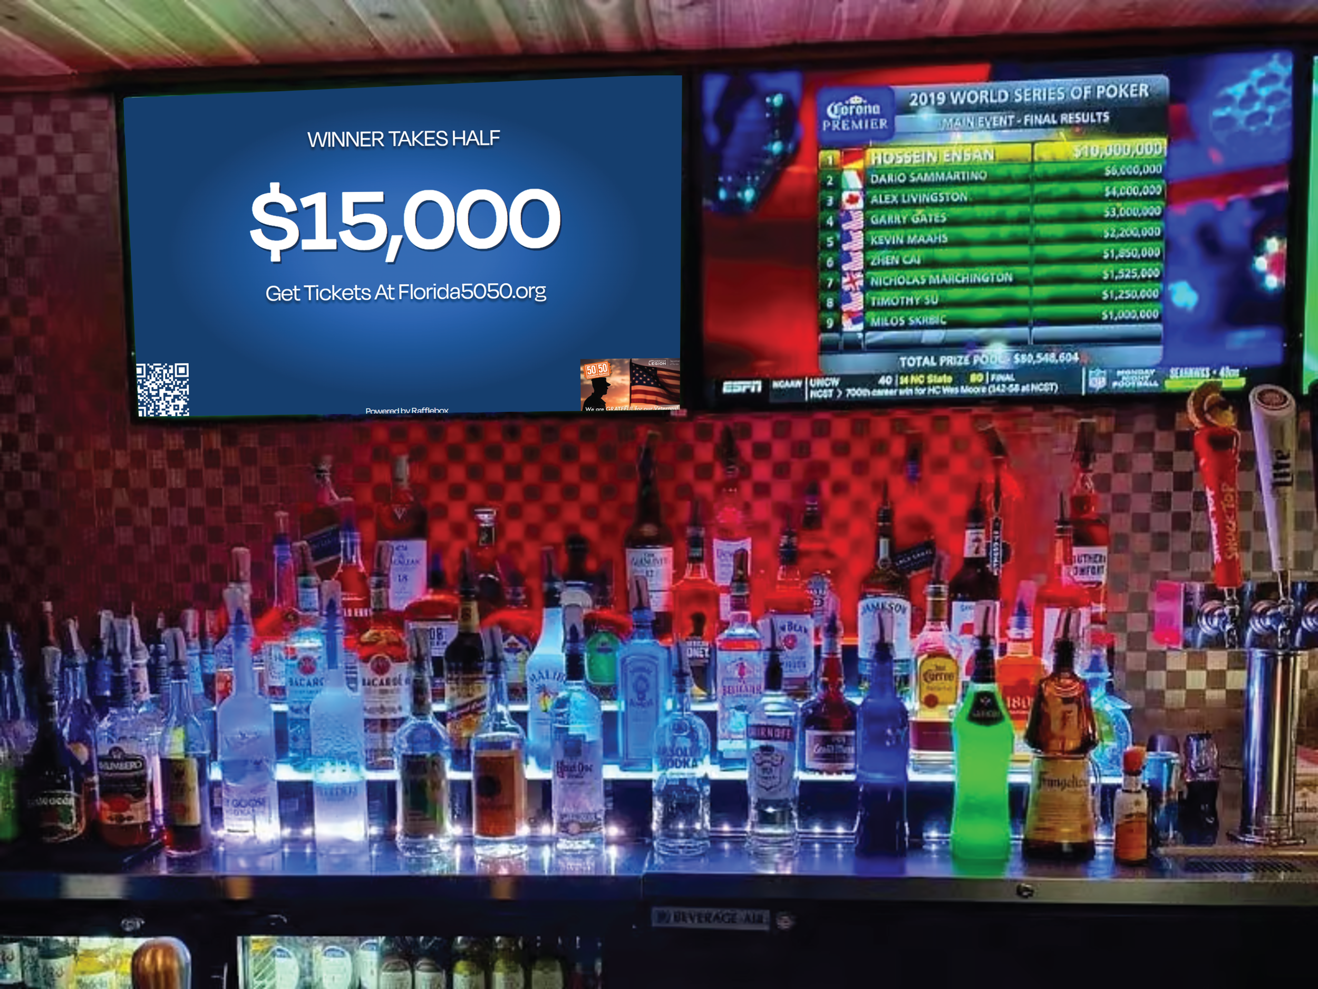

Slide 80
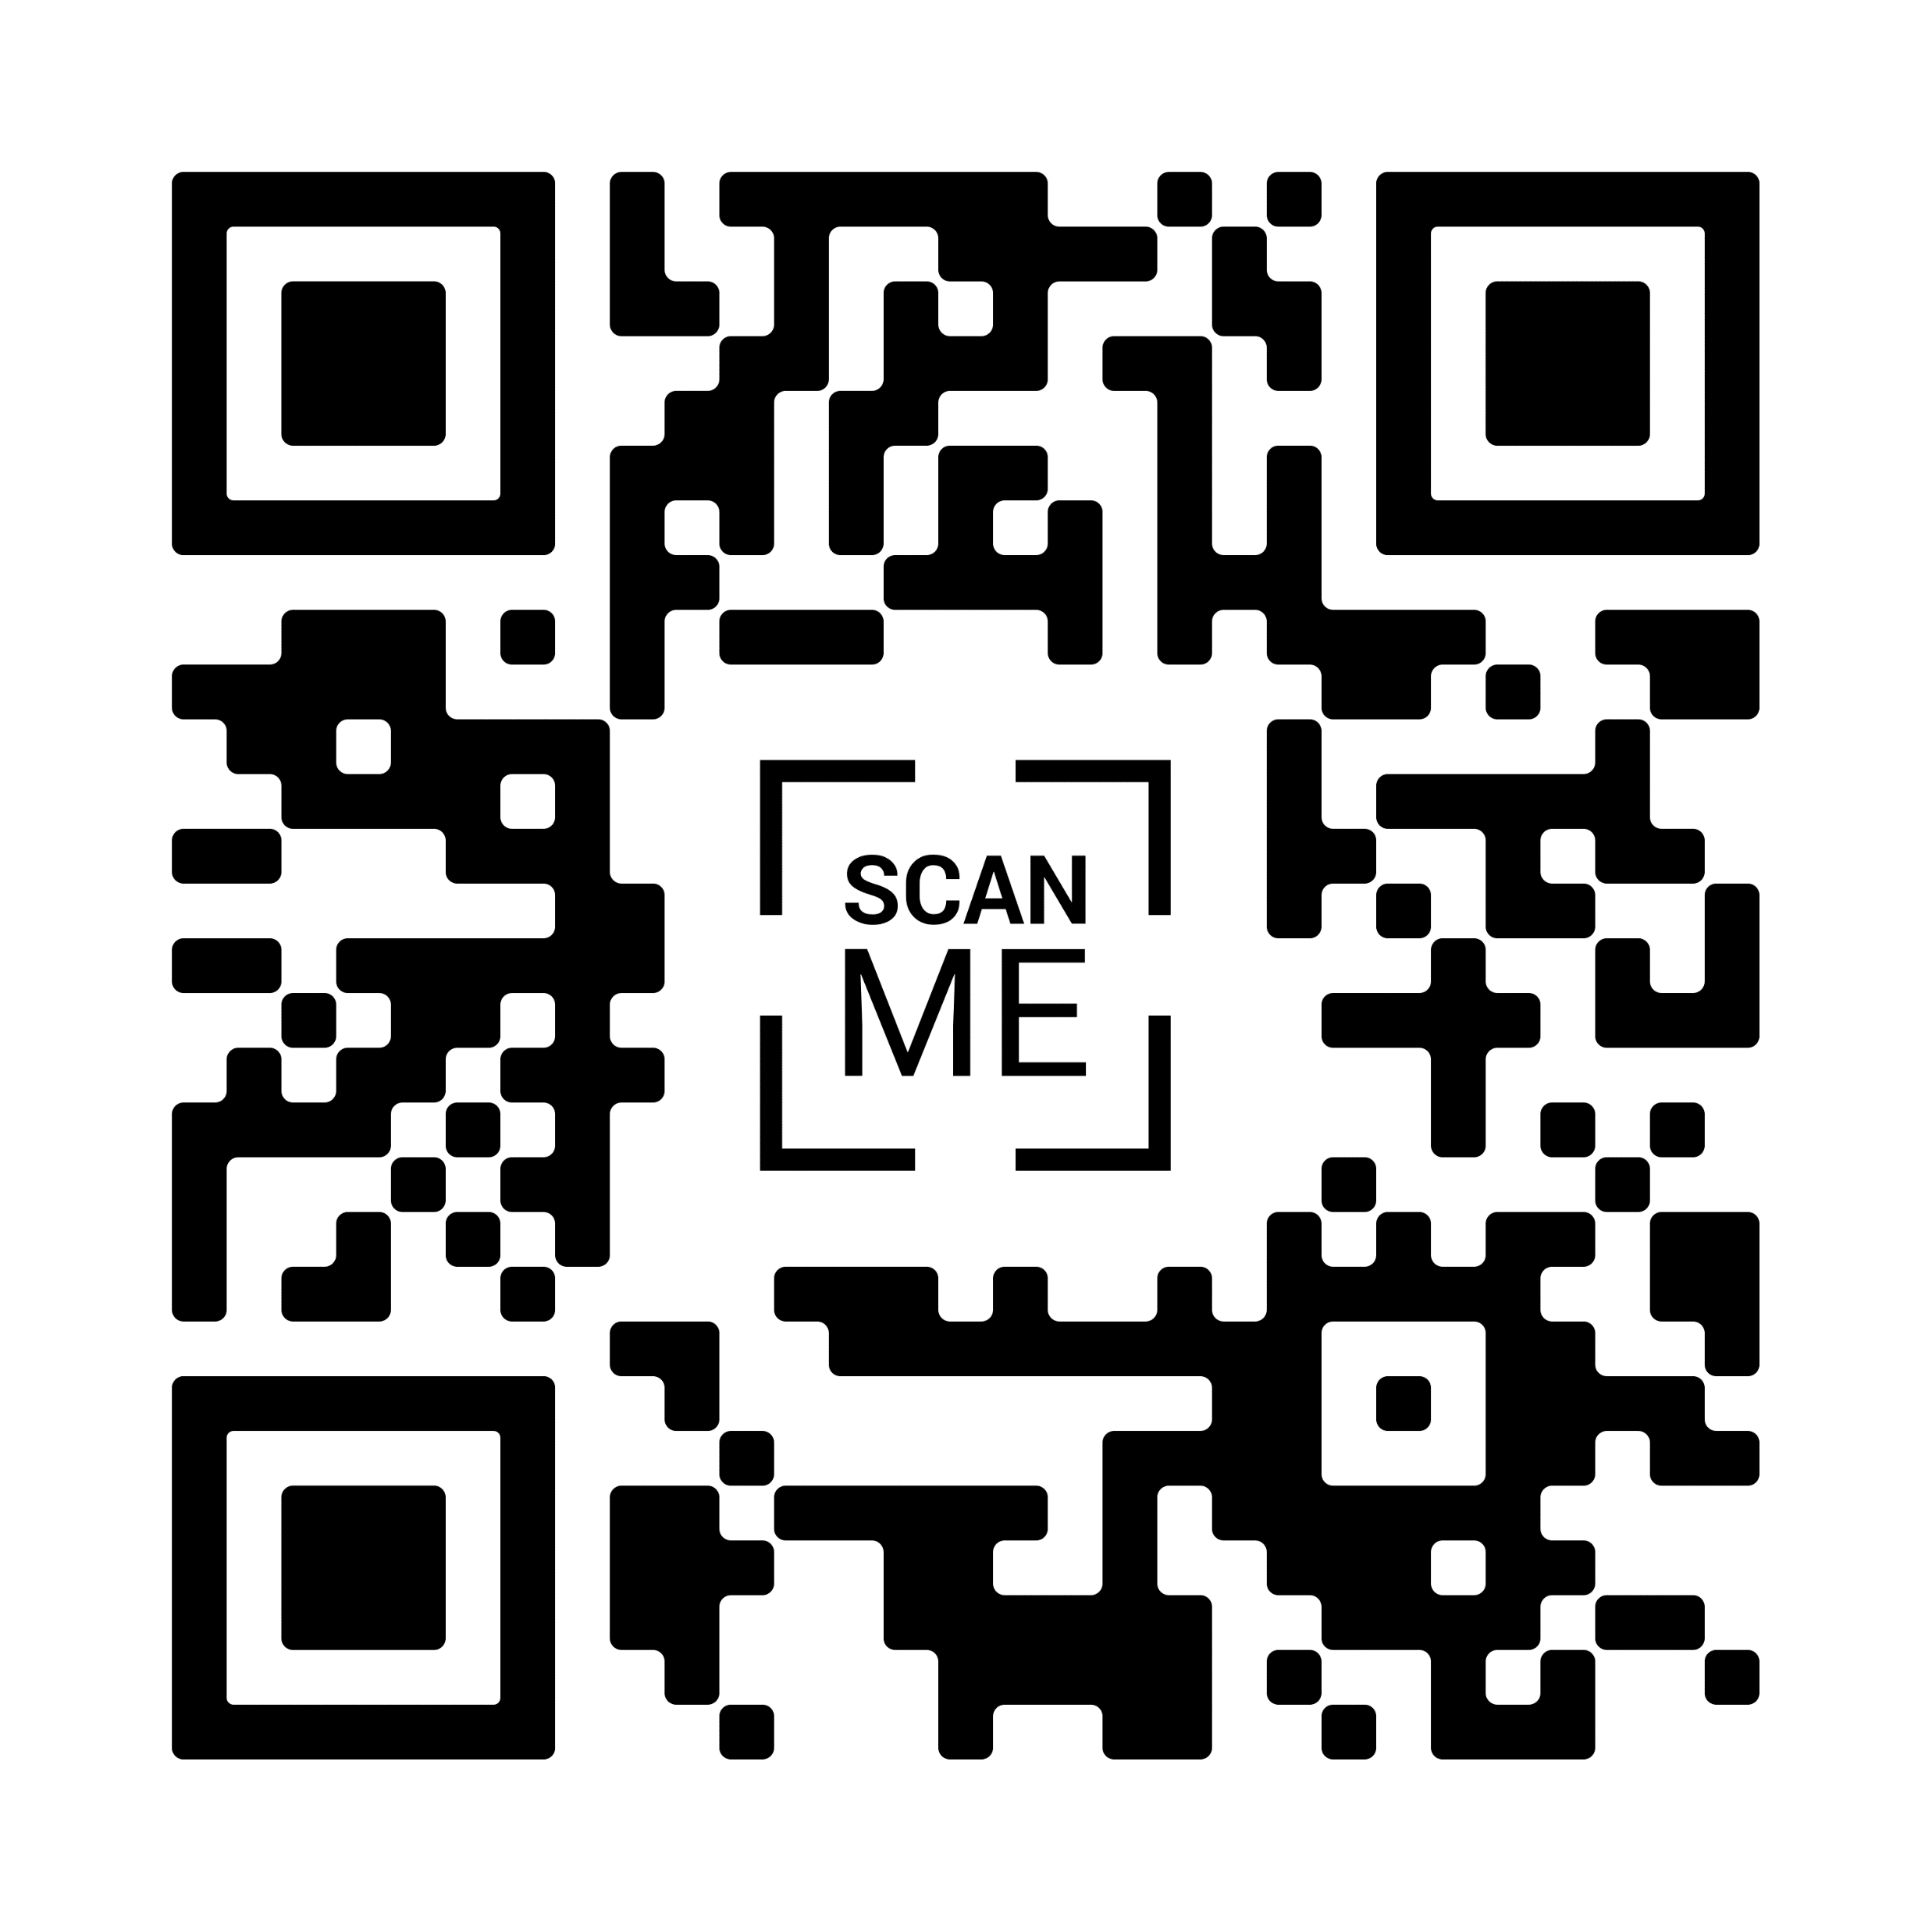
CUSTOM LINK
WWW.FLORIDA5050.ORG/XX

Slide 81
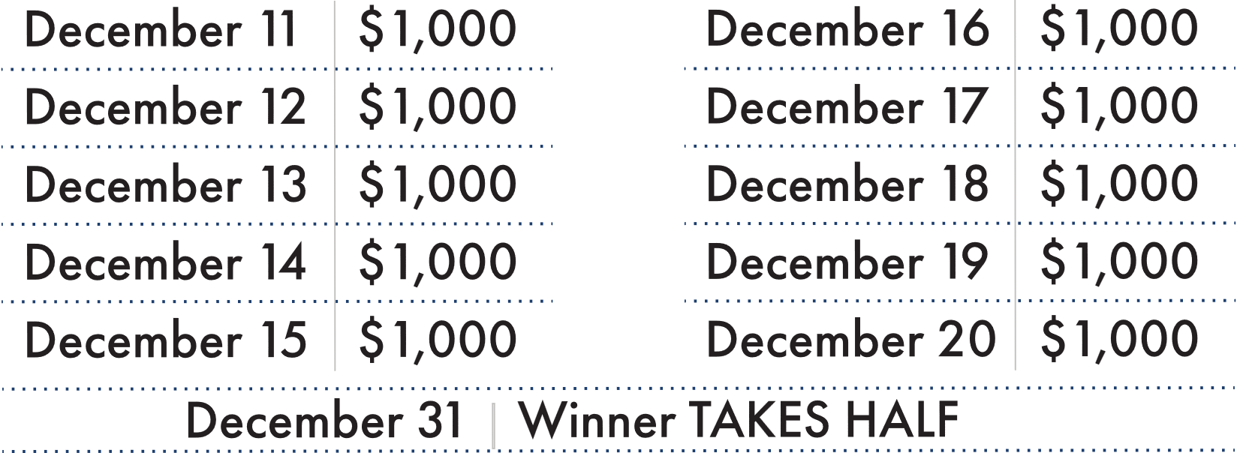
Post Proceeds:
25%

Slide 82
Questions?

Slide 83
Overview
Creating a
Mission Statement
Loreen Skobel
Stuart Scott

Slide 84
Post Finance Officer’s Charge
Mission Statement?
Why should each post have one?
Focus
Purpose
Goals
Notes:
The ultimate purpose in having a mission statement to provide a rememberable statement that anyone can recite of our your post’s mission

Slide 85
Finance Officer Role:
Focus
What is YOUR post’s purpose
What programs do you support
How do you support the community
Needs supported
Notes:
What does your post do and how do you support your community
If you close your doors tomorrow, will your post be missed

Slide 86
Overview
Purpose
Crafting words to articulate the:
Values
Personality
Notes:
When crafting your mission statement, can you easily identify your values and the post’s personality?

Slide 87
Post Finance Officer’s Charge
Goals
How does your post influence the community
Direct support you provide
Substantial veteran support
Notes:
Craft the mission statement of your post, better yet, can you craft The Department of Florida’s Mission statement?

Slide 88
Finance Officer Role:
Bruce Carl
Membership Chair
Membership

Slide 89
floridalegion.org

