Slide 1


Welcome to Florida American Legion College
2023-2024
floridalegion.org

Slide 2


Finance Officer Role:
Do’s & Don’ts of the Class
Agenda is Subject to Change
No Phone Calls and/or Texting during Class
Be on Time
Let the Instructor Finish before asking Questions
Always Work as a Group
Respect Each Other like Professionals

Slide 3
Overview
Successful District
Commanders
Lena Heredia-Perez
How to develop Posts / Post Leadership Effectively

Slide 4
Post Finance Officer’s Charge
District Function
Notes:
Why does the District Level Exist?
Especially in large departments, the district/county level represents a more "approachable" link in the chain of command. Bringing questions or issues to the district level often get results quicker than awaiting department or national answers.
Represents Posts (Members) to Department.
Segway into CB&L’s: Most district commanders have voice/vote on Department Executive Committee (DEC). Post votes are compiled and submitted by the district at Department Convention.
Resolutions passed by post members are approved and submitted by district to the department
Conducts a review of many post/member issues on behalf of the department
Implements department policies with posts
Other? -- Any local issues needing attention

Slide 5
Finance Officer Role:
ENFORCEMENT
versus
SUPPORT
Notes:
We've all heard the expression, "You can catch more flies with honey than with vinegar." A heavy hand is rarely needed to encourage post leadership to conduct their business properly. Showing them your support by proper training is best practice.

Slide 6

Overview
District Authority
Notes:
District authority is derived from the Department Executive Committee.
Post probation/suspension/cancellation can only be determined by vote of DEC
Most posts are incorporated as separate corporations
Post participation is best accomplished through motivation vs. mandate
Don’t tell me to do something, ask me to do something.
Don’t micromanage

Slide 7

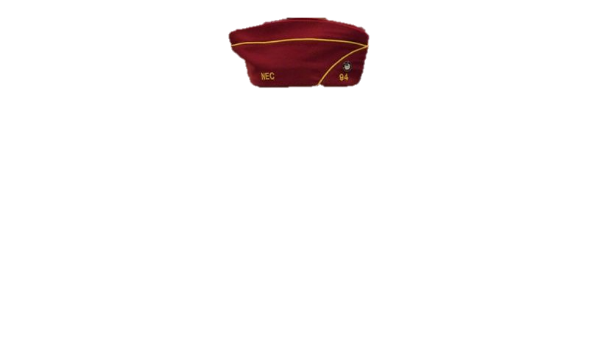


Post Finance Officer’s Charge
District Training
Notes:
National Headquarters and your Department can help you find proper training resources. Each district should choose universal training topics and some more specific to its needs:
Function of the district in the organization
Authority of district officers
Creating a purpose/vision for the district.
Using training to resolve post related issues
Getting posts to turn in reports on time
Building an on-going legacy
What can District Hosted Training do to help resolved Post issues?
Answer: Most issues can be helped through proper training. A robust training program implemented at the district or county level will go a long way to ensure your members become ambassadors for your post.

Slide 8
Finance Officer Role:
Identify factors veterans in the District are struggling to overcome.
Support dysfunctional posts who want help by providing district mentors.
Start new posts in geographic areas not represented by functioning posts.
Promote recruitment events and practices best serving the needs of veterans.
Notes:
Each district should choose universal training topics and some more specific to its needs:
Function of the district in the organization
Authority of district officers
Creating a purpose/vision for the district.
Using training to resolve post related issues
Getting posts to turn in reports on time
Building an on-going legacy

Slide 9
Overview
Reporting Requirements:
Government
Local
State
Federal
American Legion
Post Data Report
Consolidated Post Report
Post Financial Audits
Certification of Officers
Dues Transmittals
Notes:
What reports/forms are posts required to submit?
Keep track of which reports are required by your state, department, and national headquarters.

Slide 10
Post Finance Officer’s Charge
Develop a legacy of support
Develop a strategic plan to grow the District.
Notes:
A good strategy will stand the test of time. As your local market changes, these plans could be a constant.

Slide 11
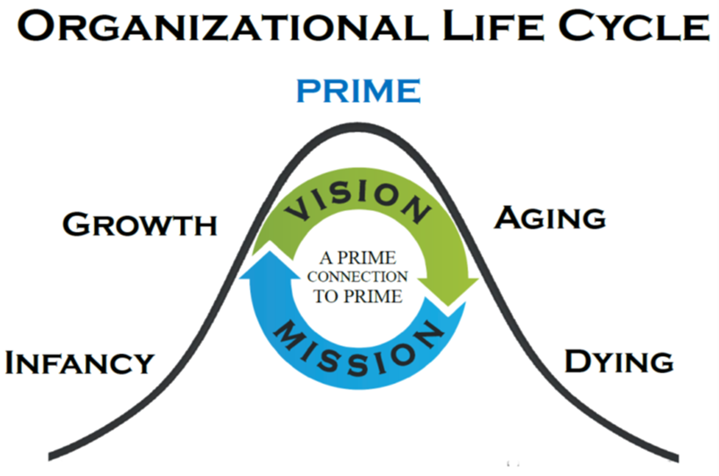
Finance Officer Role:
Notes:
Implement and adjust the plan
Continuity is key. Give the plan time to work and adjust it as necessary.

Slide 12
Overview
Successful District Commanders
Membership is key
Remember that your members are volunteers
Recognize your members/posts that have volunteered
Communicate, Delegate, Adjust
Have FUN!

Slide 13



floridalegion.org

Slide 14
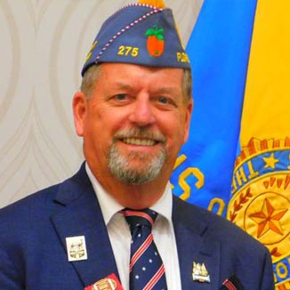

Post Finance Officer’s Charge
2023 – 2024
Department Sons of The American Legion
Gerard Sambets (Squadron 275)
“Remember always Veterans First”

Slide 15
Finance Officer Role:
Public Relations
Loreen Skobel
Notes:
Implement and adjust the plan
Continuity is key. Give the plan time to work and adjust it as necessary.

Slide 16
2023
DEPARTMENT
LEGISLATIVE
Stuart Scott
floridalegion.org

Slide 17



Where to go?
Notes:
Our National webpage has information about our National agenda in congress. Make sure you have signed up for Alerts! You can also find out via your address who is your representative in Congress. Report a meeting with one of them or their aids as well as see all the legislation that we are tracking.

Slide 18
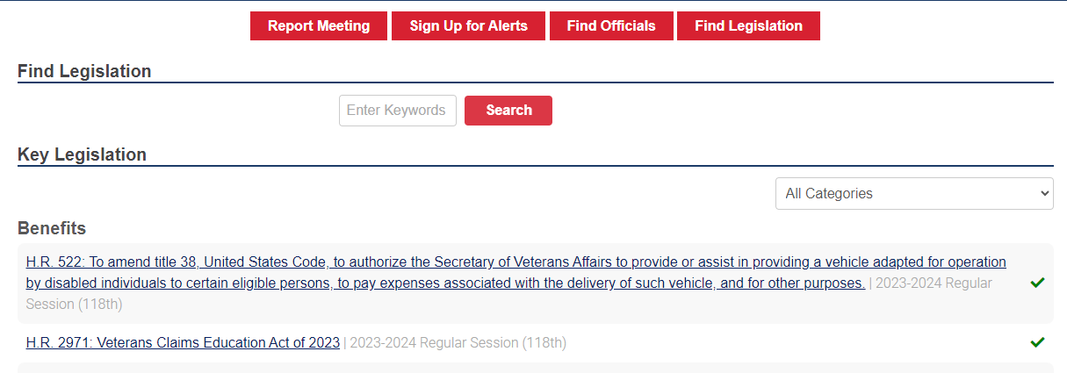
What to look for?
Notes:
The legislative process is designed to ensure that the needs of all political viewpoints and geographic regions are considered. Therefore, the need to appreciate political realities is paramount.
Review the legislation that we as The American Legion is tracking. You will see check marks for what we are in a positive standpoint, a dash if we are nutreal or an X if we are against this legislation.

Slide 19
Assumptions
They may or may not know anything about us
Inform them about yourself and our organization
Be prepared to explain in detail
Use layman terms to make it easy
Notes:
Heading the list of mistakes people make in communicating with their legislator is the assumption that the member will know who they are or what they are talking about.
First and foremost, identify yourself and describe your organization.
Secondly, be prepared to explain your legislative interest in sufficient detail so that the legislator will be able to act on your behalf. Explain your problem, the present situation, and propose a solution. Offer to answer any questions they may have.
If you make it easy for the legislator to act on your issue, you increase your chances of success. If you leave the member with a poor understanding of your issue and no proposed solution, you have wasted your time.

Slide 20
When?
Time is a commodity
Legislative Assistants are valuable
Visit your legislator at their home district office
Notes:
Appreciate that during legislative session time is a scarce commodity.
The typical legislator is assigned to several committees and subcommittees. This means the member is extremely busy dealing with a wide variety of issues.
Do not feel put off by meeting with a legislative assistant. The assistant is responsible for monitoring legislation and budget and advising the member. The assistant may be more knowledgeable about your issue and have the time to sit down with you and listen.
The best way to avoid the scheduling pitfalls of Tallahassee is to establish a relationship with the legislator in their home district. Visit with them and explain your issue prior to the beginning of session. It is much easier to follow-up than educate.

Slide 21
How?
Leave behind written materials
Be concise and factual
Short and sweet
Avoid unnecessary disclosure of information
Notes:
Although the overall intelligence level in the Legislature is high, both members and staff often misunderstand oral presentations.
This results from time constraints, unfamiliarity with the topic, and sometimes from a low priority being given to your issue.
The most effective way of assuring that your oral presentation is not misunderstood is to commit it to writing in a concise and factual manner.
The document should be no longer than one page and should include a brief explanation of the issue, your name, the name of the organization, and where to contact you.
There are some types of information that should not be shared with a legislator. This information is irrelevant to the legislative process or is likely to be misunderstood or misinterpreted.
For example, if you have experienced problems in dealing with a particular person in an agency do not complain about that person unless you are asking the legislator to do something about it.
A remark or comment unintentionally made, or made and overheard by a legislator, may undermine your case and the image of your organization.

Slide 22
Are we Political?
Legislative
The Legislative Division is governed by a full commission, and promotes the organization’s positions and recommendations to Congress, the White House, and federal departments and agencies. The division coordinates support efforts on Capitol Hill, and advises state legislative councils as they deliver the Legion message across the country. An annual portfolio of priorities is produced and presented to Congress from the national commander and chairmen of the Veterans Affairs & Rehabilitation and Legislative commissions. The portfolio, based on national resolutions, serves as a guide for volunteers and staff to use when meeting with elected representatives. The Legislative Action Center gives members an online gateway of information to track bills and follow developments in Washington.
Notes:
We are a political organization, what we ARE NOT is a partisan organization. There is a major difference.

Slide 23
State vs. Congress
Do not confuse the U.S. Senate and U.S. House of Representatives with the Florida Senate and the Florida House of Representatives
Definitely do not confuse the bills filed
Notes:
Name the US Rep’s and Senate in Florida
28 US Reps
2 US Senators

Slide 24
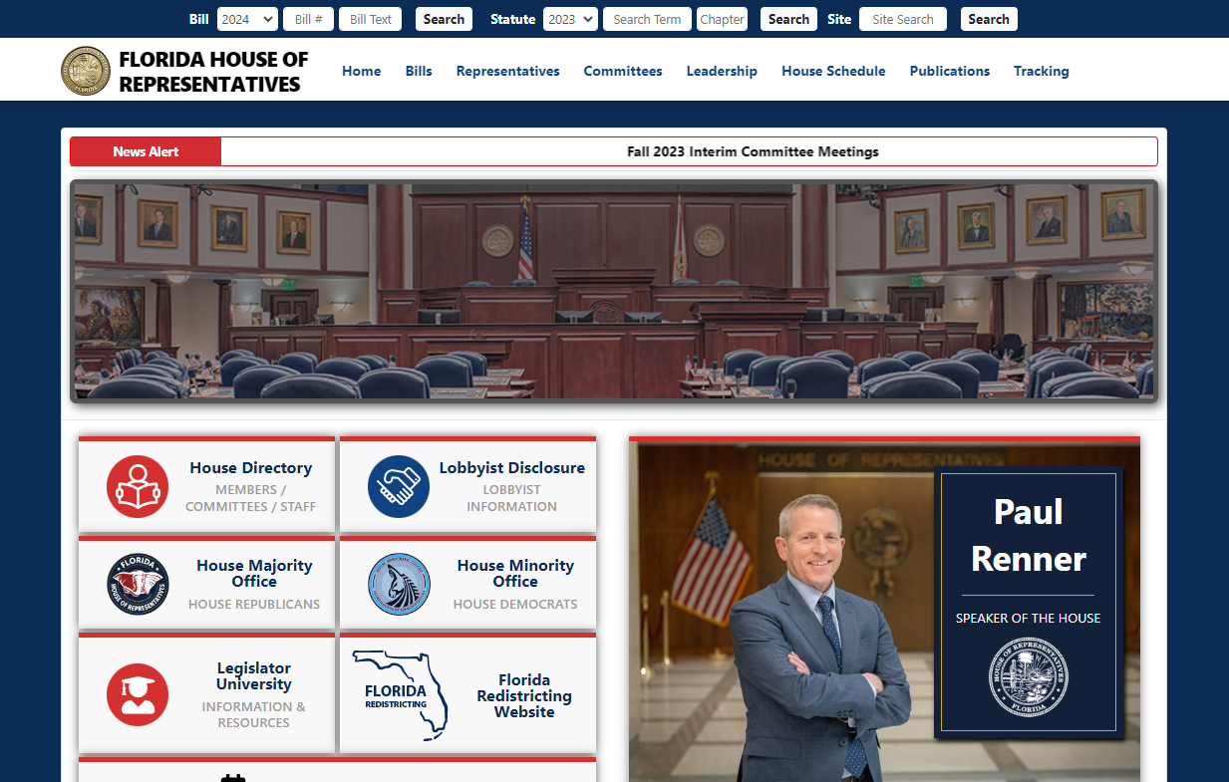
How to Locate YOURS
Notes:
Both of these sites have search engines that will assist you in finding your Rep or Senator

Slide 25
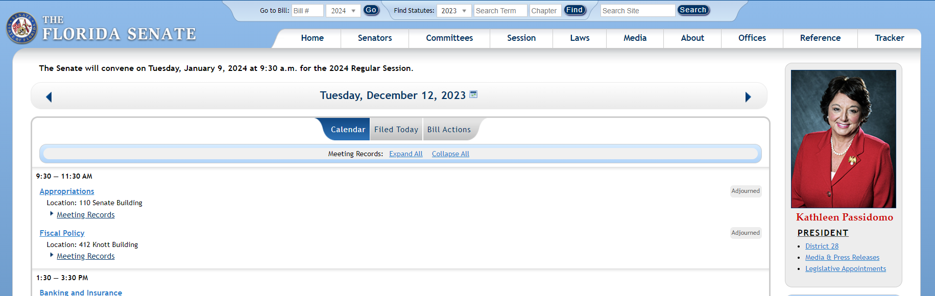
How to Locate YOURS
Notes:
Both of these sites have search engines that will assist you in finding your Rep or Senator

Slide 26
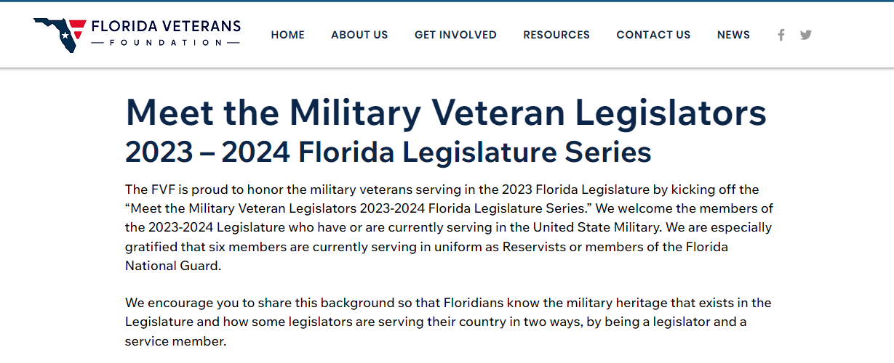
Veteran Legislators!?!
Do we have Florida Veteran Legislators?
Why yes we do!!!
Notes:
We currently have 21 either still active or prior military;
Can be found on the Florida Veterans Foundation’s webpage with their BIO.
1 Coast Guard; 4 USAF and USMC; 8 Army/Guard; 4 Navy to include the Speaker of the FL House of Rep. (Palm Coast)

Slide 27
Allowables
As a 501 (c) organization we have limitations
We must provide an equal opportunity to ALL
Do not indicate a preference for or against
NO fundraising for any candidate
Notes:
Can you ask someone to speak at your event?
if the individual was chosen to speak solely for non-candidacy reasons
They speaks in their non-candidate capacity
No reference to the upcoming election is made
No campaign activity occurred in connection with the attendance (signs/flyers etc.)
We maintain a non-partisan atmosphere
Our communication announcing the event clearly indicated the non-candidate capacity
Clearly indicate the non-candidate capacity in which the individual was appearing AND do not mention the individual's candidacy or the election

Slide 28



Notes:
The vast majority of Florida’s citizens do not follow legislation and are unlikely to understand the impact of potential law changes, all taking place without their input or approval.
Our participation is essential to the preservation of democracy, and we can make a difference.

Slide 29

Notes:
Earlier this year, House Speaker Chris Sprowls said, “Our session will be shaped by the decisions that we make, and by the opportunities we seize.”

Slide 30
QUESTIONS?
floridalegion.org

Slide 31
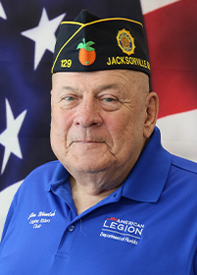

Post Finance Officer’s Charge
2023 – 2024
Department ALR Director
Jim Wineland (Post 129)

Slide 32
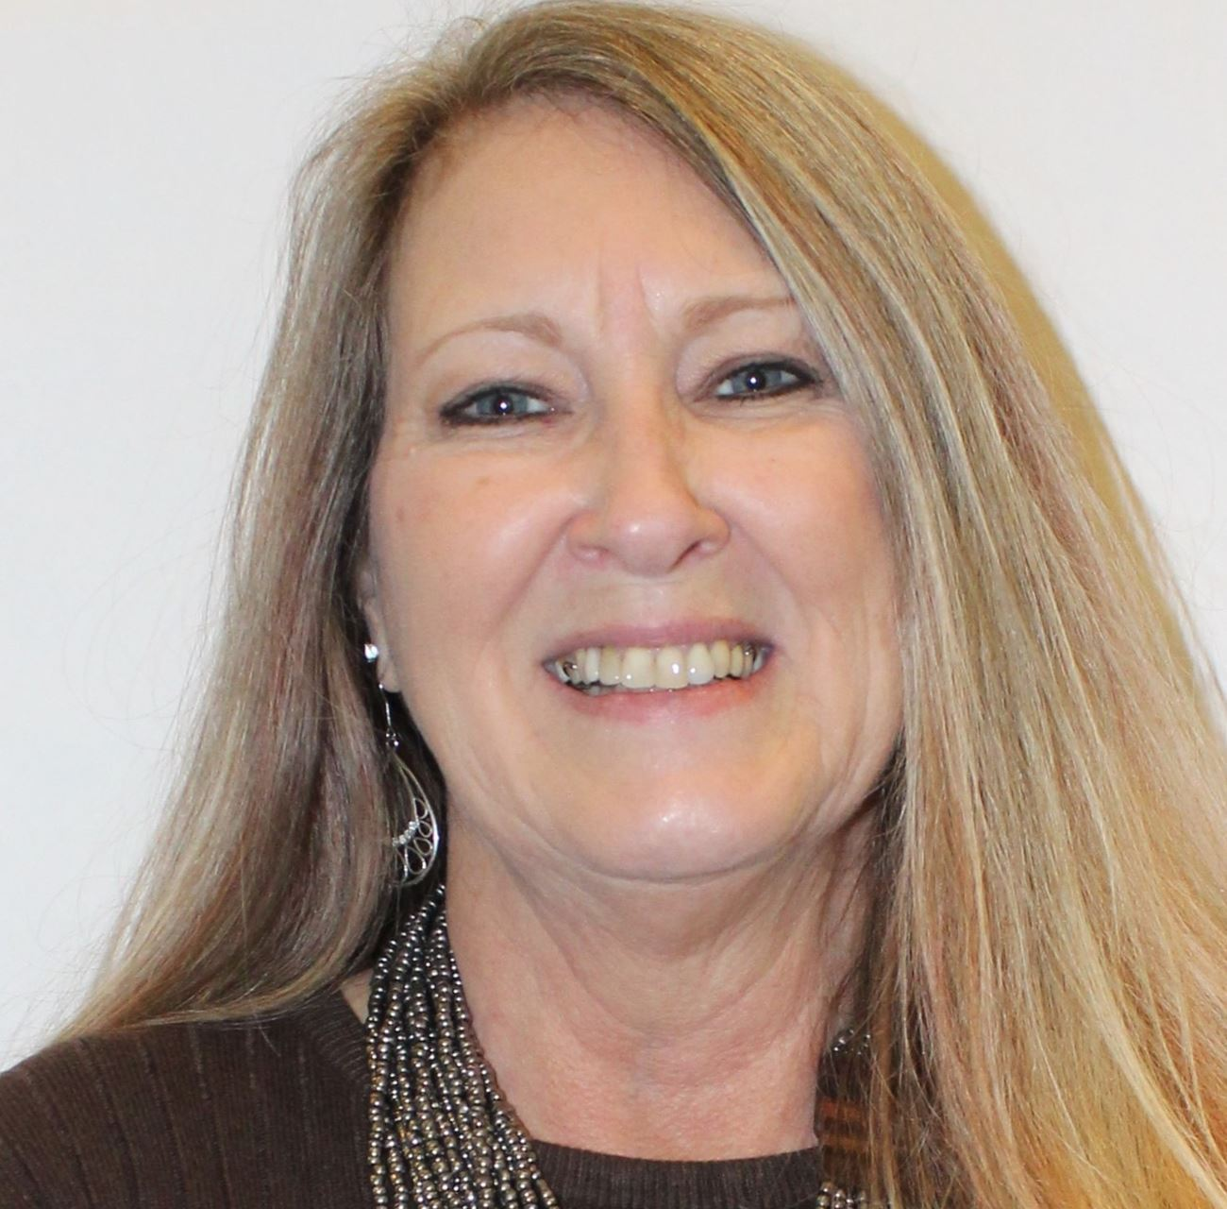
Post Finance Officer’s Charge
2023 – 2024
Department ALR Adjutant
Beverly Wooten

Slide 33

Post Finance Officer’s Charge
David Pleasanton
Department Judge Advocate

Slide 34
Finance Officer Role:
District Meetings / Constitutional Conference
Lena Heredia-Perez
Department of Florida
Northern Area Commander
Stuart Scott
Department of Florida
3rd District Commander
Notes:
Implement and adjust the plan
Continuity is key. Give the plan time to work and adjust it as necessary.

Slide 35
Overview
Overview
Purpose
Resources
Preparation
Conduct During the Meeting
Conducting the Meeting
District Constitutional Conference

Slide 36
Post Finance Officer’s Charge
Parliamentary Procedures
Keep an Orderly process
Expedite business
Keep the organization focused on its goals and principles
Understand the basics – get the Robert’s Rules of Order Book or Pamphlet

Slide 37
Finance Officer Role:
Essential Tools
Officers Guide & Manual of Ceremonies
District / County Commanders Guide
Constitution and Bylaws
Roberts Rules of Order (Current Edition)
List of Officer’s and Committee Chairs
Minutes of Previous Meetings
Agenda
Script
Notes:
Officers Guide & Manual of Ceremonies – Pg 40-42
District / County Commanders Guide – Pg 5-9
All pertinent documents can be found on floridalegion.org/resources

Slide 38


Overview
Conduct During the Meeting
Uniform of the Day
Entry if You are Late
Cell Phone Etiquette
Questions / Comments
Notes:
UNIFORM OF THE DAY
A Legionnaire is considered in uniform when wearing the official American Legion Cap. That is your blue ”cover, or garrison cap”.
Leadership should wear an appropriate color name tag with their name, title, and post during the meeting and official Legion events.
ENTRY IF YOU ARE LATE
You should not enter, and the Sgt at Arms should not allow entry, during the initiation of or close of any meeting. If you are late and enter once the meeting has begun, you should enter the room, salute the colors and quietly take your seat.
CELL PHONE ETIQUETTE
Remind the membership to turn off or silence their phones during the meetings and please remember to do the same to your phone.
QUESTIONS AND COMMENTS
Members with questions comments and concerns should rise, be recognized by the chair and always address chair with those questions, comments and concerns
Always be courteous to the chair and your comrades

Slide 39
Post Finance Officer’s Charge
Preparing for the Meeting
Send out Reminder
Gather Agenda Items
Publish Agenda
Set Up the Space
Notes:
Let’s face it, The American Legion is a volunteer ran organization and many of us are involved in other organizations. A friendly reminder goes a long way.
Preparation and execution of an agenda are equally important to a meetings success.
In the 5th District we always try to get the agenda out to the members a week out from our scheduled meeting.
Make sure that your Chairman get the agenda for the upcoming meeting and is aware of what you would like them to report on. A phone call prior to the meeting is always nice as well, to ensure they got your message.

Slide 40
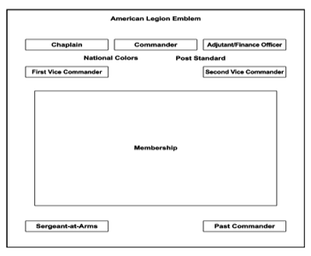
Finance Officer Role:
Set Up Meeting Room
Notes:
Set up is generally done by the Sgt-At-Arms & must be setup prior to the meeting.
This arrangement is practical for regular post meetings. Always include the ‘empty chair for POW/MIA portion of your meeting.
The room should be comfortable for all attendees with enough seating a available.
Sergeant-at-Arms should ensure there is a table at the entrance to the meeting room with a sign-in log.
Every District should adjust their setup to meet their particular needs and/or physical limitations.

Slide 41
Overview
Commander’s Role
Take charge and stay in charge
Ensure everyone is allowed to speak
Keep the discussions on track
Save new or unrelated issues for the final part of the meeting – For the Good of the Legion
Notes:
The goal is to conduct the required business in the most effective time frame; NOT “get done as fast as possible”

Slide 42

Post Finance Officer’s Charge
Opening
Ceremonies

Slide 43
Finance Officer Role:
Salute the colors
Prayer
POW/MIA remembrance
Pledge of Allegiance
Recite the Preamble to the Legion Constitution
Notes:
Remind all in attendance to silence or turn off their phones.
The Opening Ceremonies should always be done in this order (Possible deviations for education or training)
No One should enter the meeting until after the Opening Ceremonies have concluded.

Slide 44
Overview
Order of Business
Call to Order (Opening, Roll Call, Minutes, Correspondence)
Introduction of Guests/Officers
Finance Report–Discussion/Corrections
Chairman / Committee Reports
Unfinished Business
New Business
Program – Training / Presentation, etc…
For Good of the Legion
Adjournment
Notes:
Please note that NOT ALL Districts have share the same order of business; however they should have a prescribed order.
Roll Call is sometimes called for prior to the reading of minutes or the introduction of guests, but often it is found better to do this just before commencement of the business of the meeting.
In district meetings, it is always well to introduce past district commanders and never overlook past department commanders or National Executive Committeemen. When making introductions, do not ask those introduced for remarks at that time. Later, it may be in order to hear from certain distinguished guests
If department officers are present, they should be given special recognition and the opportunity to extend greetings. This should be done by the district commander, who will invite such officers to take their place for their remarks.
If the department commander is present, he/ she should be introduced with respect and dignity and given the floor for such period as may be desired.
Auditing procedures can be found in the Constitution & By-Laws
Chairperson Reports - Persons making reports should be called upon by their name, post number and title of the office for which they are reporting and then requested to come to the front and address the meeting. If the district commander knows an official or committee chair has no report, then it is better to not call upon that person.
If posts are requested to report to the meeting, then again, it is important the post commander be informed in advance of expectations to report and an outline provided on what the report is expected to cover.
District Commander Report: District Commanders should by all means have a personal report to make, and time should be spent in its preparation so the program may be properly presented. It would be well to give special recognition to posts or officers doing an outstanding job, as an encouragement to them and a stimulation to others
Announcements: No meeting should ever be concluded without announcement of coming events, such as department conferences, special programs or forthcoming observances. At all such meetings, reminders of membership deadlines and active programs should be announced.

Slide 45



Post Finance Officer’s Charge
Closing
Ceremonies
Notes:
Prayer
Recovery of the POW/MIA Flag
Salute / Retire the Colors
Closing Remarks
District Commanders should never close the meeting without an expression of appreciation to those who have attended, for their interest and support of the conference, and to the host post for its hospitality

Slide 46
Finance Officer Role:
District Constitutional
Conference

Slide 47
Overview
DCC
Composed of Delegates and Alternates from each Chartered Post
District Constitutional Conferences shall be held not more than sixty (60) nor less than ten (10) days prior to the date of the Department Convention.
A New District Commander and Vice Commanders are Elected during this Meeting.
30% of the Posts in a District, represented at such Conference by duly designated delegates shall constitute a quorum.
Notes:
Each Post shall be entitled to 2 delegates and 2 alternates and to one additional delegate and alternate for each additional one hundred 100 members or fraction thereof over and above the one hundred members and alternate delegates shall be recognized in the numerical order certified; provided that the per capita membership fee has been received by Department Headquarters 10 (10) days prior to the DCC.
It is the Department Adjutants to publish to the Post and District Officers of the respective Districts in the Department, a bulletin listing the official voting strength of each Post no later than five (5) days prior to District Constitutional Conference.
Each delegate to a District Conference shall be entitled to one (1) vote as long as they have proper certificate by the Commander and Adjutant of the Post represented by such delegate.
Nominated one (1) delegate and one (1) alternate to the National Convention for each one thousand (1000) members or major fraction thereof in said District..
Department Constitution & ByLaws – District Organization
District Commanders / Vice Commanders are to serve (1) year once ratified and confirmed by the Department Convention.
The District Commander shall within five days after adjournment of such conference forward to the department adjutant a certifies copy of the name and address of the District Commander and the District Vice Commanders elected and the delegates and alternate to the national convention nominated at such district conference.

Slide 48
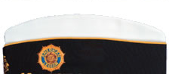
Post Finance Officer’s Charge
District Caps
District Commanders
District Vice Commanders
District Adjutant
Assistant District Adjutant
District Finance Officer
District Judge Advocate District Service Officer
District Sergeant-At-Arms
Assistant District Sergeant-At-Arms
District Chaplain
District Historian
Notes:
District Commanders should never close the meeting without an expression of appreciation to those who have attended, for their interest and support of the conference, and to the host post for its hospitality

Slide 49
floridalegion.org

Slide 50
Finance Officer Role:
Mission Statements
Presentations
by Districts

Slide 51


