Slide 1
General Session Meeting November 18, 2023 Jim Wineland, ALR Chair Beverly Wooten, ALR Adjutant
AMERICAN LEGION RIDERS

Slide 2
MONTH OF OCTOBER
Number of Veterans Assisted: 36
Mortgage/Rent = $45,339.16
Utilities = $3,300.01
Total Amount Given: $48,639.17

Slide 3
REPORTING – 135 Active Chapters
Statistics as of November 9, 2023
Officer Reporting – 106 Chapters
How Do We Increase Reporting Statistics?
Do You Know When to Report?
Officer Reporting – When The Chapter Elects New Officers/Updates
Do You know What They are Used For?
Reports to District Chairs
Fall Conference
ALR Summit
Convention

Slide 4
2023-2024 INITIATIVES
Missing Documentation (135 Chapters)
List to be sent to all Chairmen
Start Up/Approval Letters - 94
SOP Acknowledgement Form - 72
Chapter Standing Rules – 57
Charters Issued - 105
Increase Participation in Dept Events
Reporting Class @ ALR Summit
Future Rider Application

Slide 5
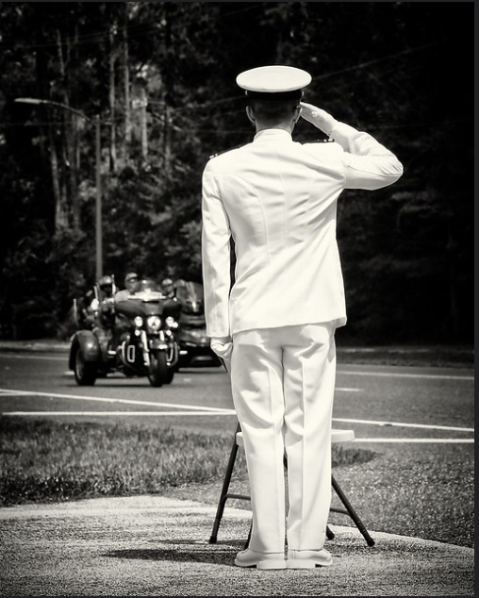
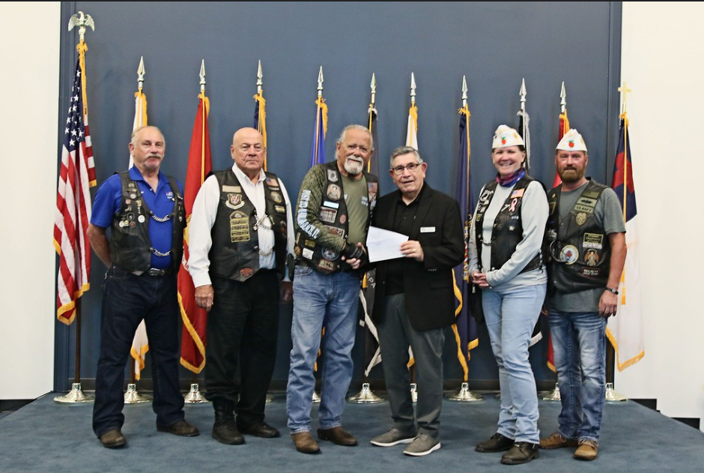
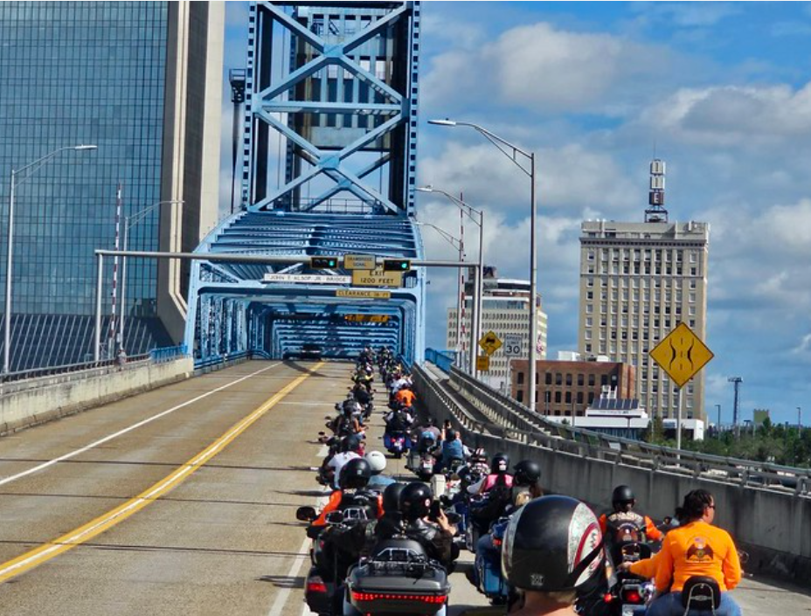
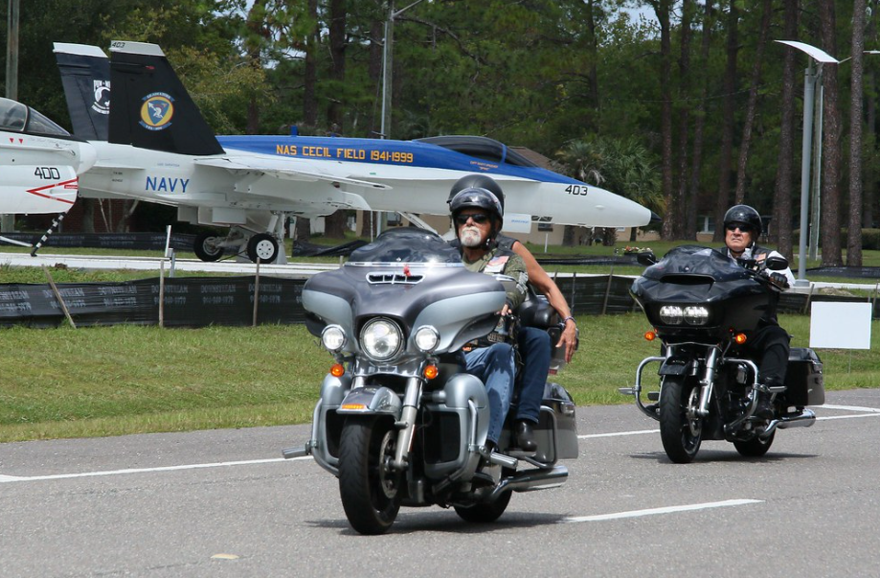
3rd ANNUAL POW/MIA CEREMONY & RIDE
September 16, 2023 - Jacksonville
Ride began @ Adamec Harley Davidson Dealership
7 Bridges Ride – 99.3 Miles – 2 hrs. 20 Mins – JSO Police Escort
Ride ended @ NATIONAL POW/MIA Memorial Park
Jax University NROTC performed the Parade of Colors &
Missing Man Table Ceremony
263 Bikes/Trikes Participated – 361 Participants
Meet & Greet & After Social Event @ Post 283
Total Chapel Donations - $5690.00

Slide 6
ALR Summit – January 31st – February 3, 2024
Hotel Information:
NOW BOOKING !!!
Holiday Inn Resort – Lake Buena Vista 13351 State Rd 535 Orlando, FL 32821
Group Code: American Legion Riders 2024 Cut-Off Date: January 1, 2024
1-877-666-3243

Slide 7
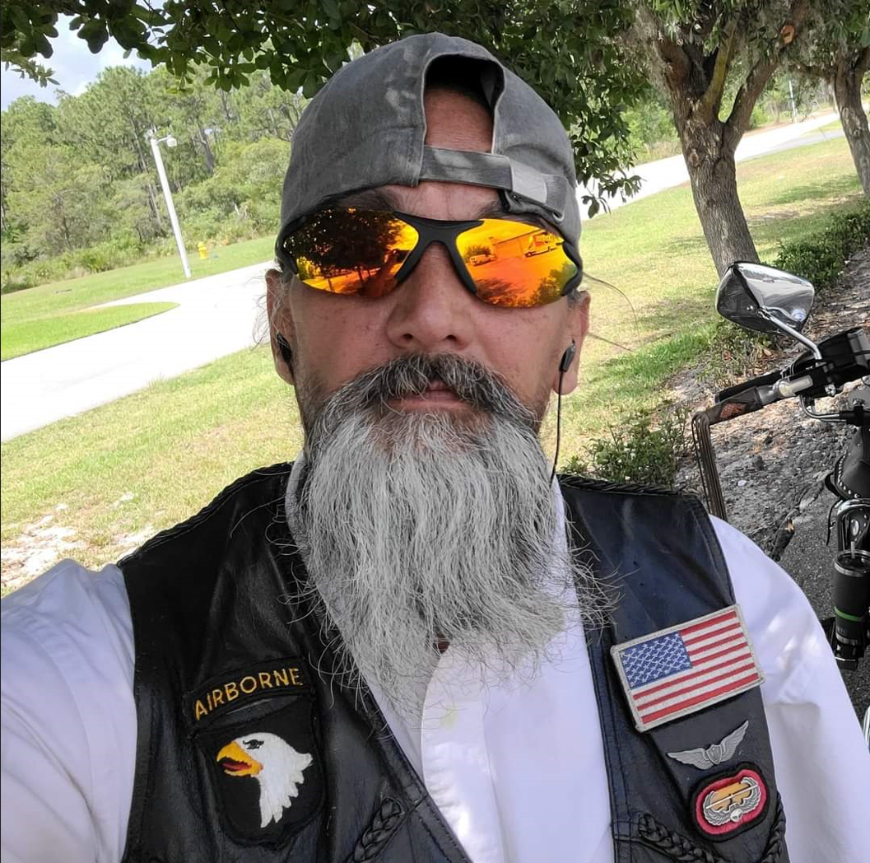
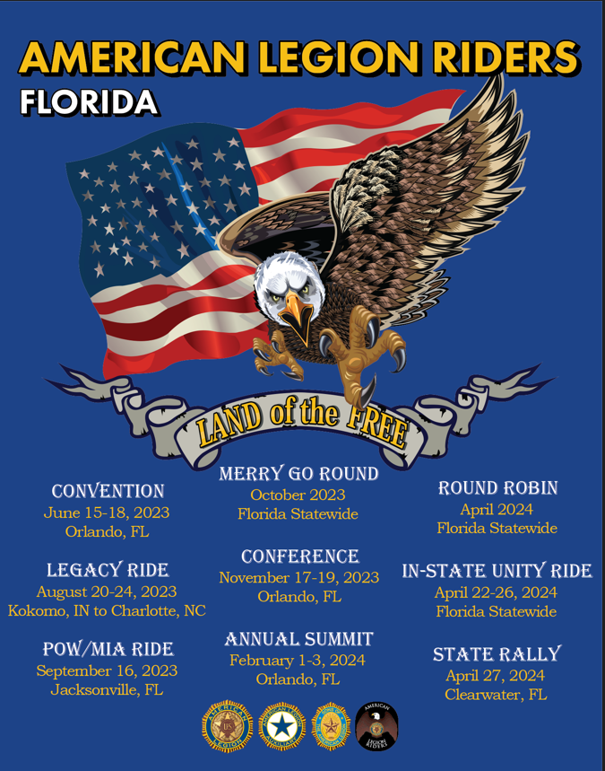
SUMMIT & TOUR SHIRT DESIGN CONTEST WINNER !!!
LAMAR ‘JOKER’ CAMACHO

Slide 8
In-State Unity Ride April 22-26, 2024
3 Routes – West Coast, Central, East Coast

Slide 9
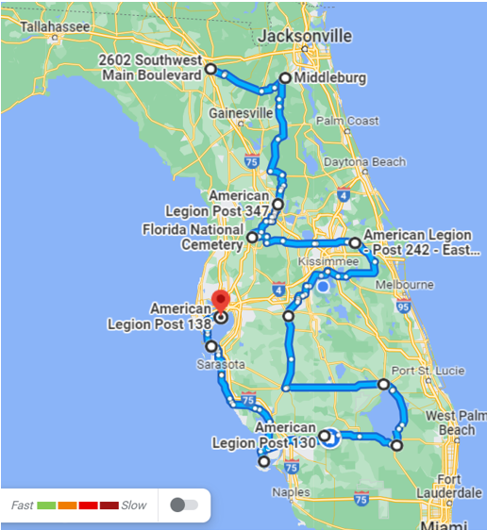
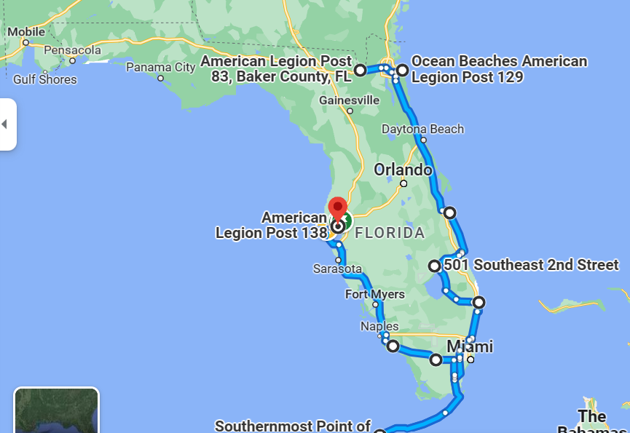
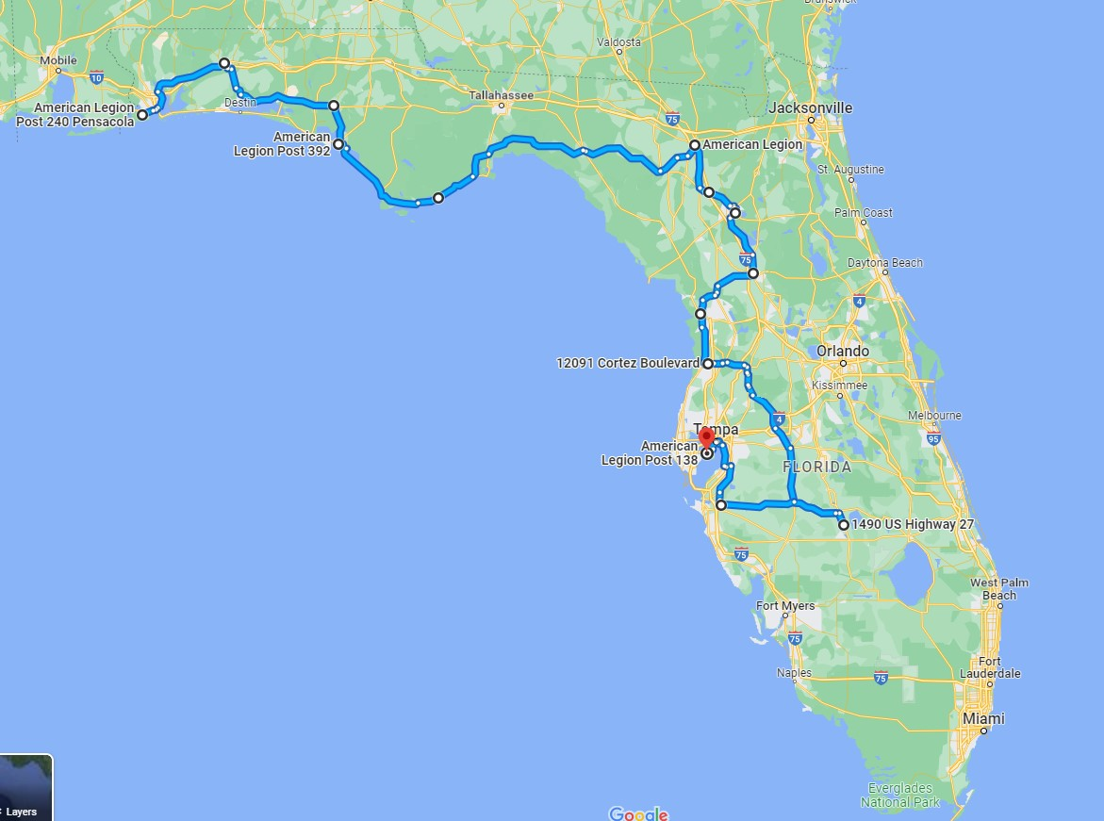
ALR IN-STATE UNITY RIDE Routes Subject to Change – Still in planning stage
Central Route – 1027 Miles
East Coast Route – 1026 Miles
West Coast Route – 765 Miles

Slide 10
ALR RAFFLE – 2024 STREET GLIDE Online Ticket Sales $20 Per Ticket or 6 for $100
Net proceeds benefit PVR/SPI

Slide 11
PROJECT VET RELIEF/SUICIDE PREVENTION INIATITIVE 2024 GOAL INCREASE BY 10%

Slide 12
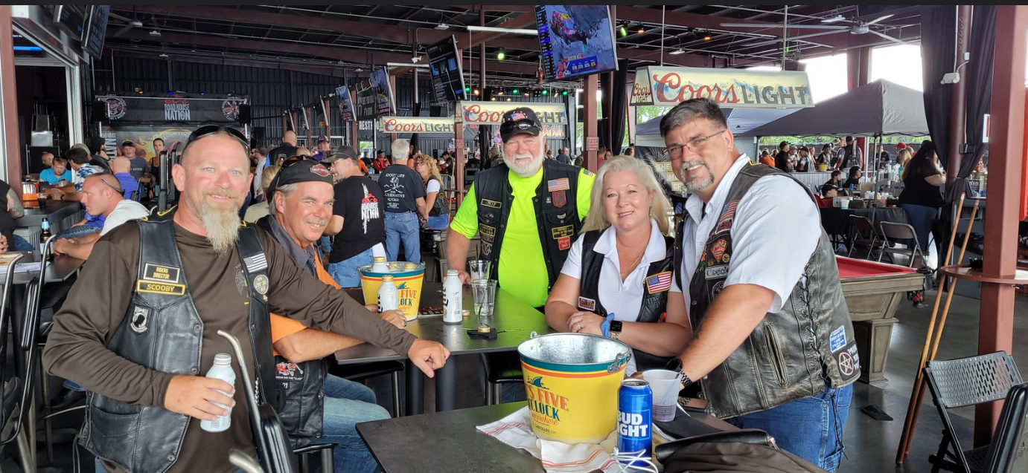
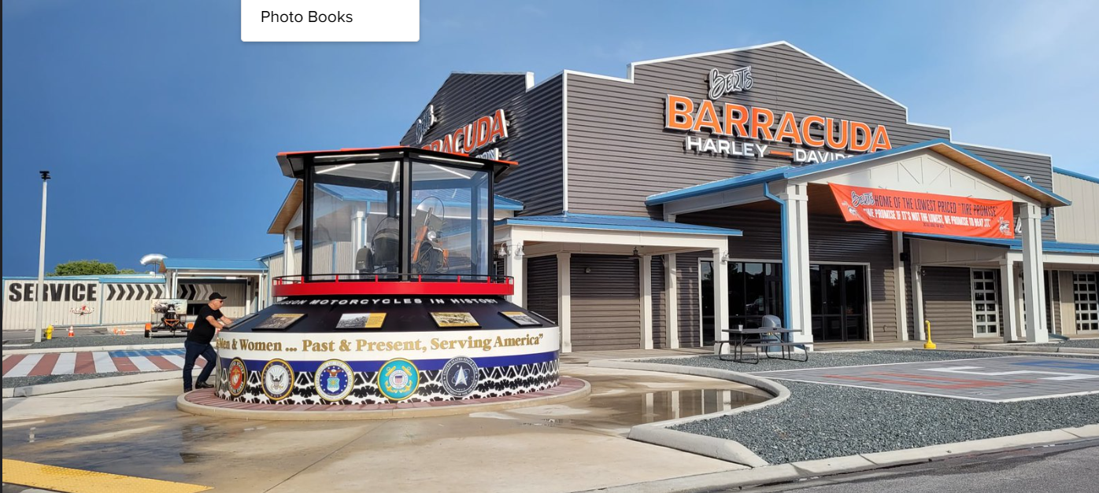
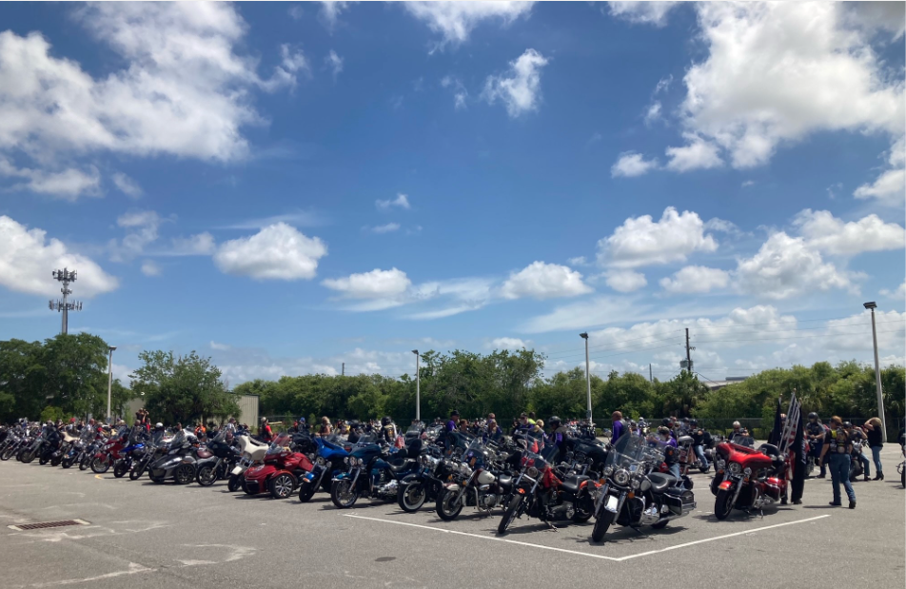
ALR State Rally Update
OCC RoadHouse & Museum
Date & Time – April 27th , 2023 - 12-5pm
Raffles – Chapter/District Donations
Food – Order from the Menu
Entertainment – Band
Vendors – OCC to book

Slide 14
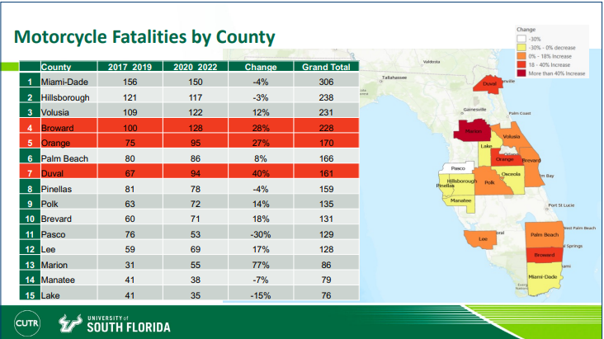
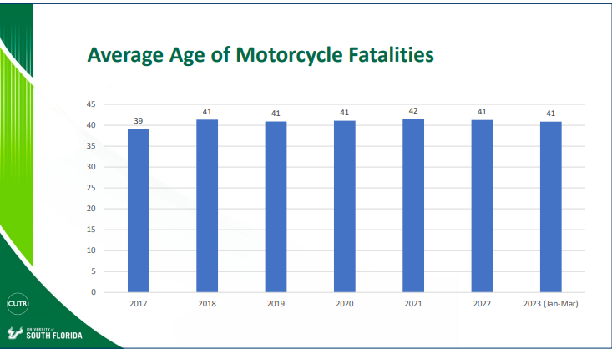
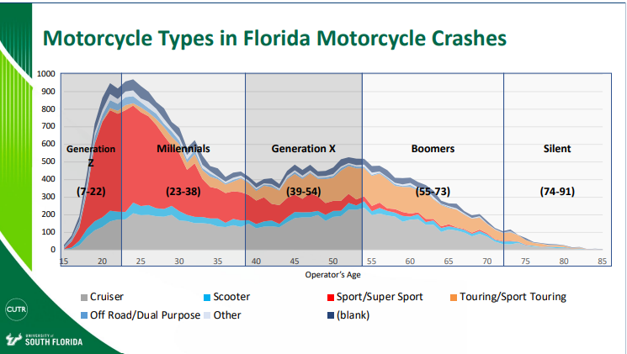
Fatality & Motorcycle Types in Crashes Statistics Provided by: University of South Florida

Slide 15
Motorcycle Safety Education Fund
The Motorcycle Safety Education Bill (SB 838) was signed on May 23, 2023 by Governor Ron DeSantis.
Went into effect on July 1, 2023.
ALR is one of 3 non-profits motorcycle organizations selected. Paperwork submitted and approved.
Promote motorcycle safety by utilizing pamphlets, advertisements, public service announcements, digital media, social media, and websites, and participate in grassroots motorcycle events.
Quarterly Meetings
Phased Approach
Phase I – Establish a Baseline – Research & Goals
Phase 2 –Identify/Develop Deliverables
Phase 3 – Execution in Q2-Q3
Phase 4 – Evaluate – Ongoing

Slide 16
PROGRAM GOALS
SAVE LIVES
Prevent as many Injuries as Possible to Florida Motorcyclists
Create Programs that Benefit All Florida Motorcyclists
Collaborate with other Program Administrators
Increase Safety Awareness
How We Accomplish these Goals
Conduct & Participate Motorcycle Safety Skills, Training & Education
Digital & Social Media Communication
Webinars
Community Engagement
Motorcycle Safety-Themed Events

Slide 17
3 Motorcycle Organizations Selected

Slide 18
ALR COMMITTEES
In-State Unity Ride
Joe Marcheggiani, Zane Koonce, and Jason Skobel
Accommodations Committee
Julie Hughes, short 2 positions
Quartermaster
Dave Campobasso, will need sales help at Summit and Rally
Event Coordinators, Summit & Rally
North & South positions
Webmaster
Lamar Camacho, & assistant if needed.
SOP & Documentation Support
Dale Fish
POW/MIA Committee
Denny Luke, need additional assistance

Slide 19
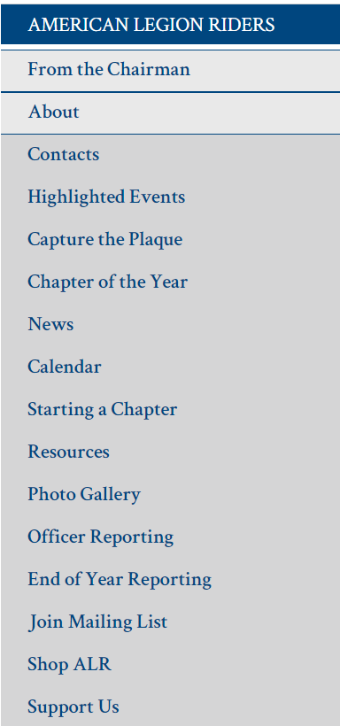
WEBSITE CONTENT https://www.floridalegion.org/programs-services/legion-riders/
Drive Chapters Directors/Riders to the website for Updates, General Information
From the Chairman Article – Monthly
Updated Content & Forms
Chapter of the Year
Capture the Plaque
Presentations/Documents from Summit online for reference
Pictures

Slide 20
2023-2024 SCHEDULE OF EVENTS
SUMMIT – Meet & Greet January 31st 2024 - Classes February 1st – 3rd
ROUND ROBIN - April 1st – April 30th, 2024 – Supporting PVR/SPI
MEET & GREET For the In-State Unity Ride - April 21st, 2024
IN-STATE UNITY RIDE - April 22nd - April 26th, 2024
ALR STATE RALLY – April 27th, 2024 - Orange County Chopper, Clearwater

Slide 21
MERRY-GO-ROUND RESULTS OCTOBER, 2023
THE AMERICAN LEGION RIDERS
We Ride for Our Children & Youth Programs

Slide 22
MERRY-GO-ROUND RESULTS
5th PLACE – DISTRICT 1

Slide 23
MERRY-GO-ROUND RESULTS
4th PLACE – DISTRICT 7

Slide 24
MERRY-GO-ROUND RESULTS
3rd PLACE – DISTRICT 5

Slide 25
MERRY-GO-ROUND RESULTS
2nd PLACE – DISTRICT 6

Slide 26
MERRY-GO-ROUND RESULTS
1ST PLACE – DISTRICT 15!!

Slide 27
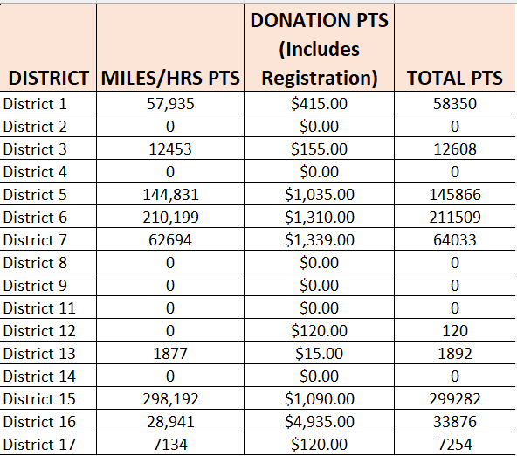
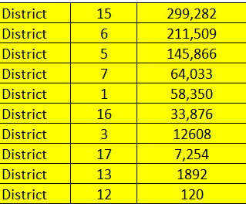
MERRY-GO-ROUND RESULTS

Slide 28
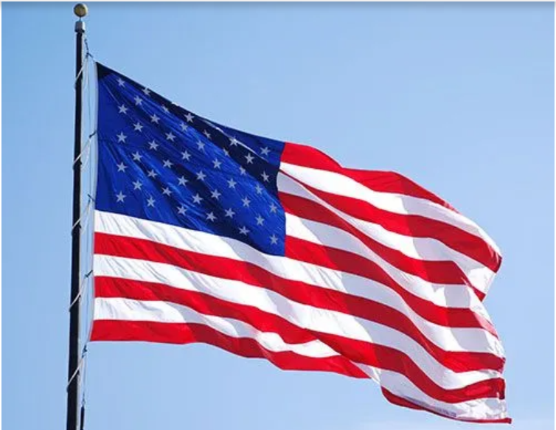
GOD BLESS THE UNITED STATES OF AMERICA

