Slide 1
General Session Meeting June 17, 2023 Jim Wineland, ALR Chair Beverly Wooten, ALR Adjutant
AMERICAN LEGION RIDERS

Slide 2
In Memory of:
Russell “Whimpy” Chamberlain – Chapter 75 – District 1
Mary Alberts – Chapter 75 – District 1
Mark Worrill – Chapter 392 – District 1
Paul “Offroad” Peacock – Chapter 75 – District 1
Kevin Summers – Chapter 240 – District 1
James “Jimmy” Campbell – Chapter 57 – District 3
Timothy Hernandez – Chapter 57 – District 3
Danny “Diamond Dan” Bethune – Chapter 137 – District 5
Sherry “Mama Smurf” Shelton – Chapter 137 – District 5
Erich “Pops” Terry – Chapter 194 – District 5
Bethany May Greenwaldt – Chapter 55 – District 6
Sandy Herrington – Chapter 10 – District 6
Barbara Lewis – Chapter 69 – District 8
David Lewis – Chapter 69 – District 8
Robert “Crazy Bob” Patric – Chapter 111 – District 15
Clay “Hobo” Lane – Chapter 111 – District 15
Donald Byrd – Chapter 138 – District 15
Eddie Hand – Chapter 252 – District 16

Slide 3
REPORTING – 136 Active Chapters
Statistics as of June 1, 2023
Officer Reporting – 112 Chapters (Increase of 38)
EOY Reporting – 56 Chapters (Decreased by 15)
CPR & Department Addendum – Unknown
How Do We Increase Reporting Statistics?
Do You Know When to Report?
Officer Reporting – When The Chapter Elects New Officers/Updates
CPR & Department Addendum Due to Post Adjutant – 1St of May
EOY Reporting – No later than 5/31
Do You know What They are Used For?

Slide 4
American Legion Riders 2022- 2023 Elements of the CPR & Department Addendum
121 Posts Indicated they had a Riders Group
Some Posts had stated that had hundreds of Riders – Reality…Post Adjutant reported total number of members of the Post
Some Posts reported numbers who either did not have a Riders Group or the Riders Group was disbanded
*CONCLUSION*
Post Adjutants are not clear on reporting details
Chapters did not provide statistics for the CPR & Addendum Report
We will add a new class at Summit to provide specific details for all reports requirements.

Slide 5
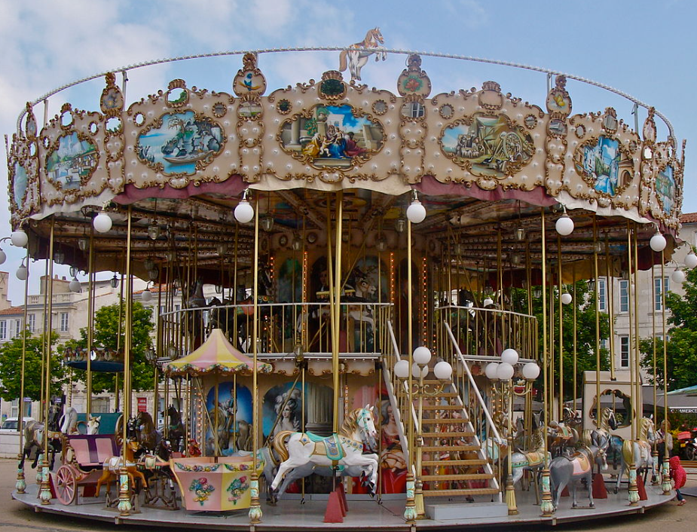
DEPARTMENT EVENTS SUMMARY
MERRY-GO-ROUND
11 Districts Participated
10 Districts Reported Miles & Hours
$19,460 Raised
$20,000.00 – Hurricane Relief Fund
$5,000.00 Child & Youth Picnic

Slide 6
DEPARTMENT EVENTS SUMMARY
ROUND ROBIN
16 Districts Participated
8 Districts Reported Miles & Hours
IN-STATE UNITY RIDE
207 Registered for the In-State Unity Ride
110 Virtual Riders Registered
Out of State Riders – OH & AL

Slide 7
AMERICAN LEGION RIDERS TOTAL DONATIONS 2022-2023
Hurricane Disaster Relief Fund - $20,000.00
Operation Precious Gifts-Patrick Space Force Base- $5000.00
Children & Youth Picnic - $5,000.00
Project Vet Relief/Suicide Prevention Initiative - $346,547.60
TOTAL DONATIONS - $376,547.60

Slide 8
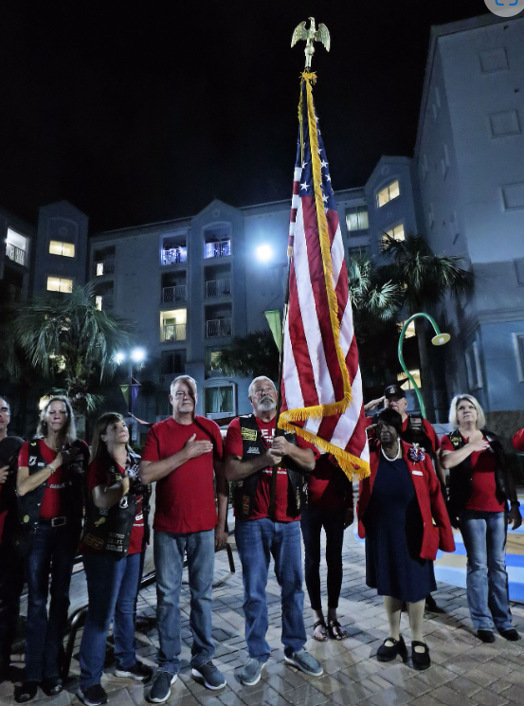
Summit Survey Responses
New Attendees – 41.67%
Value – 97.22%
It’s not only the training that’s good about the summit. It’s the networking with Florida Legion Riders.
It opened Doors to more knowledge.
Wish I could get all officers and potential officers to attend
Very high value scale 1-10. I give it a 12
I was able to understand some things that had been confusing before Summit
Rate your Instruction’s Knowledge
Excellent 69.44%
Very Good 27.78%
Fair 2.78%
Comments
Classes are Great and instructors are outstanding very good material
Larry Roberts was outstanding. Lamar Camacho was excellent as well as Ed Lewis
All classes have been excellent. The computer app and tracking class was awesome. The tracking application that Loreen Skobel introduced will be a huge benefit to the American Legion Riders and the American Legion in general.
All were very informative
Very knowledgeable instructors that were able answer questions instead of "I'll get back to you on that."
Will be attending next year – 100%

Slide 9
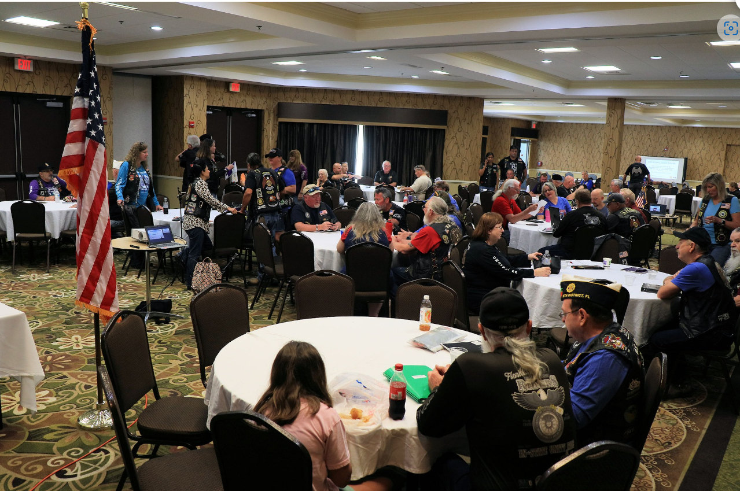
Summit Survey Comments
If I could make changes
Get larger rooms for the popular and in demand classes.
Some classes need some more time
Official service dogs Only. Proof should be required.
Can’t think of anything that needs changing
Nothing. Gets better every year
Move back to Cocoa Beach or another costal city. Orlando is not conducive for motorcycles.
More venders & Add the breakfast time onto the schedule
#1 thing I liked
Camaraderie both in and out of session. Sharing of ideas. Networking with other Chapters
All of it. But I believe the Leadership Class gets you interested and ready for the other classes.
Each class was offered several times throughout the summit
Pack filled with information we are a 1-year chapter, this was a big benefit to insure we are trying to do things right.
The classes and learning
Least thing I liked
More choices for the breakfast. It was the same thing every day.
Can’t think of any. It’s what’s you put into the classes depends on what you achieve from the classes
Area too congested.
The meet and greet ended too early for us
Saying goodbye.
Walking...lol would be nice if scooter transportation was available for those with leg knee feet problems

Slide 10
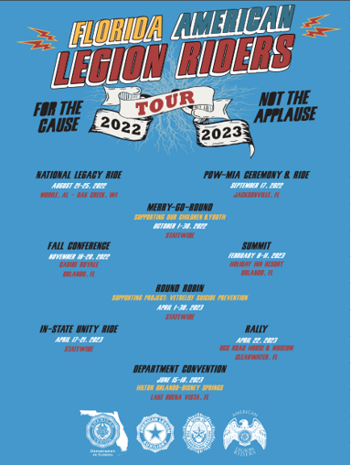
SUMMIT & TOUR SHIRT DESIGN CONTEST!!!
DEADLINE – SEPTEMBER 15, 2023
Send YOUR design to:
Jim Wineland
alr@legionmail.com
Beverly Wooten
alradjutant@legionmail.com
Dave Campobasso
dkcampo@iclould.com
**Calendar of events used for Tour Shirt**
8th
WINNER RECEIVES
1 FREE NIGHT @ SUMMIT AND A FREE T-SHIRT!!!!

Slide 11
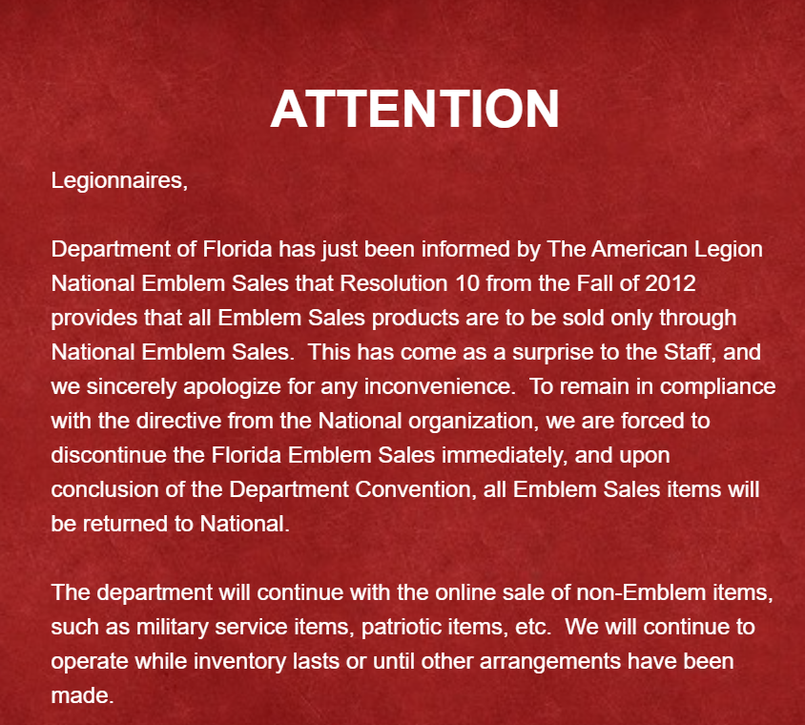
EMBLEM SALES UPDATE

Slide 12
In-State Unity Ride & ALR Rally Survey Responses
Overall Experience – 4.4 Stars
OCC Roadhouse Venue for State ALR Rally – 90.24%
ALR Rally – Day after In-State Unity Ride – 84.78%
Incentive Prizes – 3.5 Stars
Sponsored by Project Vet Relief
Prizes are determined after the month ends
Prizes distributed at Convention
Winners are announced at Convention

Slide 13
In-State Unity Ride & ALR Rally Survey Responses
IN-STATE UNITY RIDE
The Pensacola route was amazing and our road captain, Scooby, was great!
The ride itself was great and my Road Captain Zane was amazing. The main issue that made the experience only average were the terrible hotels that we had.
Stops not knowing about lunch stops on the schedule happen twice
One route if the problem we encountered with too many bikes per flight can be addressed.
The Kissimmee route was way too big!
4 routes. will be able to get more participants
More routes, for some of us the distance to the start was too far away
ALR STATE RALLY
At times it was tough hearing what was going on with donations, etc. Music seemed overly loud too
We also need a variety of bands and not just blues! it all sounds the same.
Would like to see somewhere else, loud music, expensive food and too long
Fun time great people
Should be at the end of the ride on Friday
If the Rally were to be at a resort/venue after a shorter ride on Friday more people may attend. Staying the additional night is a hotel adds more to the overall cost and may make it a bit less convenient for some riders to schedule the time to do the whole ride

Slide 14
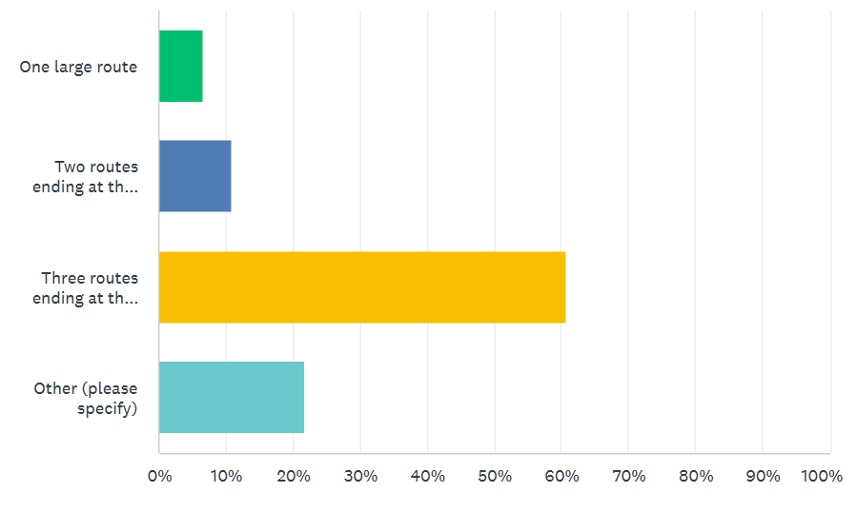
In-State Unity Ride & Rally Survey Responses
How do you think next year’s In-State Unity Ride should be?
**3 Routes**
THINGS TO CONSIDER WHILE PLANNING
*Hotel Accommodations
*Post Communication & Follow Up
*Coordinate Meals
*Gas Stops

Slide 15
LOOKING FOR IN-STATE UNITY RIDE STOPS
Post does not have to have a Rider Chapter
How about a Snack?
Host Lunch or Dinner?
Contact Jim Wineland at alr@legionmail.com

Slide 16
What are you willing to do to help make the Riders program more successful next year?
Help plan routes
Wife and I already volunteered to help plan food next year.
I would happily volunteer. Pre-group Ride the route. Ride guard/blocker. Route planning and map development. Website contributor.
Absolutely. Help planning the route, hotels, meals, etc.
Devote time, skill, and service. Participate, heck yeah! I do what's needed to help make our Riders successful! ;)
Yes, I would be happy to help, just need to know how I could assist.
Instruct at Summit. Serve on POW/MIA committee
Yes, I would definitely be interested in helping next year. I never seen any communication for any volunteers for this year’s ride but if I’m able to help I certainly would see where I could fit in
Yes, I would volunteer. I'm willing to help out with wherever I'm needed

Slide 17
CAPTURE THE PLAQUE
1. Chapters MUST have their own Plaque and in their “possession” to play the game. (example: If another chapter has your plaque, you may NOT capture another chapter’s until you retrieve your own)
“POSSESSION”
If your starting point is at your Post, The Plaque must be on visible display at your Post.
** DO NOT TAKE THE PLAQUE WITH YOU!**
If you are retrieving your Plaque, it is now in your possession and you may capture another Chapter’s Plaque.

Slide 18
CHAPTER OF THE YEAR CURRENT CALCULATION

Slide 19
Chapter of the Year Calculation Revision 2023-2024

Slide 20
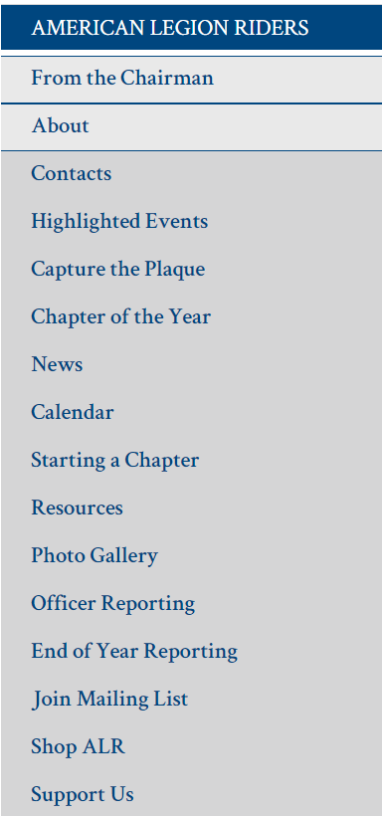
WEBSITE CONTENT https://www.floridalegion.org/programs-services/legion-riders/
Drive Chapters Directors/Riders to the website for Updates, General Information
From the Chairman Article – Monthly
Updated Content & Forms
Chapter of the Year
Capture the Plaque
Presentations/Documents from Summit online for reference
Pictures

Slide 21
2022-2023 INITIATIVES
Missing Documentation (136 Chapters)
List to be sent to all Chairmen
Start Up/Approval Letters - 95
SOP Acknowledgement Form - 69
Chapter Standing Rules – 56
Charters Issued - 102
Increase Participation in Dept Events
Increase Chapter Reporting

Slide 22
2023-2024 SCHEDULE OF EVENTS
NATIONAL LEGACY RIDE – August 20-24th, 2023
POW/MIA, Seven Bridges Ride & Ceremony Jacksonville, September 16th, 2023
**Small Registration Fee to offset cost of JSO Escort**
MERRY-GO-ROUND – October 1st – 30th, 2023 – Supporting Child & Youth
FALL CONFERENCE – November 17th – 19th, 2023
SUMMIT – Meet & Greet January 31st 2024 - Classes February 1st – 3rd
ROUND ROBIN - April 1st – April 30th, 2024 – Supporting PVR/SPI
MEET & GREET For the In-State Unity Ride - April 21st, 2024
IN-STATE UNITY RIDE - April 22nd - April 26th, 2024
ALR STATE RALLY – April 27th, 2024 - Orange County Chopper, Clearwater

Slide 25
ROUND ROBIN RESULTS APRIL, 2023
THE AMERICAN LEGION RIDERS
We Ride for Our VETERANS
Project Vet Relief: Suicide Prevention Initiative

Slide 26
ROUND ROBIN RESULTS
5th PLACE – DISTRICT 16

Slide 27
ROUND ROBIN RESULTS
4th PLACE – DISTRICT 1

Slide 28
ROUND ROBIN RESULTS
3rd PLACE – DISTRICT 6

Slide 29
ROUND ROBIN RESULTS
2nd PLACE – DISTRICT 15

Slide 30
ROUND ROBIN RESULTS
1ST PLACE – DISTRICT 5 !!

Slide 31
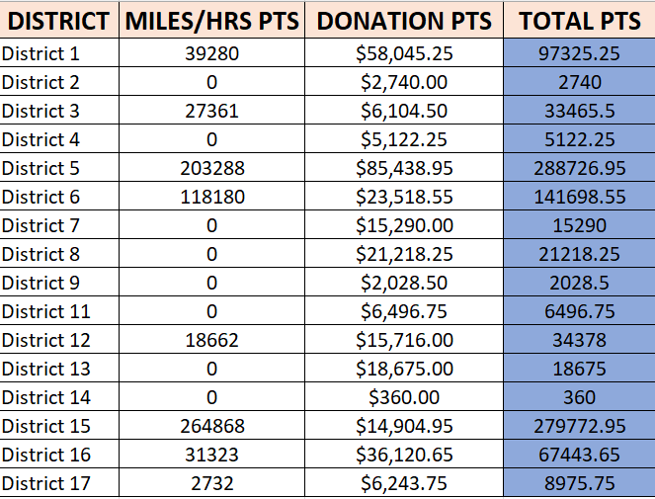
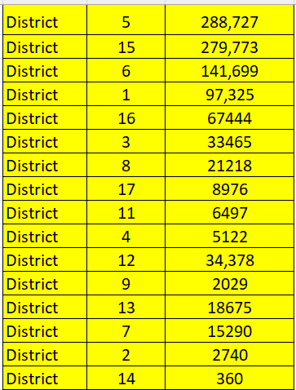
ROUND ROBIN RESULTS

Slide 32
Chapter of the Year

Slide 33
CHAPTER OF THE YEAR 2022-2023 SMALL (6-30 Members) CHAPTER 43!! HOMESTEAD

Slide 34
CHAPTER OF THE YEAR 2022-2023 MEDIUM (31-60 Members) CHAPTER 101!! BUSHNELL

Slide 35
CHAPTER OF THE YEAR 2022-2023 LARGE (61-100+) CHAPTER 237!! BEVERLY HILLS

Slide 36
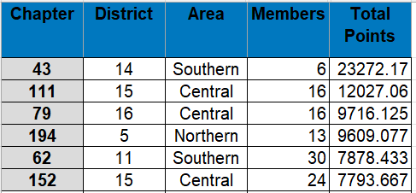
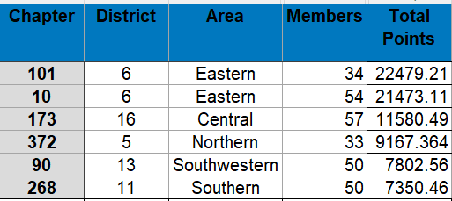
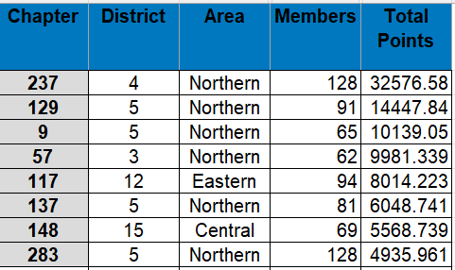
TOP 20 CHAPTERS
SMALL
MEDIUM
LARGE

Slide 37
GOD BLESS THE UNITED STATES OF AMERICA

