Slide 1


Welcome to Florida American Legion College
2022-2023
floridalegion.org

Slide 2


Welcoming
Remarks
Department Commander
Eunice Butts
God Family Courage
Notes:
Use the Restroom and come straight back.

Slide 3
Do’s & Don’ts of the Class
Agenda is Subject to Change
No Phone Calls and/or Texting during Class
Be on Time
Let the Instructor Finish before asking Questions
Always Work as a Group
Respect Each Other like Professionals
Notes:
Use the Restroom and come straight back.

Slide 4
Student Introductions
Notes:
What is your Why? As a membership driven organization it is our duty to be ready to “Sell” The American Legion at any given time. We need to be able to explain who The American Legion is to pique the listeners curiosity enough for them to take action such as taking the time to ask more questions or scheduling a follow up meeting. What does The American Legion do for me? The American Legion is nothing but a smoky filled bar with a bunch of old men telling war stories, ect…

Slide 5
Training in a Box
Stuart Scott
3rd District Commander
Lena Heredia-Perez
5th District Commander

Slide 6
Training | Florida American Legion (floridalegion.org)
Training Tuesdays | The American Legion
Dropbox - Training In A Box - Simplify your life
Write a Resolution | The American Legion
Notes:
Who here knows where to go to find various training platforms throughout The American Legion? Does anyone have any other great suggestions for different training platforms?

Slide 7
Creation of Resolutions
Mike Seidel
Resolutions Chairperson
Notes:
Resolutions are a key part of history of The American Legion

Slide 8
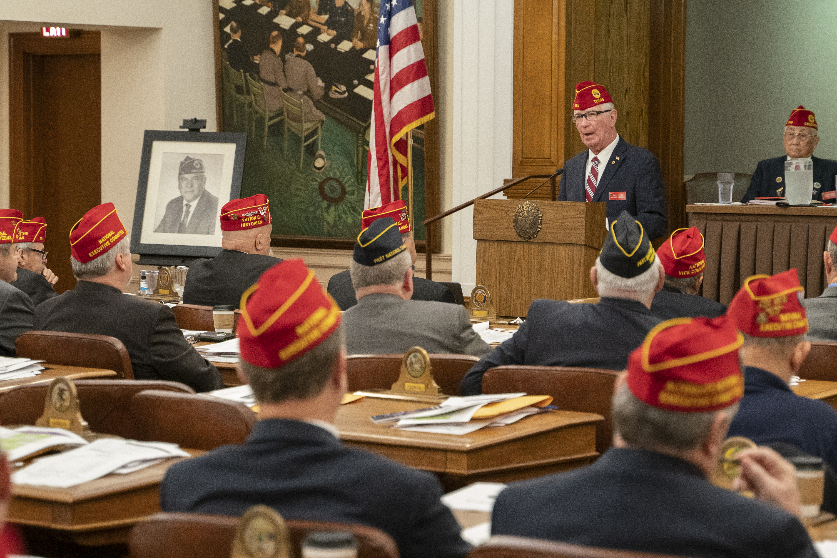
Key Topics
What is a resolution
How to write a resolution
National Commander Paul Dillard speaks to the National Executive Committee at the American Legion National Headquarters in Indianapolis, Indiana, on Wednesday, October 6, 2021. Photo by Ben Mikesell/The American Legion.

Slide 9
What is a Resolution?
A formal expression of opinion, will, or intent voted by an official body or assembled group
The act of analyzing a complex notion into simpler ones
Notes:
Resolutions are policy statement outlining a position on a specific program or requesting action
Takes a complex issue like veteran healthcare or veteran employment and identify an area of action
Considered to be legal documents
Grant the authority to do something as an organization
A key point is resolutions are vehicles of action

Slide 10
Who uses Resolutions?
U.S. Congress
United Nations
Local town councils
Most professional bodies, such as associations, organizations, clubs
Notes:
Resolutions are a part of governing.

Slide 11
Resolutions at all Levels
Legionnaire submits resolution to post
Post submits to one of the following
  District
  County
  Department
Department submits to National
National Commissions and Committees
Notes:
Resolutions can be used at all levels of the organization to determine what programs to support and how to allocate funds.
How resolutions are handled will vary from place to place. Contact your leadership for more information on how resolutions are used at the post, district and department levels.

Slide 12
Types of Resolutions
Statement of position on veteran issues
Create and support an organization’s programs
Authorize change within the organization
Statement of recognition of an individual or organization
Notes:
Resolutions that are a statement of position on veteran issues.
Related to Congressional legislation or matters at the DoD or VA.
Such as the 2021 October Res. No. 19 calling for improving veterans’ telehealth access
Create, change and support programs like scholarship programs, Operation Comfort Warriors and the Legion Baseball.
Authorize change within the organization such as the use of funds, create and manage corporate relationships, make changes to the constitution and by-laws, etc.
Useful vehicle for recognizing the contribution of an individual or organization. Normally a positive contribution.

Slide 13
Common Resolution Actions
Approved
Rejected
Consolidated
Referred
Held for Study
Received and Recorded
Disposed of Administratively
Tabled
Notes:
These are the standard actions during the review process used at the national level.
Approved, Rejected
Consolidated - grouping of similar statements together for approval.
Referred to another meeting or commission. Often used at convention when there is not enough time for review and/or no documentation.
Held for Study - a standing committee or commission may use this approach
Received and Recorded - resolutions that are not germane or more often where a policy is already in place.
Disposed of Administratively - requests that can be handled internally without a resolution
Tabled held to be later addressed but must be addressed within that meeting
Otherwise, the resolution will be die.

Slide 14
Resolution Writing
Factors to consider when writing
Is it politically sensitive?
Is a specific person, business, organization harmed?
Can intent be realistically attained?
Written in the proper format?
Notes:
There are several factors to consider before and during the writing process.

Slide 15
Resolution Writing
Parts of a Resolution
Preamble (the ‘Whereas’ clause)
    One or more clauses, each being a statement of fact logically related to the intent of the resolution
Resolve Clause
    Defines the solution, policy, or action in very clear and concise terms

Slide 16
Resolution Writing
Resolve clause
Should be written first
Identifies resolving authority
Circumstances and place of action
Date of action
Provides a resolution with a clear and unmistakable intent
Should stand on its own
Final clause ends with the only period (.) in the resolution
Notes:
Start by writing the resolve clause. This approach makes for a well-formed, actionable resolution.
Identifies the resolving authority which is the meeting that reviews and approves the statement such as a post, district, or department meeting.
Include the date and place of action

Slide 17
Resolution Writing
Resolve clause example
“Resolved, By The American Legion in Department Convention assembled in Orlando, Florida August 31, September 1, 2, 2021, That …”
The word “That” immediately following the resolving clause introduces the statement of intent
Notes:
The first part of the clause states what meeting is approving the resolution as well as the place and date of the approval.

Slide 18
Resolution Writing
Resolve clause example
  “Resolved, By the National Executive Committee of The American Legion in regular meeting in Indianapolis, Indiana, on October 17-18, 2007, That The American Legion reiterates its longstanding commitment of service to the United States of America by recognizing and promoting the truest … etc. etc.; and, be it finally”
Notes:
The example that I’m using today is Resolution No. 4: Support For Voter Registration and Voting Program (October 2007) Here is the direct link to full resolution
https://archive.legion.org/bitstream/handle/20.500.12203/1093/2007f004.pdf?sequence=2&isAllowed=y
Often times it is necessary for a number of actions to take place in order to complete the intent of a resolution
Each action should be written into the resolution with its own clause. In some cases, multiple resolve clauses may be necessary.
In this instance the first clause states the organization’s stance.
Phrase “and, be it finally” introduces the last resolve clause

Slide 19
Resolution Writing
Resolve clause example
  “Resolved, That The American Legion, through its Get Out the Vote program, encourage its members, posts, districts and departments to fully involve themselves in the electoral process by serving as poll volunteers, poll workers, by voting and by encouraging and assisting others to register and vote.”
Notes:
The next resolve clause identifies the specific program that will be supported and at what organization level and how.
In summary the resolve clause defines the solution, policy, or action in very clear and concise terms.

Slide 20
Resolution Writing
Preamble Purpose
Provides background information on the topic
Offers supporting information for the recommended policy or action
Notes:
After the establishing the intent of the resolution. You can now create the preamble.

Slide 21
Resolution Writing
Preamble Format
Made up of one or more clauses, each beginning with “Whereas”
Two or more of these clauses are joined together by a semicolon (;) followed by “and”
Final paragraph ends with a semicolon followed by “now, therefore, be it”
Notes:
As with the resolve clause the preamble also has a specific format
Review approved resolutions as a great approach to learning more about how to format and create resolutions.

Slide 22
Resolution Writing
Preamble example
  “Whereas, The American Legion, since its inception, has promoted an active involvement by its members, posts and departments in the electoral process in the United States; and
  Whereas, Numerous resolutions through the years have put The American Legion on record encouraging all eligible voters to vote on Election Day; now, therefore, be it”
Notes:
Highlighted are the key formatting phrases.

Slide 23
Resolution Writing
Checklist
Proofread for grammar and spelling
Have people not involved with writing read it
Indicate where it originated
Submit resolution to appropriate committee or officer
Keep copies for your own records
Follow status at organization’s levels
Notes:
Read the resolution aloud - Is it easy to read aloud?

Slide 24
What Not To Do
Avoid the following:
Resolve clauses depend upon the preamble
Criticize post or department operations
Self-promotion of a personal view
Attack a person or organization
Use as an avenue to ‘climb up the ladder’
Use in place of personal contact to resolve a minor problem
Notes:
Resolutions should have action not just criticism. If there is a problem, the resolution should offer a solution.

Slide 25
Resolution Writing
Tools for research and writing
Resolutions and Reports Booklet for formatting guidance
Legion publications (Magazine/Dispatch/Web)
Newspapers and magazines
The American Legion Digital Archive for example resolutions
Notes:
Awareness of current resolutions and initiatives is important. There are several tools available.

Slide 26
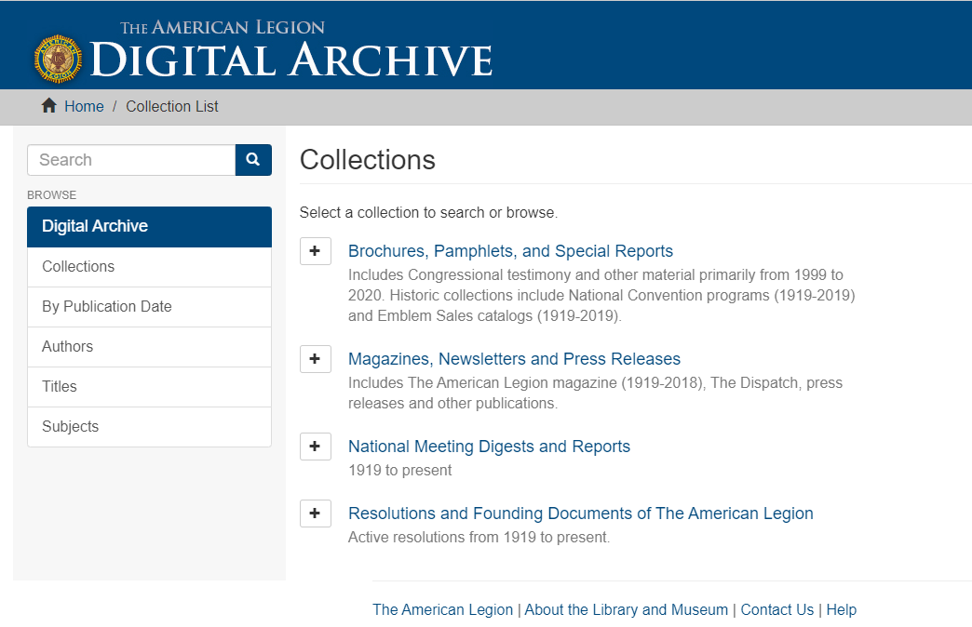
Digital Archive
archive.legion.org
Over 7,000 items
368,000 pages of material
Major Publications
Approved Resolutions
  (1919 - present)
Emblem sales catalogs
  (1919 - present)
The American Legion Magazine (1919-2018)
National Meeting Digests and Reports to Congress
  (1919 - present)
Notes:
Legion.org/archive
Next I’m going to walk you through how to access resolution in the Digital Archive.

Slide 27
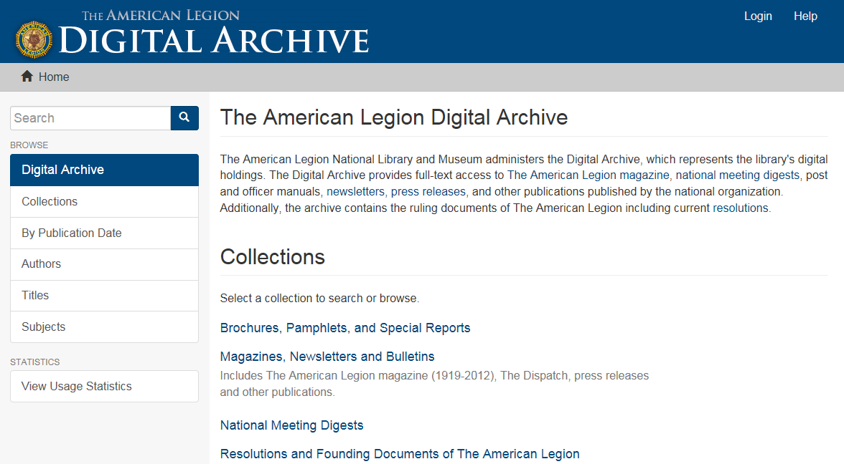
Digital Archive
Click here to search resolutions

Slide 28
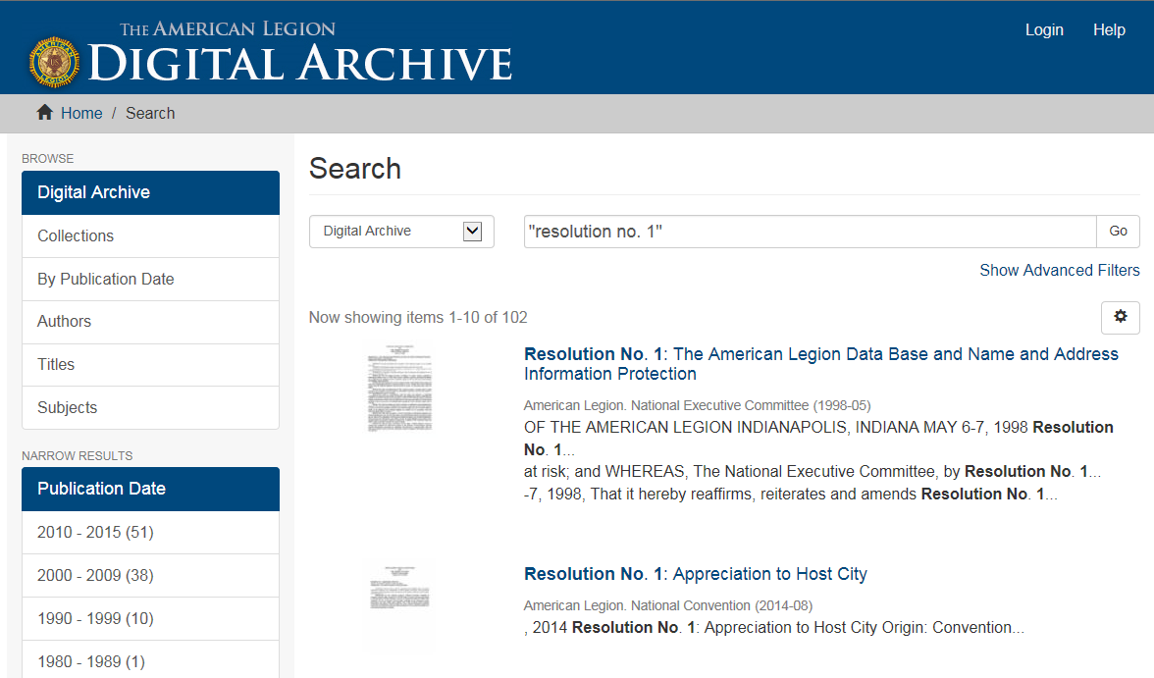
Title, Meeting, Date
Snippet of full text

Slide 29
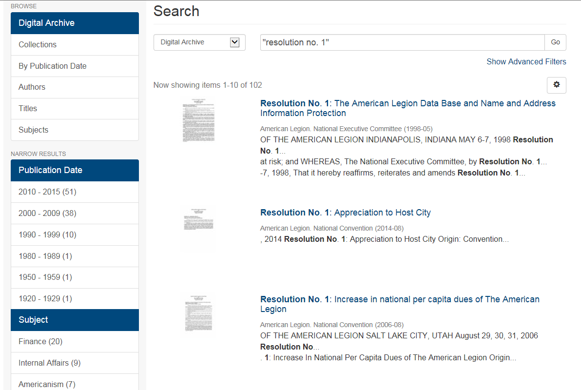
Digital Archive
Narrow your search results
Date
Subject

Slide 30
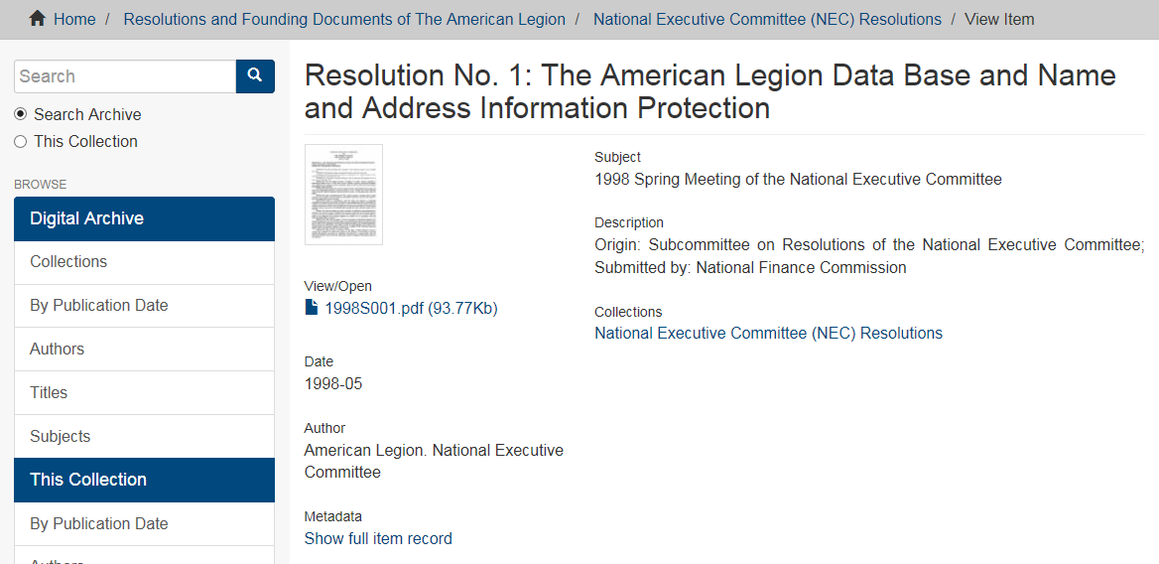
Digital Archive
View Resolutions
Title
Meeting
Click here to view resolution

Slide 31


floridalegion.org

Slide 32
Team Building Exercise
“Scenarios”

Slide 33
floridalegion.org

Slide 34



