Slide 1
AMERICAN LEGION RIDERS
FINANCE OFFICER TRAINING
Larry White, Finance Officer

Slide 2
Post Compliance on Financial Issues
EIN – Employer Identification Number (Issued by the IRS)
Non-Profit Tax Exempt – 501(c)(19) War Veteran’s Organization
Each Post is Required to file IRS Form 990 (Non-Profit Tax Return)
IRS can revoke the Non-Profit Status if Return is not Filed
Failure to file - Post considered a For-Profit Company
American Legion Riders NO longer a Non-Profit Organization
FL Dept of Revenue issues the Consumer’s Certificate of Exemption
Withholding of Taxes from Cash Winnings over $600

Slide 3
ARTICLE II American Legion Riders SOP
Section 8. Finances
Finances will be derived from Membership Dues, sale of approved merchandise and such other revenue sources as approved by the ALR General Membership.
Checks issued by the ALR Chapter must have the Post Finance Officer or his/her designee as one of the signatories on the bank account. The ALR Chapter may decide the other Chapter signatories on said instrument.
The ALR Chapter Finance Officer must file a financial statement detailing receipts and disbursements, each month with the Post Financial Officer which will be reported to the Post General Membership.
An ALR Chapter may not incur any debt in the name of Post without prior approval of the Post membership documented in the Post Memberships minutes.
The ALR Chapter of a Post is a subordinate organization to the sponsoring Post which is a non-profit organization and a tax-exempt Corporation under the laws of the State of Florida.
Should the ALR Chapter be dissolved or suspended, all funds and assets will be immediately turned over to the sponsoring Post for disposition.

Slide 4
I. Finances will be derived from Membership Dues, sale of approved merchandise and such other revenue sources as approved by the ALR General Membership.
The Finance Officer should secure from the Post Finance Officer a copy of the Post Consumer’s Certificate of Exemption which will allow the Chapter to purchase supplies free of sales tax. There is one issue with this, the credit card/debit card used to purchase must be in the name of the Post or some Posts allow American Legion Riders Post XXX debit cards. If the Post gives you such a card you can pay for hotels at Conference, Convention or this Summit and save the room tax and most all the other taxes

Slide 5
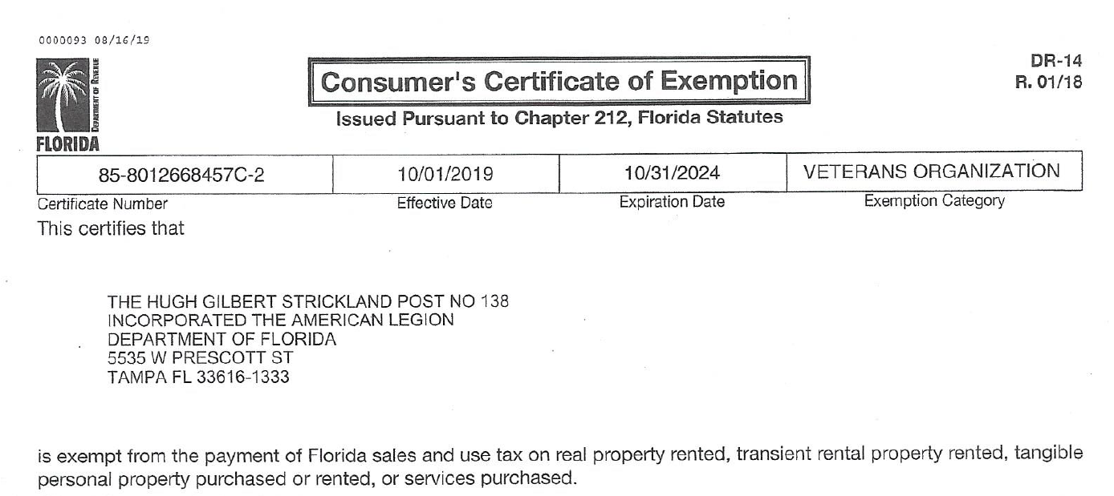
EXAMPLE

Slide 6
II. Checks issued by the ALR Chapter must have the Post Finance Officer or his/her designee as one of the signatories on the bank account. The ALR Chapter may decide the other Chapter signatories on said instrument.
To open a Checking Account, you must get permission of the Post Membership at a regular meeting and it must be part of the official minutes. The Post at the same meeting must specify who the signatories for the Post and ALR are. They can and in most cases will specify the bank you use. These sections of the minutes are required by the bank. Federal Law has recently changed, and some banks want to see all Officers to open an account. Check with your bank. Another recent development is banks saying you only need one signature to negotiate a check. My strong recommendation to everyone, even if the bank requires one signature every Post and Post organization must use two (2) signatures to protect oneself and provided complete transparency in everything that is done

Slide 7
III. The ALR Chapter Finance Officer must file a financial statement detailing receipts and disbursements, each month with the Post Financial Officer which will be reported to the Post General Membership.
I just mentioned the word transparency. I have talked about Employer Identification Numbers (EIN) which is a corporation’s social security number. A Post is a legal entity and as such must maintain complete control of the finances of all organizations working under their EIN. It is
The Post Finance Officers responsibility to watch the ALR Chapter finances and report any irregularities to the membership. Those irregularities could be too much money in a checking account begging the question why they are not making donations, or the reverse begging the question why they aren’t fundraising to build their checking account. If your Post has Trustee or Auditor’s, the Chapter must allow them to review the Chapter financials on whatever schedule the Post Finance Officer makes, most likely quarterly. At the end of the Posts fiscal year the Chapter may get questions from the Post concerning financial activities as they prepare the Post 990 for submittal to the IRS

Slide 8
IV. An ALR Chapter may not incur any debt in the name of Post without prior approval of the Post membership documented in the Post Memberships minutes.
The Post has control and responsibility for the finances of every organization using their EIN. The only group who can pledge those assets to incur debt is the Post Membership sitting at a regular meeting or meeting called for specially for this debt matter. Some Posts think their Executive Committee can authorize debt, which is not true, this is reserved strictly for the Membership.

Slide 9
V. The ALR Chapter of a Post is a subordinate organization to the sponsoring Post which is a non-profit organization and a tax-exempt Corporation under the laws of the State of Florida.
This is the way it is supposed to be. We have discussed what an EIN is and how it can affect an organizations tax-exempt status. As said, I would strongly recommend each Chapter check the status of their Posts EIN to insure they are a non-profit, tax-exempt organization. If the Post EIN is revoked, immediately bring that up to the Post Finance Officer and the Post Commander

Slide 10
VI. Should the ALR Chapter be dissolved or suspended, all funds and assets will be immediately turned over to the sponsoring Post.
This might be difficult to accept but everything you have, funds or assets, belongs to the Post therefore you must return their property to them. Remember all checks require the Post Finance Officer or his designee signature, so if you want to spend down your funds, get permission. Please remember anything the Chapter does reflects on the entire American Legion Riders organization.

Slide 11
How Do I Record Donated Items?
Item is Donated for Auction/Raffle
Item is Considered an Asset & Contribution Revenue
Contribution Revenue must be reported on Schedule G of the IRS Form 990
Provide Receipt to Donor
See Example on Separate Documentation

Slide 12
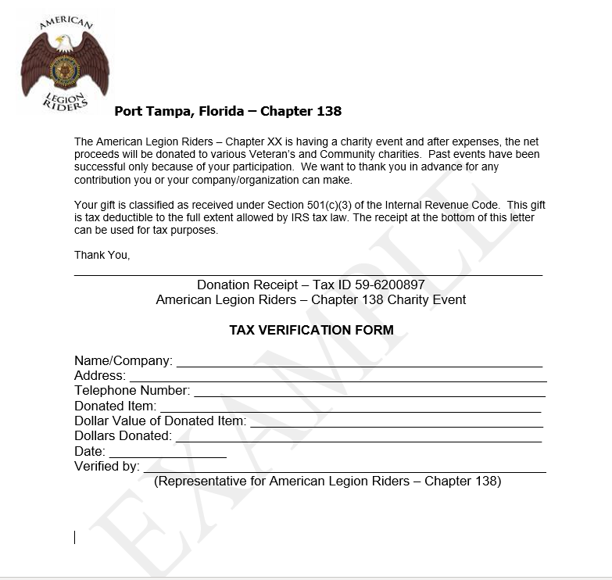
Example of a Donation Receipt

Slide 13
QUESTIONS??

