Slide 1
AMERICAN LEGION RIDERS
How to get the Google Form on your phone (kind of like an app)
Cory “Squirrel” York

Slide 2
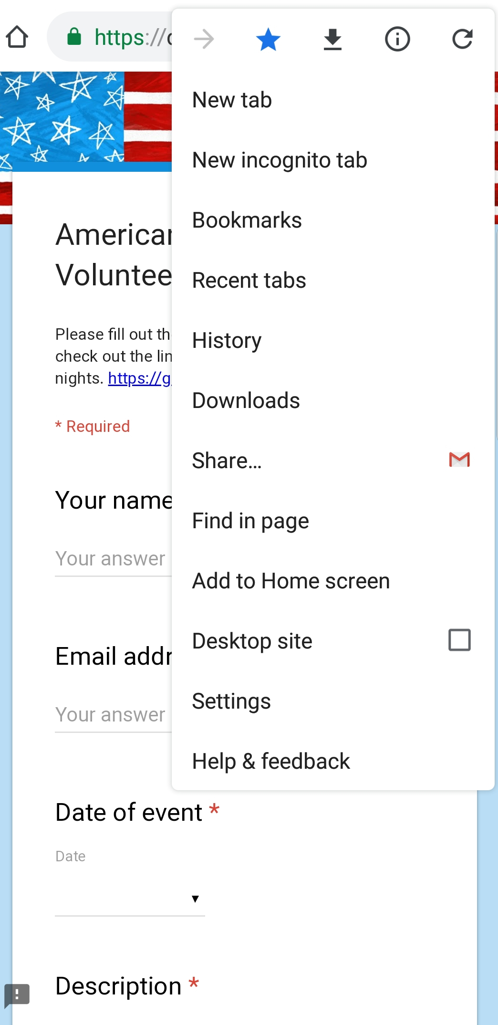
ACCESS THE FORM
Get the link to your Google Form from whoever has it…and open your internet browser of choice…since I am using an Android…I will be using Google Chrome. (Left)
Click on the three little dots at the top of the browser to bring up the Edit menu. (Right)

Slide 3
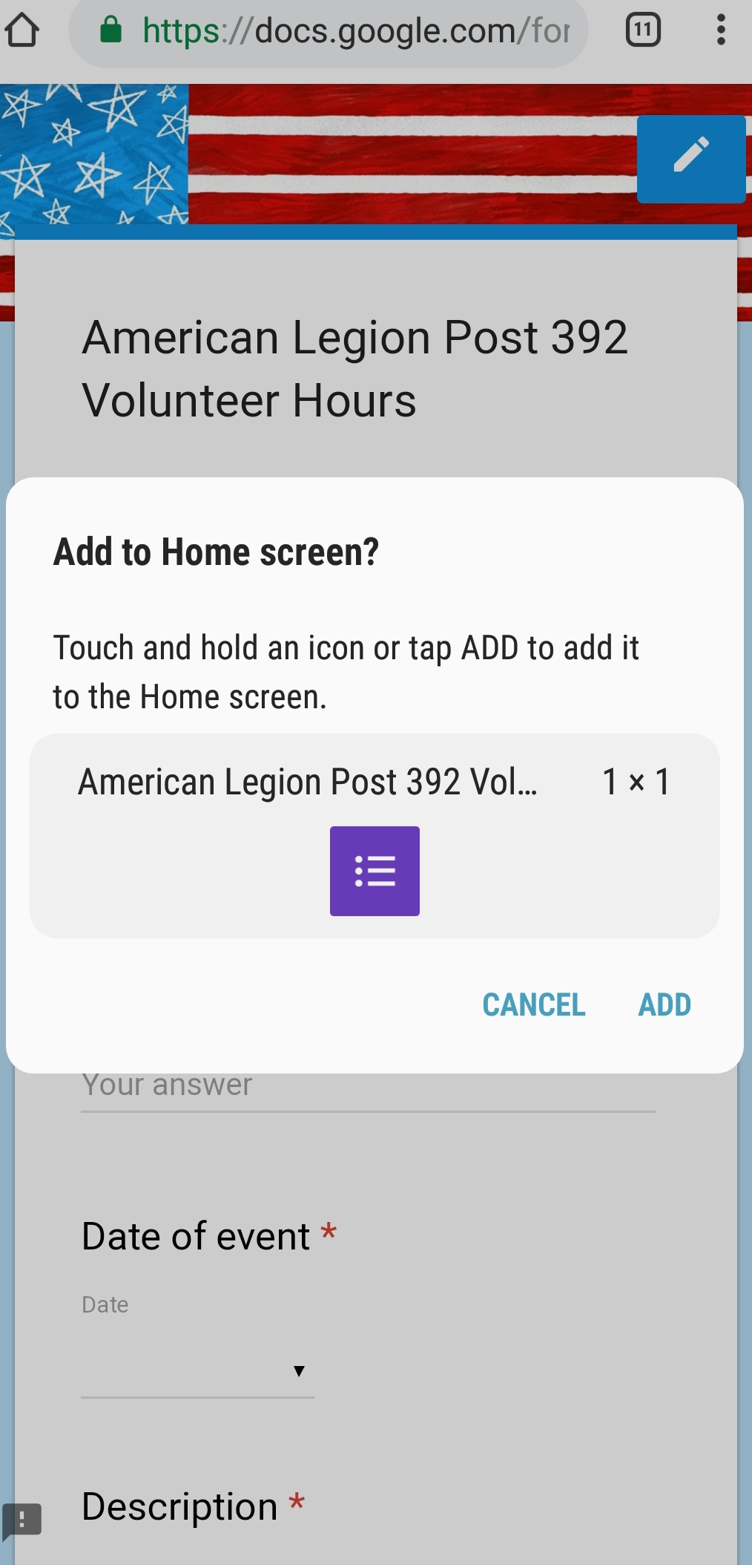
ADD TO HOME SCREEN
Once you click Add to Home Screen, the phone will prompt you for a name. You can leave the name the same as the name of the page, or customize it. Click Add (Left)
Once you click Add, you can click Add again and the phone will just add that icon anywhere, or you can click and hold the icon to add it where you want it. (Right)

Slide 4
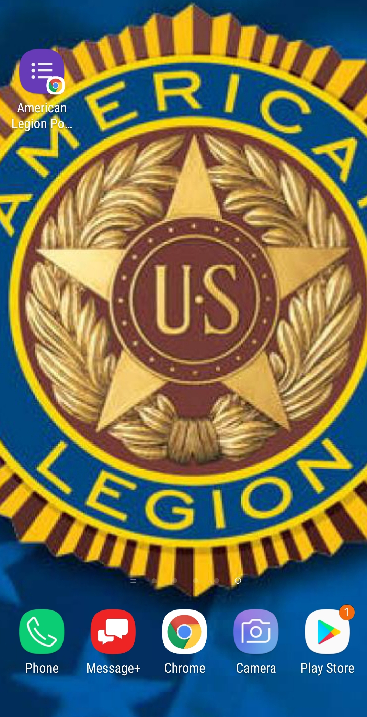
THERE IT IS…THAT’S IT!!!!!
The icon will appear on your desktop and filling out your form is only one click away.

