Slide 1
American Legion Riders 4th Annual Summit Merry-Go-Round Round Robin Unity Ride District Patch
Sonny Decker & Jeff Hawk

Slide 2
Merry-Go-Round & The Round Robin
These month-long events are intended for our American Legion Rider Family to visit other Posts inside and outside of their home Districts. To support Legion Programs, promote The American Legion, gain new members, and raise funds and awareness.

Slide 3
MERRY-GO-ROUND
Supporting Children & Youth Programs
Month of October
Promotes Unity
Plan Fun Rides
Friendly Competition between Districts
Bragging Rights for the Merry-Go-Round Trophy Presented @ Fall Conference

Slide 4
ROUND ROBIN
Supporting Project: Vet Relief/Suicide Prevention Initiative
Month of April
Promotes Unity
Plan Fun Rides
Friendly Competition between Districts
Bragging Rights for the Round Robin Trophy
Presented @ Convention

Slide 5
American Legion Riders Website
Search for website – floridalegion.org
Under “Programs & Services” select “Legion Riders” from the dropdown list – You are now on the Riders home page!
Select “Special Events” from the list located on the left of the page
Select either “Merry-Go-Round” or “Round Robin”

Slide 6
MGR/RR RULES
Must have a minimum of 3 people on each ride (either on a bike or in a cage)
Ride to a minimum of 3 American Legion Posts
$5 Registration Fee Per Member per Ride – Individual or Group online registration available
Ride miles begin at Starting Point of the Ride and can Start at any Post and end at any Post
Record the number of miles and hours for each ride/event
After each Ride, Report the ride information online
All activities/rides must be during the months of October or November respectfully
When entering miles and hours, DO NOT multiply the miles OR hours by the number of members. The number of members recorded online will be used to determine the total miles and hours.
Send checks to Department Headquarters OR Present your Donation at the ALR General Meeting at the Fall Conference
Make checks payable to: American Legion Department of Florida Memo Line: Legion Riders Merry-Go-Round
ALL RIDE TOTALS MUST BE ENTERED ONLINE
No Difference in Rules between MGR or RR

Slide 7
Registration & Reporting At the bottom of the page 4 tabs are available:

Slide 8
REGISTRATION
Individual Registration Available – Credit Card Only
New Option Available!!!
Group Registration – Credit Card Only
Benefits:
Consolidate registration fee into 1 online entry
Ease of those wanting to pay by cash or check
Real Time Saver!!

Slide 9
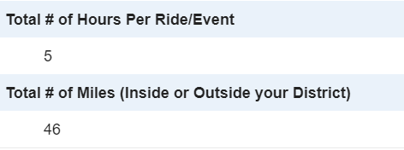
Example of Online Reporting

Slide 10
Point Calculations
1 point for each ride mile per ALR Member (Rider or Supporter)
1 point for each hour per ALR Member (Rider or Supporter)
1 point for each dollar collected (registration fee, donations, monies raised)
Want to Earn Extra Points?
Ride to any American Legion Post outside of your District to earn 100pts per person per Post visited
Plan a Unity Ride (150pts Per Person Per Post Visited)
Must be at least 3 Chapters within your District Participating – Each Chapter must have at least 3 Participants on the Unity Ride
Must visit a minimum of 3 American Legion Posts or another Veteran’s related group (VFW, AMVETS, etc)
The ALR Area/District Chairman must have knowledge of the Unity Ride
Report the ride information online and submit

Slide 11
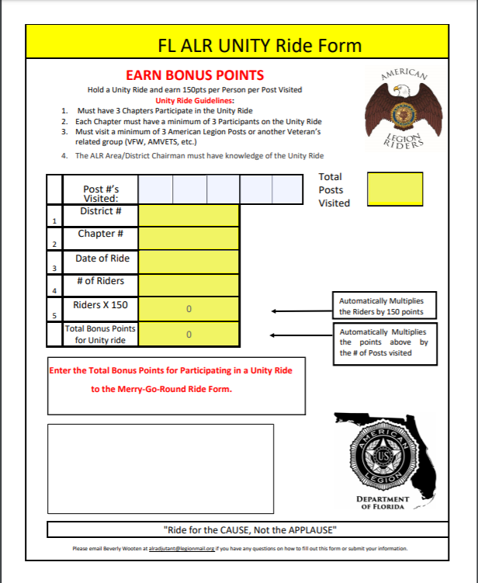
UNITY RIDE FORM
Fill out Unity Ride form
Automatically Calculates
Email to ALR Adjutant

Slide 12
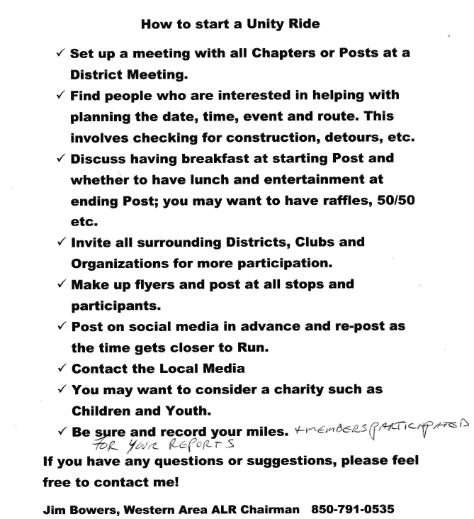
UNITY RIDE
What is a Unity Ride??
It can be a Fun Ride!
It can be a Benefit Ride!
It can used to earn extra Points on the Merry-go-Round and Round Robin Rides!

Slide 13
District Participation Patch
Set up Criteria/Qualifications to earn your District Patch
Create District Patch Design
Include “D (District#) R” & Rider Chapter Post #’s
Encourage Unity between Chapters
Increase Participation
Share with Other Districts
Challenge other Districts to Earn your District’s Patch!

Slide 14
Examples of Existing Criteria 1. Each ALR Chapter within the District Must participate 2. With 2 or more riders, visit ‘X’ posts within District in One Day 3. With 1 or more riders, attend a “Function” at 2 of the ALR District Posts 4. Assist in an ALR function at another Post within the District 5. Visit 1 ALR Chapter out of the County if Multiple Counties within a District 6. Visit 1 ALR Chapter out of the District if ALL Chapters within the same District are in the same County 7. Complete & Document Activities 8. No Time Limit to Complete Activities – Earn at your own Pace
“Function” is defined as a Bike Night, Wing Night, Car Show, etc. THIS IS NOT A VISIT. The intent is to Support Post Functions. This does not have to be an ALR Function; any Post Function qualifies.

Slide 15
DISTRICT 1 D1R EAST

Slide 16
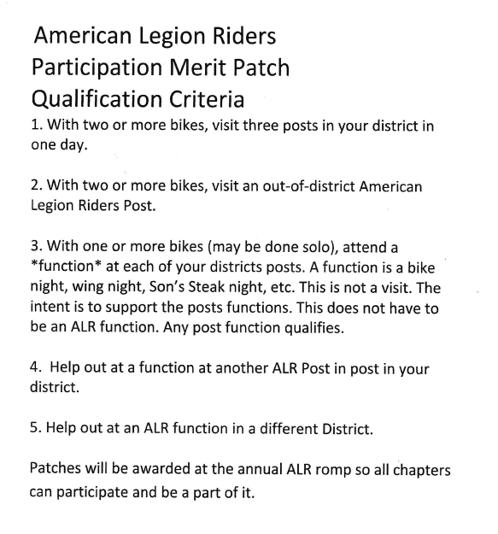
DISTRICT 1 D1R - West

Slide 17
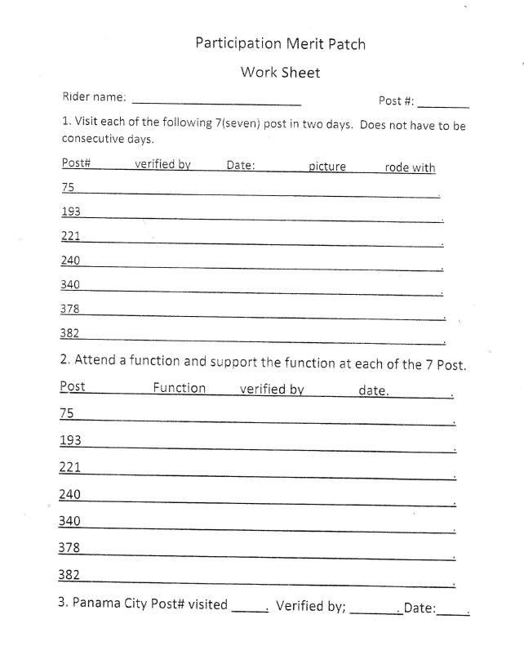
District 1– Tracking Sheet

Slide 18
DISTRICT 6 – D6R – DEEP VI

Slide 19
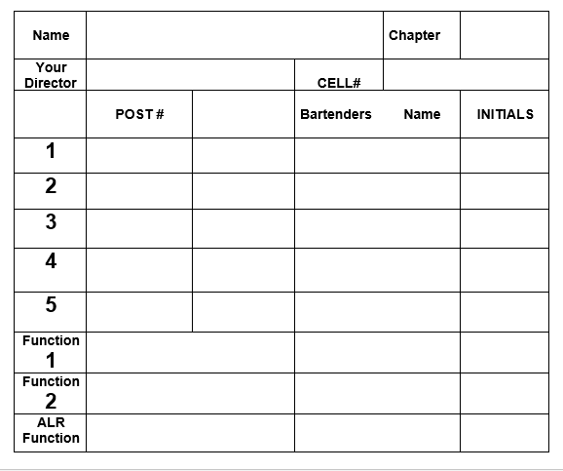
District 6 - Tracking Sheet

Slide 20
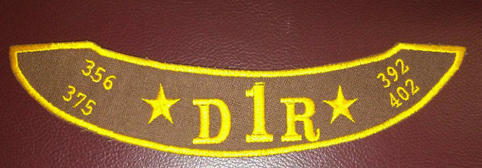
DISTRICT PATCHES
District 1 – D1R East Patch
District 1 – D1R West Patch

Slide 21
CHALLENGE TO ALL DISTRICTS
Hold Quarterly District Meetings
Participate in Round Robin & Merry-go-Round
Plan Unity Ride
Earn District Patch
Encourage Riders to Participate
Capture the Flag

Slide 22
QUESTIONS ???

