Slide 1
HOW TO CREATE YOUR ONLINE
TRACKING FORM
Go To https://docs.google.com/forms

Slide 2
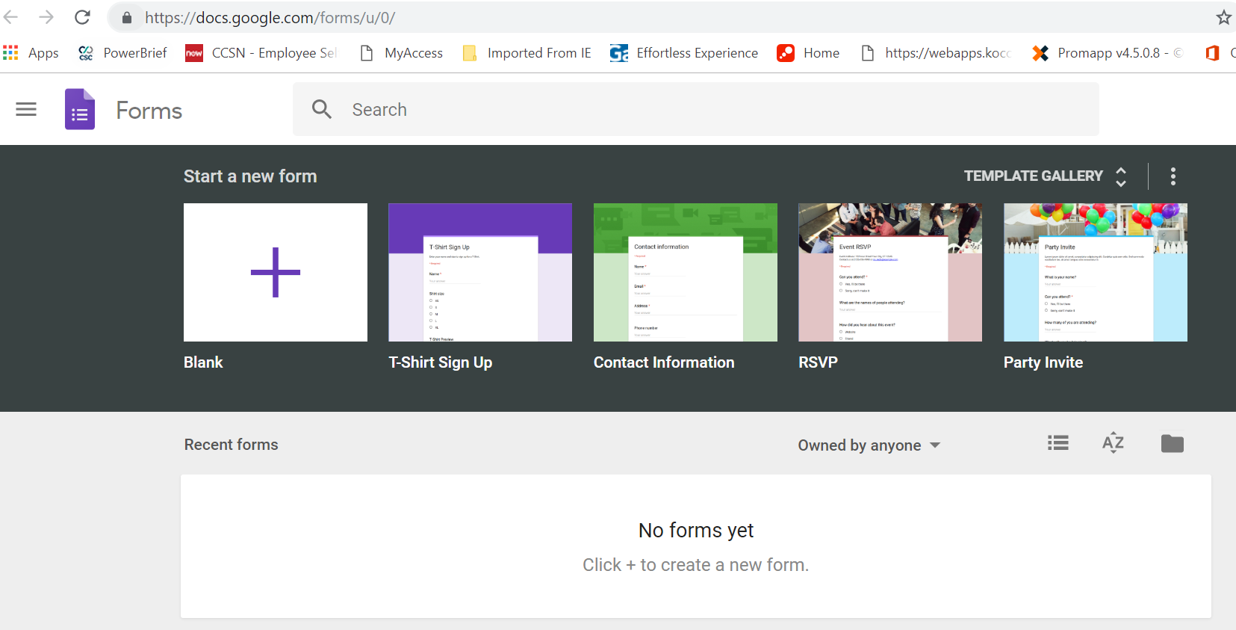
Create New Form – Select Start New Form

Slide 3
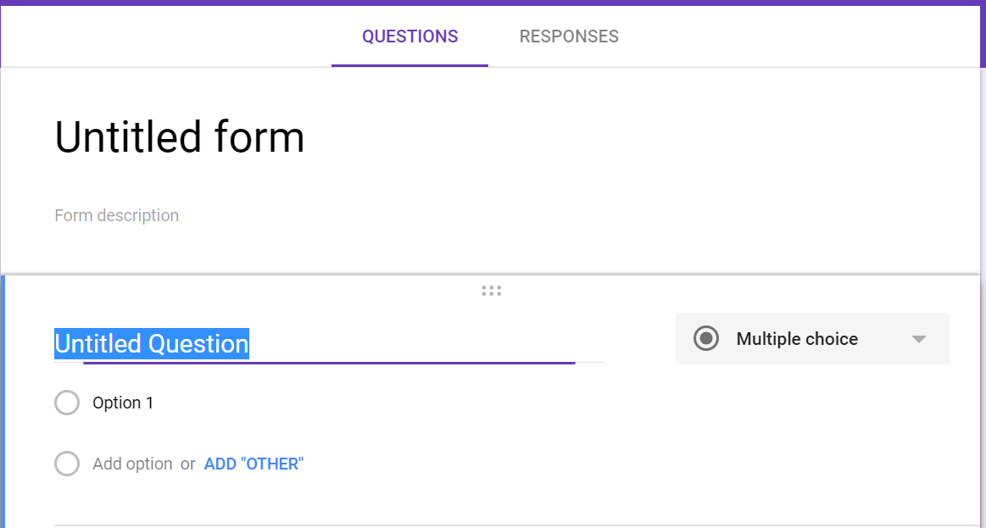
Click on “Untitled Form” to Name Your Form & Form Description
Suggested Title – ALR Chapter # or ALR District #
Suggested Form Description: Volunteer Tracking – Miles & Hours

Slide 4
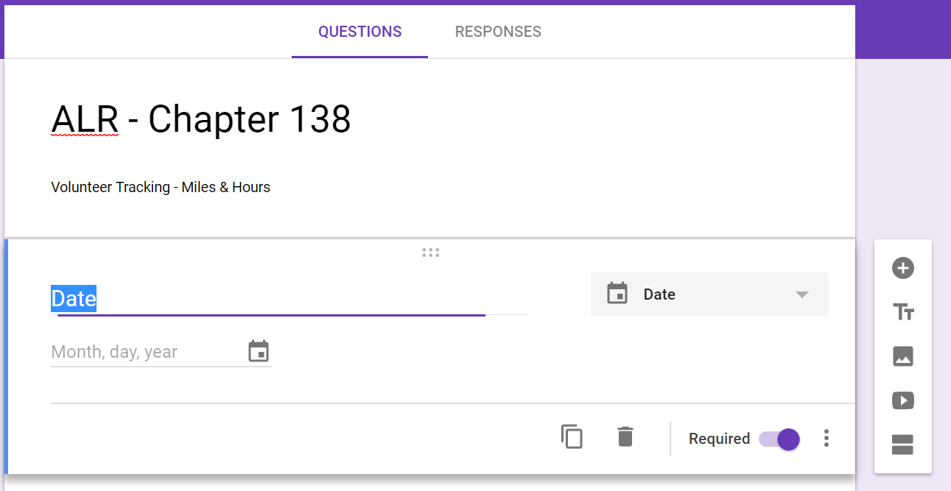
Adding Fields
Add New Field
Ensure that ALL fields are marked REQUIRED

Slide 5
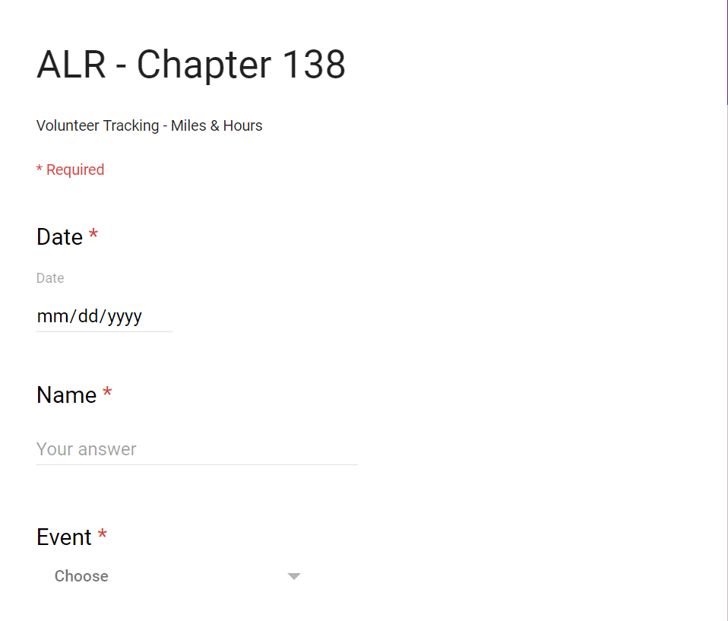
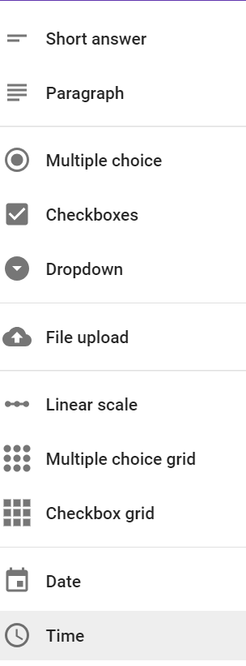
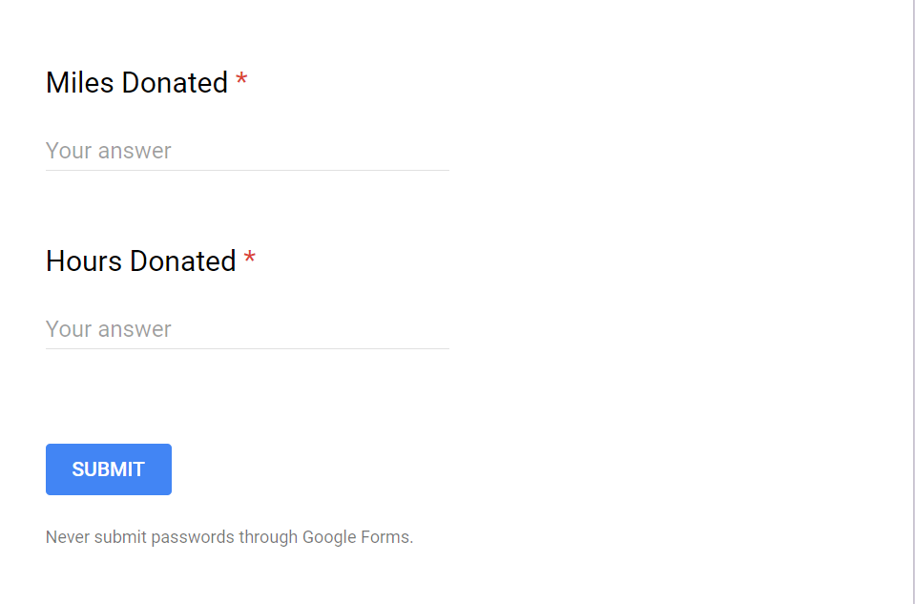
Use Drop Down Option

Slide 6
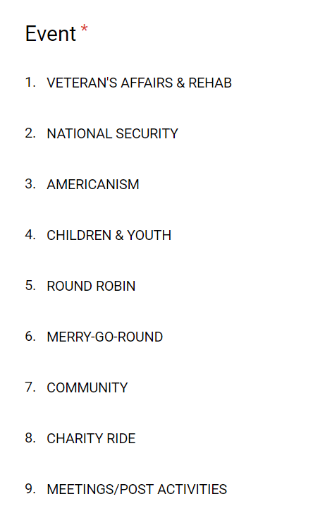
SUGGESTED CATEGORIES

Slide 7
After your Ride or Event, Fill out the Volunteer Tracking Form and SUBMIT!

Slide 8
