Slide 1
American Legion Riders VOLUNTEER TRACKING FORM & APP Mileage & Hours Reporting
Beverly J. Wooten, ALR Adjutant
Cory “Squirrel” York & Alex Hill

Slide 2
American Legion Rider Chapter
Purpose
To promote motorcycle safety programs and provide a social atmosphere for members of the American Legion, American Legion Auxiliary, and the Sons of the American Legion.
To participate in parades and other ceremonies which are in keeping with the aims and purposes of the American Legion.
To organize and participate in charity events helping veterans, their families, and the local community.
To use our association to promote and support the programs of the American Legion Family.

Slide 3
Who Reports Hours and to Whom?
What Hours are Reportable?
How to Record Mileage and Hours?
When do Members turn in their Hours?
Why Record our Mileage and Hours?
Year End Reporting

Slide 4
Who Reports Hours and To Whom?
Every Rider in good standing with the Chapter
Supporters
ALR Supporters
*Honorary Members
*Volunteers
Future Rider Members of the Chapter
Designated person to whom the Chapter assigns
Road Captain
Secretary
*Legion Family members who go “beyond the call” to support the ALR Program

Slide 5
What Hours are Reportable?
All meetings of the Post/State/National
Legionnaires/SAL/Auxiliary/Rider Monthly & E-Board meetings
Committee Meetings
Conferences/ALR Summit
Post Activities Sponsored by Legion/SAL/Auxiliary/Riders
Raffle Sales
Shopping/Preparation for events
Post Improvements
Fund Raising Events
State Sponsored Rides
Round Robin
Merry-Go-Round
Legacy Ride
Unity Ride
Awareness Rides – Scheduled or Unscheduled
Community Events
Parades/Escorts

Slide 6
How To Record Mileage and Hours?
Submit miles and hours
On form
Email
Text/Messenger
**OnLine **
Information Required
Name of Event/Ride/Meeting/Etc.
Date of Event/Ride/Meeting/Etc.
# of bikes, passengers, car/passenger
Round Trip Miles
Total hours per person

Slide 7
MILEAGE LOG WITH MONTHLY/QUARTERLY/YEARLY TOTALS REVIEW

Slide 8
Category Examples
Veteran’s Affairs & Rehabilitation – Stand Down, Final Respects, Round Robin (Project:Vet Relief), etc.
National Security – Family support programs, Gold Star Families, POW/MIA activities, etc.
Americanism – U.S. Flag Protection, Flag ceremonies, Boy Scouts, Legacy Fund, Legion Baseball, etc.
Children & Youth – Boys & Girls State, Youth Law Cadet program, Christmas for Military children, Merry-Go-Round, etc.
Community
Charity Rides
Meetings/Post Activities

Slide 9
How to Set Up A Gmail Account
How to Create Your OnLine Tracking Form

Slide 10
When Do Members Turn in Their Miles & Hours?
Preferred Method: After each event
Monthly at a minimum
Deadline determined by Chapter
Tip: Designate someone to record and to receive reports
*** If turned in late, information can be added to the next month’s report.***

Slide 11
Why Record Our Mileage and Hours?
To Make A Difference!
So Our Voice Will Be Heard on Capitol Hill!
Legislative Changes for Veterans!

Slide 12
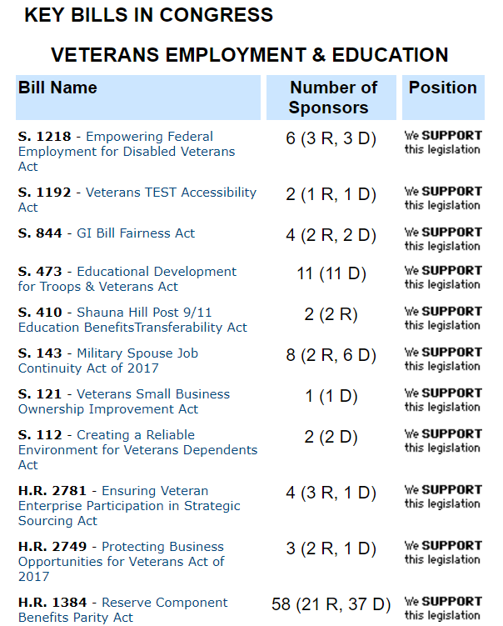
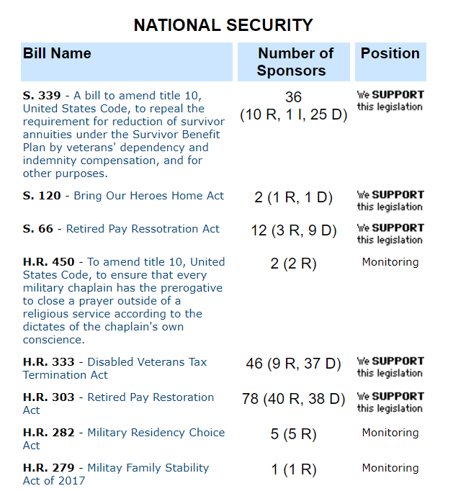
http://capwiz.com/legion/issues/bills/

Slide 13
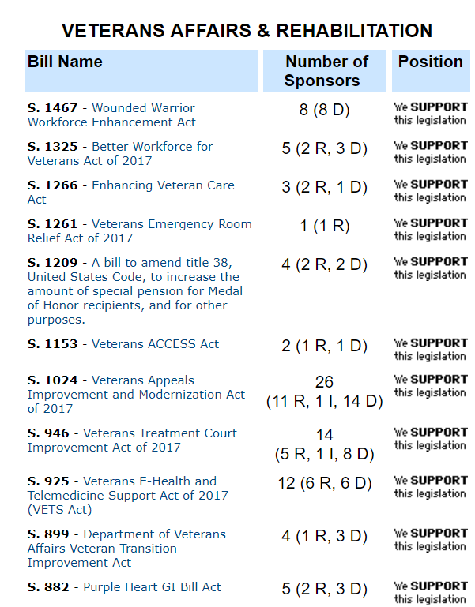
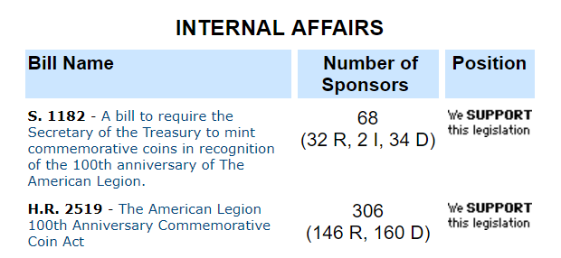
http://capwiz.com/legion/issues/bills/
And Many More!

Slide 14
Year End Reporting
https://www.floridalegion.org/programs-services/legion-riders/alr-eoy-reporting/
Reports To Be Completed by
MAY 31ST

Slide 15
QUESTIONS

