Slide 1


Slide 2

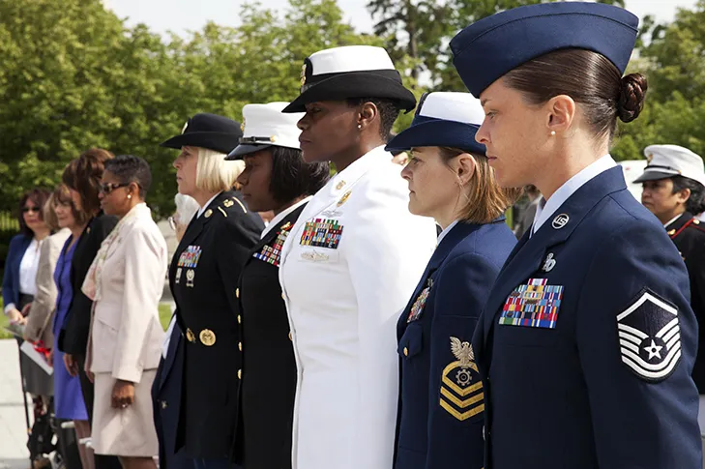
Women
Veterans
Forum
Instructors: Joan Suelter, Susan Kohler
2025 Department of Florida
Department Convention
www.floridalegion.org

Slide 3

Agenda
Introduction/Facilitators: Joan Suelter, Susan Kohler
Other Introductions
Mission
Benefits of be a member of the American Legion
Honoring women veterans
Summary of concerns
Goals to success
Open Discussion
Resources/social media support
Final Thoughts
WOMEN VETERANS FORUM
  -

Slide 4
Introductions
  Women Veterans Committee
      Joan Suelter, Post 347
      Dianne Boland, Post 117
      Jean Ware Post 418
  Women Veteran Advocates Working Behind the Scenes
      Susan Kohler, District 16, Post 273, 1st Vice Commander, Service Officer, todays co-partner/instructor
      Jean Ware, District 15, Post 418, 1st Vice Commander,
      Hernando County Women Veteran Leader.
WOMEN VETERANS FORUM
Notes:
C

Slide 5
The benefits of being part of the legion family
  Advocate for female veterans.
  Assist women veterans transition from active duty to veteran status.
  Assist our sister veterans with access to VA benefits: health care to include mental health programs addressing PTSD and MST, homelessness and compensation.
  Apply their military and life experience to further the growth of the American Legion.
  Camaraderie
WOMEN VETERANS FORUM

Slide 6
Mission Statement
  Engage our sister Veterans to foster female camaraderie.
  Educate and provide wellness assistance and other support as needed through networking and collaboration with Florida Department of Veteran Affairs, the American Legion and the VA system.
  Offer a safe environment that encourages a sense of belonging, recognition and appreciation for their service and sacrifices made in the defense of our country.
  Embrace their life and military experiences which will strengthen the growth of each other and the American Legion.
WOMEN VETERANS FORUM

Slide 7
Honoring the Resilience of Women Veterans: Acknowledging Their Struggles After Discharge
  In recent years, we have made significant strides in recognizing the sacrifices of our veterans. However, women veterans often find themselves navigating a unique set of challenges post-discharge. These challenges can encompass a broad spectrum, including mental health struggles, employment difficulties, healthcare disparities, and social reintegration.
WOMEN VETERANS FORUM

Slide 8
Honoring (continued)
First and foremost, mental health is a pressing concern for many women veterans. The experiences of military service, including exposure to combat and the stress of military life, can leave lasting psychological impacts. Women veterans are at an increased risk of conditions such as post-traumatic stress disorder (PTSD), depression, and anxiety. Unfortunately, these mental health issues are often compounded by feelings of isolation and the stigma of seeking help. It is imperative that we create a supportive environment where women veterans feel comfortable accessing the mental health resources, they need without fear of judgment.
WOMEN VETERANS FORUM

Slide 9
Summary-Transitional Concerns for our women veterans
Employment
Health Care disparities
Mental Health - Suicide
Social reintegration
Essential to acknowledge the impact of MST
WOMEN VETERANS FORUM

Slide 10
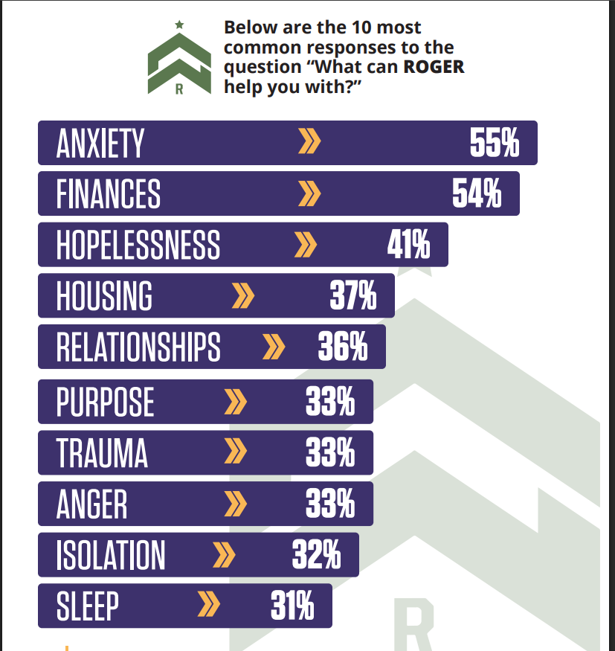
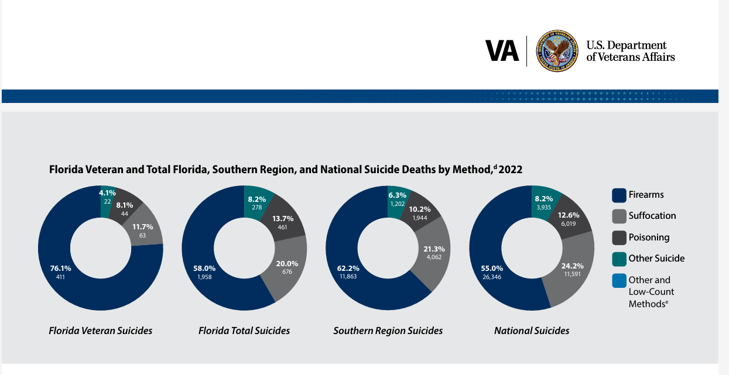
Factors Driving Suicide Among Veterans
WOMEN VETERANS FORUM
  At some point, we have to realize the connection between suicide and firearms. The overwhelming research indicates firearms are one of the leading causes of veteran suicide, in fact, nationwide, almost 3 out of 4 (71%) veterans who die by suicide use a firearm.

Slide 11
To Achieve this
**Raise Awareness**: Educate women veterans and the public about the unique struggles faced by women veterans. Increased awareness can lead to greater empathy, understanding, and support.
**Advocate for Policy Changes**: Work with lawmakers to implement policies that address the specific needs of women veterans, including healthcare improvements, employment initiatives, and mental health support.
**Strengthen Support Networks**: Encourage the development of veteran-focused organizations, peer support groups, and community programs that provide a sense of belonging and assistance.
**Improve Access to Healthcare**: Ensure that women veterans have timely access to high-quality, gender-specific healthcare services to includes expanding mental health resources and addressing the unique medical needs of women who have served.
WOMEN VETERANS FORUM

Slide 12
Achieve (continued)
**Promote Employment Opportunities**: Collaborate with businesses and organizations to create job training programs, mentorship opportunities, and hiring practices that recognize the value of women veterans' skills and experiences.
**Address Military Sexual Trauma**: Enhance support systems for MST survivors, including counseling, legal assistance, and comprehensive care tailored to their needs.
WOMEN VETERANS FORUM

Slide 13
Strides
The VA has recently expanded benefits for women veterans, with more than 50,000 women veterans enrolled in health care over the past 365 days, including
HEALTH CARE
  Breast cancer screenings and mammograms who may have been exposed to toxins.
  Increased access to reproductive health services, including birth control, preconception
  counseling and menopausal support
Disability Compensation
  Compensation benefits is at an all-time record number; with women veterans (717,141) receiving disability benefits. Of the 89% of women veterans who have applied from the VA for at least one condition, on average receiving $27,109 earned benefits each year.
Women Veteran Call Center
  Supports Women veterans in navigating all the services we might need. 1-855-829-6636
WOMEN VETERANS FORUM

Slide 14
Open Discussion
  Boots on the ground: what's happening?
  Struggles, Opportunity, Best Practices
WOMEN VETERANS FORUM

Slide 15
References/Resources
  Arlington National Cemetery is not operated by the VA but through the department of defense. For more information visit www.arlingtoncemetery.mil or National Cemetery Administration-Predetermination/eligibility www.cem.va.gov
  Access to Patient Medical Info: www.myhealth,va.gov. is online record system. Contact 1-877-327-0022
  Veterans Affairs and Rehabilitation Weekly Update. (slatterell@legion.org) American Legion National Level
  Florida Department of Veterans Affairs, Vanessa Thomas, State Women's Veteran Coordinator. (Vanessa.Thomas@fdva.fl.gov)
  Local American Legion Service Officer
WOMEN VETERANS FORUM

Slide 16
References/Resources
  Beyond PTSD/Military Sexual Trauma “You’re not alone”.
  Is a free easy to use mobile application, developed by the Department of Veteran Affairs (VA). It is a private self-help tool for healing from the effects of (MST). This app can help manage stress, improve your quality of life and move forward.
  www.mentalhealth.va.gov/msthome.asp
  Crisis Hotline: if you are in crisis or to help a fellow veteran, call the CRISIS HOTLINE (Dial 988)
WOMEN VETERANS FORUM

Slide 17
Social Media Support Organizations
  Hernando County Women Veterans
  @hernando.county.women.veterans
  Tri-County Women's Veteran Organization
  tricountywomen.org
  ROGER – Free, anonymous mental health services 1-833-906-3124 goroger.org
WOMEN VETERANS FORUM

Slide 18
Our Final Mission Today
  Hug a Sister Veteran who is not a member and bring her into the American Legion Family
  Refer a Sister Veteran to the Service Officer for resources and support
WOMEN VETERANS FORUM

Slide 19
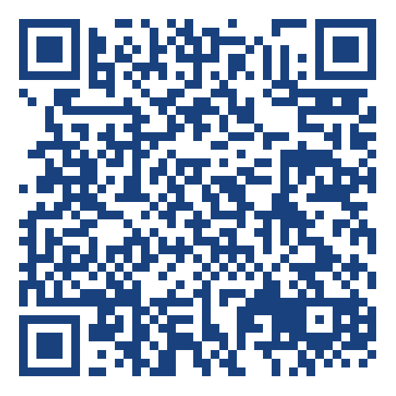
Thank You
WOMEN VETERANS FORUM
Please leave feedback.

