Slide 1


Social Media
Training
Instructor: Dana Jackson
2025 Department of Florida
Department Convention
www.floridalegion.org

Slide 2


Show of Hands
  How many of you are using social media at the post or district level?
  How often are you posting?
  What types of information are you posting?
  Are you getting feedback from your members?
SOCIAL MEDIA TRAINING
Notes:
Ramp it up to 2-3 times per week and aim to 10+ times per week by posting about certain things every Monday for example. Does anyone have a social media calendar? You can schedule in FB when you want your flyers to go out.

Slide 3

Social Media Topics
  What is Social Media?
  Why is it Social Media Important?
  Why People Avoid Social Media
  Social Media Characteristics
  Social Media Platforms
  Monthly Active Users
  Social Media Etiquette
  Work Smarter Not Harder
SOCIAL MEDIA TRAINING

Slide 4
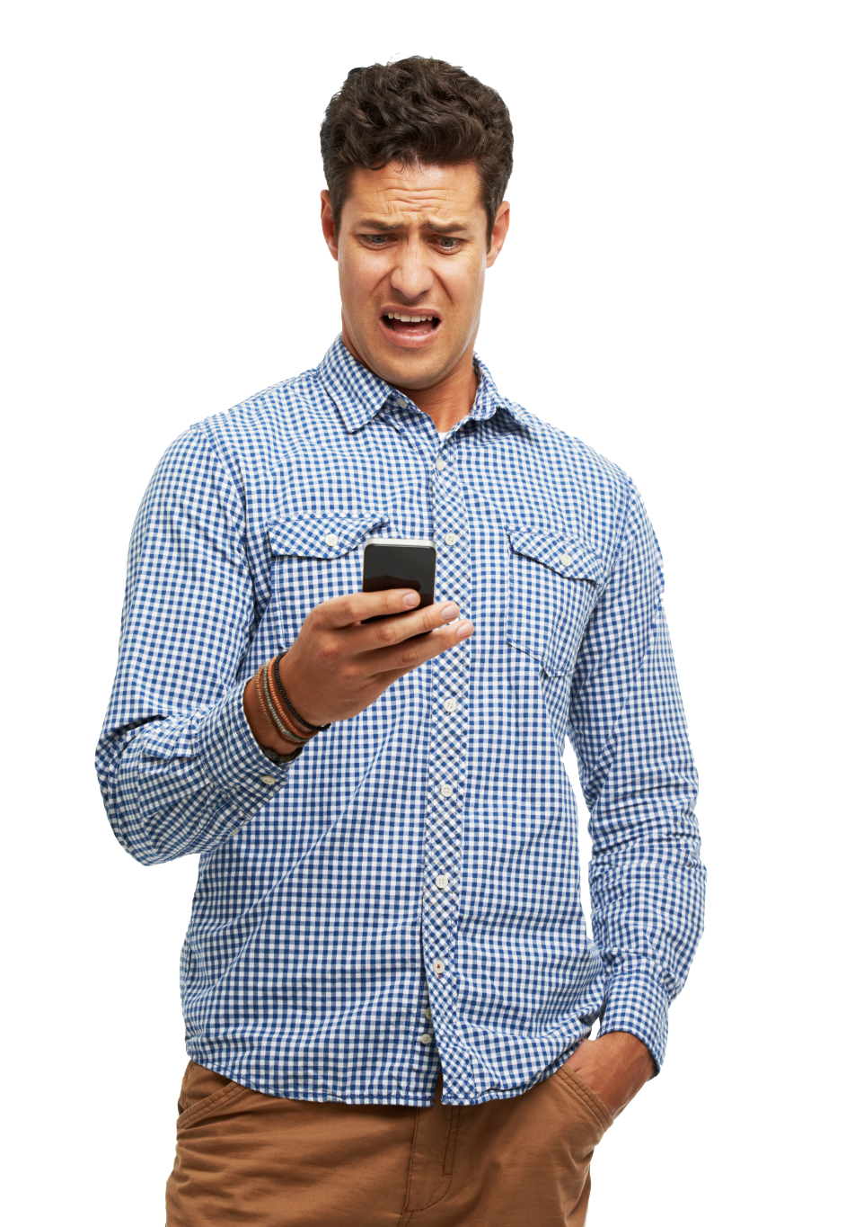

Other Social Media Topics
    Hashtag/Tagging/Retweeting
    Social Media Posts
    How Are You Sharing Information?
    Districts vs Posts
    Brand Mark vs Emblem
    Creating QR Codes
    Resources
SOCIAL MEDIA TRAINING

Slide 5
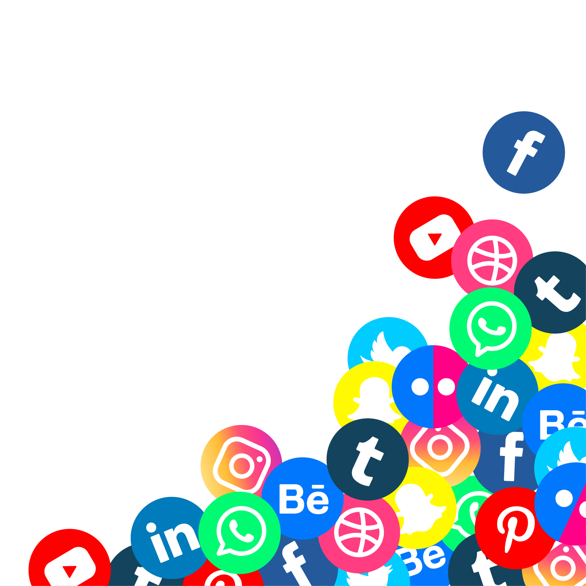
What is Social Media?
Social Media: Websites and computer programs that allow people to communicate and share information, opinions, pictures, videos, etc. on the internet, especially social networking websites
(Two-way communication)
SOCIAL MEDIA TRAINING
Cambridge University Press. (n.d.). Social media. In Cambridge Dictionary.
From https://dictionary.cambridge.org/dictionary/english/social-media.

Slide 6
Why is Social Media Important?
Recent studies revealed that only 20% of nonprofits feel ‘extremely confident’ that they’re maximizing their social media potential. That means 80% feel they could be doing even more with their social media strategy.
2023 Consolidated Post Report (CPR) – 72% of Posts are reporting they use social media & 55% have a website.
SOCIAL MEDIA TRAINING
McLachlan, Stacey. "Social Media for Nonprofits: 12 Essential Tips for Success." Hootsuite Blog, June 14, 2023, https://blog.hootsuite.com/social-media-for-nonprofits/.

Slide 7
Why is Social Media Important?
  2023 - 4.0 billion people use social media, and the average user spreads their digital footprint across 6 to 7 platforms every month, increasing the need for us to spread our digital footprint.
  2024 - increased to 5.7 billion users
  Today, 93.3% of internet users use social media
SOCIAL MEDIA TRAINING
Influencer Marketing Hub. "Top 69 Digital Marketing Statistics for 2024." Influencer Marketing Hub, May 21, 2024, https://influencermarketinghub.com/digital-marketing-stats/.

Slide 8

Why People Avoid Social Media
  I’m too old!
  It’s too complicated!
  Facebook will steal my identity!
  Social media is evil!
  Don’t know where to start?
  What are your hesitations to using social media?
SOCIAL MEDIA TRAINING
Let’s Get To It!!!

Slide 9

Social Media Characteristics
  Participation – encourages contribution
  Openness – encourages commenting &
  sharing of information
  Conversation – allows two-way communication
  Community – joins you with others who share commonalities; share events through flyers
  Connectedness – links to other sites, resources & people
SOCIAL MEDIA TRAINING

Slide 10






Social Media Platforms
  Blogs: online diaries
  Microblogging: social network + blogging
  Facebook , X (formerly Twitter)
  Content Communities: photos & videos
  Pinterest , YouTube ,& Flickr
  Professional Networking: LinkedIn
SOCIAL MEDIA TRAINING

Slide 11


Social Media Platforms
TikTok - videos
Wikis – add content to website
Podcasts – audio/visual files
Forums – online discussion
Instagram – photo sharing
SOCIAL MEDIA TRAINING

Slide 12



Monthly Active Users
  Facebook: 3.07 billion
  YouTube: 2.5 billion
  WhatsApp: 2 billion
  Instagram: 2 billion
  TikTok: 1.60 billion
  Snapchat: 800 million
SOCIAL MEDIA TRAINING
Connell, Adam. "22 Leading Social Media Platforms For 2024 (Ranked By Monthly Active Users)." Adam Connell Blog, 2024, https://adamconnell.me/social-media-platforms-maus-2024/&#8203;:contentReference[oaicite:0]{index=0}.

Slide 13

Social Media Etiquette
Social media discussions can be brutal.
The purpose for The American Legion social
media sites are to be seen and engaged.
Limit your posts to the interests
and the good of the Legion. Leave
personal feelings to your personal
page.
SOCIAL MEDIA TRAINING

Slide 14

Social Media Etiquette
Delete/block comments that:
  Are racist, sexist, vulgar, obscene, or defamatory
  Personally attack others
  Threaten the privacy of others
  Violate the privacy of others
  Are partisan, overtly political or totally unrelated to the topic of discussion
  Are inaccurate
SOCIAL MEDIA TRAINING

Slide 15
Work Smarter Not Harder
Compose Once and SHARE!
For example, if you're posting on Facebook, you can click the "share" button and select "Twitter“ from the drop-down menu. This will allow you to share your post with Twitter followers without having to leave Facebook. You can also do this in reverse by sharing your Facebook posts on Twitter. Do this with multiple platforms.
SOCIAL MEDIA TRAINING

Slide 16
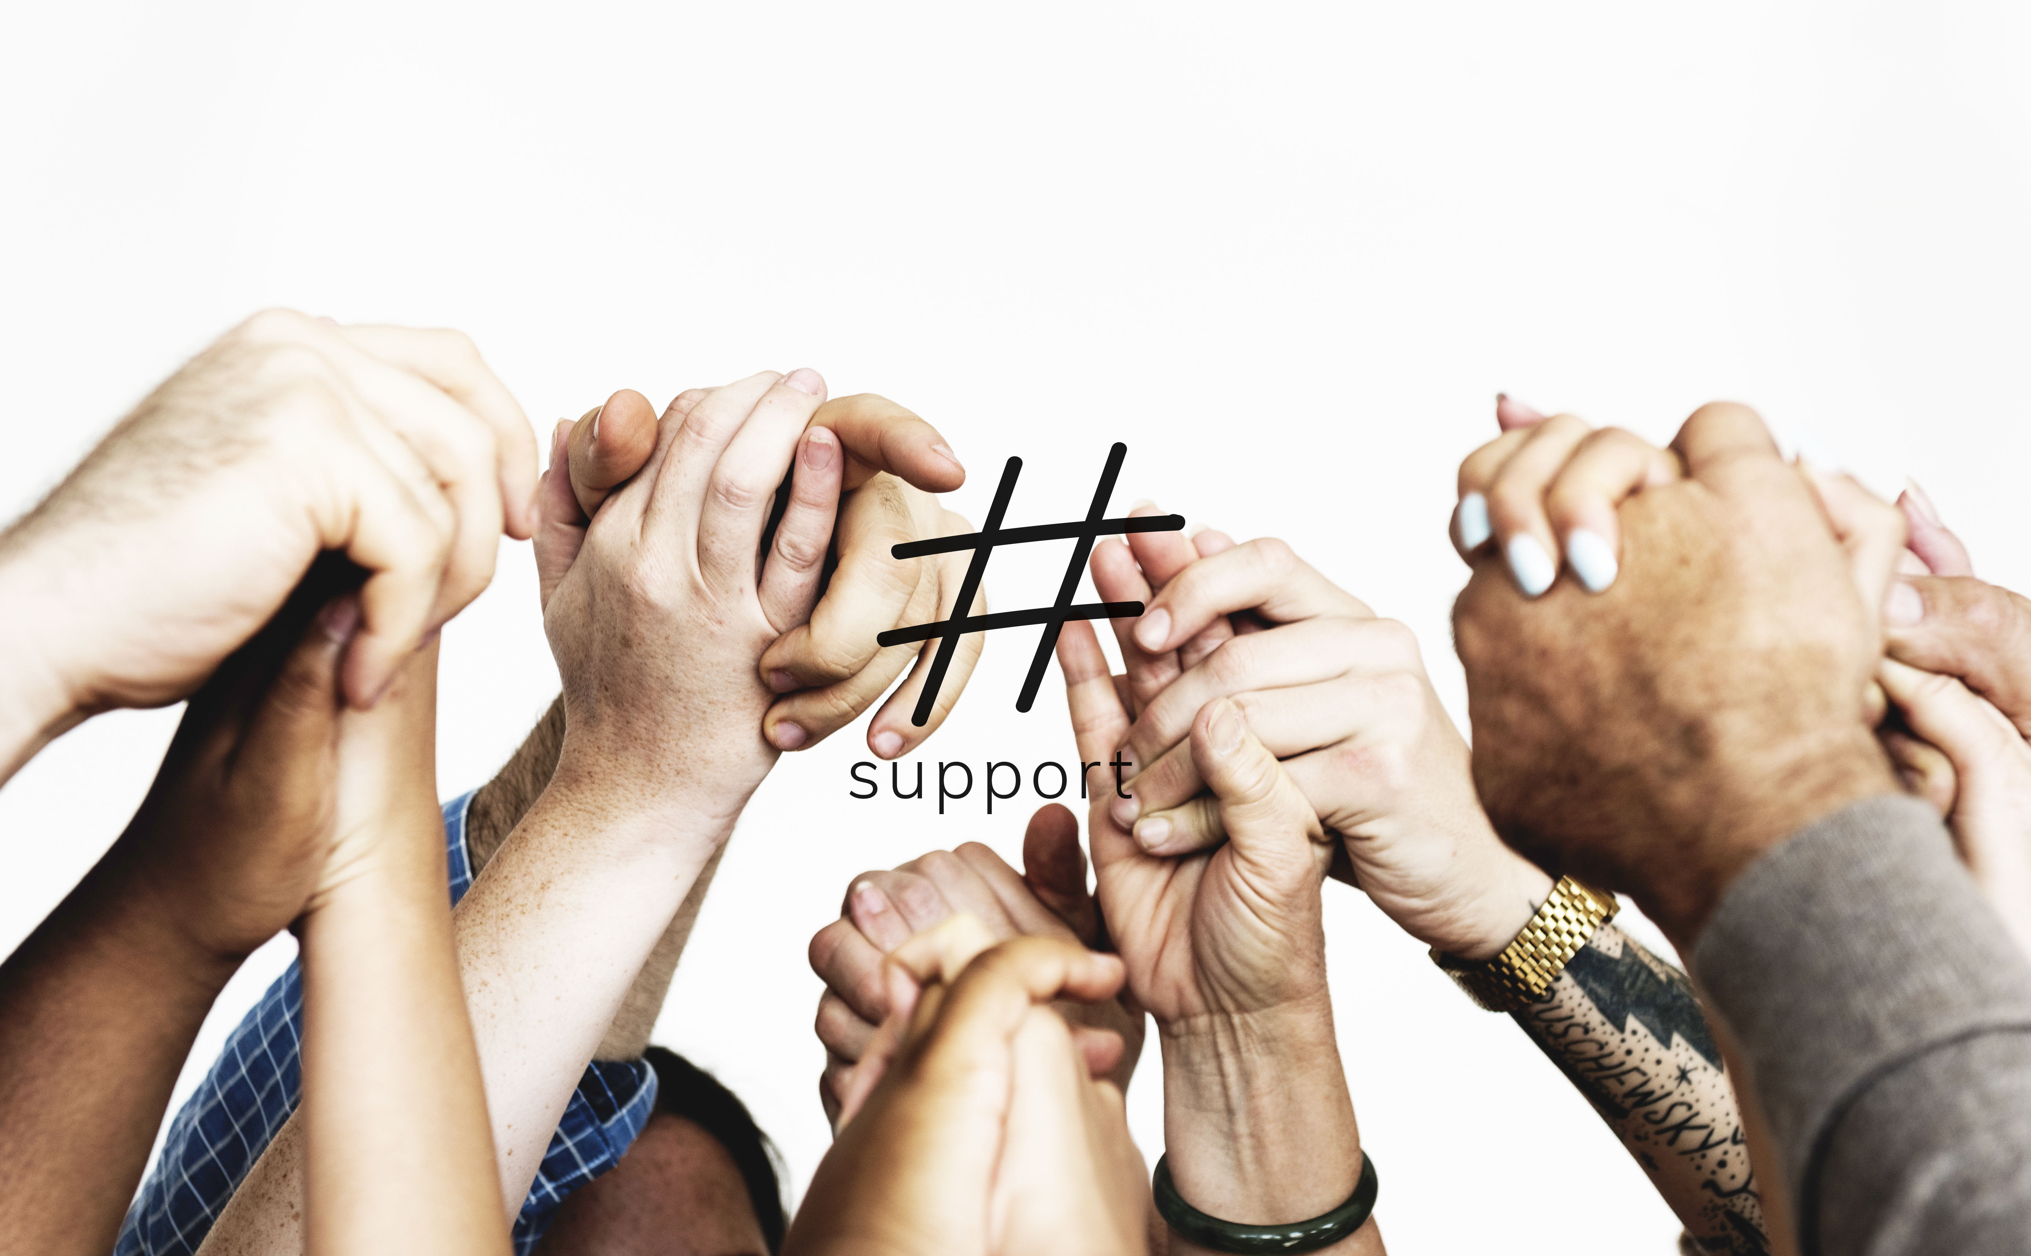
Hashtag, Tagging, & Retweeting
  #Hashtag campaigns aggregate social
  media posts into one arena on
  Facebook, Twitter, or Instagram American Legion Post 117 | Facebook #legacyrun2024 (example)
  Tagging allows you to tag an individual or group @AmericanLegion
  Retweeting allows you to elevate a message on Twitter
SOCIAL MEDIA TRAINING

Slide 17
Social Media Posts
Educate, inform, and inspire social media audiences
Powerful tool in the public relations program of an American Legion
Post Relevancy – We are ALIVE & WELL
Remind members of events, benefits, memorials, etc.
SOCIAL MEDIA TRAINING

Slide 18
Social Media Posts
Potential to Increase membership
Tell YOUR POST Story!
Rules to remember:
  Plan ahead and keep a schedule of graphics (Suicide Prevention Month, Veterans Day, Memorial Day, American Legion Birthday, etc.)
SOCIAL MEDIA TRAINING

Slide 19
Social Media Posts
Keep language brief and to the point
Consider linking the graphic to a web page for more information on event
Use the proper brand mark
Encourage sharing of graphics among your members
Include event name, date, time, location, point of contact information
SOCIAL MEDIA TRAINING

Slide 20
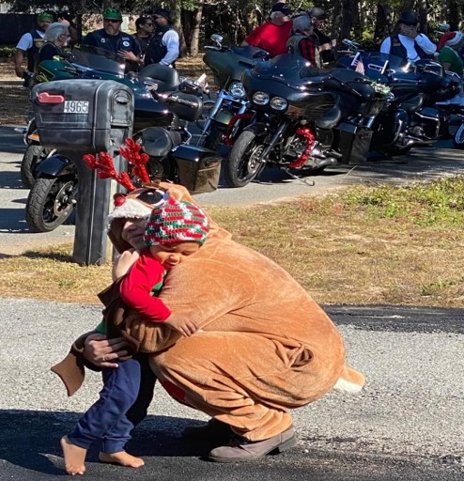
Social Media Posts
Users seek authentic non-promotional content driven by AI upsurge.
Share what your members are doing!
#Humblebragging
SOCIAL MEDIA TRAINING

Slide 21
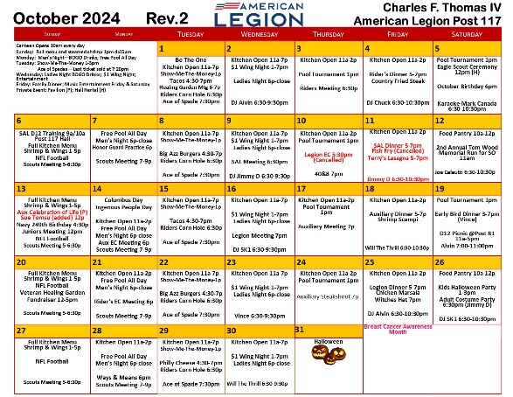
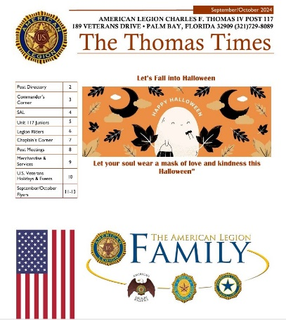

How Are You Sharing Information?
Website, www.al117.com
Calendar
Newsletter
Flyers
TV
Social Media
Press Release
Any other ways?
SOCIAL MEDIA TRAINING
Notes:
Make flyers in:
Canva.com
Postermywall.com

Slide 22
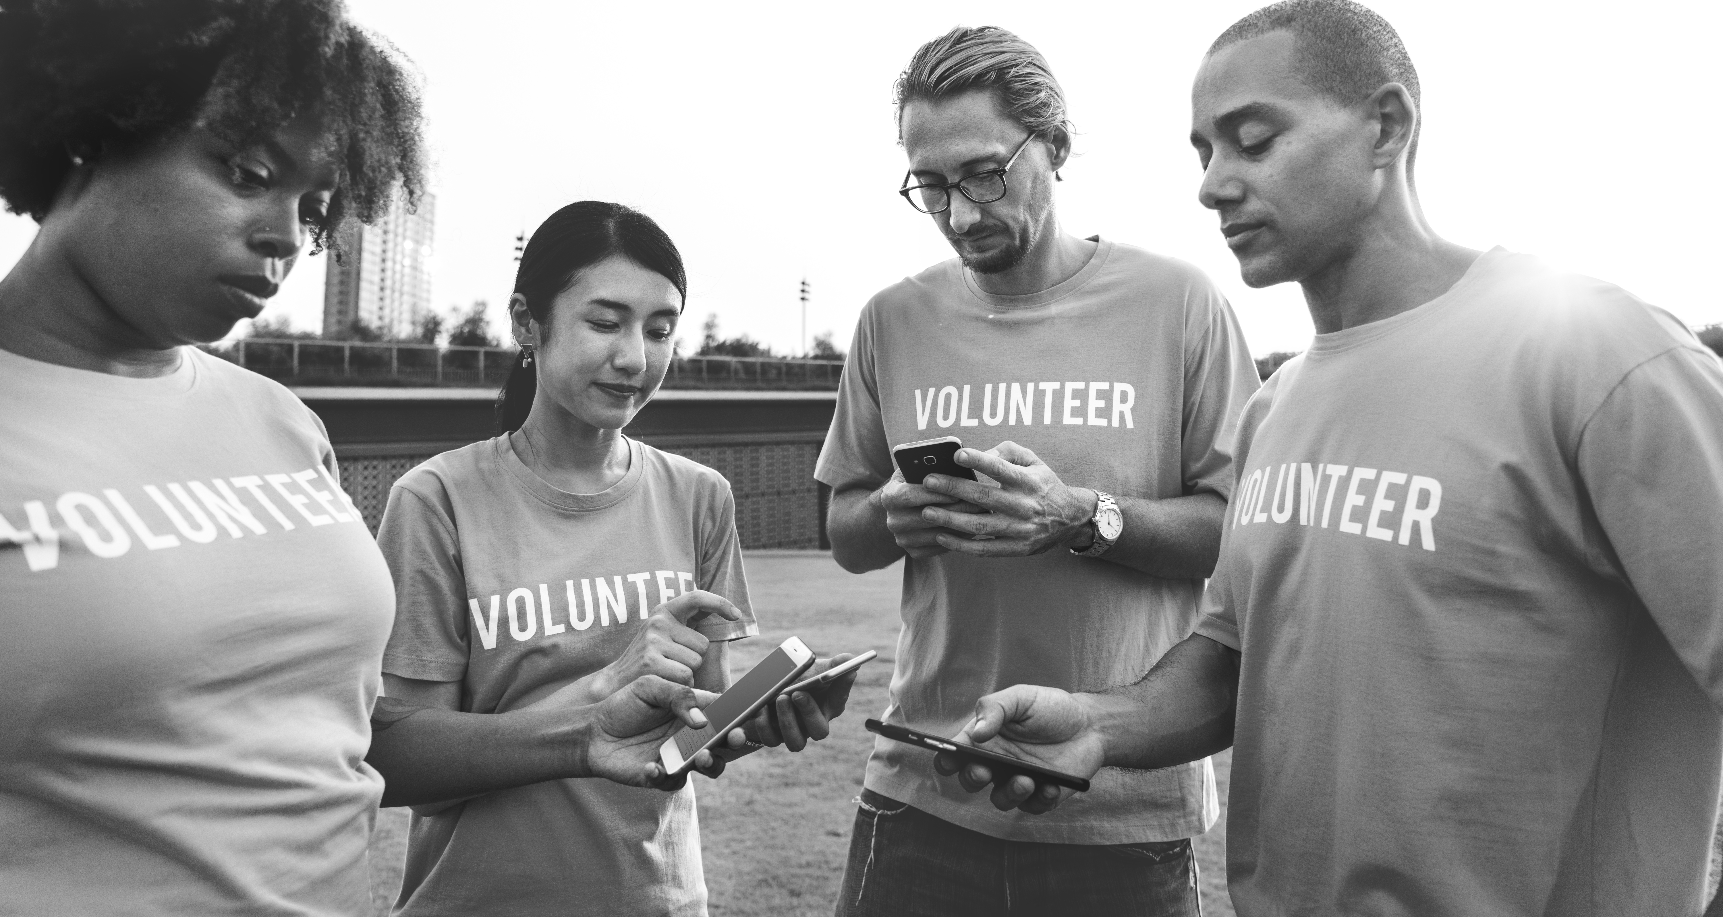
District vs. Post
  Districts - geared towards providing
  information to Posts
  Posts - geared towards providing
  information and marketing to the public (members, community, etc)
SOCIAL MEDIA TRAINING

Slide 23




Brandmark vs. Emblem
  Brand mark is to be used in all marketing communications applications.
    Advertising, Lifestyle apparel, Community service activities, Fundraising, Sponsorships, Membership Recruitment materials, Digital media, Social media, Event announcements, E-mail signature lines
SOCIAL MEDIA TRAINING
The American Legion. (n.d.). Brand marks and guidelines. The American Legion. From https://www.legion.org/about/media-toolkits/brand-marks-guidelines
https://register.legion.org/emblem/request

Slide 24




Brandmark VS Emblem
  Emblem - reserved for official documents and communications.
    Documents, Policy statements, Official Reports, Press Releases, Business Cards, Post Signage, Financial documents, Official letterhead
SOCIAL MEDIA TRAINING
The American Legion. (n.d.). Brand marks and guidelines. The American Legion. From https://www.legion.org/about/media-toolkits/brand-marks-guidelines

Slide 25
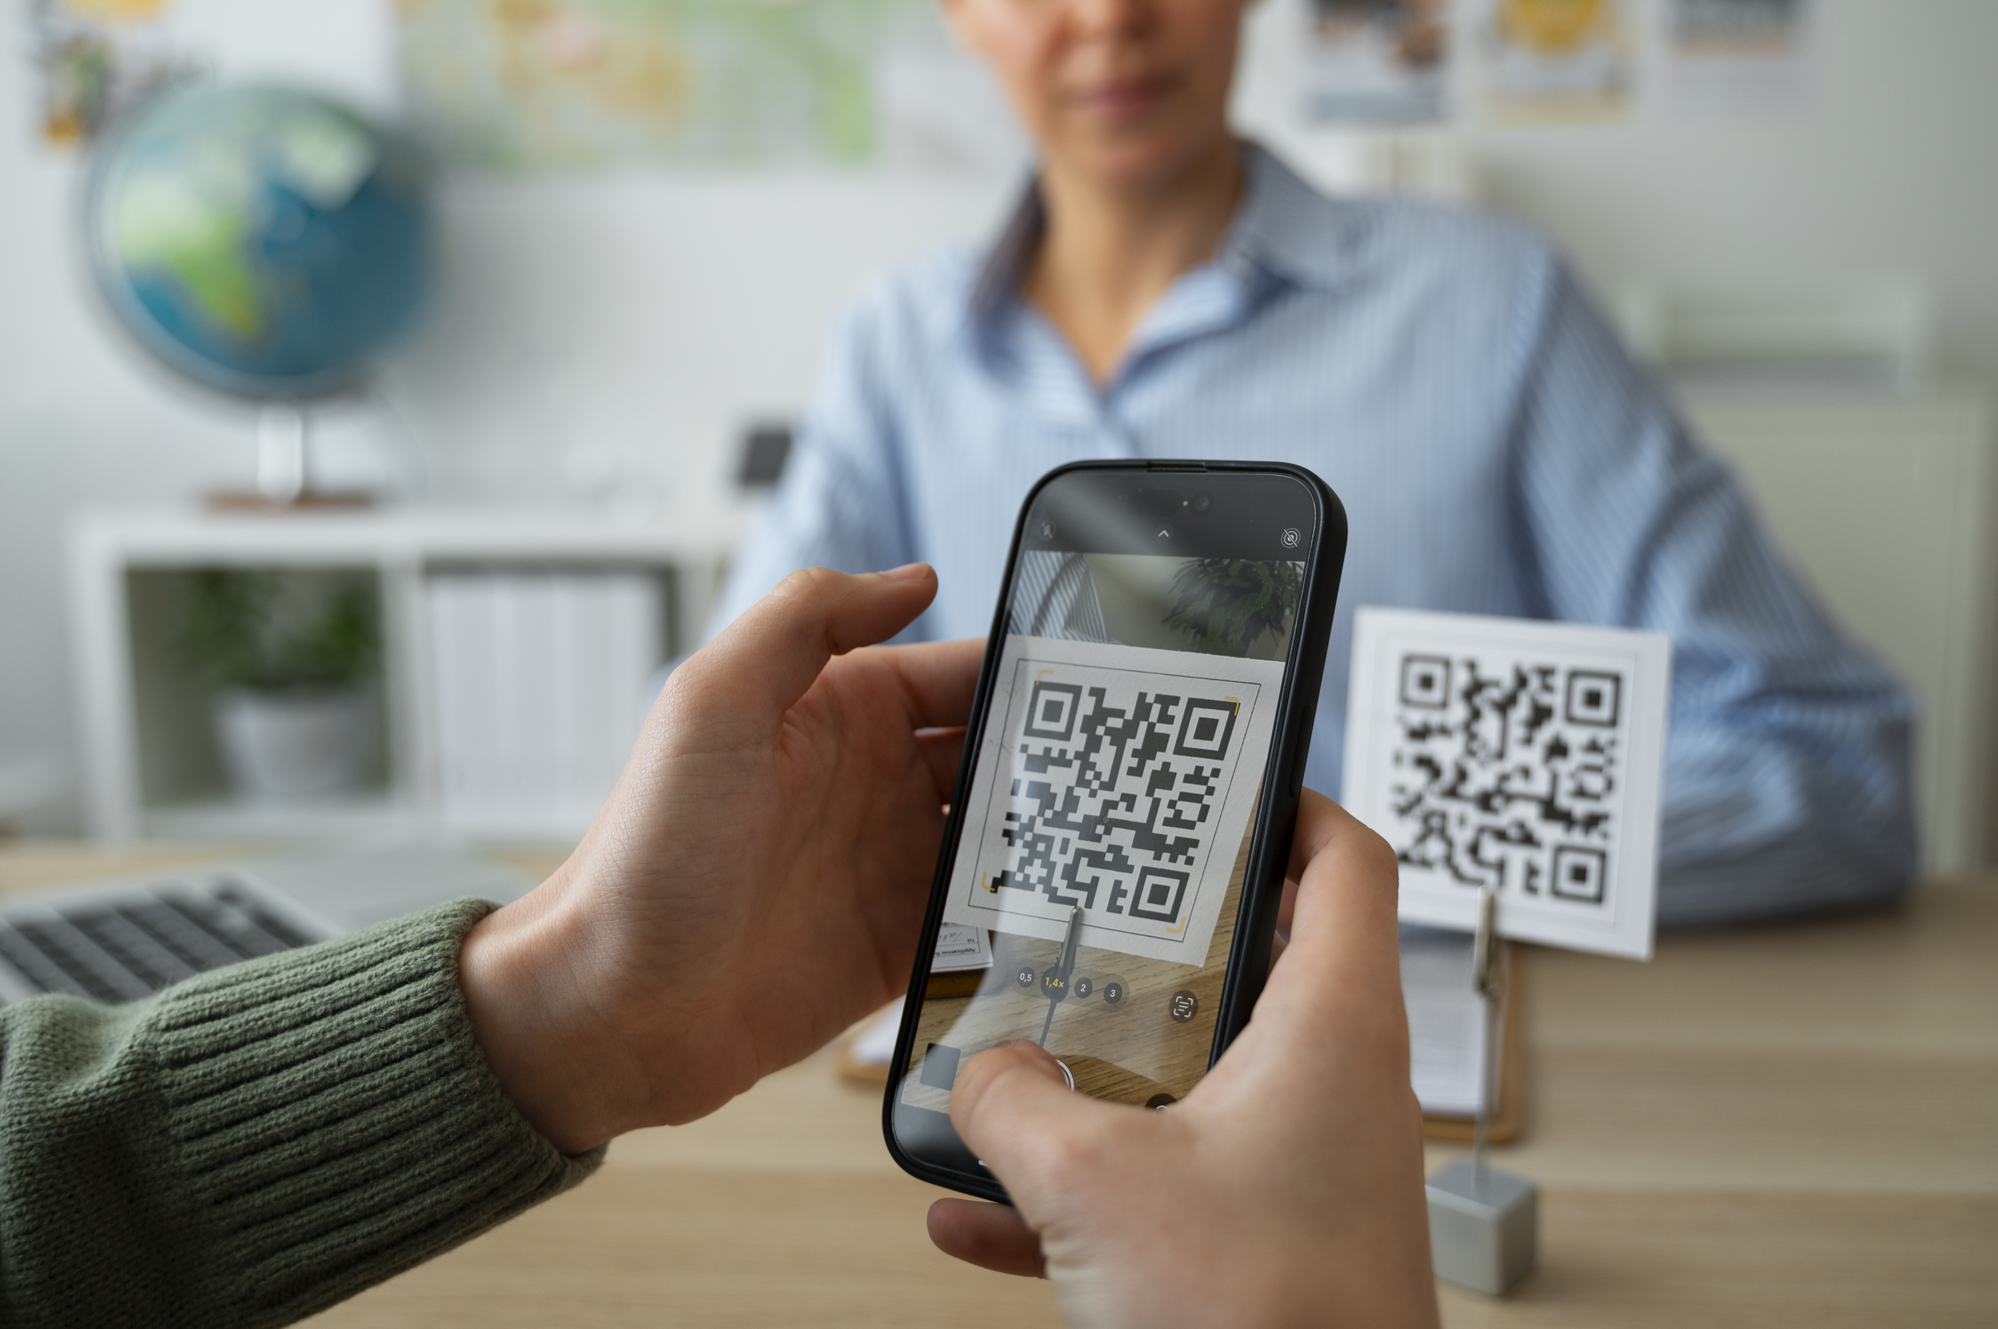
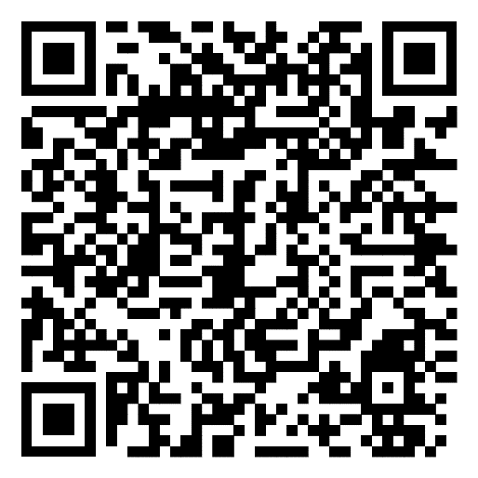
Creating QR Code
  Link QR code using https://scanqr.org
  URL
  Text
  Location
  Wifi
  vCard
  SMS
  Call
  Event or Mail
SOCIAL MEDIA TRAINING
Where does this QR Code take you?

Slide 26
Resources
The American Legion Public Relations Tool Kit
A Legionnaire’s Guide to the Web
American Legion Branding Guidelines
2024 NC Media Training Workshop
Connect your Instagram & Facebook accounts
American Legion Post 117 | Facebook
HistorianAL117 (@al117palmbay) • Instagram photos and videos
SOCIAL MEDIA TRAINING

Slide 27
Resources
American Legion Post 117 - YouTube
Cambridge University Dictionary
Adam Connell Blog
Influencer Marketing Hub
Hootsuite
SOCIAL MEDIA TRAINING

Slide 28
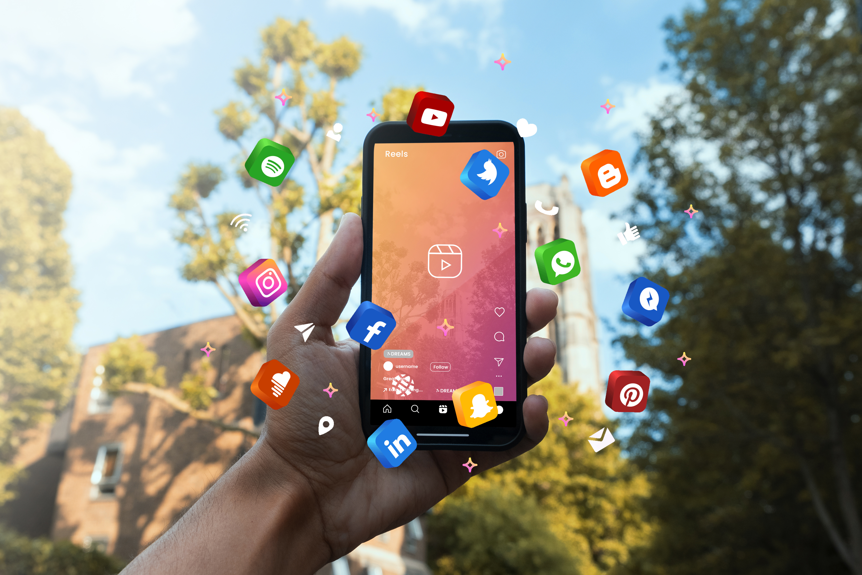
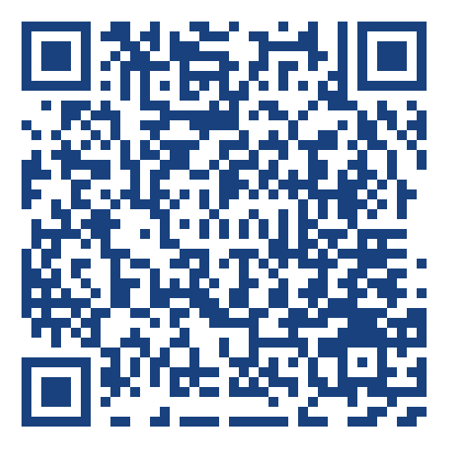
Social Media Training
Thank you for attending today’s
Social Media Training Class.
Dana Jackson, Department Social Media Chair, 719-459-6334
SOCIAL MEDIA TRAINING
Please leave feedback.

