Slide 1


Department
Legislative
Instructor: Stuart Scott
2025 Department of Florida
Department Convention
www.floridalegion.org

Slide 2



Advice
  This is for those who are not professional lobbyists
  We will focus on the three basic
  elements of effective lobbying:
    Preparation
    Presentation
    Perseverance
Department legislative
Notes:
This presentation is designed for people who are not Professional lobbyists. It is intended to help avoid some of the most common mistakes we have observed in our 20 years plus of experience in Tallahassee.
The advice in this document relates primarily as to how to talk face-to-face with members of the legislature
The 3 P’s

Slide 3

Who?
Know WHO you are attempting to communicate with
Are they on the committee?
Are they active in your area of interest?
What is their background?
Don’t simply “use” them
Department legislative
Notes:
Know the Legislator you want to communicate with. Learn whether he or she is on the committee with jurisdiction over your issue.
Generally speaking, legislators not on the committee in question are less able to impact policy than their colleagues who are. Find out if the legislator has been active in your area of interest. Members with a reputation for being knowledgeable of a specific topic is more effective and better advocate.
Know their political and social background of the legislator, try to establish common ground. Use that personal touch for a successful and productive relationship.
No legislator likes to be viewed purely as a conduit for the policy or budget aspiration of his or her constituents.

Slide 4

What?
The process has a design
Don’t ask for too much
Be fair in your request
Understand the realities of the process
Department legislative
Notes:
The legislative process is designed to ensure that the needs of all political viewpoints and geographic regions are considered. Therefore, the need to appreciate political realities is paramount.
Do not ask for too much. An initiative that seeks to provide a complete solution, at the expense of someone else’s interest, is often legislatively impossible to enact.
A more likely road to success is to moderate your request and ask for incremental relief. You will be viewed as “fair” rather than “greedy.”
The major problem you will encounter in developing your request is to figure out what the “reasonable” approach is. If you ask for too little, you may convince your legislator that you don’t have an issue which merits attention. If you ask for too much, your demands may appear to exceed any expectation of being satisfied.
Legislators will appreciate your understanding of the realities of the process and will usually reward you accordingly.

Slide 5
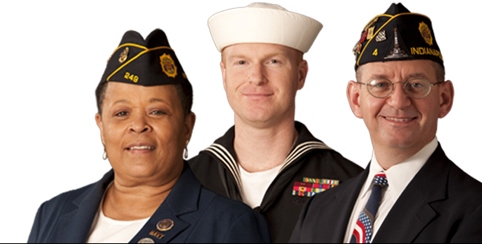
Assumptions
They may or may not know anything about us
Inform them about yourself and our organization
Be prepared to explain in detail
Use layman terms to make it easy
Department legislative
Notes:
Heading the list of mistakes people make in communicating with their legislator is the assumption that the member will know who they are or what they are talking about.
First and foremost, identify yourself and describe your organization.
Secondly, be prepared to explain your legislative interest in sufficient detail so that the legislator will be able to act on your behalf. Explain your problem, the present situation, and propose a solution. Offer to answer any questions they may have.
If you make it easy for the legislator to act on your issue, you increase your chances of success. If you leave the member with a poor understanding of your issue and no proposed solution, you have wasted your time.

Slide 6

When?
Time is a commodity
Legislative Assistants are valuable
Visit your legislator at his home district office
Department legislative
Notes:
Appreciate that during legislative session time is a scarce commodity.
The typical legislator is assigned to several committees and subcommittees. This means the member is extremely busy dealing with a wide variety of issues.
Do not feel put off by meeting with a legislative assistant. The assistant is responsible for monitoring legislation and budget and advising the member. The assistant may be more knowledgeable about your issue and have the time to sit down with you and listen.
The best way to avoid the scheduling pitfalls of Tallahassee is to establish a relationship with the legislator in their home district. Visit with them and explain your issue prior to the beginning of session. It is much easier to follow-up than educate.

Slide 7

How?
Leave behind written materials
Be concise and factual
Short and sweet
Avoid unnecessary disclosure of information
Department legislative
Notes:
Although the overall intelligence level in the Legislature is high, both members and staff often misunderstand oral presentations.
This results from time constraints, unfamiliarity with the topic, and sometimes from a low priority being given to your issue.
The most effective way of assuring that your oral presentation is not misunderstood is to commit it to writing in a concise and factual manner.
The document should be no longer than one page and should include a brief explanation of the issue, your name, the name of the organization, and where to contact you.
There are some types of information that should not be shared with a legislator. This information is irrelevant to the legislative process or is likely to be misunderstood or misinterpreted.
For example, if you have experienced problems in dealing with a particular person in an agency do not complain about that person unless you are asking the legislator to do something about it.
A remark or comment unintentionally made, or made and overheard by a legislator, may undermine your case and the image of your organization.

Slide 8

Do’s and Don’ts
Never make political
retribution threats
Don’t sour your victory
Make sure you follow up!
Be sure to show you’re
thankful for their help
Department legislative
Notes:
You should not seek to achieve your objective through a threat of political retribution. Legislators will react negatively to an attempt to pressure them into taking a position they do not want.
In most cases, you will no longer be welcome in the member’s office and create permanent hostility to your issue.
Even if the legislator succumbs to your threat, your “victory” will sour the relationship. Most likely, the legislator will do no more than is necessary to appear to be acting on your behalf. He or she will be an unenthusiastic champion of your interests.
Requests for a member support should always be politely made, with the justification for your position based on sound policy.
Never hesitate to let a legislator know that you appreciate his or her help. The political process is one in which a member is asked for much but thanked for little.
One means of accomplishing this is to send a short note to the member expressing your appreciation.
Another is to become a valued professional resource offering to provide candid and confidential reactions to legislation affecting your organization.
A better means is to send him or her a check at election time. All politicians will welcome your support, provided that the contribution is legal and that you understand the etiquette of political giving.
Without exception, legislators react positively to “no strings attached” help. If the member’s experience with you is positive, you will have made major strides to establishing a valued ally.

Slide 9
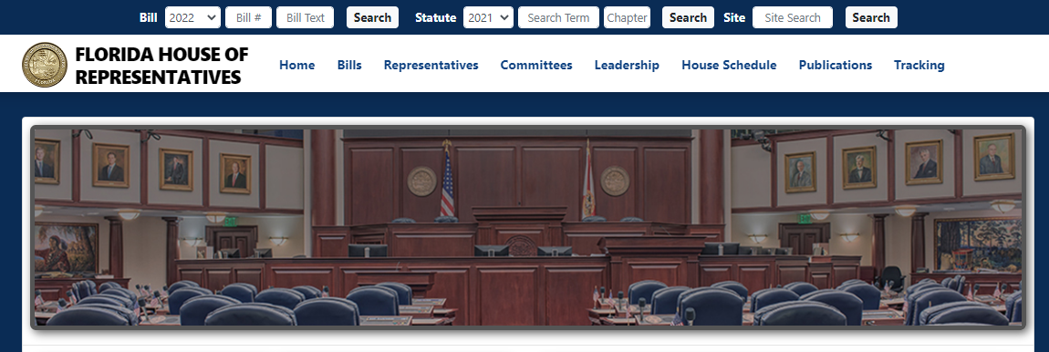

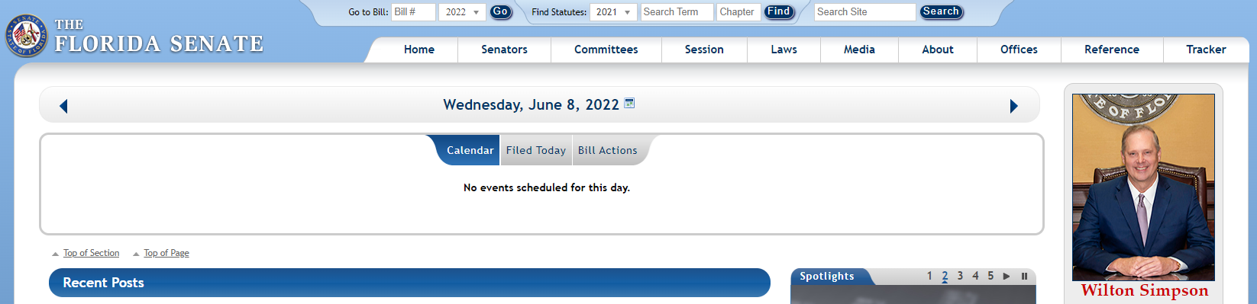

How to Locate YOURS
www.myfloridahouse.gov
Department legislative
www.flsenate.gov
Notes:
Both of these sites have search engines that will assist you in finding your Rep or Senator

Slide 10
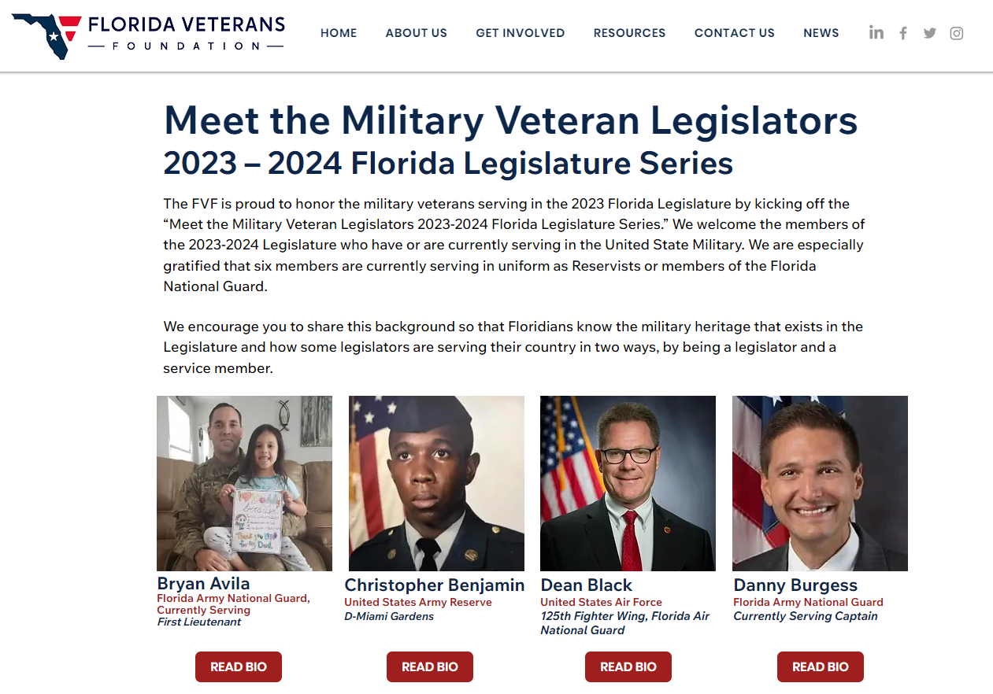

Veteran Legislators
Do we have Florida Veteran Legislators? Why yes we do!!!
www.helpflvets.org
Department legislative
Notes:
We currently have 21 either still active or prior military;
Rep Christopher Benjamin – Rep Bryan Avila (Active) – Sen Jeff Brandes – Sen Danny Burgess (Active) – Rep Joseph Casello – Rep Wyman Duggan – Rep Elizabeth Fetterhoff – Rep Mike Giallombardo (Active) – Rep Tommy Gregory – **Rep Sam Killebrew – Rep Andrew Learned (Active) – Rep Thomas Patterson “Patt” Maney – Rep Fiona McFarland (Active) – Rep Paul Renner – Rep Spencer Roach – Rep Anthony Sabatini (Active) – Rep David Smith – Rep Michelle Salzman – Rep John Snyder – Sen Victor Torres – Rep Keith Truenow – Rep Matt Willhite

Slide 11


State vs U.S. Legislators
Don’t confuse the US Senate and US House of Representatives with the Florida Senate and the Florida House of Representatives
Definitely don’t confuse the bills filed
Department legislative
Notes:
Name the US Rep’s and Senate in Florida
27 US Reps
2 US Senators

Slide 12

Allowable’s
As a 501 (c) organization we have limitations
We must provide an equal opportunity to ALL
Do not indicate a preference for or against
NO fundraising for any candidate
Department legislative
Notes:
Can you ask someone to speak at your event?
if the individual was chosen to speak solely for non-candidacy reasons
They speaks in their non-candidate capacity
No reference to the upcoming election is made
No campaign activity occurred in connection with the attendance (signs/flyers etc.)
We maintain a non-partisan atmosphere
Our communication announcing the event clearly indicated the non-candidate capacity
Clearly indicate the non-candidate capacity in which the individual was appearing AND do not mention the individual's candidacy or the election

Slide 13
Exercise
RUN
Department legislative
Notes:
Let’s do an exercise;
Draw a circle with 5 lines off of it…like a sun…like this
Then write this word in the center….RUN
Now I want you to write on each line 5 different things of what RUN means to you…this is not a group exercise
OK, now we are in a group exercise… discuss with each person at your table what you have…
Now how many had all 5 exactly the same…4…3…2…who had 5 that no one at your table had. What did you have.

Slide 14
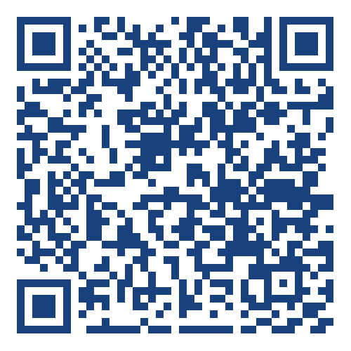
Updates
Subscribe to The American Legion’s email list to receive updates concerning Florida Legislation and Veterans
Department legislative
https://bit.ly/fallegislative
Notes:
https://bit.ly/fallegislative

Slide 15


Questions?
Department legislative
Please leave feedback.
Notes:
The vast majority of Florida’s citizens don’t follow any legislation. Much less the wording of the actual bills filed. They garner their information from either news sources or word of mouth. As we just demonstrated, what we think when hearing a word or someone's ideas can be conveyed in many ways. That’s why as leaders, we must get down to the actual facts of the matter.
Our participation is essential to the preservation of democracy, and we can make a difference.

