Slide 1

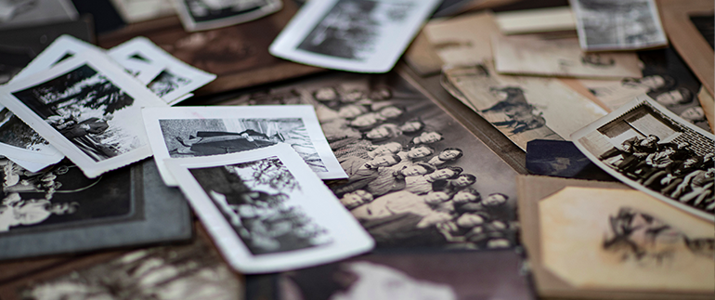
Historian
Training
Instructors: Edward Lewis
2025 Department of Florida
Department Convention
www.floridalegion.org

Slide 2

History Book Timeframe
  One year
  Installation of officers to next installation of officers
  (NO Perfect Book)
  Deadline is the First day of Department Convention!
HISTORIAN TRAINING

Slide 3

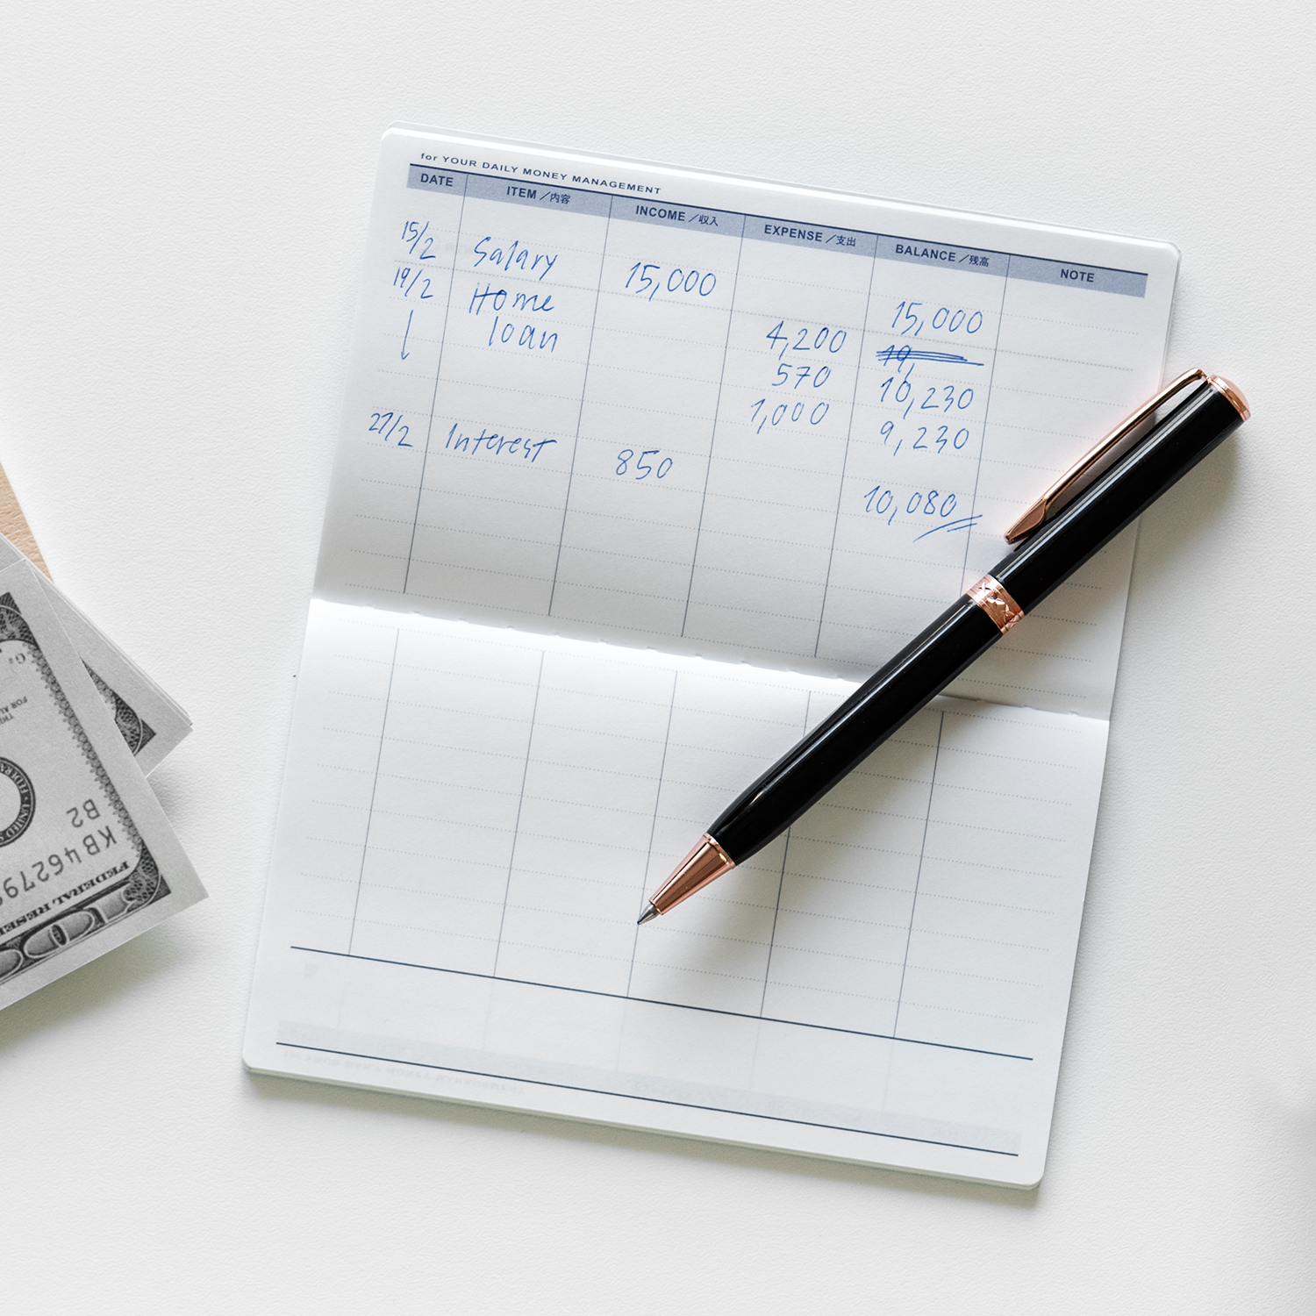


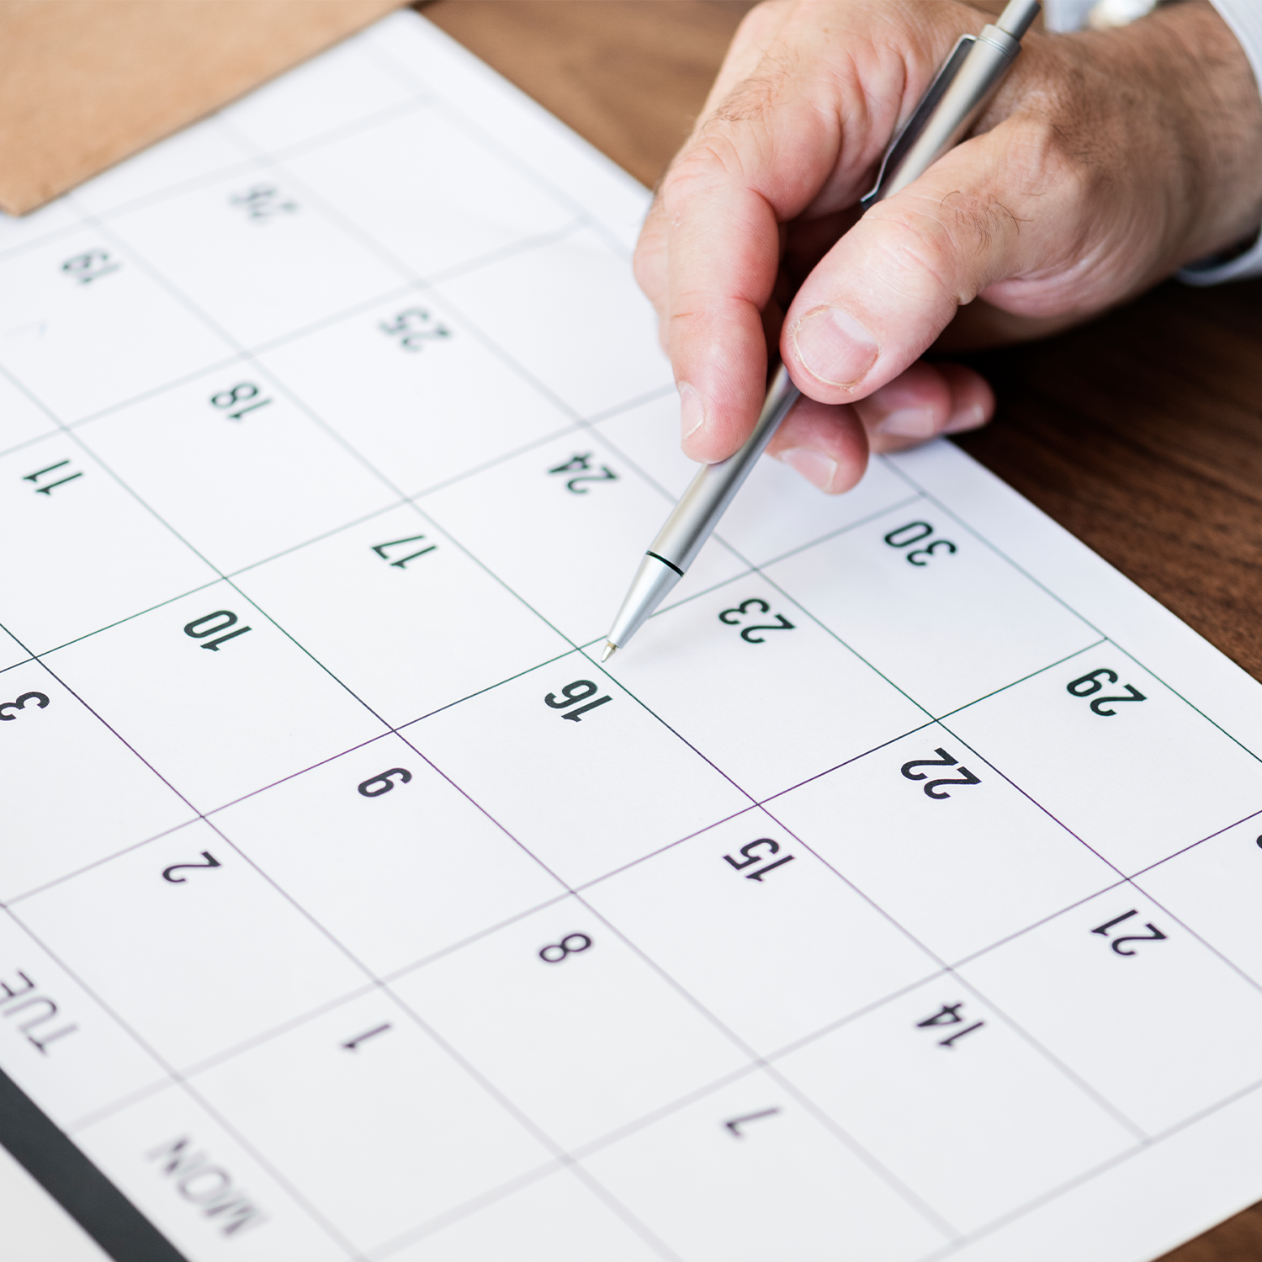

Where do you get the information?
Individual
Members Report
Checkbook
Records
Call Members
HISTORIAN TRAINING
Meeting Minutes
Post Calendar
News Clippings

Slide 4
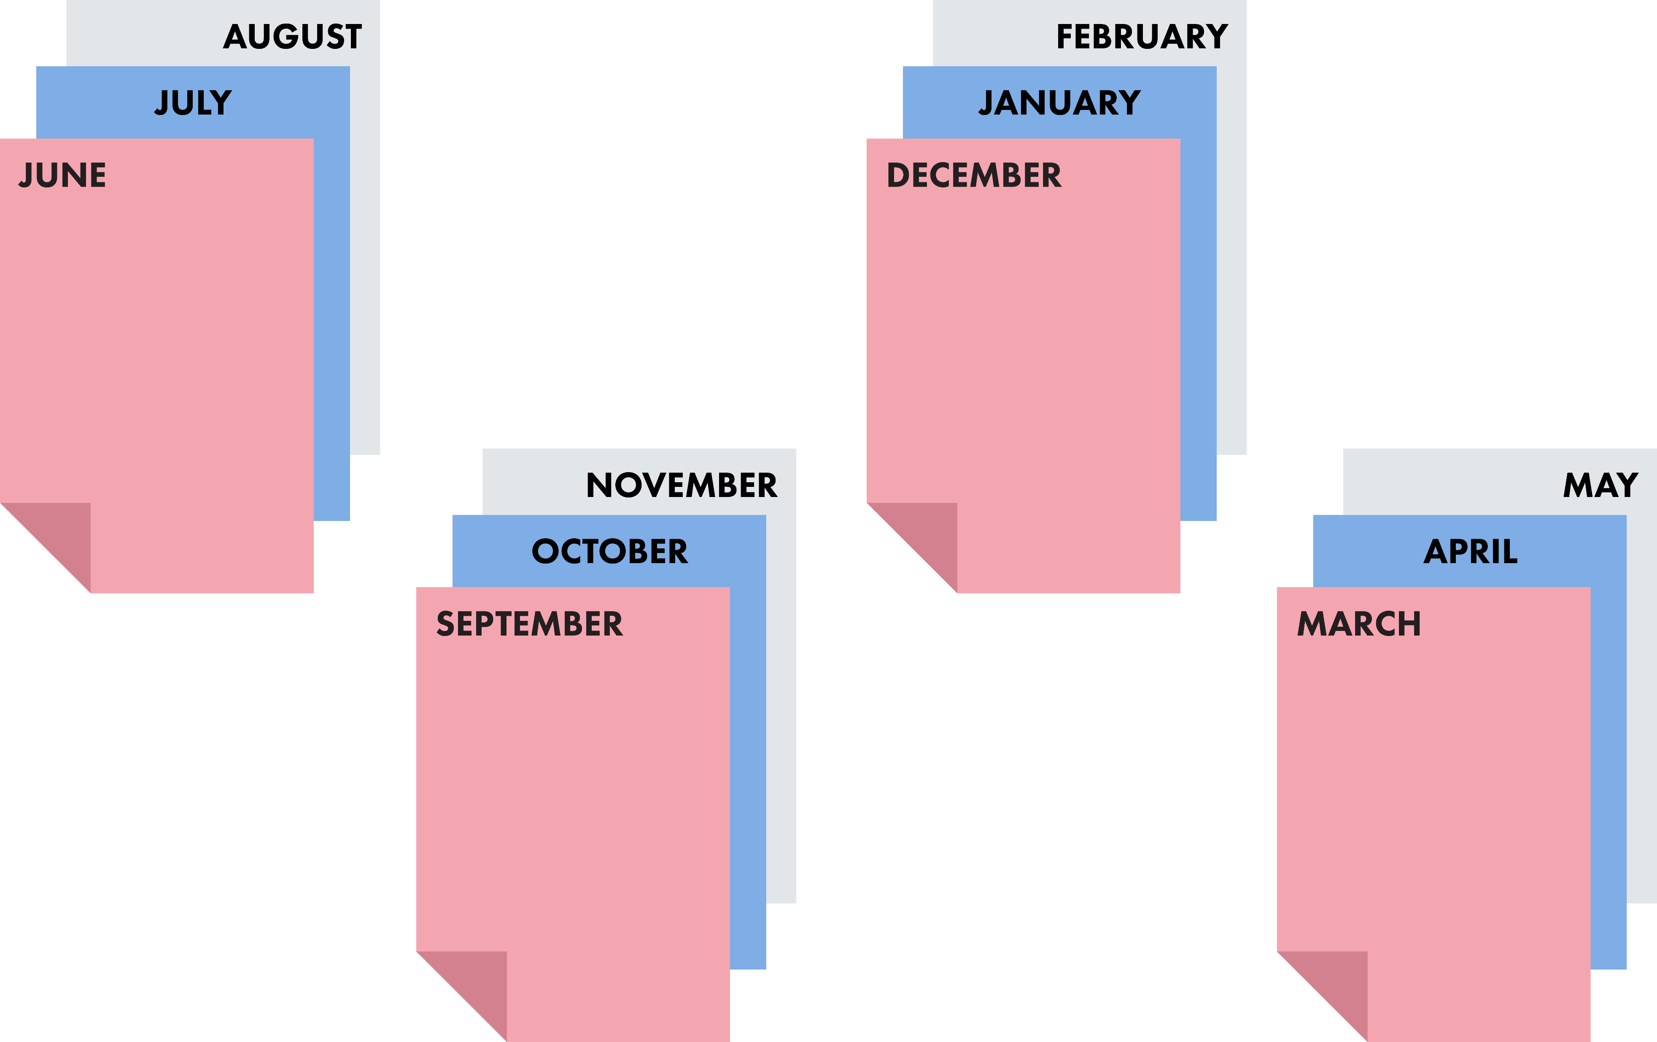
History Book Timeframe
HISTORIAN TRAINING

Slide 5
The Historian Competition
Here are some of the things you need to keep in mind.
HISTORIAN TRAINING

Slide 6
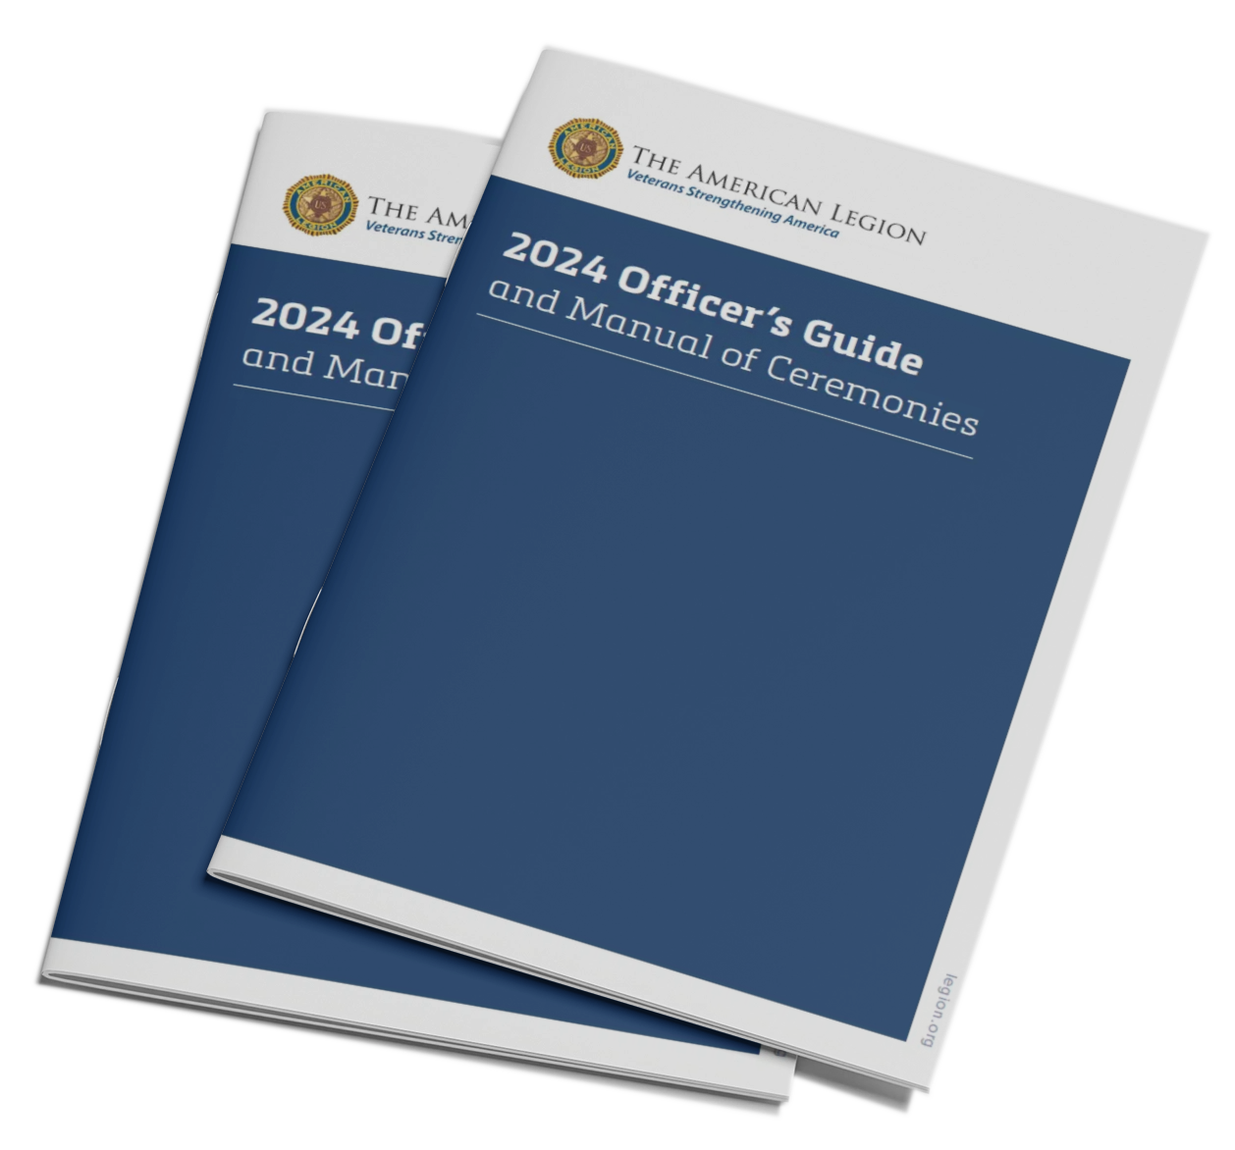
History Book Guidelines
HISTORIAN TRAINING
Check for the most current version at www.legion.org

Slide 7
Be Creative
The Judges have optional points that they can award for items that are especially attractive or useful.
HISTORIAN TRAINING

Slide 8
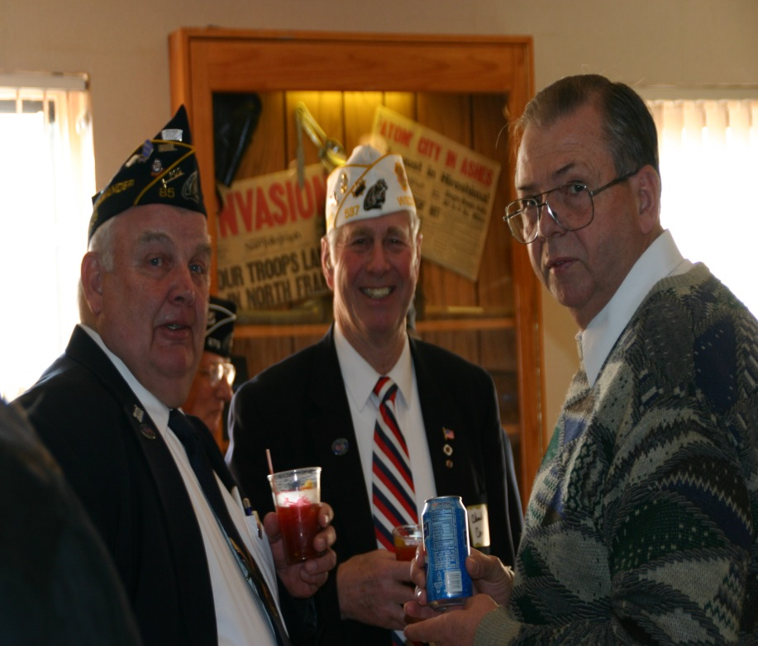
Clear Photos
Crop photos
Avoid Beverages, Cigarettes, or Offensive Content
Don’t place to close to the center of the book
HISTORIAN TRAINING

Slide 9
K.I.S.S. Theory
  Don’t distract the viewer
    Only three or four photos per event (recommended)
    Leave Napkins and Matchbooks out
  You can add the “Fluff” back into your book when it’s returned from competition.
HISTORIAN TRAINING

Slide 10
Yearbooks / Scrapbooks
HISTORIAN TRAINING
Compilation and Judging

Slide 11
Follow the Rules
Yearbook/Scrapbook Contest
judging breaks out is as follows:
HISTORIAN TRAINING

Slide 12
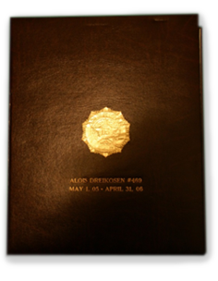
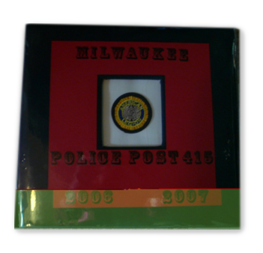
Part 1: Format – 40 Points
COVER (5)
  Size 12 X 15 max.
  Legion Emblem – centered L to R
  Name and Number of Post
  Volume Number if needed
  Bindery
HISTORIAN TRAINING

Slide 13

Part 1: Format – 40 Points
Use spacers to make both sides of the book the same thickness
COVER (5)
Not to exceed three (3) inches between front and back cover
HISTORIAN TRAINING

Slide 14
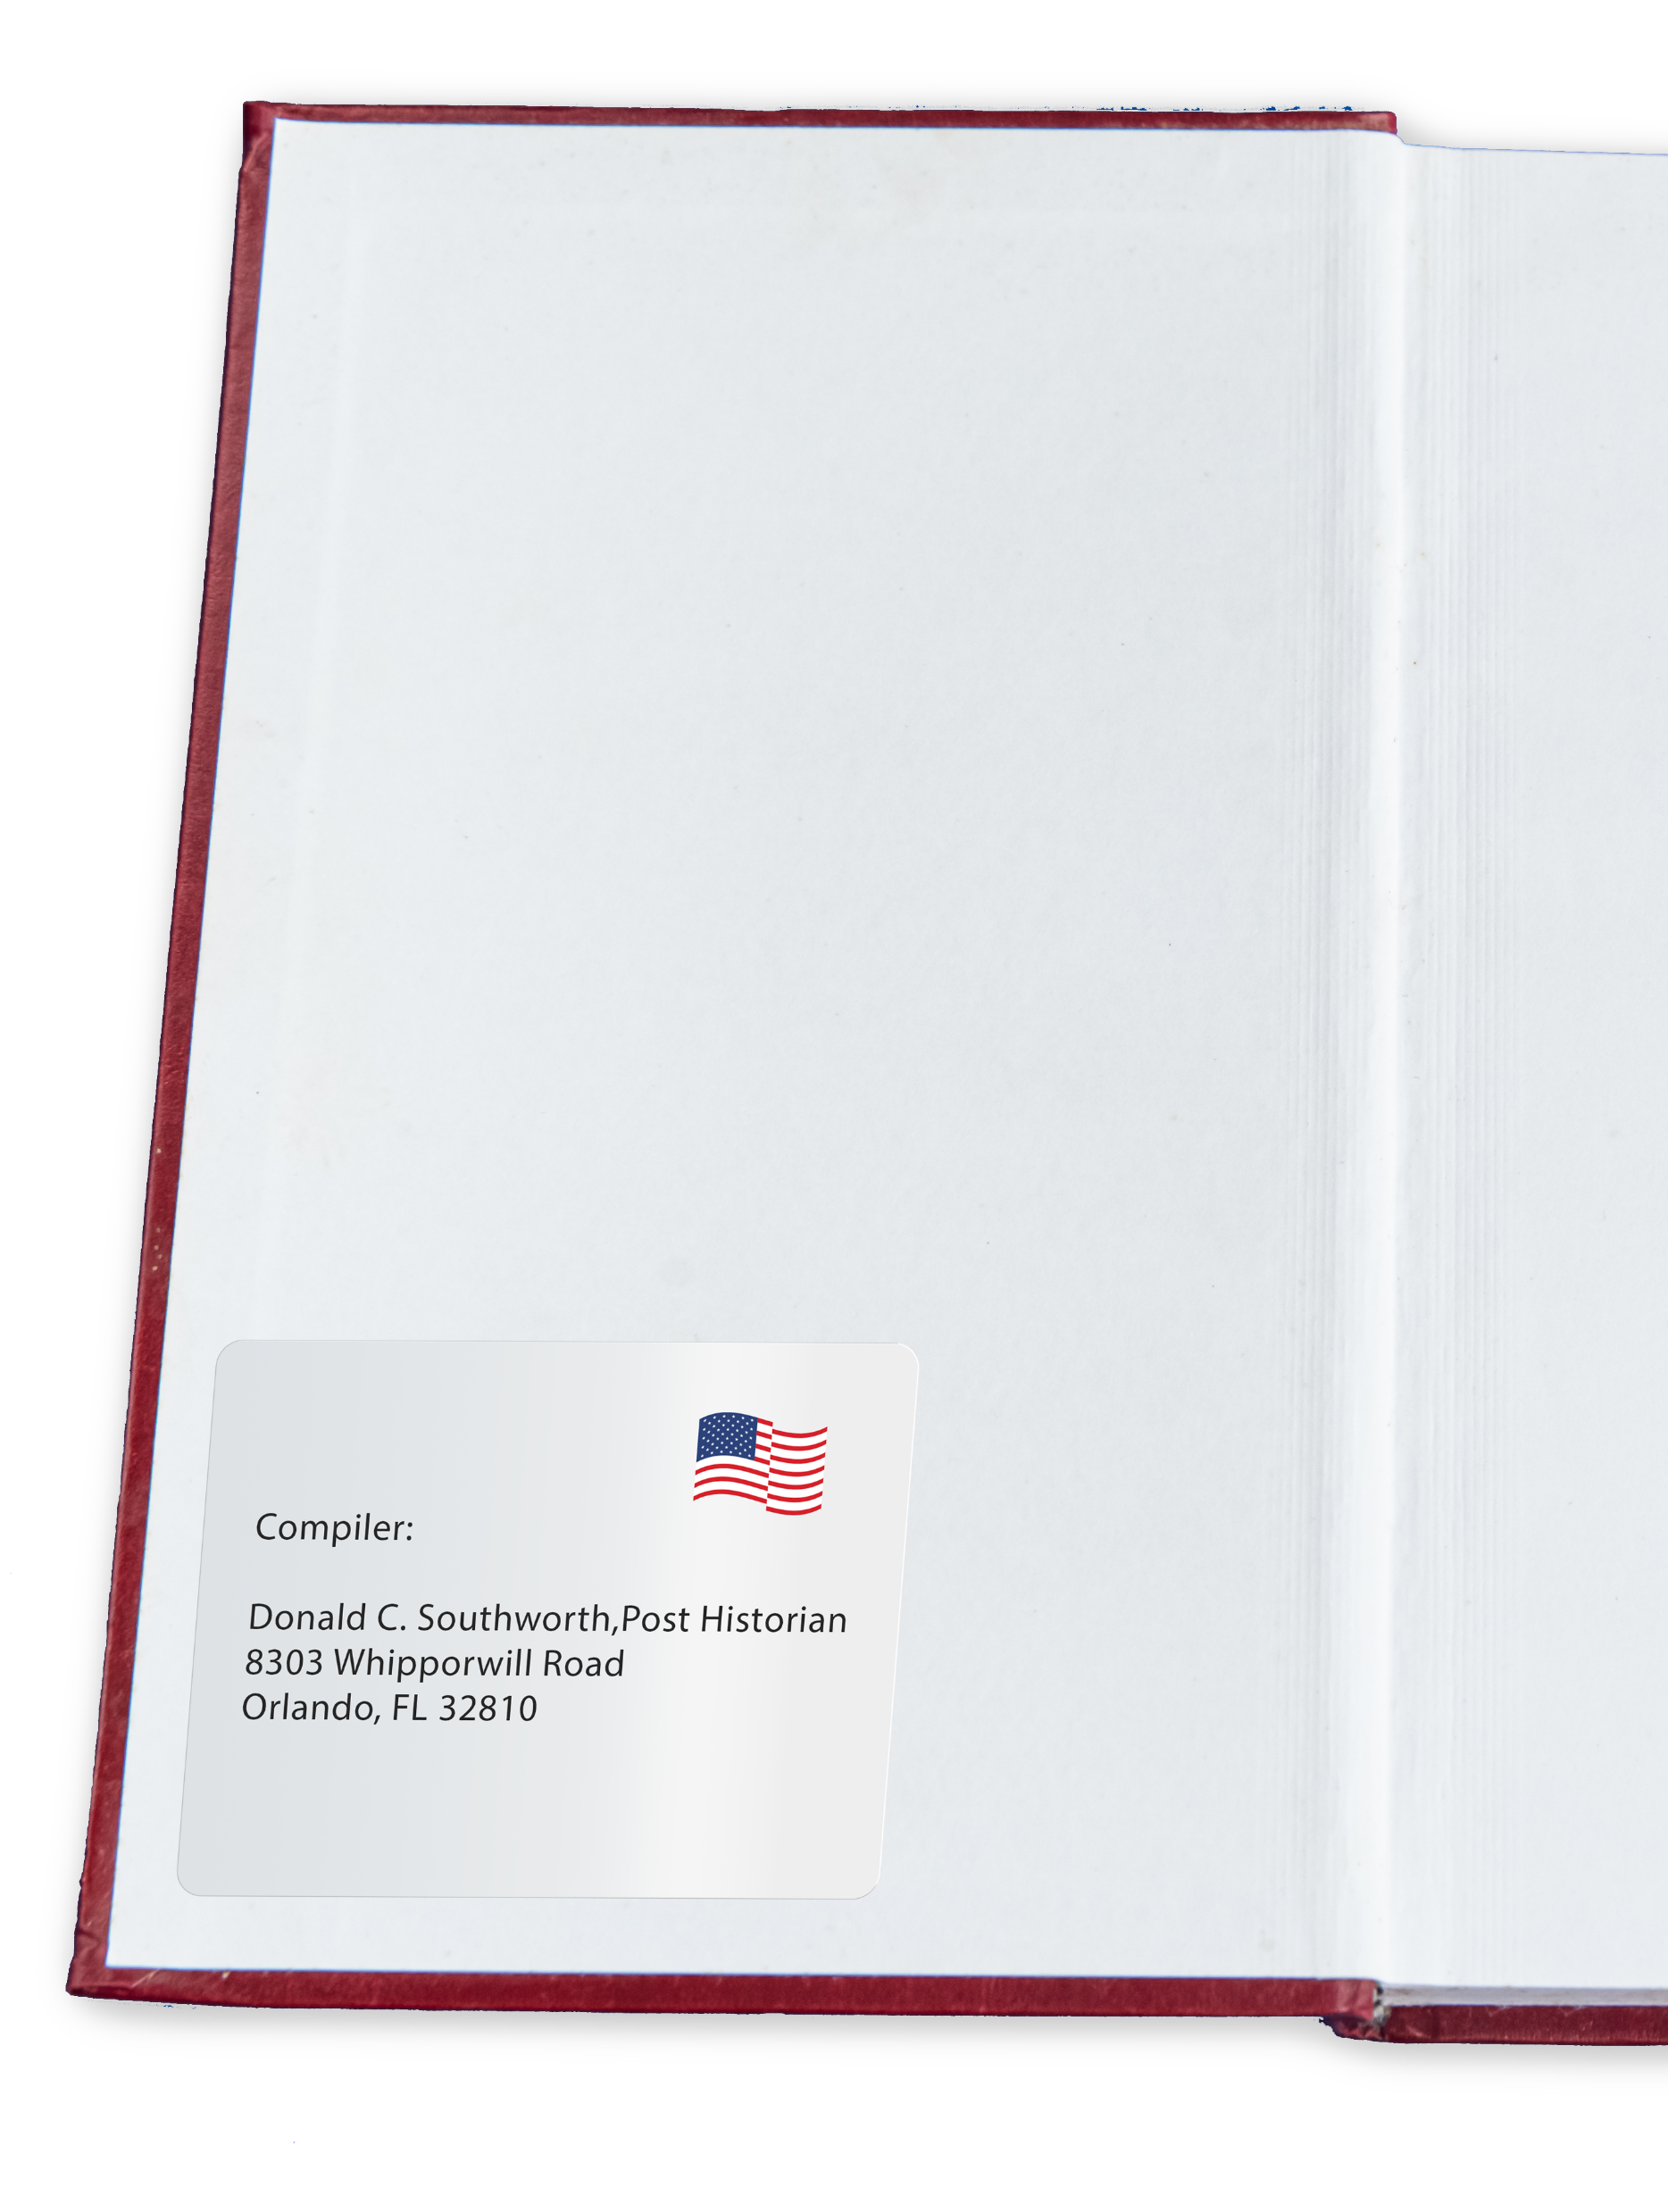
Part 1: Format – 40 Points
Name/Address (3)
  Full name and address of author
  Located in lower left corner
  Neatly typed
  Centered
  3 x 5 index card
HISTORIAN TRAINING

Slide 15
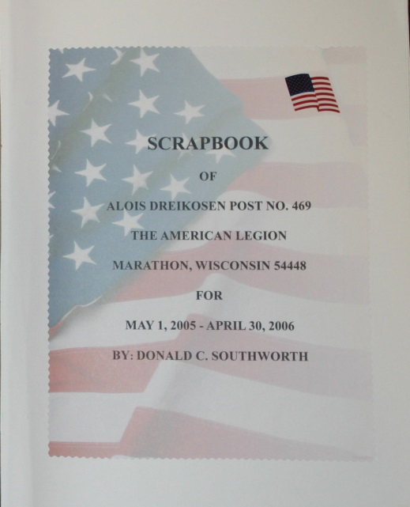
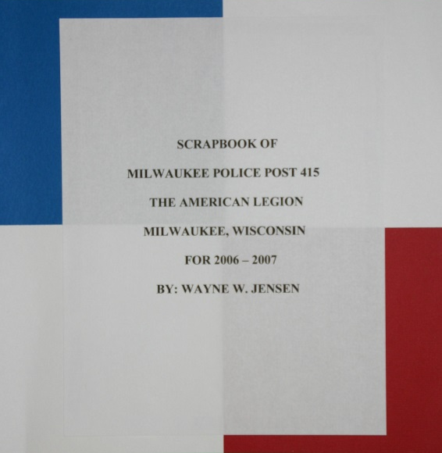
Part 1: Format – 40 Points
Title Page (5)
  First page facing the reader
  Centered on page
  Double-spaced or more
HISTORIAN TRAINING

Slide 16
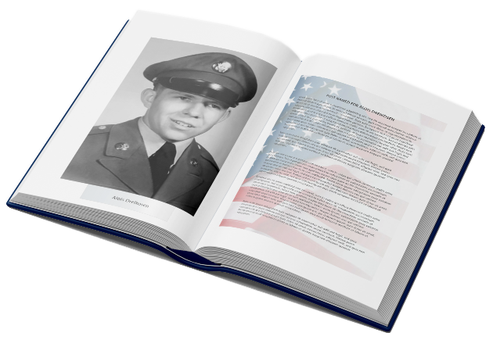
Part 1: Format – 40 Points
Introduction (5)
  Formation of National and Department (Brief)
  How Post name was selected (Brief)
  Brief resume of the community
  Post Home information
  Post Officer background
HISTORIAN TRAINING

Slide 17
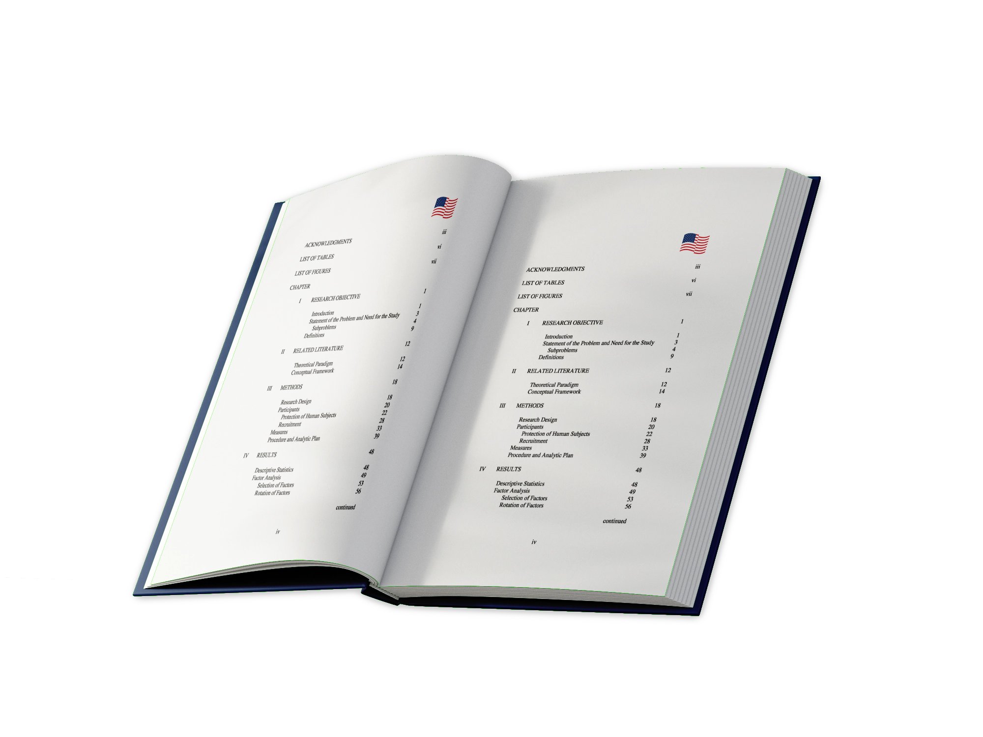
Part 1: Format – 40 Points
Table of Contents (5)
  Separate units covering programs with page references
  If more than one volume, each volume should have a complete table of content
HISTORIAN TRAINING

Slide 18
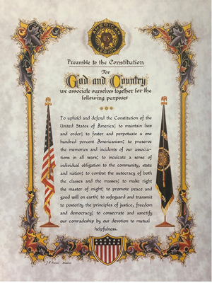

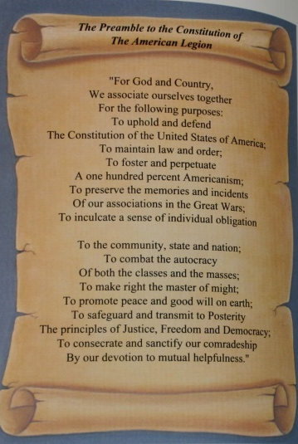
Part 1: Format – 40 Points
Preamble (2)
  Multicolored print is available from Emblem Sales
  Be creative and make your own
HISTORIAN TRAINING

Slide 19
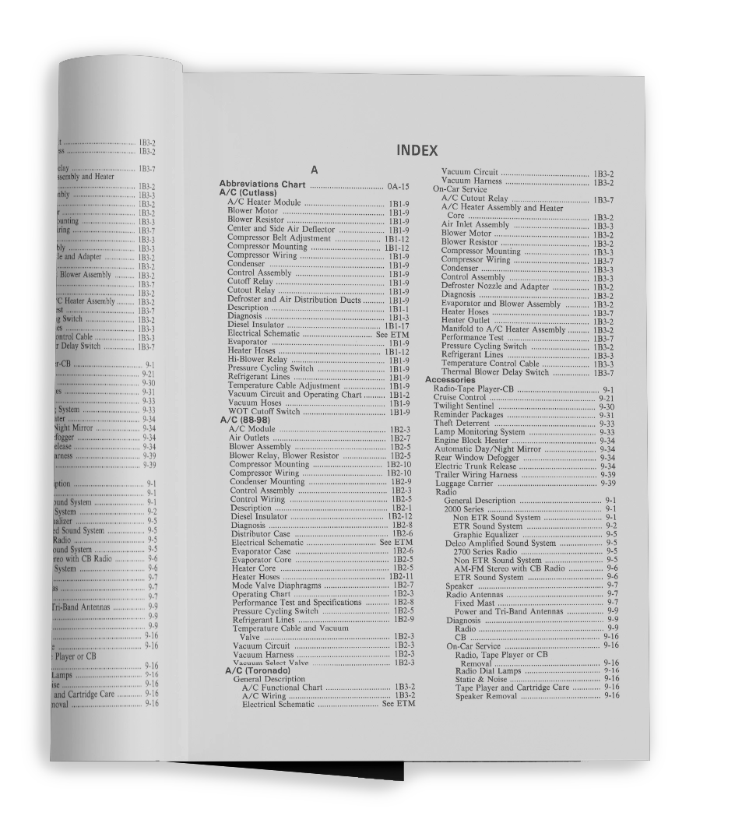
Part 1: Format – 40 Points
Index (10)
  Alphabetical index of
    Names
    Places
    Events
  This is at the end of the book
  If more than one volume, each volume should have a complete index
HISTORIAN TRAINING

Slide 20
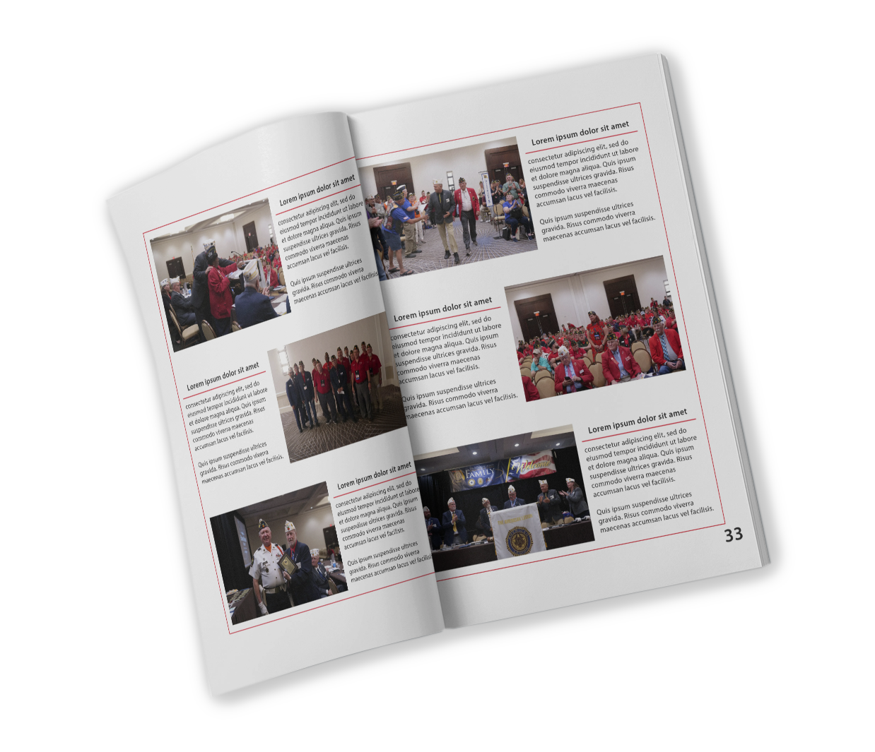
Part 1: Format – 40 Points
Page Numbering (5)
  Start with Title Page
  Be consistent
    In location
      Top or Bottom
  Count all pages even if they are blank
  Blank pages should state “Page intentionally left blank”
HISTORIAN TRAINING

Slide 21

Part 2: Account/Readability – 40 Points
Arrangement (20)
  Systematic and logical
  Chronological order
  Easy for reader to follow
HISTORIAN TRAINING

Slide 22
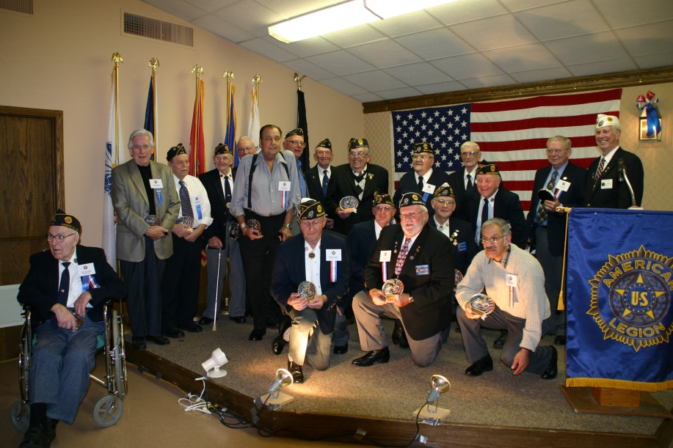
Part 2: Account/Readability – 40 Points
Identification (10)
  Who – use full proper name
  What
  Where
  When
  Identified left to right & front to back
  Large groups don’t need identification
HISTORIAN TRAINING
Department Commander Charles Cooney (far right back row) along with Charter Members of Landt-Thiel Post 470 Saukville during the Post’s 60th Anniversary celebration on November 11, 2006

Slide 23
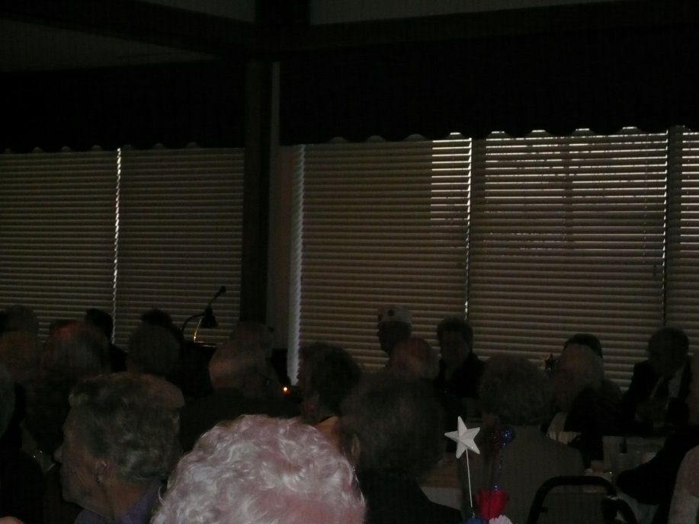
Part 2: Account/Readability – 40 Points
Clear Cut Photo (10)
  Clear and sharp
  Blurry or fuzzy will distract
  Proper arrangement
HISTORIAN TRAINING

Slide 24
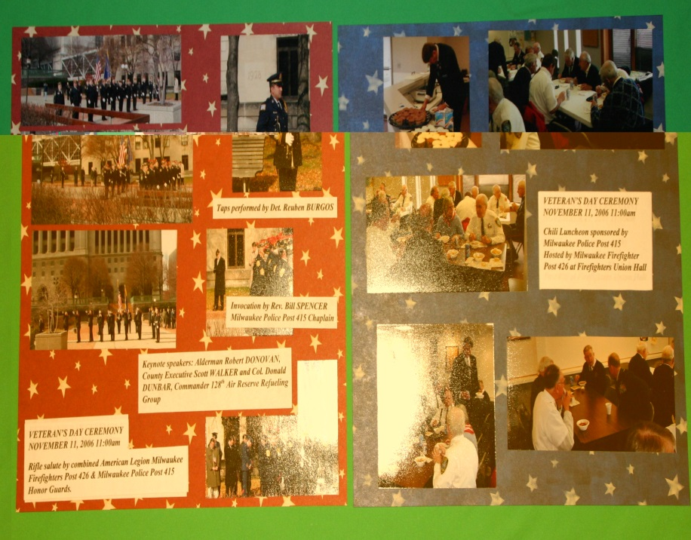
Part 3: Judges Option/Originality – 10 Points
Originality (10)
  Different in Thought
  Different in Presentation
HISTORIAN TRAINING

Slide 25
Part 3: Judges Option/Originality – 10 Points
Items not readily cataloged under other headings
Features that make the book more useful
Inaccuracies will have a disqualifying effect
HISTORIAN TRAINING

Slide 26
Part 3: Judges Option/Originality – 10 Points
Arrangement (20)
  Systematic and logical
  Chronological order
  Easy for reader to follow
HISTORIAN TRAINING

Slide 27


Scoring
If an item is in the book, you can not give the book a zero (0) for that item
Except, judges' points start at zero
HISTORIAN TRAINING

Slide 28
Any questions about the Yearbook / Scrapbook?
HISTORIAN TRAINING

Slide 29
Narratives
HISTORIAN TRAINING
Compilation and Judging

Slide 30
Narratives
Some items are the same as yearbook, others are very different.
Re-examine the Outline using the Standards as a checklist before submitting your entry.
HISTORIAN TRAINING

Slide 31


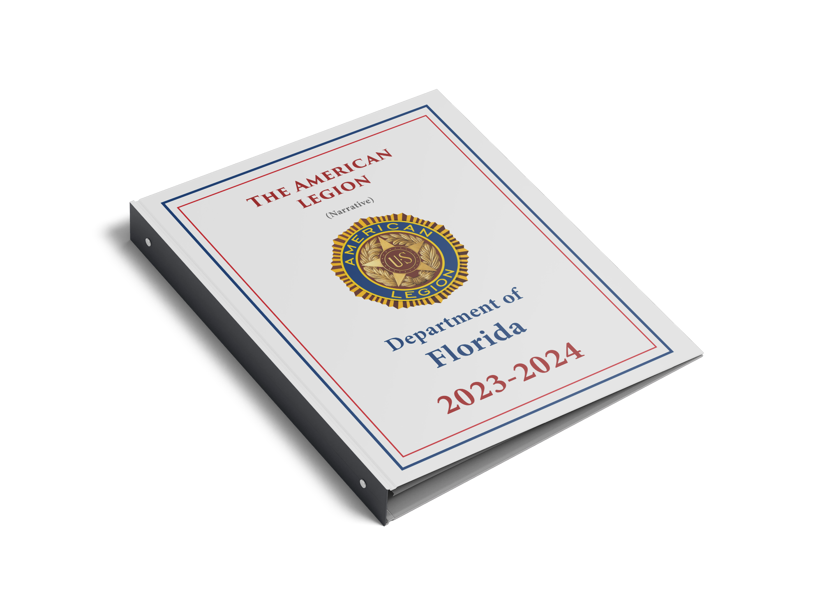
Part 1: Format – 40 Points
Cover (5)
Standard 3 ring binder for 8 ½ x 11 paper
Legion Emblem
Name and Number of Post
Volume Number if needed
Not to exceed 3 inches front to back
HISTORIAN TRAINING

Slide 32
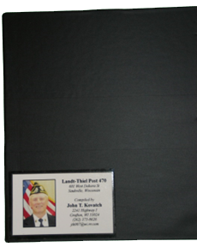
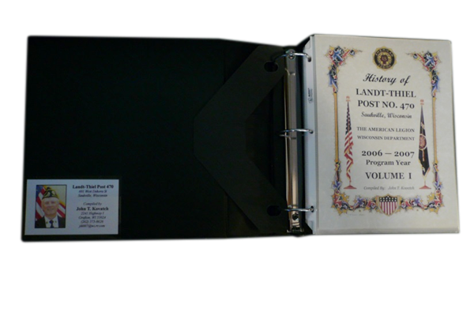
Part 1: Format – 40 Points
Name / Address (3)
Full name and address of author
Located in lower left corner
Neatly typed
3 x 5 index card
Centered
HISTORIAN TRAINING

Slide 33
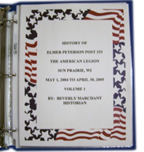
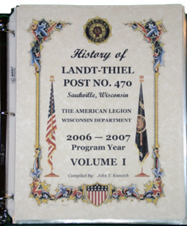
Part 1: Format – 40 Points
Title Page (5)
First Page facing the reader
Centered on Page
Double spaced or more
HISTORIAN TRAINING

Slide 34
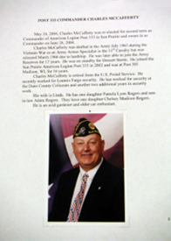
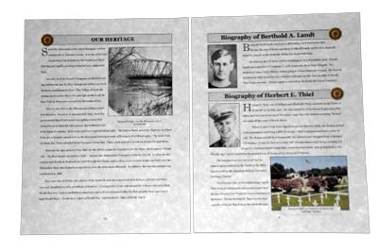
Part 1: Format – 40 Points
Introduction (5)
Formation of National and Department
How Post name was selected
Brief resume of the community
Post Home information
Post Officer background
HISTORIAN TRAINING

Slide 35
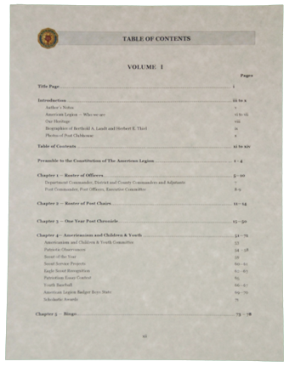
Part 1: Format – 40 Points
Table of Contents (5)
Page reference of CHAPTERS and APPENDICES
HISTORIAN TRAINING

Slide 36
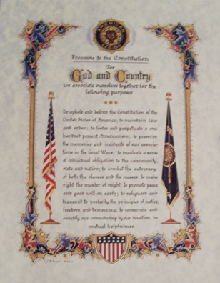
Part 1: Format – 40 Points
Preamble (2)
Multicolored print is available from Emblem Sales
Be creative and make your own
HISTORIAN TRAINING

Slide 37
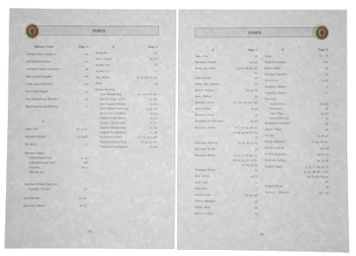
Part 1: Format – 40 Points
Index (10)
Alphabetical index of
Names
Places
Events
After the APPENDICES
HISTORIAN TRAINING

Slide 38
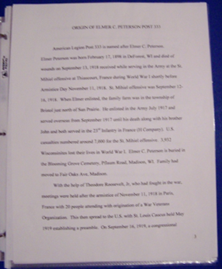
Part 1: Format – 40 Points
Page Numbering (5)
Title Page 1 or i
Introduction 2 or ii
Table of Content 3 or iii
Preamble 4 or iv
The rest using Arabic Numbers
HISTORIAN TRAINING

Slide 39
Chapters
HISTORIAN TRAINING

Slide 40
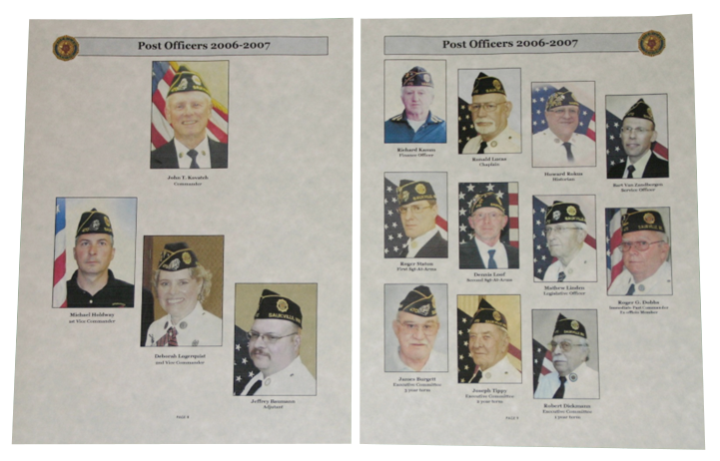
Chapters: Chapter 1 – Roster of Post Officers
HISTORIAN TRAINING

Slide 41
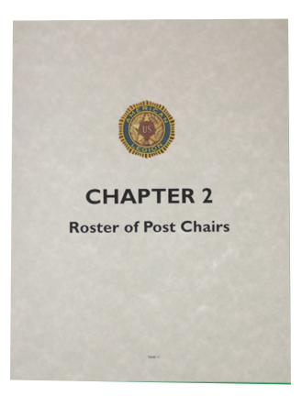
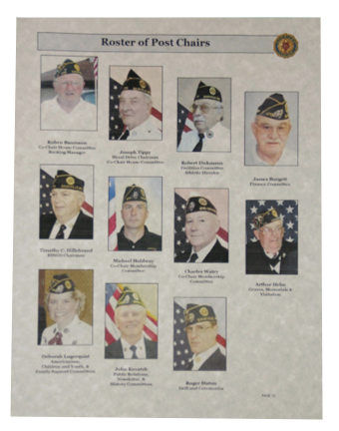
Chapters: Chapter 2 – Roster of Post Chairs
HISTORIAN TRAINING

Slide 42
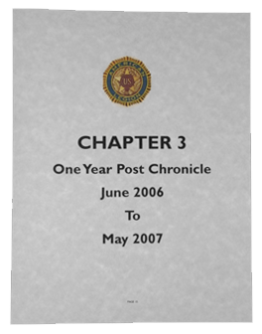
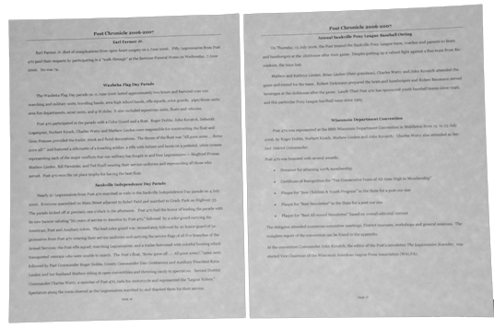
Chapters: Chapter 3 – One-Year Post
Chronicle
Use minutes of meeting for information
No photos or newspaper articles
HISTORIAN TRAINING

Slide 43
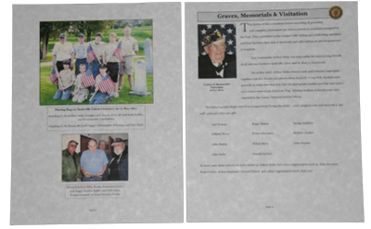
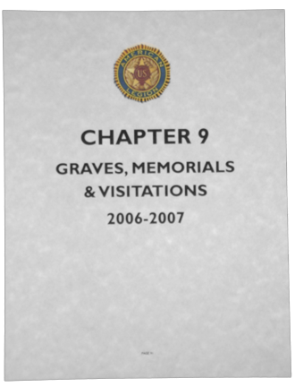
Chapters: Chapter 4⁺ – Programs
Chapters dedicated to individual committees
Include photos with captions
HISTORIAN TRAINING

Slide 44
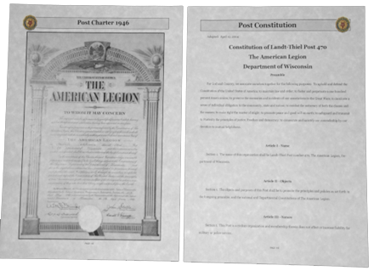
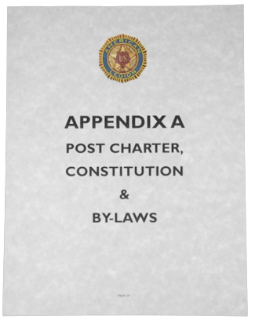
Appendices
Statistical data after the Chapters before Index
Post Constitution and By-Laws
HISTORIAN TRAINING

Slide 45
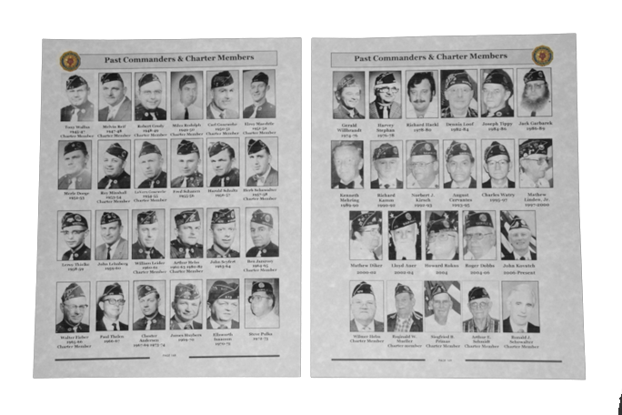
Appendices
Roster of Past Commanders
HISTORIAN TRAINING

Slide 46
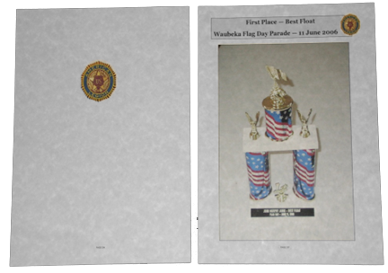
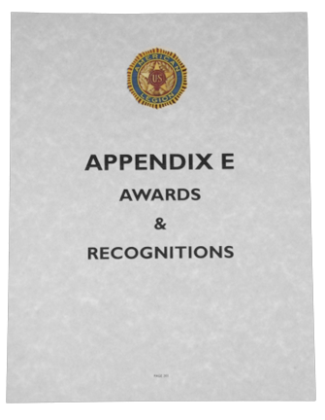
Appendices
Citations and Awards
HISTORIAN TRAINING

Slide 47
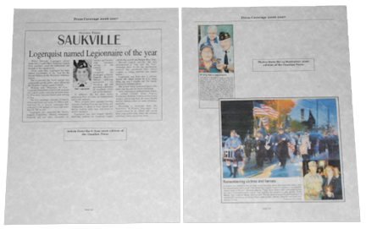

Appendices
News Coverage – This is where news clippings are displayed.
Newspaper deteriorates so use photo copy.
HISTORIAN TRAINING

Slide 48
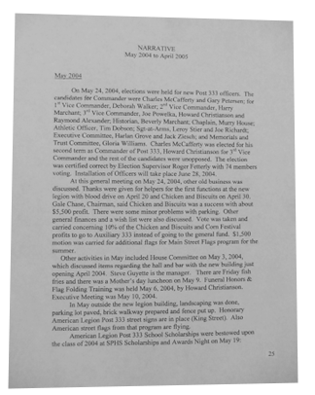
Part 2 – Graphic Account / Readability – 30 Points
Narrative not statistical style
Pleasing to general reader
Write in third person
Chronological / detailed account
No analysis or interpretation
HISTORIAN TRAINING

Slide 49
Part 3 – Illustration - 10 Points
Arrangement (5)
  All photos identified
    Who – (use full proper name)
    What
    Where
    When
    Identified Left to Right
    Front to back
  Check for relation to text
Clear-Cut Photo (5)
HISTORIAN TRAINING

Slide 50
Part 4 – Judges Option - 10 Points
Items not cataloged under other headings
Features that make the book more useful
Inaccuracies will have a disqualifying effect
HISTORIAN TRAINING

Slide 51

Questions?
HISTORIAN TRAINING
Please leave feedback.

