Slide 1

AREA COMMANDER TRAINING

Slide 2

WHAT IS THE PURPOSE OF THE AREA COMMANDER?

Slide 3
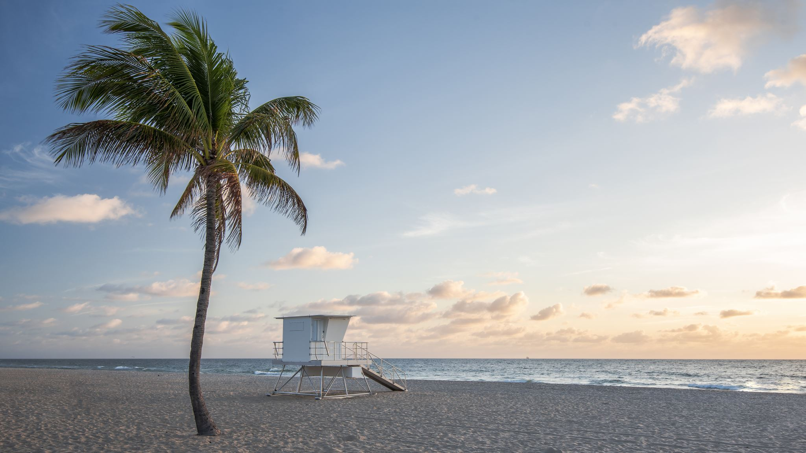
The Area Commander is the link between the Districts, the Posts, and the Department of Florida

Slide 4

To unite all Districts within the Area into one team working together
To assist all Districts and Posts with any problems they are unable to resolve
To provide guidance and supervision when requested

Slide 5

To act as overseer and cheerleader, urging the Districts to be the best they can be
To assist the Districts with American Legion Programs

Slide 6

Provide training for all Districts and Posts
Provide activities for Districts and Posts to gather together for comradeship

Slide 7

The Area is there to serve the individual Posts and Districts
You are not there to run the Posts and Districts.

Slide 8
The Area will not get involved in the internal affairs of Posts or Districts unless specifically requested by the Post, District, or the Department of Florida

Slide 9
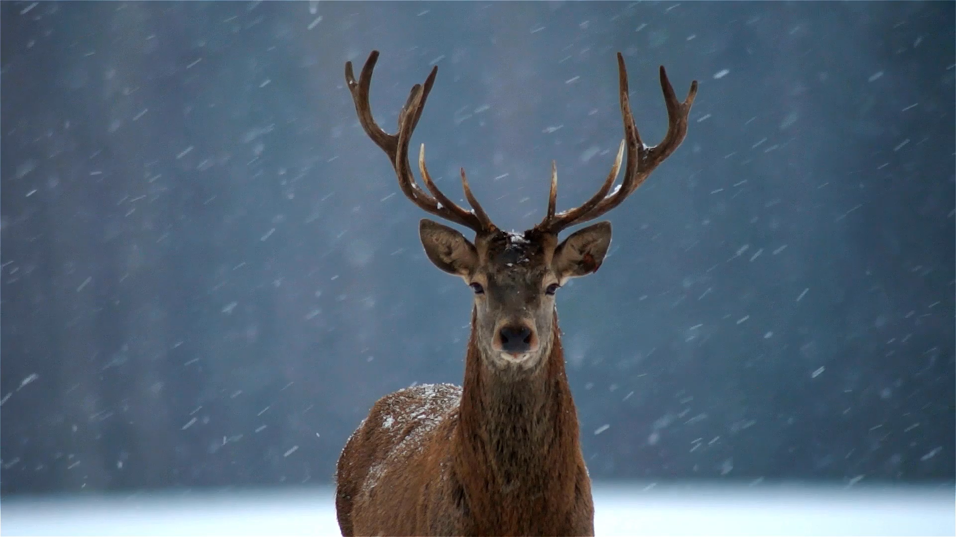
THE BUCK STOPS HERE!

Slide 10
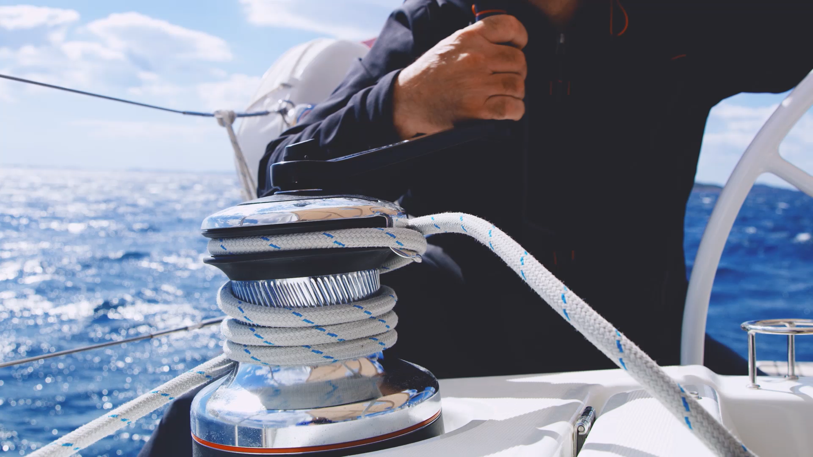
DUTIES OF THE AREA COMMANDER

Slide 11

The Area Commanders shall be the personal representatives of the Department Commander in their respective Areas

Slide 12

1. Communicate and assist
2. Performance of other assigned duties
3. Attend all Department, Area, and as many District meetings as possible

Slide 13
The office of Area Commander is very important and prestigious.
Therefore, each Commander should do their best to carry out the following duties:

Slide 14
1. Support and maintain the policies of the Department of Florida per the CBL
2. Support the Department Commander and the programs for the year
3. Always dress properly
4. Be aware of the various Department programs and support them through your appointed chairs
5. Follow Protocol
6. Keep accurate records
7. Speaking to media
8. Attend all Department meetings
9. Membership
10. Review CBL to make sure you are giving out correct information
11. Fill out and turn in Monthly Activity and Expense reports
12. Check the Department event calendar

Slide 15

SOCIAL MEDIA USAGE

Slide 16
Have a great year and have fun doing it!
Any Questions?

